Slide 1
Business Statistics
Inference About Population Variances
This lecture flows well with
Statistics for Business and Economics, Anderson, Sweeney, and Williams, 13th edition, chapter 11.

Slide 2
Inferences About Population Variances
Inference about a Population Variance
Inferences about Two Populations Variances

Slide 3
Inferences About a Population Variance
A variance can provide important decision-making information.
Consider the production process of filling containers with a liquid detergent product.
The mean filling weight is important, but also is the variance of the filling weights.
By selecting a sample of containers, we can compute a sample variance for the amount of detergent placed in a container.
If the sample variance is excessive, overfilling and underfilling may be occurring even though the mean is correct.

Slide 4
Inferences About a Population Variance
Chi-Square Distribution
Interval Estimation of σ ²
Hypothesis Testing

Slide 5
Chi-Square Distribution
The chi-square distribution is based on sampling from a normal population.
The sampling distribution of (n - 1)s²/σ ² has a chi-square distribution with n-1 degrees of freedom whenever a simple random sample of size n is selected from a normal population.
We can use the chi-square distribution to develop interval estimates and conduct hypothesis tests about a population variance.

Slide 6
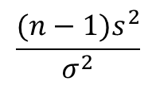
Examples of Sampling Distribution of (n - 1)s²/σ ²
With 2 degrees
of freedom
With 5 degrees
of freedom
With 10 degrees
of freedom
$$\frac{(n−1)s^{2}}{σ^{2}}$$
0

Slide 7
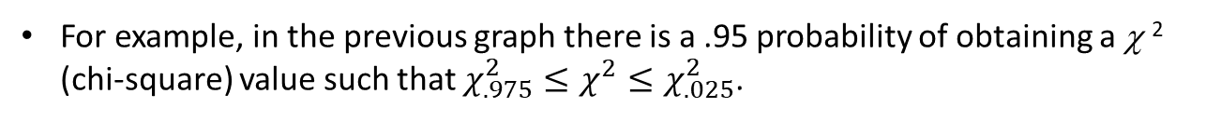

Chi-Square Distribution
We will use the notation $χ_{α}^{2}$ to denote the value for the chi-square distribution that provides an area of a to the right of the stated $χ_{α}^{2}$ value.
For example, in the previous graph there is a .95 probability of obtaining a χ ² (chi-square) value such that $χ_{.975}^{2}≤χ^{2}≤χ_{.025}^{2}$.

Slide 8



Interval Estimation of σ ²
$χ_{.975}^{2}≤\frac{(n−1)s^{2}}{σ^{2}}$ <${ χ}_{.025}^{2}$
.025
.025
95% of the
possible χ² values
χ²
0
$$χ_{.975}^{2}$$
$$χ_{.025}^{2}$$

Slide 9
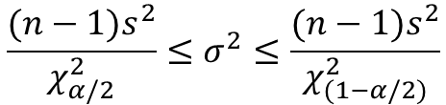


Interval Estimation of σ ²
There is a (1 – α) probability of obtaining a χ² value such that
$χ_{(1−α/2)}^{2}≤χ^{2}≤$ $χ_{α/2}^{2}$
Substituting (n – 1)s²/s ² for the χ² we get
$χ_{(1−α/2)}^{2}≤\frac{(n−1)s^{2}}{σ^{2}}≤$ $χ_{α/2}^{2}$
Performing algebraic manipulation we get
$$\frac{(n−1)s^{2}}{χ_{α/2}^{2}}≤σ^{2}≤\frac{(n−1)s^{2}}{χ_{(1−α/2)}^{2}}$$

Slide 10
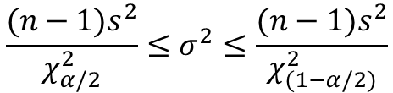
Interval Estimation of σ ²
Interval Estimate of a Population Variance
$$\frac{(n−1)s^{2}}{χ_{α/2}^{2}}≤σ^{2}≤\frac{(n−1)s^{2}}{χ_{(1−α/2)}^{2}}$$
where the χ² values are based on a chi-square distribution with n - 1 degrees of freedom and where 1 - α is the confidence coefficient.

Slide 11
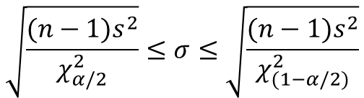
Interval Estimation of σ
Interval Estimate of a Population Standard Deviation
Taking the square root of the upper and lower limits of the variance interval provides the confidence interval for the population standard deviation.
$$\sqrt{\frac{(n−1)s^{2}}{χ_{α/2}^{2}}}≤σ≤\sqrt{\frac{(n−1)s^{2}}{χ_{(1−α/2)}^{2}}}$$

Slide 12
Interval Estimation of σ ²
Example: Buyer’s Digest (A)
Buyer’s Digest rates thermostats manufactured for home temperature control. In a recent test, 10 thermostats manufactured by ThermoRite were selected and placed in a test room that was maintained at a temperature of 68ºF. The temperature readings of the ten thermostats are shown on the next slide.

Slide 13
Interval Estimation of σ ²
Example: Buyer’s Digest (A)
We will use the 10 readings below to develop a 95% confidence interval estimate of the population variance.
Thermostat 1 2 3 4 5 6 7 8 9 10
Temperature 67.4 67.8 68.2 69.3 69.5 67.0 68.1 68.6 67.9 67.2

Slide 14
Interval Estimation of σ ²
For n - 1 = 10 - 1 = 9 d.f. and α = .05
Selected Values from the Chi-Square Distribution Table
Degrees
Area in Upper Tail
of Freedom
.99
.975
.95
.90
.10
.05
.025
.01
5
0.554
0.831
1.145
1.610
9.236
11.070
12.832
15.086
6
0.872
1.237
1.635
2.204
10.645
12.592
14.449
16.812
7
1.239
1.690
2.167
2.833
12.017
14.067
16.013
18.475
8
1.647
2.180
2.733
3.490
13.362
15.507
17.535
20.090
9
2.088
2.700
3.325
4.168
14.684
16.919
19.023
21.666
10
2.558
3.247
3.940
4.865
15.987
18.307
20.483
23.209

Slide 15

Interval Estimation of σ ²
For n - 1 = 10 - 1 = 9 d.f. and α = .05
2.700$≤\frac{(n−1)s^{2}}{σ^{2}}≤χ_{.025}^{2}$
.025
Area in
Upper Tail
= .975
χ²
0
2.700

Slide 16
Interval Estimation of σ ²
For n - 1 = 10 - 1 = 9 d.f. and α = .05
Selected Values from the Chi-Square Distribution Table
Degrees
Area in Upper Tail
of Freedom
.99
.975
.95
.90
.10
.05
.025
.01
5
0.554
0.831
1.145
1.610
9.236
11.070
12.832
15.086
6
0.872
1.237
1.635
2.204
10.645
12.592
14.449
16.812
7
1.239
1.690
2.167
2.833
12.017
14.067
16.013
18.475
8
1.647
2.180
2.733
3.490
13.362
15.507
17.535
20.090
9
2.088
2.700
3.325
4.168
14.684
16.919
19.023
21.666
10
2.558
3.247
3.940
4.865
15.987
18.307
20.483
23.209

Slide 17

Interval Estimation of σ ²
n - 1 = 10 - 1 = 9 degrees of freedom and α = .05
$2.700≤\frac{(n−1)s^{2}}{σ^{2}}≤$19.023
.025
Area in Upper
Tail = .025
χ²
0
2.700
19.023

Slide 18
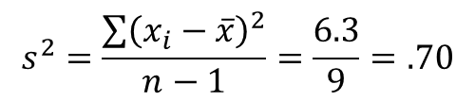
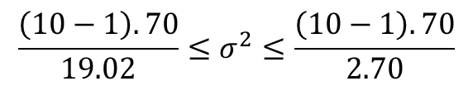
Interval Estimation of σ ²
Sample variance s² provides a point estimate of σ ².
$$s^{2}=\frac{\sum{{\left(x_{i}−\overline{x}\right)}^{2}}}{n−1}=\frac{6.3}{9}=.70$$
A 95% confidence interval for the population variance is given by:
$$\frac{\left(10−1\right).70}{19.02}≤σ^{2}≤\frac{\left(10−1\right).70}{2.70}$$
.33 < σ ² < 2.33

Slide 19
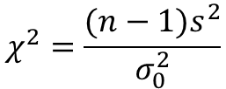



Hypothesis Testing About a Population Variance
Lower-Tail Test
Hypotheses:
$$H_{0}:σ^{2}≥σ_{0}^{2}$$
$$H_{a}:σ^{2}<σ_{0}^{2}$$
where $σ_{0}^{2}$ is the hypothesized value
for the population variance
Test Statistic:
$$χ^{2}=\frac{(n−1)s^{2}}{σ_{0}^{2}}$$

Slide 20

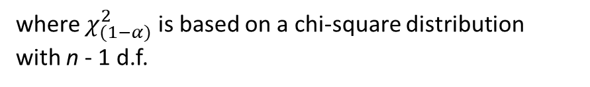
Hypothesis Testing About a Population Variance
Lower Tail Test (continued)
Rejection Rule
Critical value approach:
Reject H₀ if $χ^{2}≤$ $χ_{(1−α)}^{2}$
p-Value approach:
Reject H₀ if p-value < α
where $χ_{(1−α)}^{2}$ is based on a chi-square distribution
with n - 1 d.f.

Slide 21
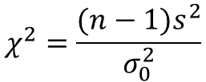




Hypothesis Testing About a Population Variance
Upper Tail Test
Hypotheses:
$$H_{0}:σ^{2}≤σ_{0}^{2}$$
$$H_{a}:σ^{2}>σ_{0}^{2}$$
where $σ_{0}^{2}$ is the hypothesized value
for the population variance
Test Statistic:
$$χ^{2}=\frac{(n−1)s^{2}}{σ_{0}^{2}}$$
Rejection Rule:
Critical value approach:
Reject H₀ if $χ^{2}≥$ $χ_{α}^{2}$
p-Value approach:
Reject H₀ if p-value < α
where $χ_{α}^{2}$ is based on a chi-square distribution with n - 1 d.f.

Slide 22




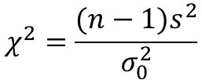
Hypothesis Testing About a Population Variance
Two-Tailed Test
Hypotheses:
$$H_{0}:σ^{2}=σ_{0}^{2}$$
$$H_{a}:σ^{2}≠σ_{0}^{2}$$
where $σ_{0}^{2}$ is the hypothesized value
for the population variance
Test Statistic:
$$χ^{2}=\frac{(n−1)s^{2}}{σ_{0}^{2}}$$
Rejection Rule:
Critical value approach:
Reject H₀ if $χ^{2}≤$ $χ_{(1−α/2)}^{2}$or $χ^{2}≥$ $χ_{α/2}^{2}$
p-Value approach:
Reject H₀ if p-value < α
where $χ_{(1−α/2)}^{2}and χ_{α/2}^{2}$ are based on a chi-square distribution with n - 1 d.f.

Slide 23
Hypothesis Testing About a Population Variance
Example: Buyer’s Digest (B)
Recall that Buyer’s Digest is rating ThermoRite thermostats. Buyer’s Digest gives an “acceptable” rating to a thermostat with a temperature variance of 0.5 or less.
We will conduct a hypothesis test (with α = .10) to determine whether the ThermoRite thermostat’s temperature variance is “acceptable”.

Slide 24
Hypothesis Testing About a Population Variance
Example: Buyer’s Digest (B)
Using the 10 readings, we will conduct a hypothesis test (with α = .10) to determine whether the ThermoRite thermostat’s temperature variance is
“acceptable”.
Thermostat 1 2 3 4 5 6 7 8 9 10
Temperature 67.4 67.8 68.2 69.3 69.5 67.0 68.1 68.6 67.9 67.2

Slide 25
Hypothesis Testing About a Population Variance
H₀: σ ² < 0.5
(right-tailed test)
Hypotheses:
H_{a}: σ ² > 0.5
Rejection Rule:
Reject H₀ if χ ² > 14.684

Slide 26
Hypothesis Testing About a Population Variance
For n - 1 = 10 - 1 = 9 d.f. and α = .10
Selected Values from the Chi-Square Distribution Table
Degrees
Area in Upper Tail
of Freedom
.99
.975
.95
.90
.10
.05
.025
.01
5
0.554
0.831
1.145
1.610
9.236
11.070
12.832
15.086
6
0.872
1.237
1.635
2.204
10.645
12.592
14.449
16.812
7
1.239
1.690
2.167
2.833
12.017
14.067
16.013
18.475
8
1.647
2.180
2.733
3.490
13.362
15.507
17.535
20.090
9
2.088
2.700
3.325
4.168
14.684
16.919
19.023
21.666
10
2.558
3.247
3.940
4.865
15.987
18.307
20.483
23.209

Slide 27
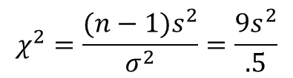
Hypothesis Testing About a Population Variance
Rejection Region
$$χ^{2}=\frac{(n−1)s^{2}}{σ^{2}}=\frac{9s^{2}}{.5}$$
Area in Upper
Tail = .10
χ ²
0
14.684
Reject H₀

Slide 28
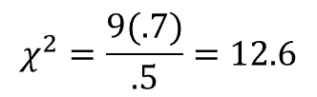
Hypothesis Testing About a Population Variance
Test Statistic
The sample variance s² = 0.7
$$χ^{2}=\frac{9(.7)}{.5}=12.6$$
Conclusion
Because χ² = 12.6 is less than 14.684, we cannot reject H₀. The sample variance s² = .7 is insufficient evidence to conclude that the temperature variance for ThermoRite thermostats is unacceptable.

Slide 29
Hypothesis Testing About a Population Variance
Using the p-Value
  The rejection region for the ThermoRite thermostat example is in the upper tail; thus, the appropriate p-value is less than .90 (χ ² = 4.168) and greater than .10 (χ ² = 14.684).
Because the p –value > α = .10, we cannot reject the null hypothesis.
The sample variance of s² = .7 is insufficient evidence to conclude that the temperature variance is unacceptable (>.5).
(The exact p-value is .18156.)

Slide 30
Inferences About Two Population Variances
We may want to compare the variances in:
  product quality resulting from two different production processes,
  temperatures for two heating devices, or
  assembly times for two assembly methods.
We use data collected from two independent random samples, one from population 1 and another from population 2.
The two sample variances will be the basis for making inferences about the two population variances.

Slide 31



Hypothesis Testing About the Variances of Two Populations
One-Tailed Test
Hypotheses:
$$H_{0}:σ_{1}^{2}≤σ_{2}^{2}$$
$$H_{a}:σ_{1}^{2}>σ_{2}^{2}$$
Denote the population providing the
larger sample variance as population 1.
Test Statistic:
$$F={s_{1}^{2}}/{s_{2}^{2}}$$

Slide 32
Hypothesis Testing About the Variances of Two Populations
One-Tailed Test (continued)
Rejection Rule:
Critical value approach:
Reject H₀ if F > F_{α}
where the value of F_{α} is based on an F distribution with n₁ - 1 (numerator) and n₂ - 1 (denominator) d.f.
p-Value approach:
Reject H₀ if p-value < α

Slide 33



Hypothesis Testing About the Variances of Two Populations
Two-Tailed Test
Hypotheses:
$$H_{0}:σ_{1}^{2}=σ_{2}^{2}$$
$$H_{a}:σ_{1}^{2}≠σ_{2}^{2}$$
Denote the population providing the
larger sample variance as population 1.
Test Statistic:
$$F={s_{1}^{2}}/{s_{2}^{2}}$$

Slide 34
Hypothesis Testing About the Variances of Two Populations
Two-Tailed Test (continued)
Rejection Rule
Critical value approach:
Reject H₀ if F > F_{α/2}
where the value of F_{α/2} is based on an F distribution with n₁ - 1 (numerator) and n₂ - 1 (denominator) d.f.
p-Value approach:
Reject H₀ if p-value < α

Slide 35
Hypothesis Testing About the Variances of Two Populations
Example: Buyer’s Digest (C)
Buyer’s Digest has conducted the same test, as was described earlier, on another 10 thermostats, this time manufactured by TempKing. The temperature readings of the ten thermostats are listed on the next slide.
We will conduct a hypothesis test with  = .10 to see if the variances are equal for ThermoRite’s thermostats and TempKing’s thermostats.

Slide 36
Hypothesis Testing About the Variances of Two Populations
Example: Buyer’s Digest (C)
ThermoRite Sample
Thermostat 1 2 3 4 5 6 7 8 9 10
Temperature 67.4 67.8 68.2 69.3 69.5 67.0 68.1 68.6 67.9 67.2
TempKing Sample
Thermostat 1 2 3 4 5 6 7 8 9 10
Temperature 67.7 66.4 69.2 70.1 69.5 69.7 68.1 66.6 67.3 67.5

Slide 37


Hypothesis Testing About the Variances of Two Populations
Hypotheses:
$$H_{0}:σ_{1}^{2}=σ_{2}^{2}$$
(TempKing and ThermoRite thermostats
have the same temperature variance)
$$H_{a}:σ_{1}^{2}≠σ_{2}^{2}$$
(Their variances are not equal)
Rejection Rule:
  The F distribution table (on next slide) shows that with α/2 = .05,
  9 d.f. (numerator), and 9 d.f. (denominator), F_{.05} = 3.18.
Reject H₀ if F > 3.18

Slide 38
Hypothesis Testing About the Variances of Two Populations
Selected Values from the F Distribution Table
Denominator
Area in
Degrees
Upper
Numerator Degrees of Freedom
of Freedom
Tail
7
8
9
10
15
8
.10
2.62
2.59
2.56
2.54
2.46
.05
3.50
3.44
3.39
3.35
3.22
.025
4.53
4.43
4.36
4.30
4.10
.01
6.18
6.03
5.91
5.81
5.52
9
.10
2.51
2.47
2.44
2.42
2.34
.05
3.29
3.23
3.18
3.14
3.01
.025
4.20
4.10
4.03
3.96
3.77
.01
5.61
5.47
5.35
5.26
4.96

Slide 39
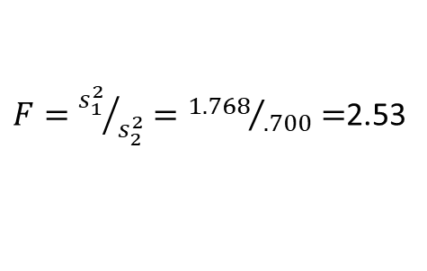
Hypothesis Testing About the Variances of Two Populations
Test Statistic:
  TempKing’s sample variance is 1.768
  ThermoRite’s sample variance is .700
$F={s_{1}^{2}}/{s_{2}^{2}}={1.768}/{.700}=$2.53
Conclusion:
  We cannot reject H₀. F = 2.53 < F_{.05} = 3.18.
  There is insufficient evidence to conclude that the population variances differ for the two thermostat brands.

Slide 40
Hypothesis Testing About the Variances of Two Populations
Determining and Using the p-Value
Area in Upper Tail .10 .05 .025 .01
F Value (df₁ = 9, df₂ = 9) 2.44 3.18 4.03 5.35
Because F = 2.53 is between 2.44 and 3.18, the area in the upper tail of the distribution is between .10 and .05.
But this is a two-tailed test; after doubling the upper-tail area, the p-value is between .20 and .10.
Because α = .10, we have p-value > α and therefore we cannot reject the null hypothesis.

