Slide 1
Business Statistics
Simple Linear Regression
This lecture flows well with
Statistics for Business and Economics, Anderson, Sweeney, and Williams, 13th edition, chapter 14.

Slide 2
Simple Linear Regression
Simple Linear Regression Model
Least Squares Method
Coefficient of Determination
Model Assumptions
Testing for Significance

Slide 3
Simple Linear Regression
Managerial decisions often are based on the relationship between two or more variables.
Regression analysis can be used to develop an equation showing how the variables are related.
The variable being predicted is called the dependent variable and is denoted by y.
The variables being used to predict the value of the dependent variable are called the independent variables and are denoted by x.

Slide 4
Simple Linear Regression
Simple linear regression involves one independent variable and one dependent variable.
The relationship between the two variables is approximated by a straight line.
Regression analysis involving two or more independent variables is called multiple regression.

Slide 5
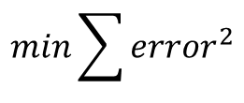
Simple Linear Regression
Simple Liner Regression fits a line which minimizes the sum of the squared errors?
y
$$min\sum{{error}^{2}}$$
This line is considered BLUE (Best Linear Unbiased Estimator), and under certain conditions is accepted as a good description or predictor of the data.
error
error
0
x

Slide 6
Simple Linear Regression Model
The equation that describes how y is related to x and an error term is called the regression model.
The simple linear regression model is:
y = β₀ + β₁x + ε
where:
  β₀ and β₁ are called parameters of the model.
  ε is a random variable called the error term.

Slide 7
Simple Linear Regression Equation
The simple linear regression equation is:
E(y) = β₀ + β₁x
  Graph of the regression equation is a straight line.
  β₀ is the y intercept of the regression line.
  β₁ is the slope of the regression line.
  E(y) is the expected value of y for a given x value.

Slide 8

Simple Linear Regression Equation
Quantity
This linear equation minimizes the sum of squared errors.
120
$$\hat{y}=103.87−15.73x$$
100
80
60
error (-14.53)
40
error (+9.80)
20
0
$0
$1.00
$2.00
$3.00
$4.00
$5.00
Price

Slide 9
Simple Linear Regression Equation
Positive Relationship
Negative Relationship
No Relationship
E(y)
E(y)
E(y)
Regression line
β₀
Regression line
Regression line
Slope β₁
is positive
β₀
β₀
Slope β₁
is positive
Slope β₁
is positive
x
x
x

Slide 10

Estimated Simple Linear Regression Equation
The estimated simple linear regression equation
$$\hat{y}=b_{0}+b_{1}x$$
  The graph is called the estimated regression line.
  b₀ is the y intercept of the line.
  b₁ is the slope of the line.
  $\hat{y}$is the estimated value of y for a given x value.

Slide 11


Estimation Process
Regression Model: y = β₀ + β₁x +ε
Regression Equation: E(y) = β₀ + β₁x with unknown parameters: β₀, β₁
Data:
x y
x₁ y₁
. .
. .
x_{n} y_{n}
Estimated Regression Equation
$$\hat{y}=b_{0}+b_{1}x$$
with estimated statistics: $b_{0},b_{1}$

Slide 12
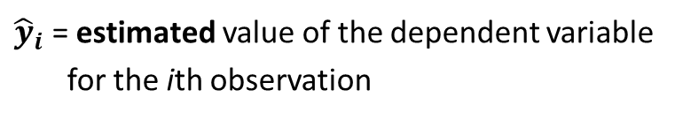
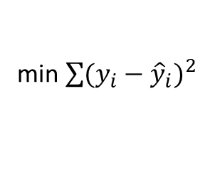
Least Squares Method
Least Squares Criterion
min$\sum{{(y_{i}−{\hat{y}}_{i})}^{2}}$
where:
y_{i} = observed value of the dependent variable
for the ith observation
${\hat{y}}_{i}$ = estimated value of the dependent variable
for the ith observation

Slide 13


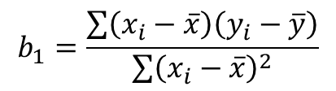

Least Squares Method
Slope for the Estimated Regression Equation
$$b_{1}=\frac{\sum{\left(x_{i}−\overline{x}\right)\left(y_{i}−\overline{y}\right)}}{\sum{{\left(x_{i}−\overline{x}\right)}^{2}}}$$
where:
x_{i} = value of independent variable for ith observation
y_{i} = value of dependent variable for ith observation
$\overline{x}$= mean value for independent variable
$\overline{y}$ = mean value for dependent variable
y-Intercept for the Estimated Regression Equation
$$b_{0}=\overline{y}−b_{1}\overline{x}$$

Slide 14
Simple Linear Regression
Example: Tractor Sales
Right Implement sells agriculture equipment in central Kentucky. As part of new advertising campaign Right Implement runs one or more television commercials during the weekend preceding a special sales weeks. Data from a sample of 5 previous sales are shown on the next slide.

Slide 15


Simple Linear Regression
Example: Reed Auto Sales
Number of
TV Ads (x)
Number of
Tractors Sold (y)
1
3
2
1
3
14
24
18
17
27
Σx = 10
Σy = 100
$$\overline{x}=2$$
$$\overline{y}=20$$

Slide 16


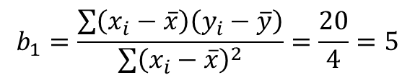
Estimated Regression Equation
Slope for the Estimated Regression Equation
$$b_{1}=\frac{\sum{\left(x_{i}−\overline{x}\right)\left(y_{i}−\overline{y}\right)}}{\sum{{\left(x_{i}−\overline{x}\right)}^{2}}}=\frac{20}{4}=5$$
y-Intercept for the Estimated Regression Equation
$$b_{0}=\overline{y}−b_{1}\overline{x}=20−5\left(2\right)=10$$
Estimated Regression Equation
$$\hat{y}=10+5x$$
How it was done

Slide 17
Using Excel’s Chart Tools for
Scatter Diagram & Estimated Regression Equation
Actual tractor sales was 27 the model estimated 25 sales
How it was done

Slide 18
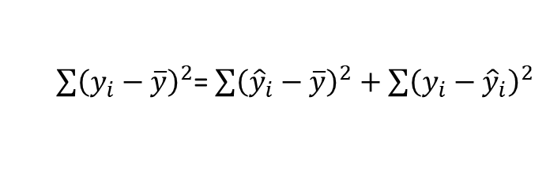
Coefficient of Determination
Relationship Among SST, SSR, SSE
SST = SSR + SSE
$\sum{{\left(y_{i}−\overline{y}\right)}^{2}}$= $\sum{{\left({\hat{y}}_{i}−\overline{y}\right)}^{2}+\sum{{\left(y_{i}−{\hat{y}}_{i}\right)}^{2}}}$
where:
SST = total sum of squares
SSR = sum of squares due to regression
SSE = sum of squares due to error

Slide 19
Coefficient of Determination
The coefficient of determination is:
r² = SSR/SST
where:
SSR = sum of squares due to regression
SST = total sum of squares

Slide 20
Coefficient of Determination
r² = SSR/SST = 100/114 = .8772
The regression relationship is very strong; 87.72% of the variability in the number of tractors sold can be explained by the linear relationship between the number of TV ads and the number of tractors sold.
Using Excel to Compute the Coefficient of Determination
r ²
= 0.87719
The model can explanation 88% of the total data variation
How it was done

Slide 21

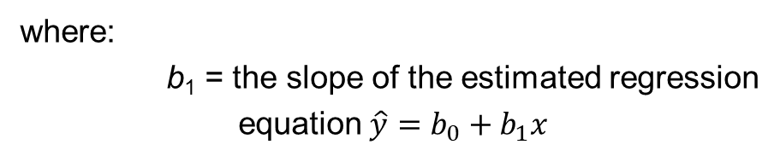
Sample Correlation Coefficient
$$r_{xy}=(sign of b_{1})\sqrt{Coefficient of Determination}$$
$$r_{xy}=(sign of b_{1}) \sqrt{r^{2}}$$
where:
b₁ = the slope of the estimated regression
equation $\hat{y}=b_{0}+b_{1}x$

Slide 22



Sample Correlation Coefficient
$$r_{xy}=(sign of b_{1}) \sqrt{r^{2}}$$
The sign of b₁ in the equation $\hat{y} \text{= 10 + 5}\text{x} \text{is}\text{ "+"}.$
$$r_{xy}=+\sqrt{.8772}$$
r_{xy} = +.9366

Slide 23
Assumptions About the Error Term ε
1. The error ε is a random variable with mean of zero.
2. The variance of ε , denoted by σ ², is the same for all values of the independent variable.
3. The values of ε are independent.
4. The error ε is a normally distributed random variable.

Slide 24
Testing for Significance
To test for a significant regression relationship, we must conduct a hypothesis test to determine whether the value of β₁ is zero.
Two tests are commonly used:
t Test
F Test
and
Both the t test and F test require an estimate of σ ², the variance of ε in the regression model.

Slide 25
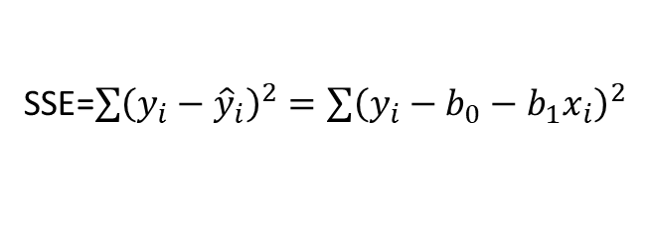
Testing for Significance
An Estimate of σ ²
  The mean square error (MSE) provides the estimate of σ ², and the notation s² is also used.
s ² = MSE = SSE/(n - 2)
where:
SSE=$\sum{{\left(y_{i}−{\hat{y}}_{i}\right)}^{2}}=\sum{{\left(y_{i}−b_{0}−b_{1}x_{i}\right)}^{2}}$

Slide 26
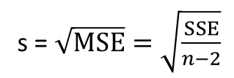
Testing for Significance
An Estimate of σ
To estimate σ, we take the square root of s².
The resulting s is called the standard error of the estimate.
s = $\sqrt{MSE}=\sqrt{\frac{SSE}{n−2}}$

Slide 27
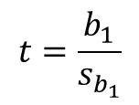
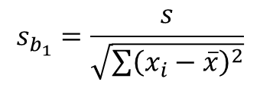
Testing for Significance: t Test
Hypotheses:
Test Statistic:
H₀: β₁ = 0
H_{a}: β₁ ≠ 0
$$t=\frac{b_{1}}{s_{b_{1}}}$$
where
$$s_{b_{1}}=\frac{s}{\sqrt{\sum{{\left(x_{i}−\overline{x}\right)}^{2}}}}$$

Slide 28
Testing for Significance: t Test
Rejection Rule:
Reject H₀ if p-value < α
or t < -t_{α/2} or t > t_{α/2}
where:
t_{α/2} is based on a t distribution
with n - 2 degrees of freedom

Slide 29
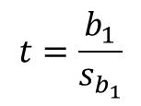
Testing for Significance: t Test
1. Determine the hypotheses:
H₀: β₁ = 0
H_{a}: β₁ ≠ 0
2. Specify the level of significance:
α = .05
3. Select the test statistic:
$$t=\frac{b_{1}}{s_{b_{1}}}$$
4. State the rejection rule:
Reject H₀ if p-value < .05
or |t| > 3.182 (with
3 degrees of freedom)

Slide 30

Testing for Significance: t Test
5. Compute the value of the test statistic:
$t=\frac{b_{1}}{s_{b_{1}}}$= $\frac{5}{1.08}=4.63$
6. Determine whether to reject H₀:
t = 4.541 provides an area of .01 in the upper tail. Hence, the p-value is less than .02. (Also,
t = 4.63 > 3.182.) We can reject H₀.

Slide 31
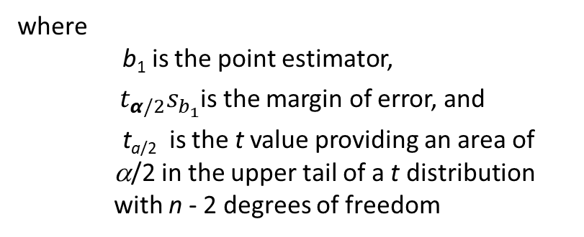

Confidence Interval for β₁
We can use a 95% confidence interval for β₁ to test the hypotheses just used in the t test.
H₀ is rejected if the hypothesized value of β₁ is not included in the confidence interval for β₁.
The form of a confidence interval for β₁ is:
$$b_{1}±t_{α/2}s_{b_{1}}$$
where
b₁ is the point estimator,
${ t}_{α/2}s_{b_{1}}$is the margin of error, and
t_{a/2} is the t value providing an area of α/2 in the upper tail of a t distribution with n - 2 degrees of freedom

Slide 32

Confidence Interval for β₁
Rejection Rule:
Reject H₀ if 0 is not included in the confidence interval for β₁.
95% Confidence Interval for β₁:
$$b_{1}±t_{α/2}s_{b_{1}}$$
= 5 +/- 3.182(1.08) = 5 +/- 3.44 or 1.56 to 8.44
Conclusion:
0 is not included in the confidence interval. Reject H₀

Slide 33
Testing for Significance: F Test
Hypotheses:
Test Statistic:
H₀: b₁ = 0
H_{a}: b₁ ≠ 0
F = MSR/MSE
Rejection Rule:
Reject H₀ if: p-value < α or F > F_{α}
where:
F_{α} is based on an F distribution with
1 degree of freedom in the numerator and
n - 2 degrees of freedom in the denominator

Slide 34
Testing for Significance: F Test
1. Determine the hypotheses:
H₀: b₁ = 0
H_{a}: b₁ ≠ 0
2. Specify the level of significance:
α = .05
3. Select the test statistic:
F = MSR/MSE
4. State the rejection rule:
Reject H₀ if p-value < .05 or F > 10.13
(with 1 d.f. in numerator and 3 d.f. in denominator)

Slide 35
Testing for Significance: F Test
5. Compute the value of the test statistic:
F = MSR/MSE = 100/4.667 = 21.43
6. Determine whether to reject H₀:
F = 17.44 provides an area of .025 in the upper tail. Thus, the p-value corresponding to F = 21.43 is less than .025. Hence, we reject H₀.
The statistical evidence is sufficient to conclude that we have a significant relationship between the number of TV ads aired and the number of tractors sold.

Slide 36
Some Cautions about the Interpretation of Significance Tests
Rejecting H₀: β₁ = 0 and concluding that the relationship between x and y is significant does not enable us to conclude that a cause-and-effect relationship is present between x and y.
Just because we are able to reject H₀: β₁ = 0 and demonstrate statistical significance does not enable us to conclude that there is a linear relationship between x and y.

Slide 37
Using the Estimated Regression Equation for Estimation and Prediction
A confidence interval is an interval estimate of the mean value of y for a given value of x.
A prediction interval is used whenever we want to predict an individual value of y for a new observation corresponding to a given value of x.
The margin of error is larger for a prediction interval.

Slide 38


Using the Estimated Regression Equation for Estimation and Prediction
Confidence Interval Estimate of E(y*)
$${\hat{y}}^{∗}±t_{α/2}s_{{\hat{y}}^{∗}}$$
Prediction Interval Estimate of y*
$${\hat{y}}^{∗}±t_{α/2}s_{pred}$$
where:
confidence coefficient is 1 - α and t_{α/2} is based on a t distribution with n - 2 degrees of freedom

Slide 39

Point Estimation
If 3 TV ads are run prior to a sale, we expect the mean number of tractors sold to be:
$$\hat{y}=10+5\left(3\right)=25 tractors$$

Slide 40
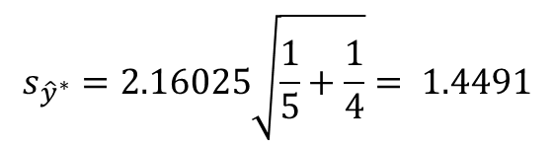
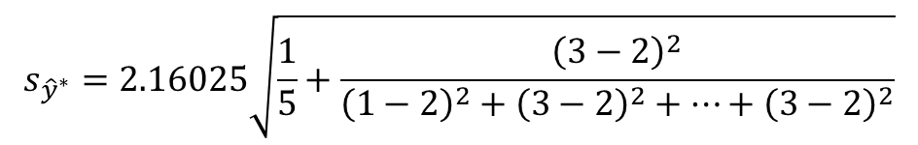
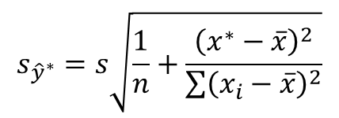
Confidence Interval for E(y*)
Estimate of the Standard Deviation of ${\hat{y}}^{∗}$
$$s_{{\hat{y}}^{∗}}=s\sqrt{\frac{1}{n}+\frac{{\left(x^{∗}−\overline{x}\right)}^{2}}{\sum{{\left(x_{i}−\overline{x}\right)}^{2}}}}$$
$$s_{{\hat{y}}^{∗}}=2.16025\sqrt{\frac{1}{5}+\frac{{\left(3−2\right)}^{2}}{{\left(1−2\right)}^{2}+{\left(3−2\right)}^{2}+…+{\left(3−2\right)}^{2}}}$$
$$s_{{\hat{y}}^{∗}}=2.16025\sqrt{\frac{1}{5}+\frac{1}{4}}= 1.4491$$

Slide 41

Confidence Interval for E(y*)
The 95% confidence interval estimate of the mean number of tractors sold when 3 TV ads are run is:
$${\hat{y}}^{∗}±t_{α/2}s_{{\hat{y}}^{∗}}$$
25 + 3.1824(1.4491)
25 + 4.61
20.39 to 29.61 tractors

Slide 42
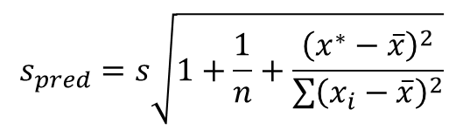
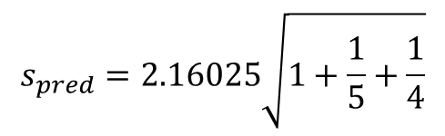
Prediction Interval for y*
Estimate of the Standard Deviation of an Individual Value of y*
$$s_{pred}=s\sqrt{1+\frac{1}{n}+\frac{{\left(x^{∗}−\overline{x}\right)}^{2}}{\sum{{\left(x_{i}−\overline{x}\right)}^{2}}}}$$
$$s_{pred}=2.16025\sqrt{1+\frac{1}{5}+\frac{1}{4}}$$
s_{pred} = 2.16025(1.20416) = 2.6013

Slide 43

Prediction Interval for y*
The 95% prediction interval estimate of the number of tractors sold in one particular week when 3 TV ads are run is:
$${\hat{y}}^{∗}±t_{α/2}s_{pred}$$
25 + 3.1824(2.6013)
25 + 8.28
16.72 to 33.28 tractors

Slide 44
Using Excel’s Regression Tool Output
SUMMARY OUTPUT
Regression Statistics
Multiple R | 0.936586
R Square | 0.877193
Adjusted R Square | 0.836257
Standard Error | 2.160247
Observations | 5
ANOVA
 | df | SS | MS | F | Significance F
Regression | 1 | 100 | 100 | 21.42857 | 0.018986
Residual | 3 | 14 | 4.666667
Total | 4 | 114
 | Coefficients | Standard Error | t Stat | P-value | Lower 95% | Upper 95% | Lower 95.0% | Upper 95.0%
Intercept | 10 | 2.366432 | 4.225771 | 0.024236 | 2.468958 | 17.53104 | 2.468958 | 17.53104
No. of TV ads (x) | 5 | 1.080123 | 4.6291 | 0.018986 | 1.562565 | 8.437435 | 1.562565 | 8.437435

Slide 45

Residual Analysis
If the assumptions about the error term ε appear questionable, the hypothesis tests about the significance of the regression relationship and the interval estimation results may not be valid.
The residuals provide the best information about ε .
Residual for observation i
$$y_{i}−{\hat{y}}_{i}$$
Much of the residual analysis is based on an examination of graphical plots.

Slide 46
Residual Plot Against x
If the assumption that the variance of ε is the same for all values of x is valid, and the assumed regression model is an adequate representation of the relationship between the variables, then the residual plot should give an overall impression of a horizontal band of points.

Slide 47
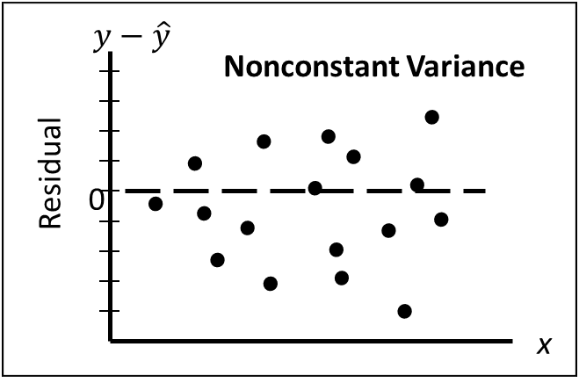


Residual Plot Against x
$$y−\hat{y}$$
Good Pattern
Residual
0
x
$$y−\hat{y}$$
Model Form Not Adequate
Residual
0
x

Slide 48
Residual Plot Against x
Residuals
Observation
Predicted tractors sold
Residuals
1
15
-1
2
25
-1
3
20
-2
4
15
2
5
25
2

Slide 49
Residual Plot Against x

Slide 50
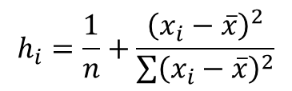
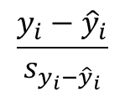

Standardized Residuals
Standardized Residual for Observation i
$$\frac{y_{i}−{\hat{y}}_{i}}{s_{y_{i}−{\hat{y}}_{i}}}$$
where:
$$s_{y_{i}−{\hat{y}}_{i}}=s\sqrt{1−h_{i}}$$
$$h_{i}=\frac{1}{n}+\frac{{\left(x_{i}−\overline{x}\right)}^{2}}{\sum{{\left(x_{i}−\overline{x}\right)}^{2}}}$$

Slide 51
Standardized Residual Plot
The standardized residual plot can provide insight about the assumption that the error term ε has a normal distribution.
If this assumption is satisfied, the distribution of the standardized residuals should appear to come from a standard normal probability distribution.

Slide 52
Standardized Residual Plot
Standardized Residuals
Standardized
Observation
Predicted y
Residual
Residual
1
15
-1
-0.5345
2
25
-1
-0.5345
3
20
-2
-1.0690
4
15
2
1.0690
5
25
2
1.0690

Slide 53
Standardized Residual Plot
All of the standardized residuals are between –1.5 and +1.5 indicating that there is no reason to question the assumption that e has a normal distribution.

Slide 54
Outliers and Influential Observations
Detecting Outliers
  An outlier is an observation that is unusual in comparison with the other data.
  Minitab classifies an observation as an outlier if its standardized residual value is < -2 or > +2.
  This standardized residual rule sometimes fails to identify an unusually large observation as being an outlier.
  This rule’s shortcoming can be circumvented by using studentized deleted residuals.
  The |i th studentized deleted residual| will be larger than the |i th standardized residual|.

