Slide 1
Monopolistic Competition

Slide 2
Monopolistic Competition
Market Structure – A classification system for the key traits of a market, including
the number of firms,
the similarity of the products they sell, and
the ease of entry and exit
Monopolistic Competition
  Many sellers
  Product differentiation
    Not price takers
    Downward sloping demand curve
  Free entry and exit

Slide 3
Market Structure
Economists who study industrial organization divide markets into four types: monopoly, oligopoly, monopolistic competition, and perfect competition.
Number of Firms
Many Firms
One Firm
Product Type
Few Firms
Differentiated
Identical
Monopoly
Oligopoly
Monopolistic Competition
Perfect
Competition
Tap Water
Sewer Services
½ ton trucks
Wireless phones
Novels
Movies
Wheat
Corn
Imperfect Competition

Slide 4
Monopolistic Competition
Firms operating in “Monopolistic Competition” need product differentiation to offer different prices and face a downward sloping firm demand curve.
Example: The bar soap industry is differentiated with easy entry.
Characteristics
Brands
Sales Outlets
Color
Scent
Size
Packaging
Texture
Antibacterial
Allergenic
Irish Spring
Dove
Dial
Zest
Lava
Coast
Unbranded
Grocery Stores
Big Box Stores
Convenience Stores
Specialty Stores
Department Stores
On-line
Flea Markets

Slide 5
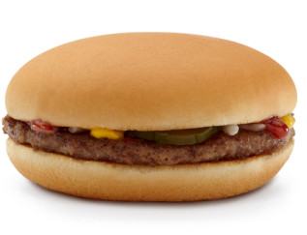

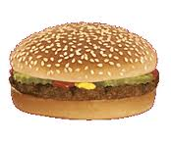
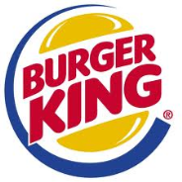
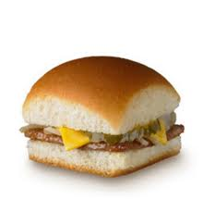
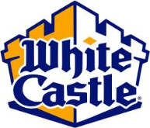
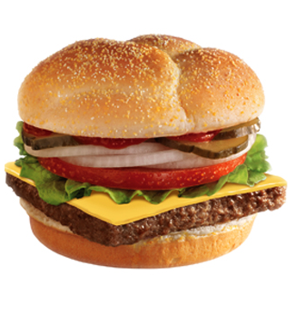
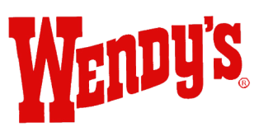
Monopolistic Competition
Example: Fast food hamburger
Sales Outlets
Are hamburgers differentiated?
McDonalds
Burger King
Dairy Queen
White Castle
Hardees
Rally’s
Wendy’s
Only represents half the market
Mom and Pops make up the other half
Again, in Monopolistic Competition product differentiation is critical otherwise firms have no control over price

Slide 6
Short Run
Firm makes profit
Firm makes losses
Price
Price
MC
MC
ATC
Price
ATC
ATC
ATC
Price
Profit
Demand
Loss
Demand
MR
MR
0
Q*
Quantity
0
Q*
Quantity
Monopolistic competitors maximize profit by producing the quantity at which marginal revenue equals marginal cost.
The firm to the left makes a profit because, at this quantity, price is above average total cost.
The firm to the right makes losses because, at this quantity, price is less than average total cost.

Slide 7
Short Run
Monopolistically competitive firms in short run maximizes profit at quantity consistent with
MR = MC
  Price on the demand curve
  If P > ATC: profit
  If P < ATC: loss

Slide 8
Long Run Equilibrium
When firms are earning an economic profit
  New firms enter the market
  Increase number of products
  Reduces demand faced by each firm
    Each firm’s demand curve shifts left
  Each firm’s profit declines until zero economic profit
When firms experiencing economic lose
  Firms have incentive to exit the market
  Decrease number of products
  Increases demand faced by each firm
    Each firm’s demand curve shifts right
  Each firm’s loss declines until zero economic profit

Slide 9
Long Run Equilibrium
Price
A Single Firm
MC
ATC
Price = ATC
Demand
MR
0
Q*
Quantity
In the long run if firms are making profit, new firms enter, and the demand curves for the incumbent firms shift to the left.
If firms are making losses, old firms exit, and the demand curves of the remaining firms shift to the right.
Because of these shifts in demand, a monopolistically competitive firm eventually finds itself in the long-run equilibrium where price equals average total cost, and the firm earns zero economic profit.

Slide 10
Long Run Equilibrium
Zero economic profit
Demand curve is tangent to average total cost curve
  At quantity where marginal revenue = marginal cost
  Price = average total cost

Slide 11
Inefficiencies
Perfectly Competitive Firm
Monopolistically Competitive Firm
Price
Price
MC
MC
ATC
Price
ATC
P=MC
Demand
Markup
MC
Demand
MR
0
Quantity produced
at efficient scale
Quantity
0
Quantity
produced
Efficient
scale
Quantity
Excess capacity
The right graph shows the long-run equilibrium in a perfectly competitive market while the left graph shows the long-run equilibrium in a monopolistically competitive market.
Note the perfectly competitive firm produces at the efficient scale, where average total cost is minimized while the monopolistically competitive firm produces at less than the efficient scale.
Also price equals marginal cost under perfect competition, but price is above marginal cost under monopolistic competition.

Slide 12
Summary
Monopolistic competition, inefficiency and society welfare
  Produces a quantity where price is greater then marginal cost
    Price is higher than perfect competition
  Quantity produced is lower than perfect competition
    Excess capacity
    Quantity is not at minimum ATC (inefficient scale)
  Too much or too little entry
  Product variety
    Positive externality on consumers (more choice)
    Negative externality on producers (business stealing)

Slide 13
Oligopoly

Slide 14
Oligopoly
Market Structure – A classification system for the key traits of a market, including
the number of firms,
the similarity of the products they sell, and
the ease of entry and exit
Oligopoly
only a few firms (firms have market power, can change price)
offer identical (homogeneous) or similar (differentiated) products
difficult to enter or exit the industry
Interdependent unlike participants in perfect competition where firms don’t need to consider actions of other producers in the short run, in oligopoly actions of each firm will impact other firms in the market

Slide 15
Market Structure
Economists who study industrial organization divide markets into four types: monopoly, oligopoly, monopolistic competition, and perfect competition.
Number of Firms
Many Firms
One Firm
Product Type
Few Firms
Differentiated
Identical
Monopoly
Oligopoly
Monopolistic Competition
Perfect
Competition
Tap Water
Sewer Services
½ ton trucks
Wireless phones
Novels
Movies
Wheat
Corn
Imperfect Competition

Slide 16
Oligopoly Definition
Homogeneous Oligopoly
  Steel (U.S. Steel, Arcelor Mittal, Nuco)
  Copper (Phelps Dodge, Arasco, Freeport-McMoRan, Southwire)
  GE or GM both needing Steel and Copper will write specification and no matter which producer wins the business GE and GM will get an identical product.
Differentiated Oligopoly
  ½ Ton Truck Market (Ford, GM, Chrysler, Toyota)
  Commercial Airline Market (America, United, Southwest, Delta, _________, ___________
  Even if you don’t know a thing about ½ ton trucks you can identify every truck producer. How? Trucks are different and each one has the brand name on the vehicle.

Slide 17
Oligopoly Theory
Oligopoly Price and Output Decisions
Nonprice Competition – compete using advertising and product differentiation
  Unique product features (iPhone, iPad)
  Increase transaction cost of switching
    Contracts (Wireless phones, insurance, etc…)
    Lock-in (FirstName.LastName@yahoo.com)
Price Leadership – a dominant firm sets the industry pricing strategy used by all other firms
Cartel – firms formally agree coordination price and output decisions.

Slide 18
Game Theory
  Game Theory: how people or firms behave in strategic situations
    Choose among alternative courses of action
    Must consider how others might respond to the action they take
  Nash equilibrium: economic actors interacting with one another each choose their best strategy given the strategies that all the other actors have chosen

Slide 19
Non-collusive
The prisoners’ dilemma
  Particular “game” between two captured prisoners
  Illustrates why cooperation is difficult to maintain even when it is mutually beneficial
Dominant strategy
  A strategy that is best for a player in a game regardless of the strategies chosen by the other players
Pay-off Table quantifies the value of each outcome in game theory based on participant choices

Slide 20
Prisoners’ dilemma
 |  | Bonnie’s decision
 |  | Confess | Remain silent
Clyde’s Decision | Confess
 | Remain silent
Bonnie gets 8 years
Bonnie gets 20 years
Clyde gets 8 years
Clyde goes free
Bonnie goes free
Bonnie gets 1 year
Clyde gets 20 years
Clyde gets 1 year
In this game between two criminals suspected of committing a crime, the dominate strategy for each is to confess. Why because no matter what the other does confession is the best choice.

Slide 21
Prisoners’ dilemma
Oligopolies as a prisoners’ dilemma
  In trying to reach the monopoly outcome
  Firms have self-interest
    and do not cooperate even though cooperation would increase profits
    each firm has incentive to cheat to maximize profit
Example Ford and GM (1/2 ton pick-up trucks)
  Differentiated oligopoly
  Ford is low cost producer
  Discounting vs. Free Features

Slide 22
Prisoners’ dilemma
 |  | GM Decision
 |  | Free Options | No Free Options
Ford Decision | Rebate
 | No Rebate
GM earns $4
million profit
GM earns $3
million profit
Ford gets $4
million profit
Ford gets $6
million profit
GM earns $6
million profit
GM earns $5
million profit
Ford gets $3
million profit
Ford gets $5
million profit
In the ½ ton truck market, using the above payoff table, Ford will choice to Rebate and GM to offer free options. While each could earn more by cooperating, cooperation is not a sustainable equilibrium in the ½ ton truck market.

