Slide 1
The Public Sector

Slide 2
Size of Government
Since the 1950’s, government expenditures have grown from about one-quarter to over one third of GDP
50%
45%
40%
Total government expenditures
35%
30%
25%
State & Local Gov. Expenditures
20%
15%
Federal government expenditures
10%
5%
45
50
55
60
65
70
75
80
85
90
95
00
05
10

Slide 3
U.S.A. taxes compared to other countries (2006)
U.S. citizens are among the most lightly taxed people in the industrialized world
60
56%
54%
50%
46%
40
45%
40%
36%
34%
20
Sweden
France
Italy
Germany
U.K.
Canada
Japan
U.S.

Slide 4
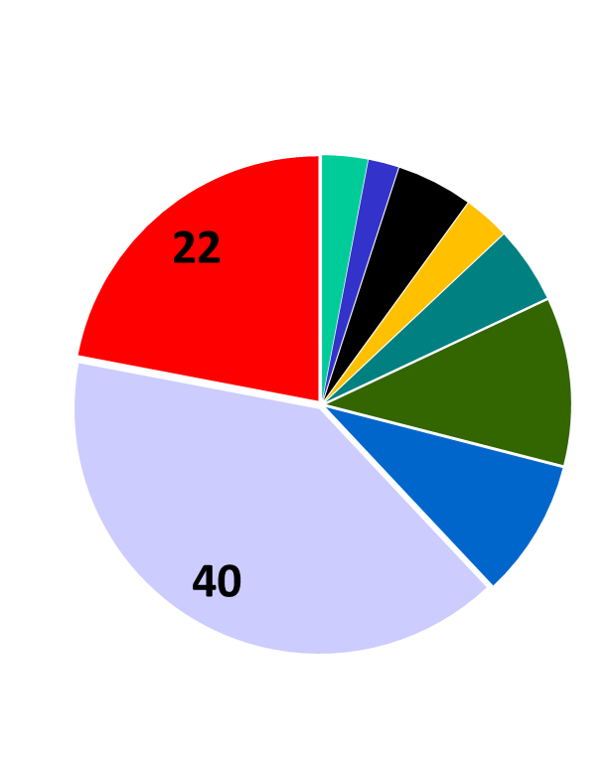
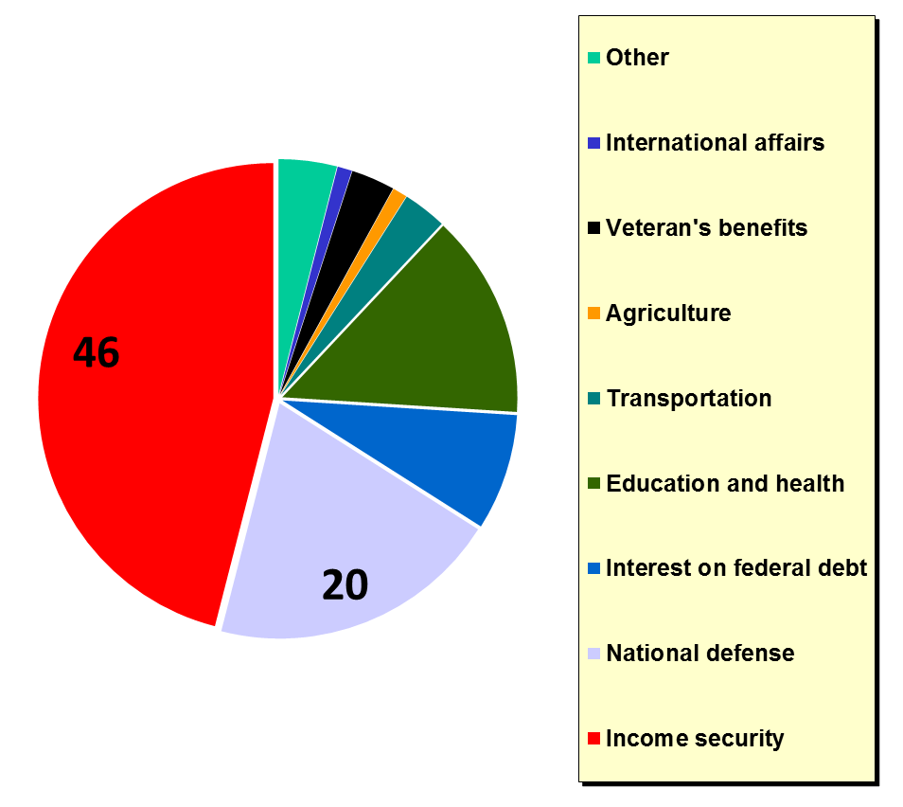
Federal Outlays
1970
2006

Slide 5
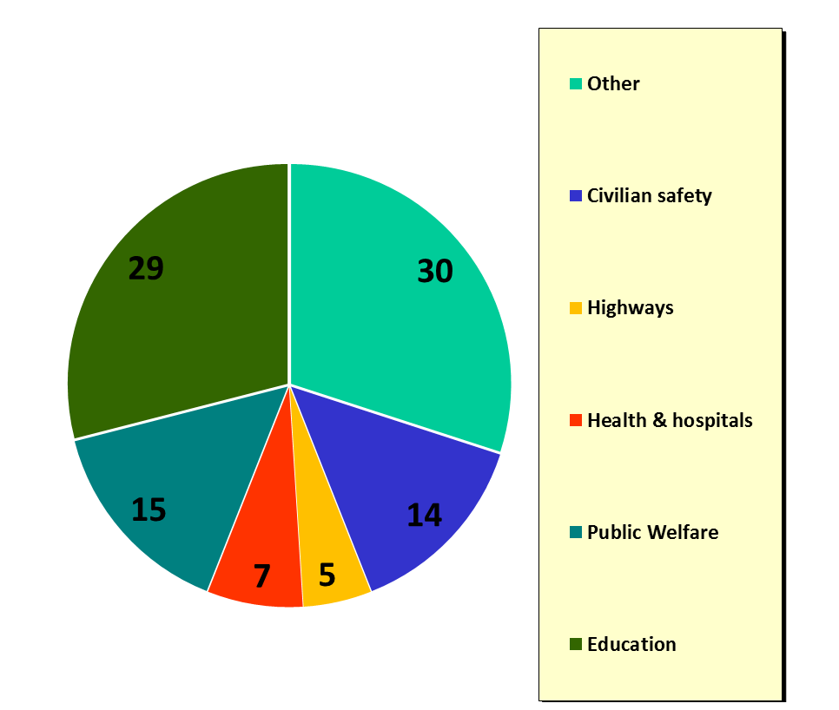
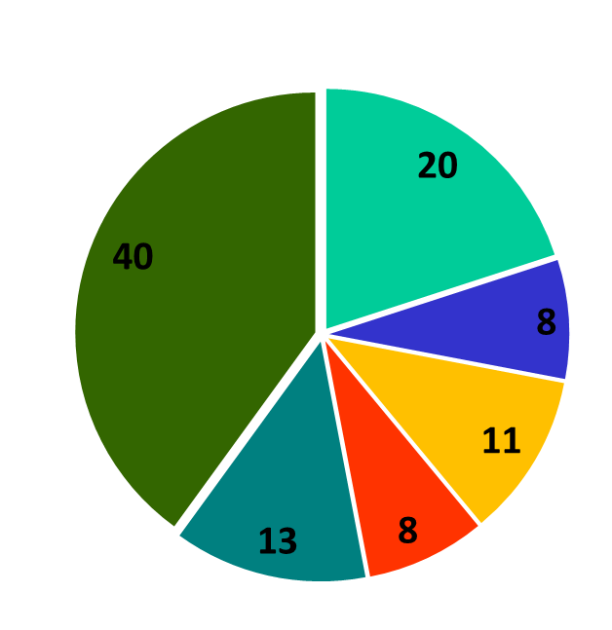
State & Local Outlays
1970
2006

Slide 6
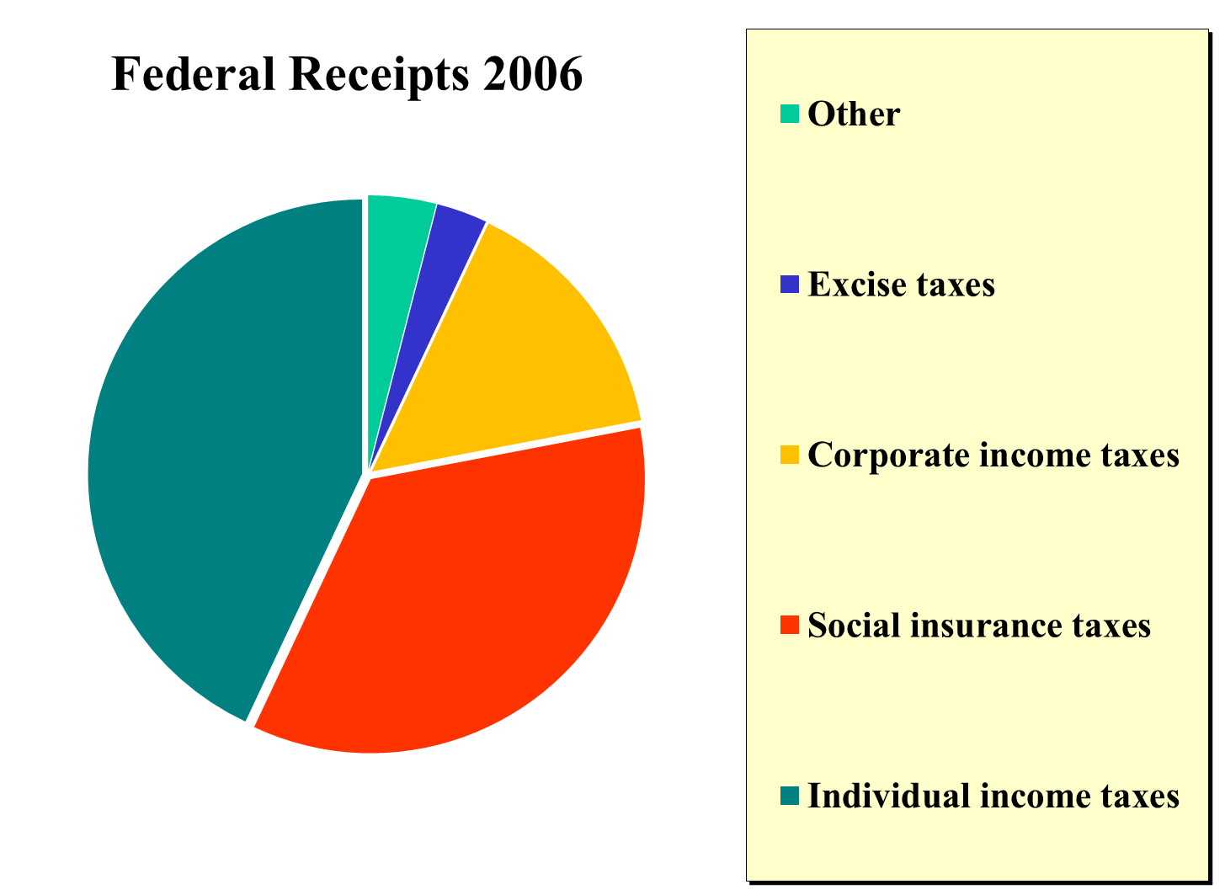

Slide 7
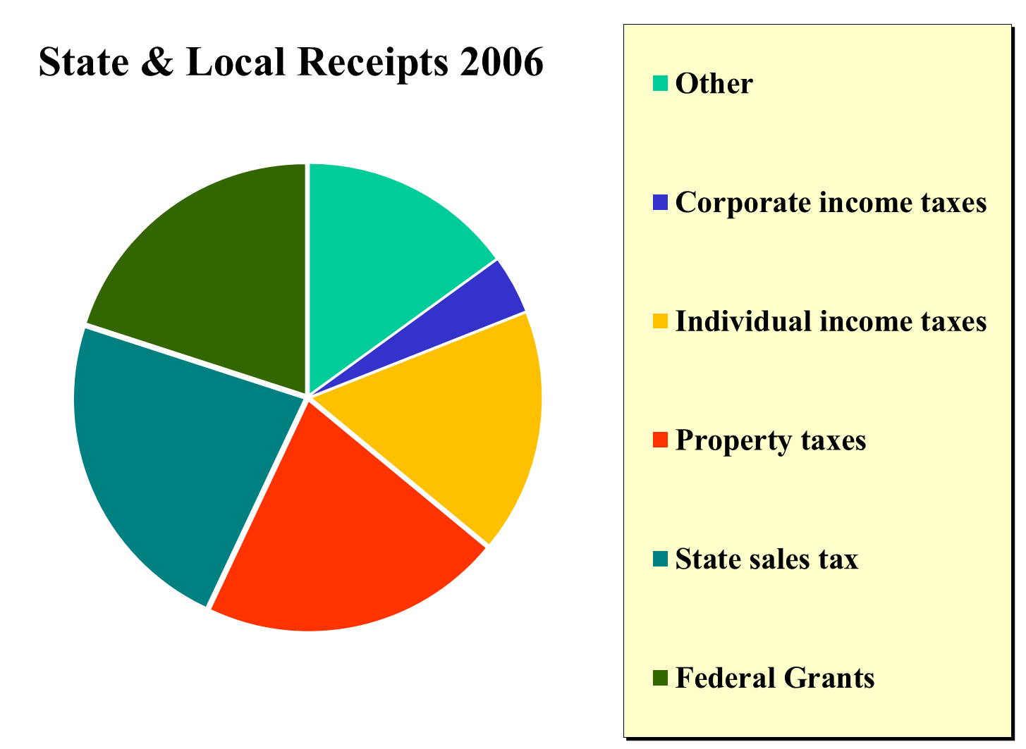

Slide 8
Growth in Taxes in the U.S., 1935 - 2006
50%
45%
40%
Total government taxes
35%
30%
25%
State & Local Gov. Taxes
20%
15%
Federal government taxes
10%
5%
45
50
55
60
65
70
75
80
85
90
95
00
05
10

Slide 9
Types of Taxes
Benefits received
Ability to pay
Benefits Received Principle
Those who benefit from government expenditures should pay the taxes that finance their benefits
Ability to Pay Principle
Those who have higher incomes can afford to pay a greater proportion of their income in taxes, regardless of the benefits

Slide 10
Average Tax Rate
Total tax due divided by total taxable income
Marginal Tax Rate
The change in taxes due divided by the change in taxable income
Regressive Tax
A tax that charges a lower percentage of income as income rises

Slide 11
Progressive Tax
A tax that charges a higher percentage of income as income rises
Proportional Tax
A tax that charges the same percentage of income, regardless of the size of income
Flat Rate Tax
Same as a proportional tax

Slide 12
Progressive Income Tax versus a Flat Tax
35%
33%
35%
28%
30%
25%
25%
17% Flat-rate tax
20%
15%
15%
10%
10%
5%
7,150
29,050
70,360
145,760
319,100
Federal government taxes

Slide 13
Public Choice Theory
The analysis of the government decision-making process to allocate resources
Benefit - Cost Analysis
The comparison of the additional rewards and costs of an economic alternative
What is the basic rule of benefit-cost analysis?
A firm will produce additional units as long as marginal benefit exceeds the marginal cost

Slide 14
Government maybe inefficient in solving society’s problems
Majority rule problem
Special interest effect
Rationale ignorance
Bureaucratic inefficiency
Shortsightedness effect

Slide 15
Can majority rule lead to inefficient solutions?
Majority Rule Problem
Voting can lead to a rejection of projects with marginal total benefits exceeding the marginal cost
Yes, “one person one vote” cannot measure the intensity of voters’ preferences as well as the market

Slide 16
Special-Interest Group Effect
Special-interest groups can create government support for programs with costs out-weighing their benefits
Why can special-interest voting be inefficient?
A small group within the society can benefit while the whole society pays the costs

Slide 17
Rational Ignorance
The voters choose to remain uninformed because the marginal cost of obtaining information is higher than the marginal benefit from knowing it
Bureaucratic Inefficiency
The bureaucracy may become more powerful than elected officials
Shortsightedness Effect
Democracy has a bias toward programs offering clear benefits and hidden costs

