Slide 1
Federal Deficits, Surpluses and the National Debt

Slide 2
Four Stages of the Budget Process
Formation of the budget
Presidential budget submission
Budget resolution
Budget passed
Federal Fiscal Year
October 1 through September 30

Slide 3
What is the federal deficit?
How much money the government borrows in any given fiscal year
What is the national debt?
Amount owed by the federal government to owners of government securities
How does the U.S. Treasury borrow money?
By selling securities promising to make interest payments and to repay on a given date

Slide 4
Federal Expenditures and Tax Revenues
$2,800
$2,400
$2,000
Expenditures
$1,600
$1,200
$800
Revenues
$400
70
75
80
85
90
95
00
05
10

Slide 5
Federal Budget Surpluses and Deficits
$+250
+200
+150
+100
+50
0
-50
Billions of dollars
Deficit
-100
-150
-200
-250
-300
-350
-400
-450
-500
-550
70
75
80
85
90
95
00
05
10

Slide 6
What is the net public debt?
National debt minus all government inter-agency borrowing

Slide 7
Federal Expenditures and Tax Revenues
24
23
22
21
Percentage of GDP
Deficit
20
Surplus
19
Deficit
Deficit
18
17
1985
1990
2000
2005

Slide 8
What has been done to curb the national debt?
Tax increase
Spending caps
Debt ceiling

Slide 9
What happened to taxes in 1993?
Raised the highest marginal tax rate from 31% to 36%
Increased tax on gasoline by 4.3 cents per gallon
What happened to spending in 1993?
Reduced military spending and cut some entitlements, including Medicare, Medicaid, and food stamps

Slide 10
The Balanced Act of 1997?
The act continued mandatory limits on spending and taxes
What happened between 2004 and 2006?
Tax revenues as a percentage of GDP grew, while expenditures as a percentage of GDP remained constant

Slide 11
Debt Ceiling
The legislated legal limit on the national debt
What usually happens when the debt pushes against the ceiling?
Congress raises the ceiling to accommodate the budget deficit

Slide 12
The National Debt
$8
$7
$6
$5
Trillions of dollars
$4
$3
$2
60
70
80
90
00
05
10

Slide 13
National Debt as a Percentage of GDP
140
120
100
Percentage of GDP
80
60
40
20
50
60
70
80
90
00
05

Slide 14
What is the internal national debt?
The portion of the national debt owed to a nation’s own citizens
What is the external national debt?
The portion of the national debt owed to foreign citizens

Slide 15
Federal Net Interest as a Percentage of GDP
4.0
3.5
3.0
2.5
Percentage of GDP
2.0
1.5
1.0
.05
60
70
80
90
00
05
10

Slide 16
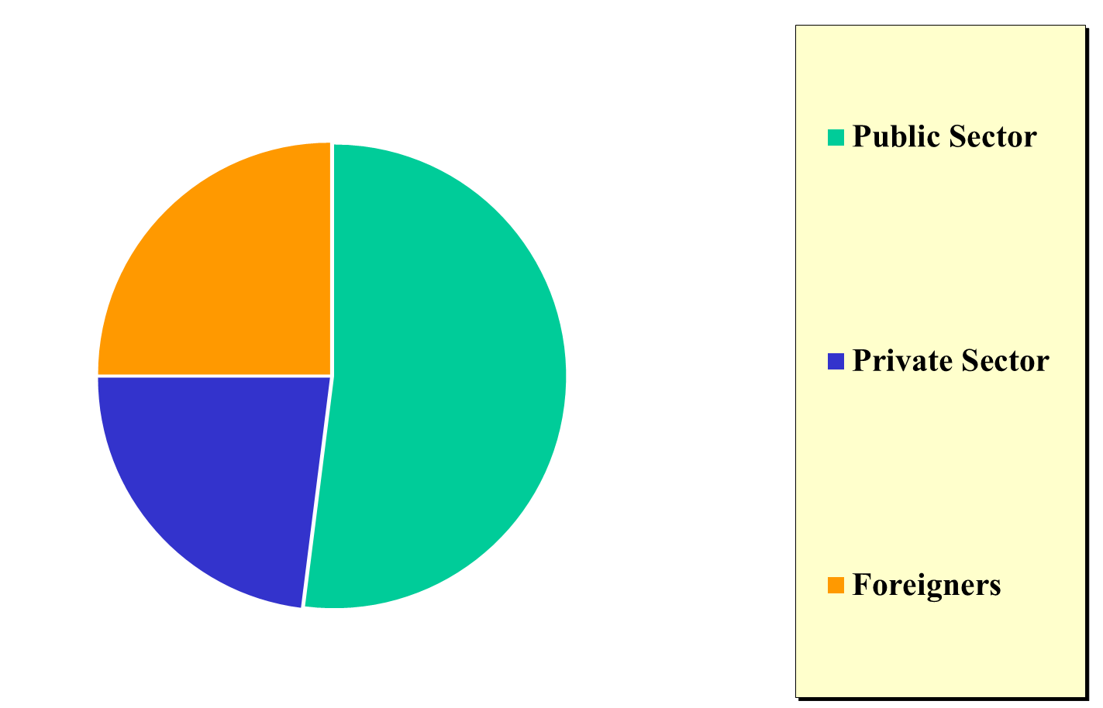
Ownership of the National Debt, 2006

Slide 17
Does government borrowing crowd out private-sector spending?
The crowding-out effect
When federal government borrowing increases interest rates, the result is lower consumption and investments
Yes, the more the government borrows the less loanable funds for everyone else
No, especially if it occurs during economic downturns

Slide 18
Can Uncle Sam go bankrupt?
Yes, it’s possible
No, the debt need never be paid off
Are we passing the debt burden to our children?
Yes, especially if it continues to increase
No, not as long as the debt is internally owned

Slide 19
Zero, Partial, and Complete Crowding Out
AS
200
E₂
150
E₂
E₁
AD₂
100
AD₂
50
AD₁
2
4
6
8
12
fe

Slide 20
AD and real GDP increase dampened
Consumers and business spending decrease
Interest rates rise
Govt. competes with private borrowers
Govt. spends and borrows

