Slide 1
Demand and Supply
This lecture flows well with Managerial Economics, Mark Hirschey, 12th edition, chapter 3.

Slide 2
Chapter 3
OVERVIEW
Basis for Demand
Market Demand Function
Demand Curve
Basis For Supply
Market Supply Function
Supply Curve
Market Equilibrium

Slide 3
Basis for Demand
Direct Demand
  Demand is the quantity customers are willing to buy under current market conditions.
  Direct demand is demand for consumption.
Derived Demand
  Derived demand is input demand.
  Firms demand inputs that can be profitably employed.

Slide 4
Demand Curve
Six variables that influence Q_{d}
  Price of good or service (P)
  Non-Price Determinants
  Incomes of consumers (M)
  Prices of related goods & services (P_{R})
  Taste patterns of consumers (T )
  Expected future price of product (P_{e})
  Number of consumers in market (N)
Generalized demand function
Q_{d} = f(P, M, P_{R}, T, P_{e}, N)

Slide 5
Generalized Demand Function
$$Q_{d}=a+bP+cM+dP_{R}+e +fP_{e}+gN$$
T
b, c, d, e, f, & g are slope parameters
  Measures the effect on Q_{d} of changing one of the variables while holding the others constant
Sign of parameter shows how variable is related to Q_{d}
  Positive sign indicates direct relationship
  Negative sign indicates inverse relationship

Slide 6
Generalized Demand Function
Variable | Relation to Q_{d} | Sign of Slope Parameter
P
Inverse
b = ΔQ_{d}/ΔP is negative
Direct for normal goods
c = ΔQ_{d}/ΔM is positive
M
Inverse for inferior goods
c = ΔQ_{d}/ΔM is negative
Direct for substitutes
d = ΔQ_{d}/ΔP_{R} is positive
P_{R}
Inverse for complements
d = ΔQ_{d}/ΔP_{R} is negative
T
Direct
e = ΔQ_{d}/Δ is positive
P_{e}
Direct
f = ΔQ_{d}/ΔP_{e} is positive
N
Direct
g = ΔQ_{d}/ΔN is positive

Slide 7
Demand Function
Demand function, or demand, shows relation between P & Q_{d} when all other variables are held constant
  Q_{d} = f(P)
Law of Demand
  Q_{d} increases when P falls and
  Q_{d} decreases when P rises, all else constant
  ΔQ_{d}/ΔP or “b” must be negative

Slide 8
Graphing Demand Curves
Traditionally price (P) is plotted on the vertical axis & quantity demanded (Q_{d}) is plotted on the horizontal axis
  The equation plotted is the inverse demand function
  P = f(Q_{d})

Slide 9
Graphing Demand Curves
A point on a demand curve shows either:
  Maximum amount of a good that will be purchased for a given price
  Maximum price consumers will pay for a specific amount of the good

Slide 10
Graphing Demand Curves
Change in quantity demanded
  Occurs when price changes
  Movement along demand curve
Change in demand
  Occurs when one of the other variables, or determinants of demand, changes
  Demand curve shifts rightward or leftward

Slide 11
Beef Example
Demand for Beef
  Price of Beef
  Price of Chicken
  Price of Pork
  Price of Vegetables
  Income (Budget)
  Taste for Beef
  Expectations about Beef
  Size of Market

Slide 12
Beef Example
Q_{d} = a + b₁P_{b} + b₂P_{c} + b₃P_{p} + b₄P_{v} + b₅M + b₆E_{b} + b₇T_{b}
Q_{d} = the quantity demand for beef
P_{b} = Price Index of Beef
P_{c} = Price Index of Chicken
P_{p} = Price Index of Pork
P_{v} = Price Index of Vegetables
M = Household Income (000)
E_{b} = Expectations (Weekly Industry Ad spend) (000,000)
T_{b} = Tastes (Ratio of good Ads and Articles to Bad)
A = intercept constant
b₁, b₂, b₃, b₄, b₅, b₆, and b₇ are slope constants

Slide 13
Beef Example
Q_{d} = a + b₁P_{b} + b₂P_{c} + b₃P_{p} + b₄P_{v} + b₅M + b₆E_{b} + b₇T_{b}
Q_{d} = 41.2 – 3.4P_{b} + 5.2P_{c} + 2.8P_{p} – 5.5P_{v} + .32M + 1.2E_{b} + 1.6T_{b}
Q_{d} = 41.2 – 3.4P_{b} + 5.2($1.70) + 2.8($2) – 5.5($1) + .32(38) + 1.2(3) + 1.6(3)
Q_{d} = 41.2 – 3.4P_{b} + 30.06
Q_{d} = 71.26 – 3.4P_{b}

Slide 14




Demand Curve
Price
$$Q_{d}=71.26−3.4P_{beef}$$
$$Q_{d}−71.26=−3.4P_{beef}$$
$$\frac{Q_{d}−71.26}{−3.4}=P_{beef}$$
$20.95
$$P_{beef}=20.95−0.294Q$$
0
71.26
Quantity

Slide 15
Beef Example (Change in P_{R})
Q_{d} = a + b₁P_{b} + b₂P_{c} + b₃P_{p} + b₄P_{v} + b₅M + b₆E_{b} + b₇T_{b}
Q_{d} = 41.2 – 3.4P_{b} + 5.2P_{c} + 2.8P_{p} – 5.5P_{v} + .32M + 1.2E_{b} + 1.6*T_{b}
Q_{d} = 41.2 – 3.4P_{b} + 5.2($1.70) + 2.8($2) – 5.5($1) + .32(38) + 1.2(3) + 1.6(3)
Q_{d} = 41.2 – 3.4P_{b} + 30.06
Q_{d} = 71.26 – 3.4P_{b}
Price of Chicken increases to $2.00
Q_{d} = 41.2 – 3.4P_{b} + 5.2($2) + 2.8($2) – 5.5($1) + .32(38) + 1.2(3) + 1.6(3)
Q_{d} = 41.2 – 3.4P_{b} + 31.62
Q_{d} = 72.82 – 3.4P_{b}

Slide 16




Demand Curve
Price
$$Q_{d0}^{}=71.26−3.4P_{beef}$$
$$Q_{d1}^{}=72.82−3.4P_{beef}$$
$21.42
$20.95
Change in Demand resulting from an increase in the price of chicken from $1.70 to $2.00
$$Q_{d1}^{}$$
$$Q_{d0}^{}$$
0
71.26
72.82
Quantity

Slide 17
Basis For Supply
Firms Offer Supply To Make Profits
  When prices rise, firms boost the quantity supplied.
  When prices fall, firms cut the quantity supplied.
Everything That Affects Marginal Production Costs Affects Supply
  If MC falls, supply rises.
  If MC rises, supply falls.

Slide 18
Market Supply Function
Determinants of Supply
  Supply is determined by price, prices of other goods, technology, and so on.
Industry Supply Versus Firm Supply
  Firm supply is determined by economic conditions and competition.
  Industry supply is the sum of firm supply.

Slide 19

Supply
Six variables that influence Q_{s}
  Price of good or service (P)
  Non-Price Determinants
  Input prices (P_{I} )
  Prices of goods related in production (P_{r})
  Technological advances (T)
  Expected future price of product (P_{e})
  Number of firms producing product (F)
Generalized supply function
$$Q_{s}=f(P, P_{I},P_{r},T,P_{e},F)$$

Slide 20
Generalized Supply Function
$$Q_{s}=h+kP+lP_{I}+mP_{r}+nT+rP_{e}+sF$$
k, l, m, n, r, & s are slope parameters
  Measure effect on Q_{s} of changing one of the variables while holding the others constant
Sign of parameter shows how variable is related to Q_{s}
  Positive sign indicates direct relationship
  Negative sign indicates inverse relationship

Slide 21
Generalized Supply Function
Variable | Relation to Q_{s} | Sign of Slope Parameter
P
Direct
k = ΔQ_{s}/ΔP is positive
P_{I}
Inverse
l = ΔQ_{s}/ΔP_{I} is negative
Inverse for substitutes
m = ΔQ_{s}/ΔP_{r} is negative
P_{r}
Direct for complements
m = ΔQ_{s}/ΔP_{r} is positive
T
Direct
n = ΔQ_{s}/ΔT is positive
P_{e}
Inverse
r = ΔQ_{s}/ΔP_{e} is negative
F
Direct
s = ΔQ_{s}/ΔF is positive

Slide 22
Supply Function
Supply function, or supply, shows relation between P & Q_{s} when all other variables are held constant
  Q_{s} = g(P)

Slide 23
Graphing Supply Curves
A point on a supply curve shows either:
  Maximum amount of a good that will be offered for sale at a given price
  Minimum price necessary to induce producers to voluntarily offer a particular quantity for sale

Slide 24
Graphing Supply Curves
Change in quantity supplied
  Occurs when price changes
  Movement along supply curve
Change in supply
  Occurs when one of the other variables, or determinants of supply, changes
  Supply curve shifts rightward or leftward

Slide 25
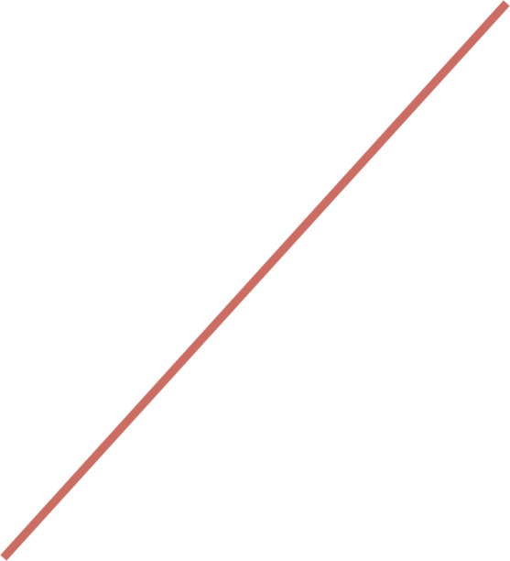

Shifts in Supply
P
S₂
80
S₀
Price (dollars)
70
S₁
$60, 700
$60, 400
•
60
•
Supply decrease
50
•
•
40
$40, 500
$40, 650
30
Supply increase
20
10
Q_{s}
0
100
300
500
700
900
Quantity

Slide 26
Market Equilibrium
Demand and Supply Balance
  Equilibrium exists if perfect balance exists in the quantities demanded and supplied.
  Equilibrium reflects productive and allocative efficiency.
Surplus and Shortage
  Surplus is excess supply.
  Shortage is excess demand.

Slide 27
Market Equilibrium
Equilibrium price & quantity are determined by the intersection of demand & supply curves
  At the point of intersection, Q_{d} = Q_{s}
  Consumers can purchase all they want & producers can sell all they want at the “market-clearing” price

Slide 28
Beef Example
Q_{d} = 71.26 – 3.4P_{b}
Suppose Q_{s} = 62
(Market Period, that is, no time to change output)
Q_{s} = Q_{d}
in equilibrium
62 = 71.26 – 3.4P_{b}
P_{b}=$2.72
P
Q_{d} = 71.26 – 3.4($2.72) = 62
Q_{s}
Q_{d}
$2.72
0
62
Q

Slide 29
Beef Example
Q_{d} = 71.26 – 3.4P_{b}
Suppose Q_{s} = 50.55 + 2.1P_{b}
Q_{s} = Q_{d}
in equilibrium
50.55 + 2.1P_{b} = 71.26 – 3.4P_{b}
P_{b}=$2.72
P
Q_{d} = 71.26 – 3.4($2.72) = 62
Q_{d}
Q_{s}
$2.72
0
62
Q

Slide 30
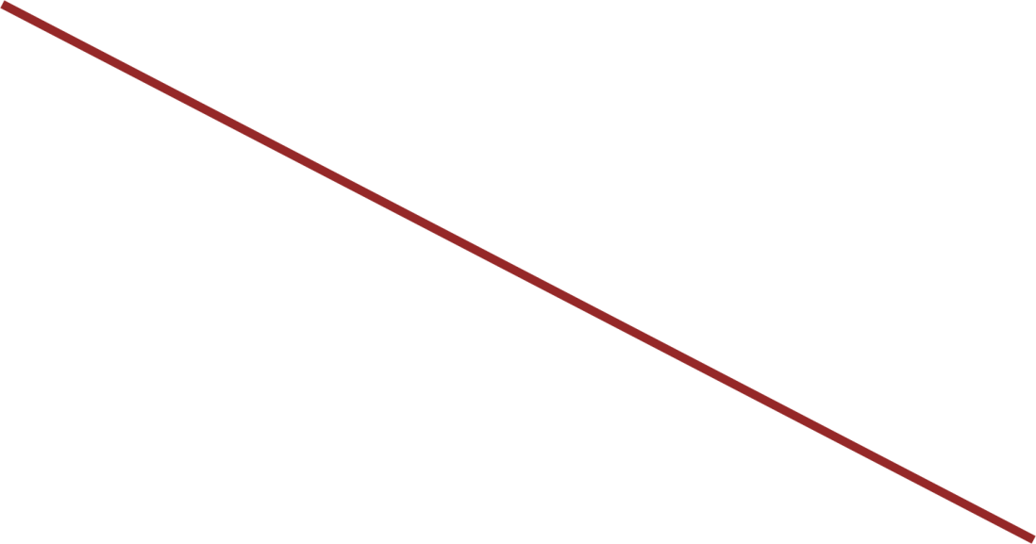
Market Equilibrium
P
80
70
S₀
Price (dollars)
60
•
•
50
•
40
30
•
•
20
10
D₀
Q_{d} , Q_{s}
0
100
300
500
700
900
1,100
1,300
1,500
Quantity

Slide 31
Comparative Statics
Changes in Equilibrium
  Equilibrium exists when there is no economic incentive for change in demand or supply.
  Changing demand or supply affects equilibrium.
Comparative Statics
  Study of how equilibrium changes with changing demand or supply.
  Change continues until a new equilibrium is established.

Slide 32
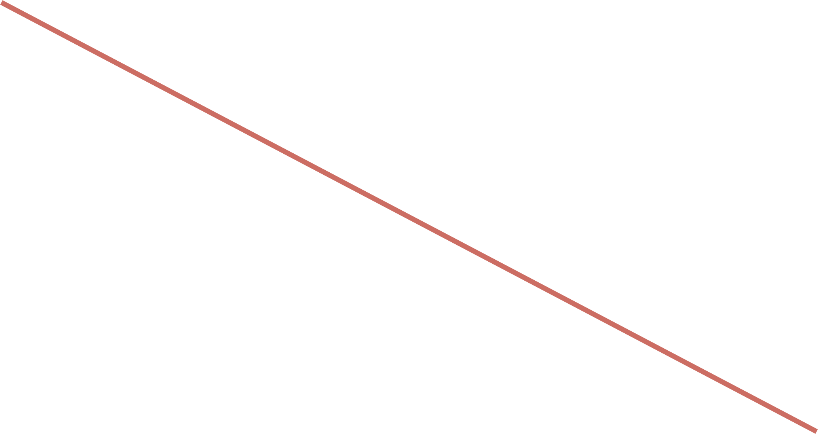

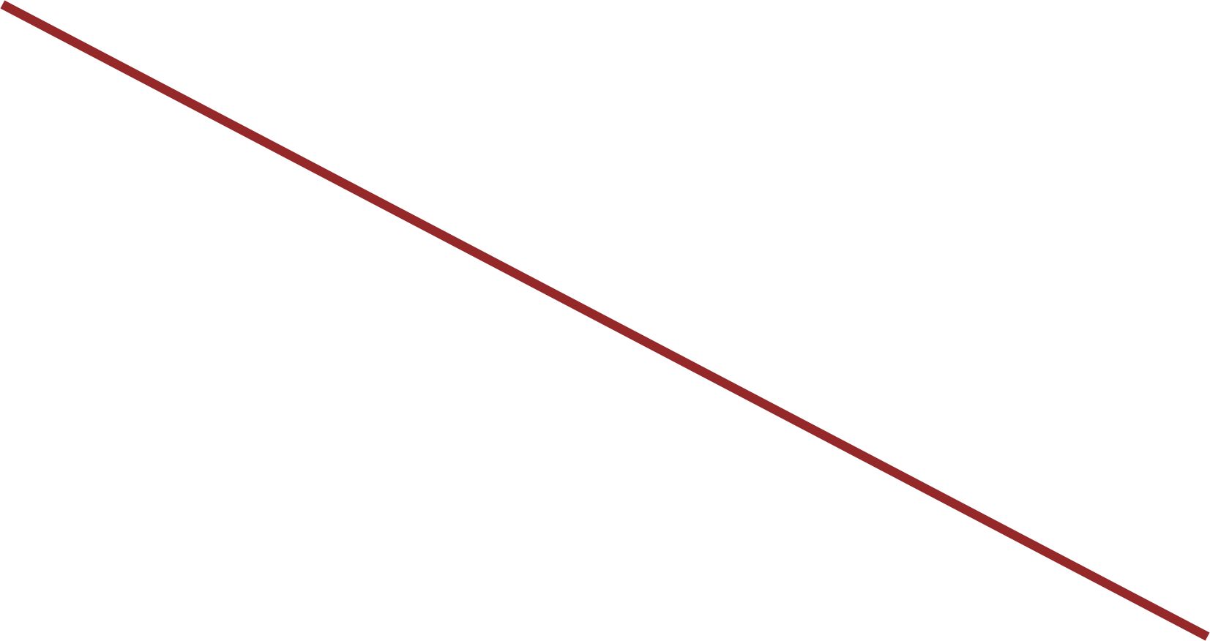
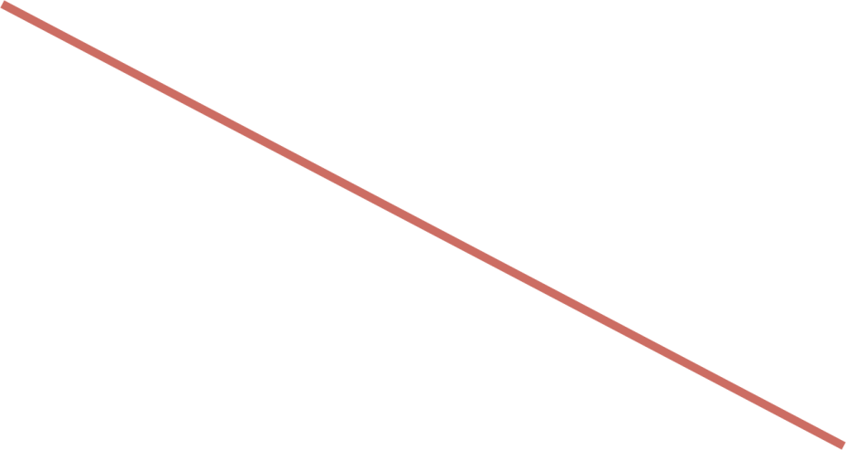
Demand Shifts (Supply Constant)
P
80
S₀
Price (dollars)
70
60
B
•
50
A
•
•
•
40
C
•
30
20
10
D₂
D₀
D₁
Q_{d} , Q_{s}
0
100
300
500
700
900
1,100
1,300
1,500
Quantity

Slide 33



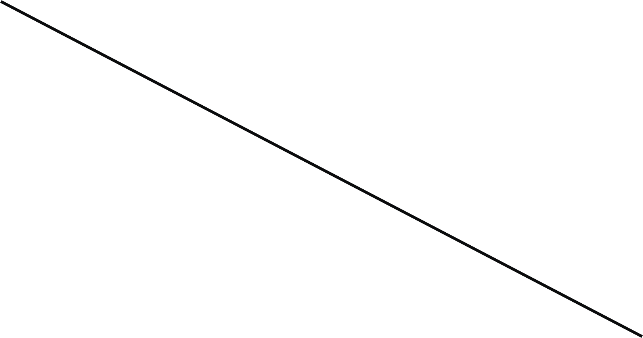
Supply Shifts (Demand Constant)
P
S₂
80
S₀
S₁
Price (dollars)
70
60
T
•
50
R
•
•
•
40
•
30
S
20
10
D₀
Q_{d} , Q_{s}
0
100
300
500
700
900
1,100
1,300
Quantity

Slide 34
Simultaneous Shifts
When demand & supply shift simultaneously
  Can predict either the direction in which price changes or the direction in which quantity changes, but not both
  The change in equilibrium price or quantity is said to be indeterminate when the direction of change depends on the relative magnitudes by which demand & supply shift

Slide 35


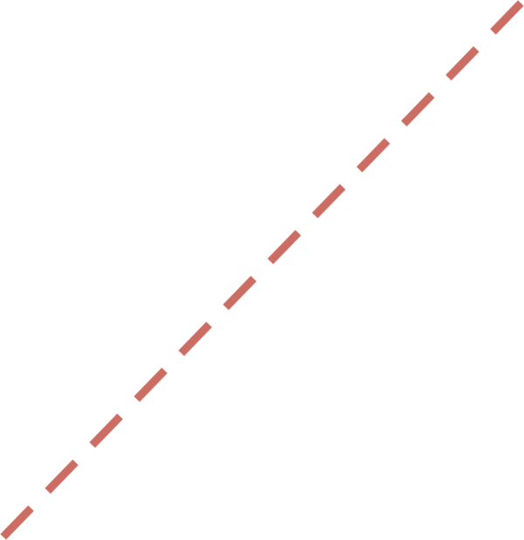
Simultaneous Shifts: (↑D, ↑S)
P
S
S’
S’’
B
P’
•
A
P
•
•
C
P’’
D’
D
Q
Q
Q’
Q’’
Price may rise or fall; Quantity rises

Slide 36
Simultaneous Shifts: (↓D, ↑S)
P
S
S’
S’’
A
•
P
B
P’
•
•
C
P’’
D
D’
Q
Q’
Q
Q’’
Price falls; Quantity may rise or fall

Slide 37
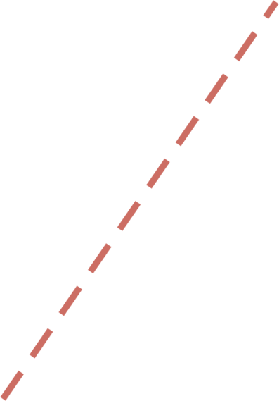
Simultaneous Shifts: (↑D, ↓S)
P
S’’
S’
•
S
P’’
C
B
•
P’
A
•
P
D’
D
Q
Q’’
Q’
Q
Price rises; Quantity may rise or fall

Slide 38
Simultaneous Shifts: (↓D, ↓S)
P
S’’
S’
S
P’’
•
C
A
P
•
•
B
P’
D
D’
Q
Q’’
Q’
Q
Price may rise or fall; Quantity falls

