Slide 1
Risk Analysis
This lecture flows well with Managerial Economics, Mark Hirschey, 12th edition, chapter 16.

Slide 2
Chapter 16
OVERVIEW
Concepts of Risk and Uncertainty
Probability Concepts
Standard Normal Concept
Utility Theory and Risk Analysis
Adjusting the Valuation Model for Risk
Decision Trees and Computer Simulation

Slide 3
Concepts of Risk and Uncertainty
Economic Risk and Uncertainty
  Economic risk is the chance of loss because all possible outcomes and their probability of occurrence are unknown.
  Uncertainty exists because outcomes cannot be predicted with assurance.
General Risk Categories
  Business risk is the chance of loss.
  Market risk is the chance of loss because of swings in the financial markets.

Slide 4
Probability Concepts
Probability Distribution
  A payoff matrix shows the dollar outcome associated with each possible state of nature.
Expected Value
  E(π) = ∑ π_{i} x p_{i} where π_{i} is a profit outcome and p_{i} is its associated probability.
Risk Measurement
  Absolute risk is measured by standard deviation, σ.
  Relative risk is measured by the coefficient of variation, C.V. = σ_{π}/ E(π).

Slide 6
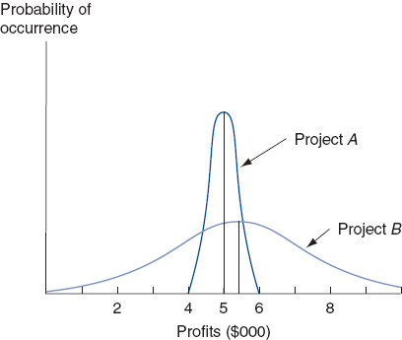

Slide 7
Standard Normal Concept
Normal Distribution
  A normal distribution is a symmetrical distribution about the mean.
  Actual outcomes lie within ±1σ (68%).
  Actual outcomes lie within ±2σ (95%).
  Actual outcomes lie within ±3σ (99%).

Slide 9
Standardized Variables
Standardized variables have a mean of zero and a standard deviation of one.
  They are measured in units of σ.
Z = (x-μ)/σ, where z is a standardized variable, x is a point of interest, µ is the mean, and σ is standard deviation.

Slide 10
Utility Theory and Risk Analysis
Possible Risk Attitudes
  Risk aversion is desire to avoid risk.
  Risk neutrality is to disregard risk.
  Risk seeking is preference for risk.
Relation Between Money and its Utility
  Risk aversion implies DMU for money.
  Risk neutrality implies CMU for money.
  Risk seeking implies IMU for money.

Slide 12
Adjusting the Valuation Model for Risk
The certainty equivalent adjustment factor α is a certain sum divided by an expected risky amount, where both provide the same utility, α = Certain Sum/E(R).
  α < 1 implies risk aversion.
  α = 1 implies risk indifference.
  α > 1 implies risk preference.
Risk-adjusted Discount Rates
  Risk‑adjusted discount rate k = R_{F} + R_{P}.

Slide 13
Decision Trees and Computer Simulation
Decision Trees
  Involve a series of choice alternatives constrained by previous decisions.
Computer Simulation
  Hypothetical “what if?” questions can be answered on the basis of measurable differences in underlying assumptions
  Limited-scale simulations are used to project outcomes for projects or strategies.

