Slide 1
Chapter 2
Demand, Supply, and Market Equilibrium

Slide 2
Demand
Quantity demanded (Q_{d})
  Amount of a good or service consumers are willing & able to purchase during a given period of time

Slide 3
General Demand Function
Six variables that influence Q_{d}
  Price of good or service (P)
  Incomes of consumers (M)
  Prices of related goods & services (P_{R})
  Taste patterns of consumers (T)
  Expected future price of product (P_{e})
  Number of consumers in market (N)
General demand function
  Q_{d} = f(P, M, P_{R}, T, P_{e} , N)

Slide 4
General Demand Function
Q_{d} = a + bP + cM + dP_{R} + eT + fP_{e} + gN
b, c, d, e, f, & g are slope parameters
  Measure effect on Q_{d} of changing one of the variables while holding the others constant
Sign of parameter shows how variable is related to Q_{d}
  Positive sign indicates direct relationship
  Negative sign indicates inverse relationship

Slide 5
General Demand Function
Normal good
  A good or service for which an increase (decrease) in income causes consumers to demand more (less) of the good, holding all other variables in the general demand function constant
Inferior good
  A good or service for which an increase (decrease) in income causes consumers to demand less (more) of the good, all other factors held constant

Slide 6
General Demand Function
Substitutes
  Two goods are substitutes if an increase (decrease) in the price of one good causes consumers to demand more (less) of the other good, holding all other factors constant
Complements
  Two goods are complements if an increase (decrease) in the price of one good causes consumers to demand less (more) of the other good, all other things held constant

Slide 7
General Demand Function
Variable | Relation to Q_{d} | Sign of Slope Parameter
P
Inverse
b = ΔQ_{d}/ΔP is negative
Direct for normal goods
c = ΔQ_{d}/ΔM is positive
M
Inverse for inferior goods
c = ΔQ_{d}/ΔM is negative
Direct for substitutes
d = ΔQ_{d}/ΔP_{R} is positive
P_{R}
Inverse for complements
d = ΔQ_{d}/ΔP_{R} is negative
T
Direct
e = ΔQ_{d}/ΔT is positive
P_{e}
Direct
f = ΔQ_{d}/ΔP_{e} is positive
N
Direct
g = ΔQ_{d}/ΔN is positive

Slide 8
Direct Demand Function
The direct demand function, or simply demand, shows how quantity demanded, Q_{d} , is related to product price, P, when all other variables are held constant
  Q_{d} = f(P)
Law of Demand
  Q_{d} increases when P falls, all else constant
  Q_{d} decreases when P rises, all else constant
  ΔQ_{d}/ΔP must be negative

Slide 9
Inverse Demand Function
Traditionally, price (P) is plotted on the vertical axis & quantity demanded (Q_{d}) is plotted on the horizontal axis
  The equation plotted is the inverse demand function, P = f(Q_{d})

Slide 10
Graphing Demand Curves
A point on a direct demand curve shows either:
  Maximum amount of a good that will be purchased for a given price
  Maximum price consumers will pay for a specific amount of the good (demand price)

Slide 11
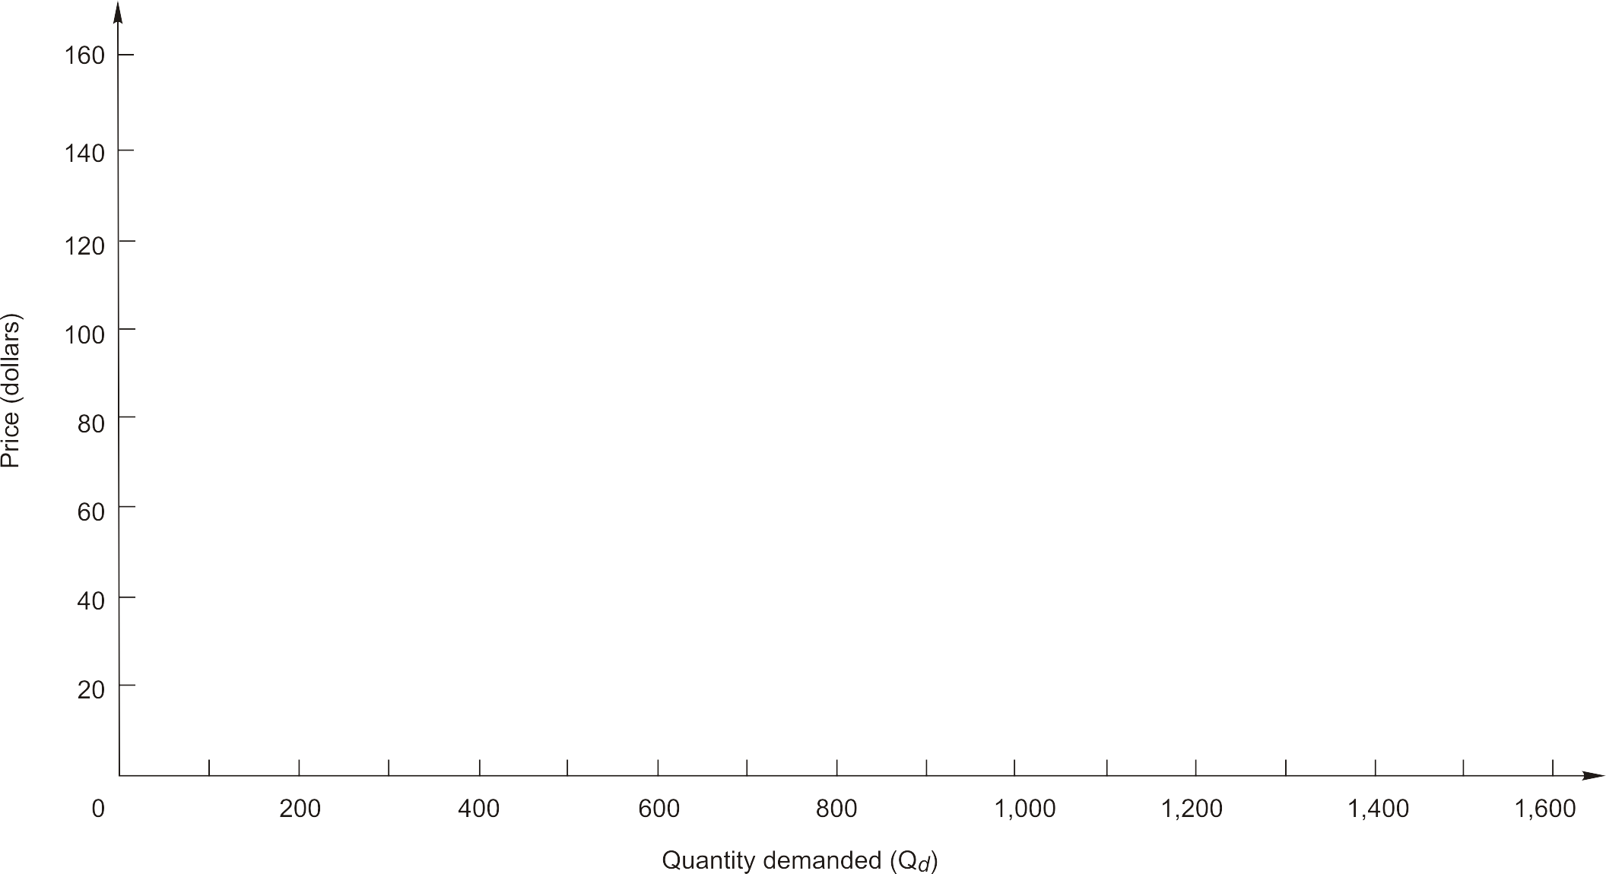
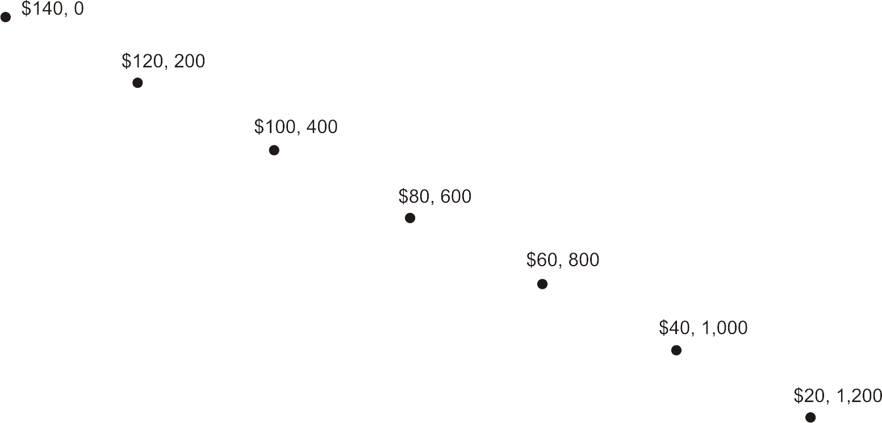
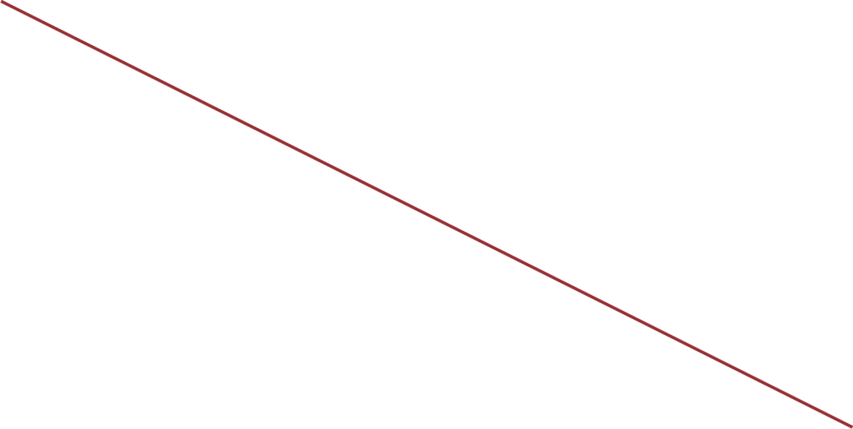
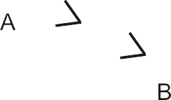
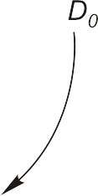
A Demand Curve (Figure 2.1)
Q_{d} = 1,400 – 10P

Slide 12
Graphing Demand Curves
Change in quantity demanded
  Occurs when price changes
  Movement along demand curve
Change in demand
  Occurs when one of the other variables, or determinants of demand, changes
  Demand curve shifts rightward or leftward

Slide 13
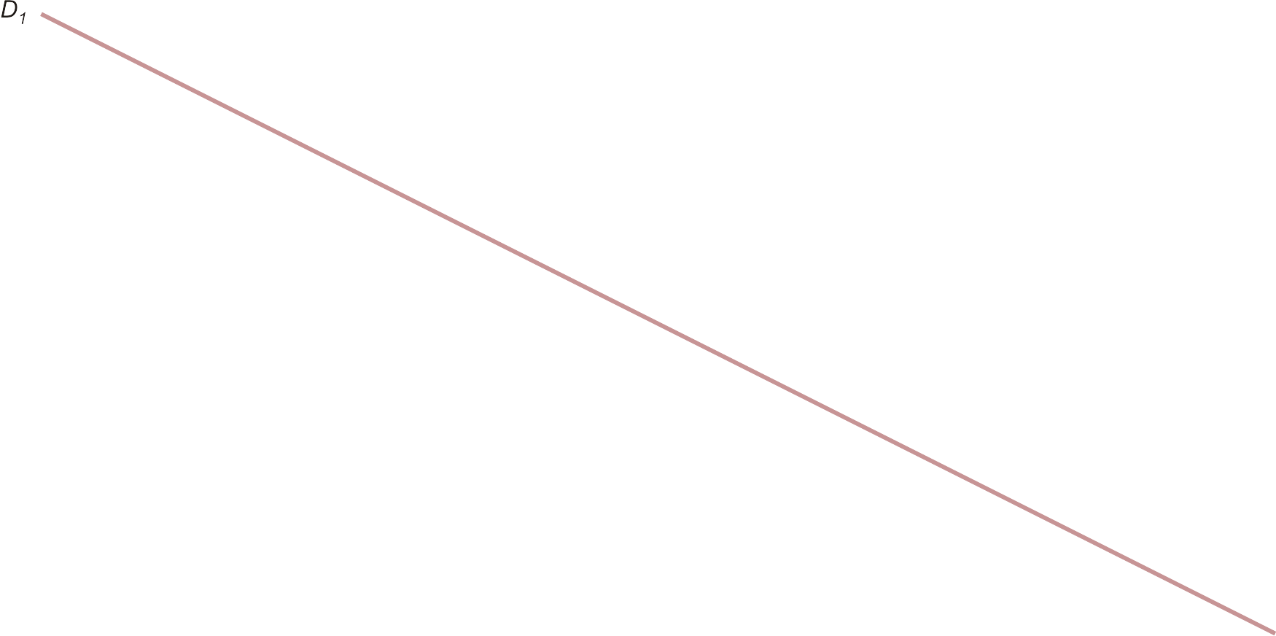
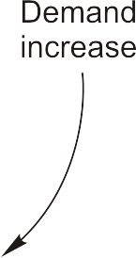
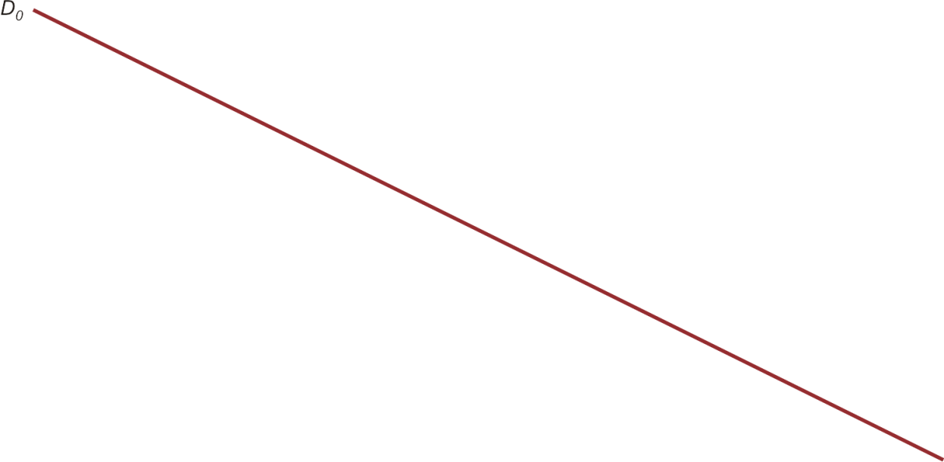

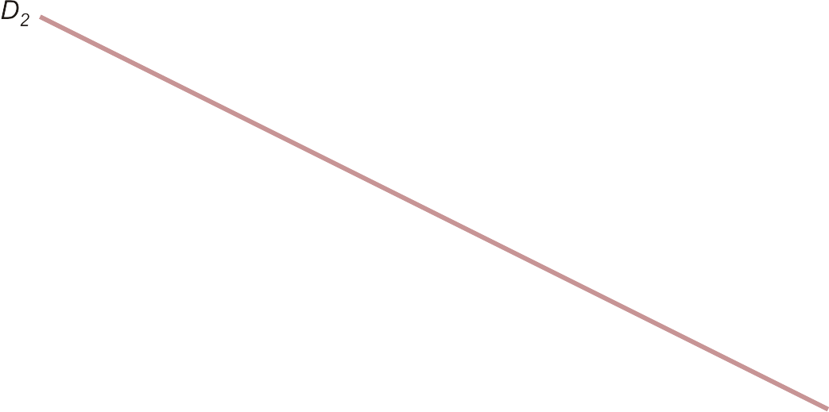

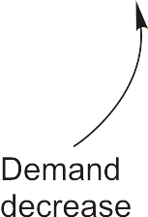
Shifts in Demand (Figure 2.2)

Slide 14
Supply
Quantity supplied (Q_{s})
  Amount of a good or service offered for sale during a given period of time

Slide 15
Supply
Six variables that influence Q_{s}
  Price of good or service (P)
  Input prices (P_{I} )
  Prices of goods related in production (P_{r})
  Technological advances (T)
  Expected future price of product (P_{e})
  Number of firms producing product (F)
General supply function
  Q_{s} = f(P, P_{I}, P_{r}, T, P_{e}, F)

Slide 16
General Supply Function
  Q_{s} = h + kP + lP_{I} + mP_{r} + nT + rP_{e} + sF
k, l, m, n, r, & s are slope parameters
  Measure effect on Q_{s} of changing one of the variables while holding the others constant
Sign of parameter shows how variable is related to Q_{s}
  Positive sign indicates direct relationship
  Negative sign indicates inverse relationship

Slide 17
General Supply Function
Substitutes in production
  Goods for which an increase in the price of one good relative to the price of another good causes producers to increase production of the now higher-priced good and decrease production of the other good
Complements in production
  Goods for which an increase in the price of one good, relative to the price of another good, causes producers to increase production of both goods

Slide 18
General Supply Function
Variable | Relation to Q_{s} | Sign of Slope Parameter
P
Direct
k = ΔQ_{s}/ΔP is positive
P_{I}
Inverse
l = ΔQ_{s}/ΔP_{I} is negative
Inverse for substitutes
m = ΔQ_{s}/ΔP_{r} is negative
P_{r}
Direct for complements
m = ΔQ_{s}/ΔP_{r} is positive
T
Direct
n = ΔQ_{s}/ΔT is positive
P_{e}
Inverse
r = ΔQ_{s}/ΔP_{e} is negative
F
Direct
s = ΔQ_{s}/ΔF is positive

Slide 19
Direct Supply Function
The direct supply function, or simply supply, shows how quantity supplied, Q_{s} , is related to product price, P, when all other variables are held constant
  Q_{s} = f(P)

Slide 20
Inverse Supply Function
Traditionally, price (P) is plotted on the vertical axis & quantity supplied (Q_{s}) is plotted on the horizontal axis
  The equation plotted is the inverse supply function, P = f(Q_{s})

Slide 21
Graphing Supply Curves
A point on a direct supply curve shows either:
  Maximum amount of a good that will be offered for sale at a given price
  Minimum price necessary to induce producers to voluntarily offer a given quantity for sale (supply price)

Slide 22
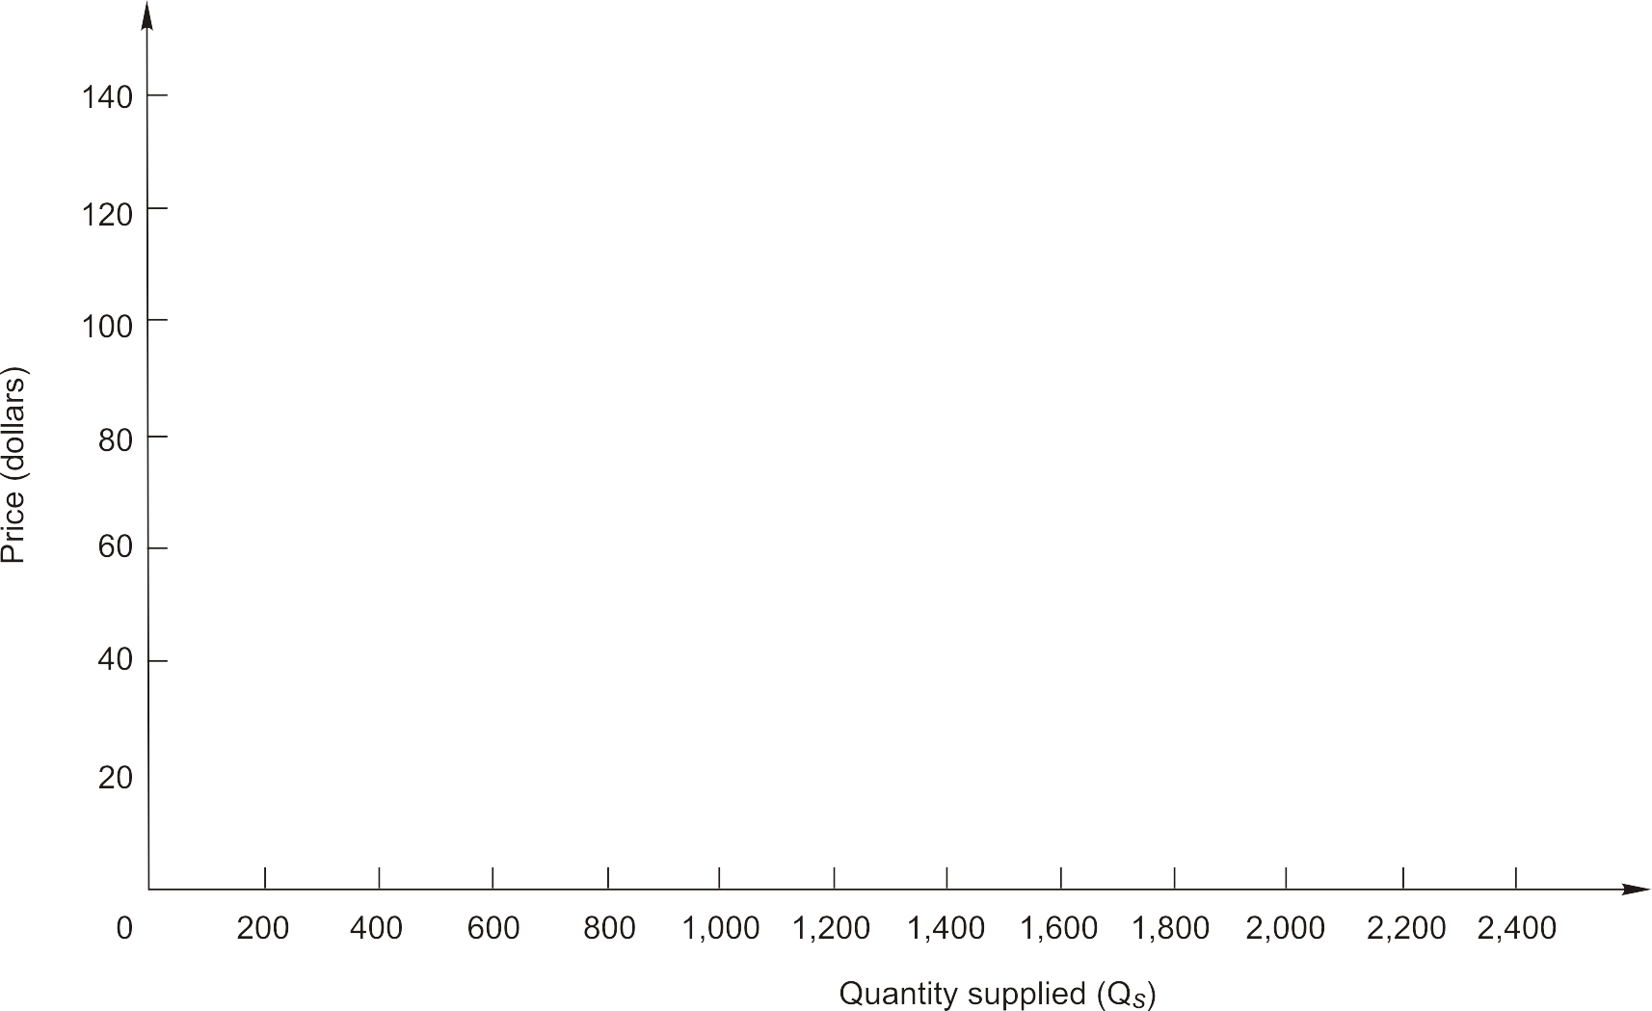
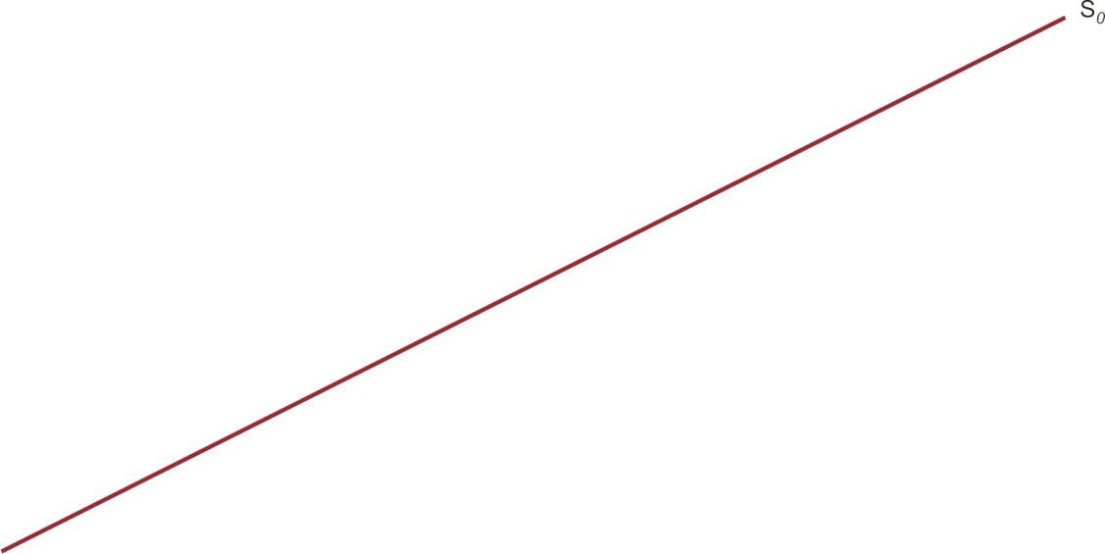
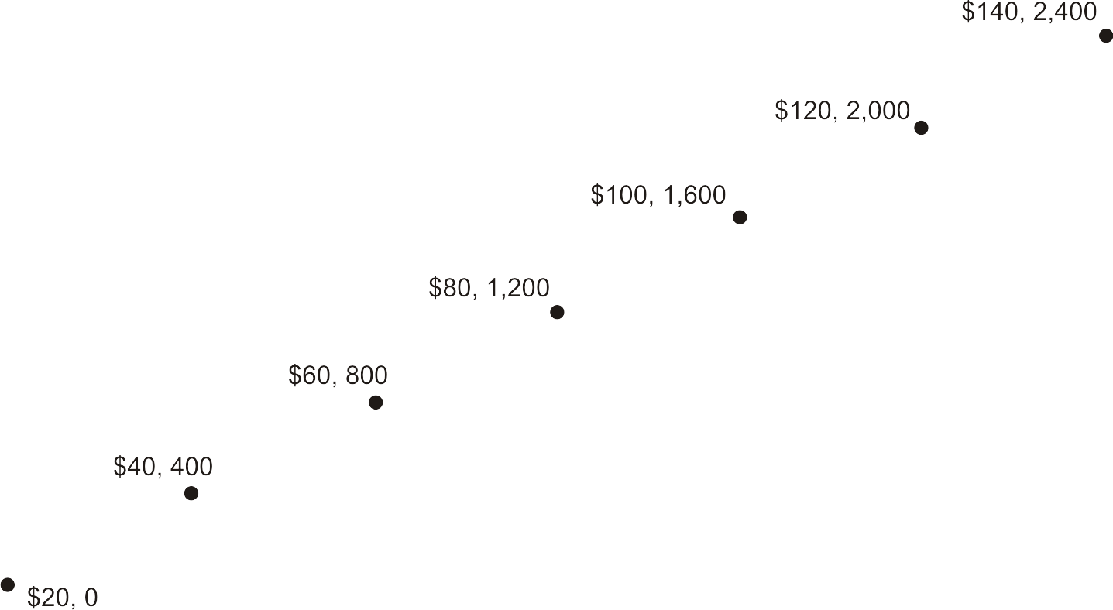
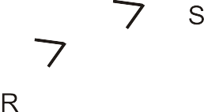
A Supply Curve (Figure 2.3)
Q_{s} = -400 + 20P

Slide 23
Graphing Supply Curves
Change in quantity supplied
  Occurs when price changes
  Movement along supply curve
Change in supply
  Occurs when one of the other variables, or determinants of supply, changes
  Supply curve shifts rightward or leftward

Slide 24
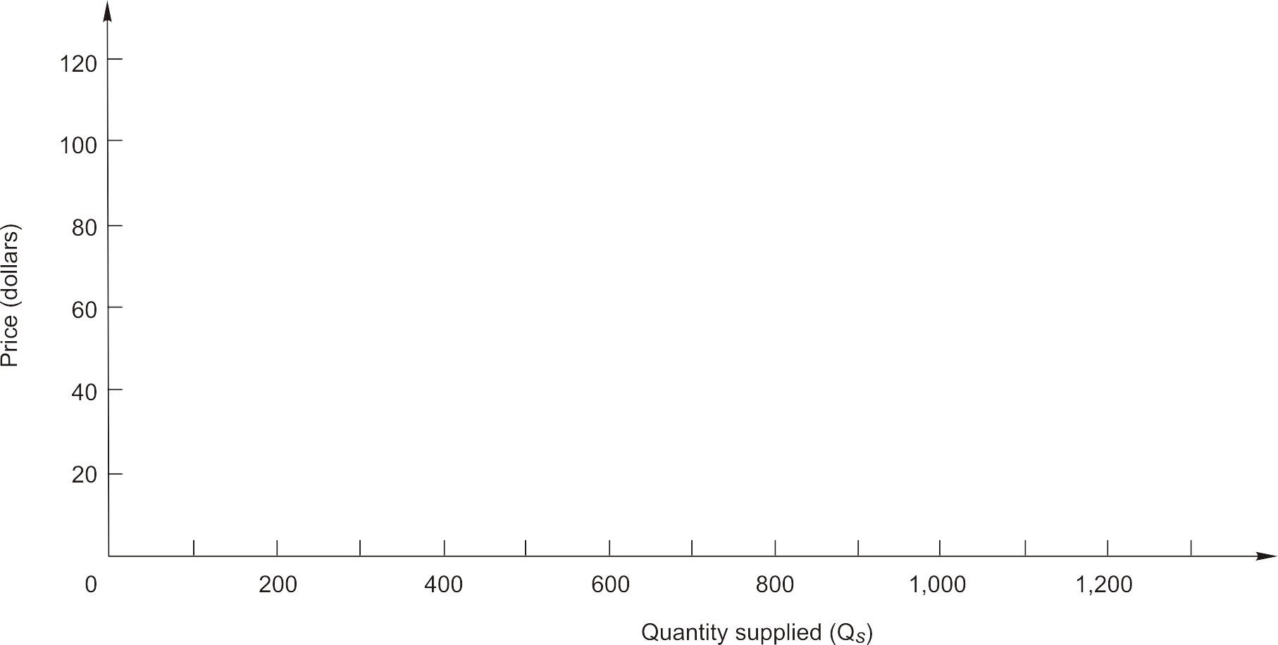
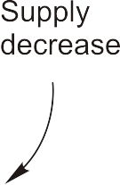
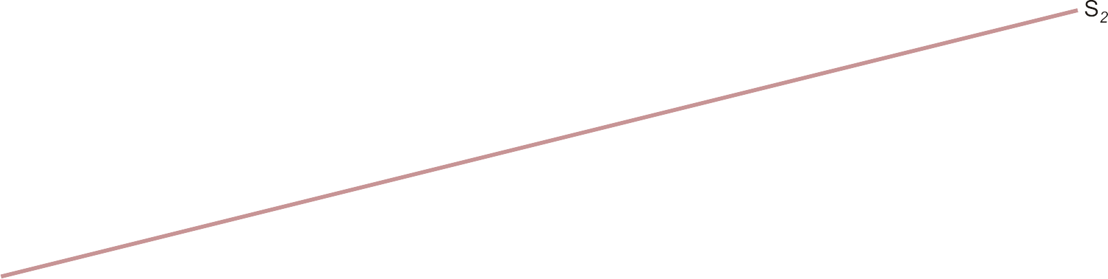
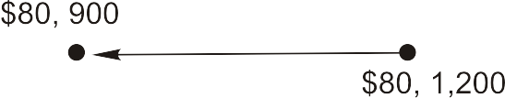
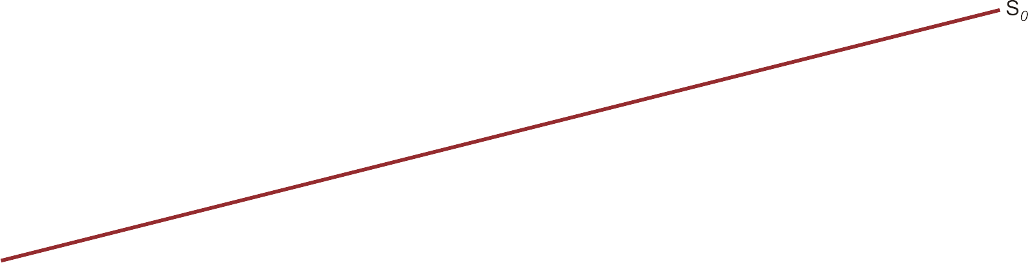
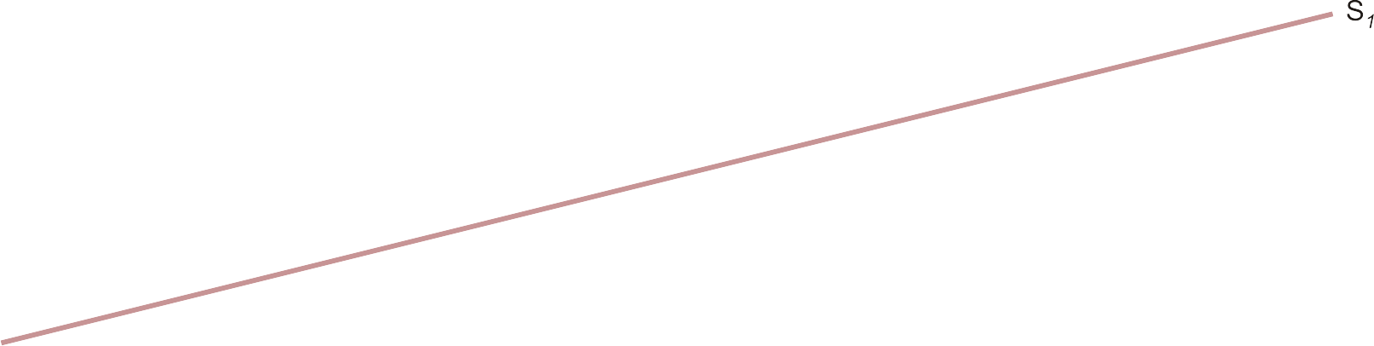

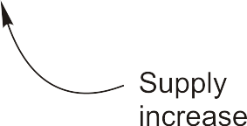
Shifts in Supply (Figure 2.4)

Slide 25
Market Equilibrium
Equilibrium price & quantity are determined by the intersection of demand & supply curves
  At the point of intersection, Q_{d} = Q_{s}
  Consumers can purchase all they want & producers can sell all they want at the “market-clearing” or “equilibrium” price

Slide 26
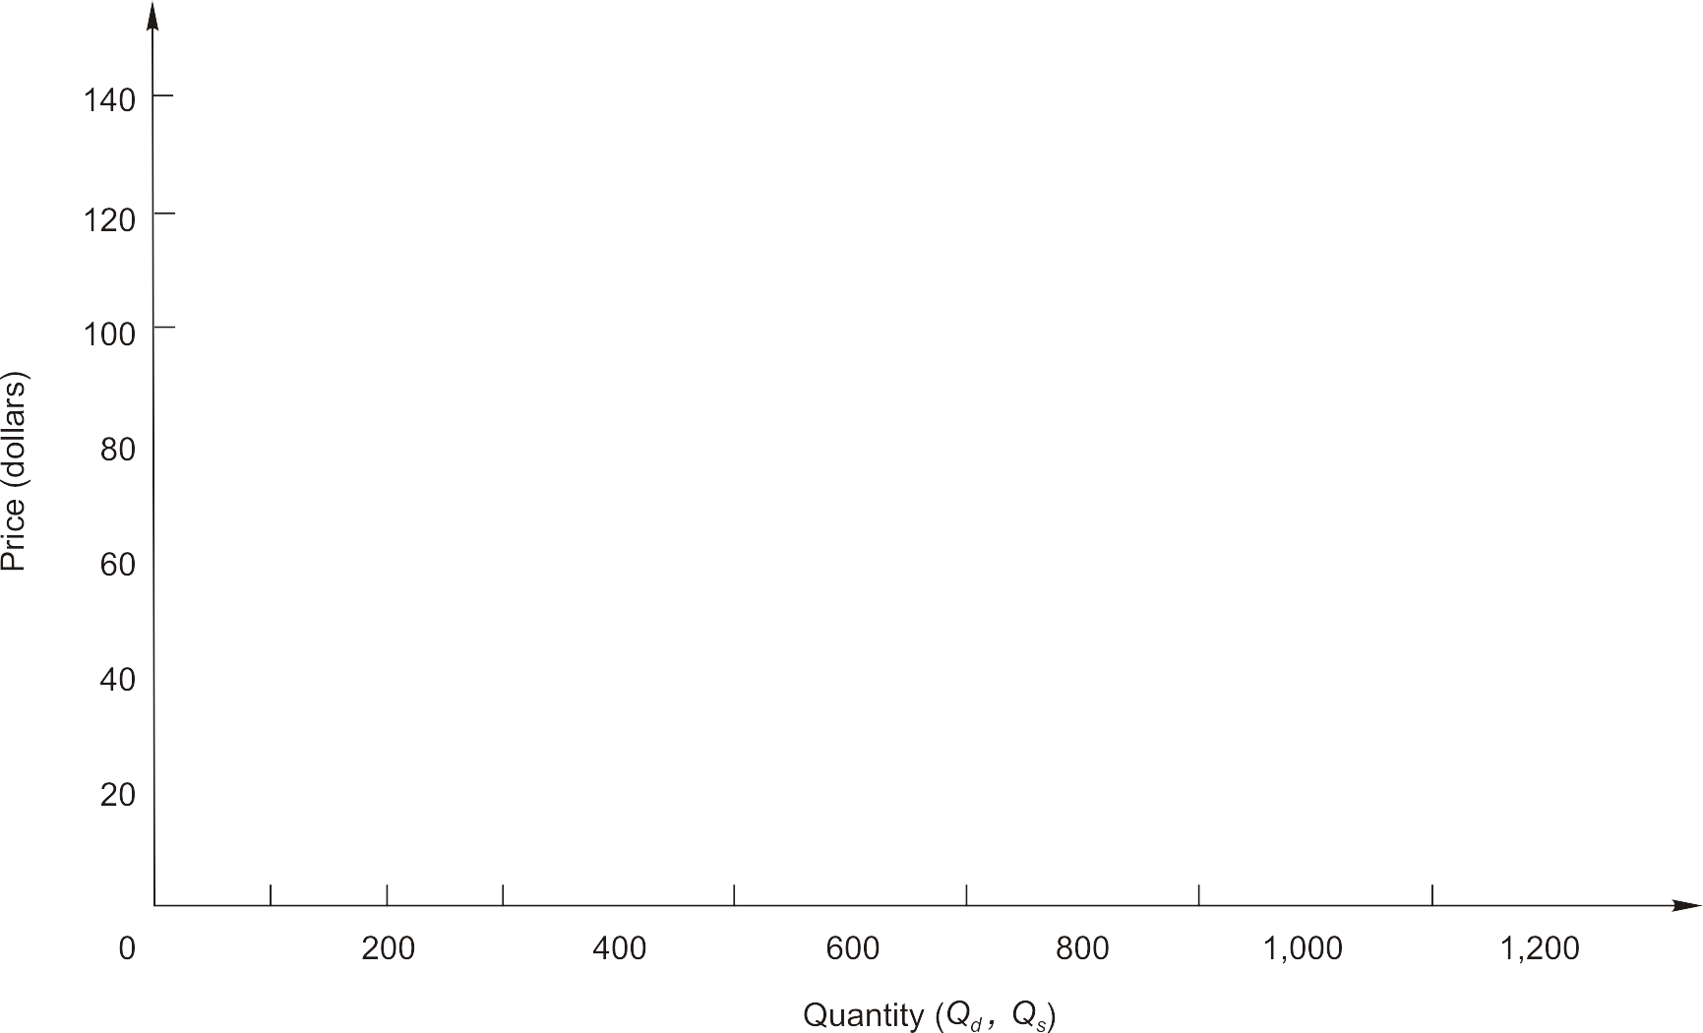
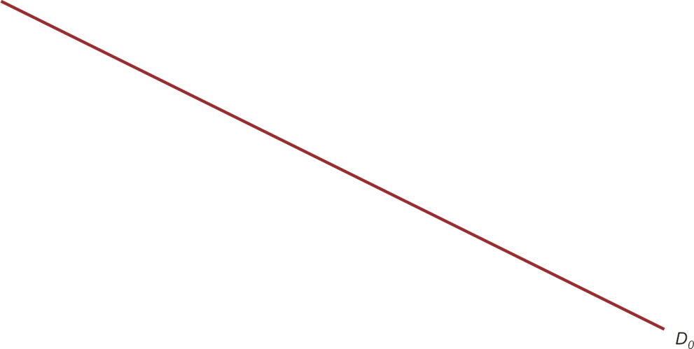
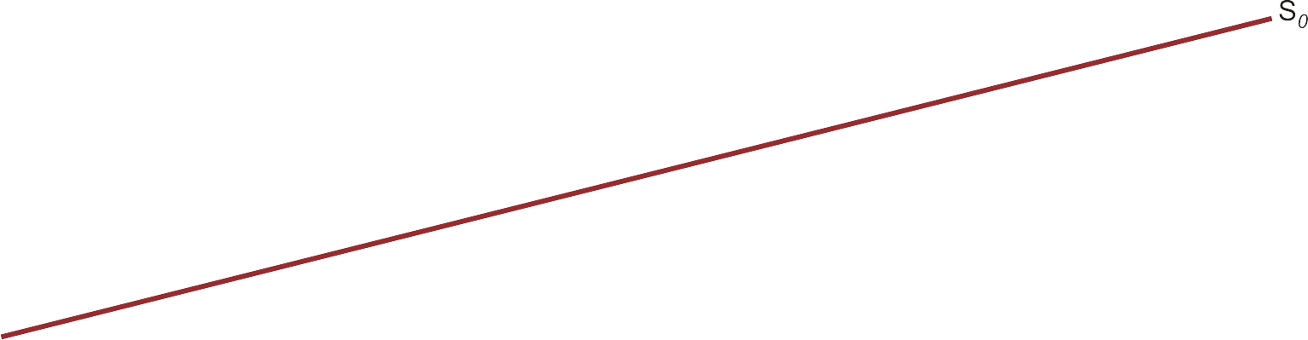
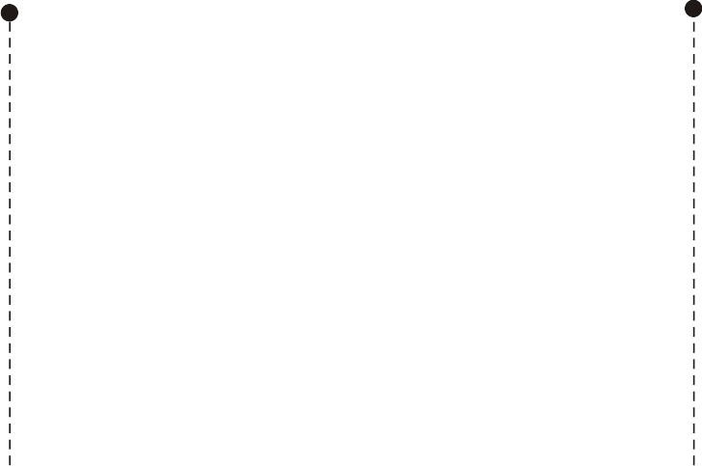
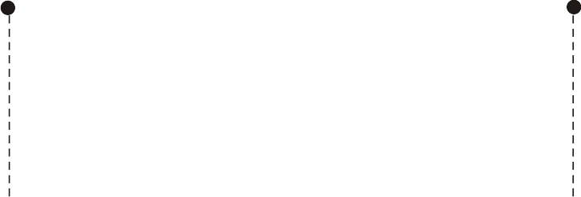
Market Equilibrium (Figure 2.5)

Slide 27
Market Equilibrium
Excess supply (surplus)
  Exists when quantity supplied exceeds quantity demanded
Excess demand (shortage)
  Exists when quantity demanded exceeds quantity supplied

Slide 28
Changes in Market Equilibrium
Qualitative forecast
  Predicts only the direction in which an economic variable will move
Quantitative forecast
  Predicts both the direction and the magnitude of the change in an economic variable

Slide 29
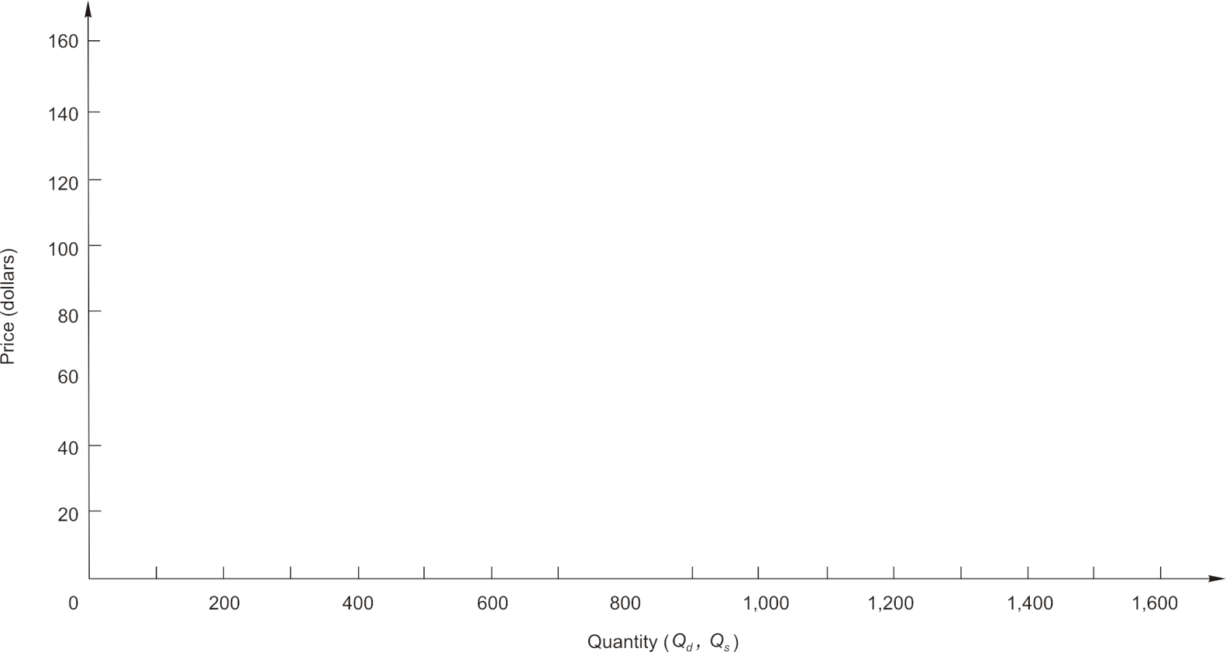
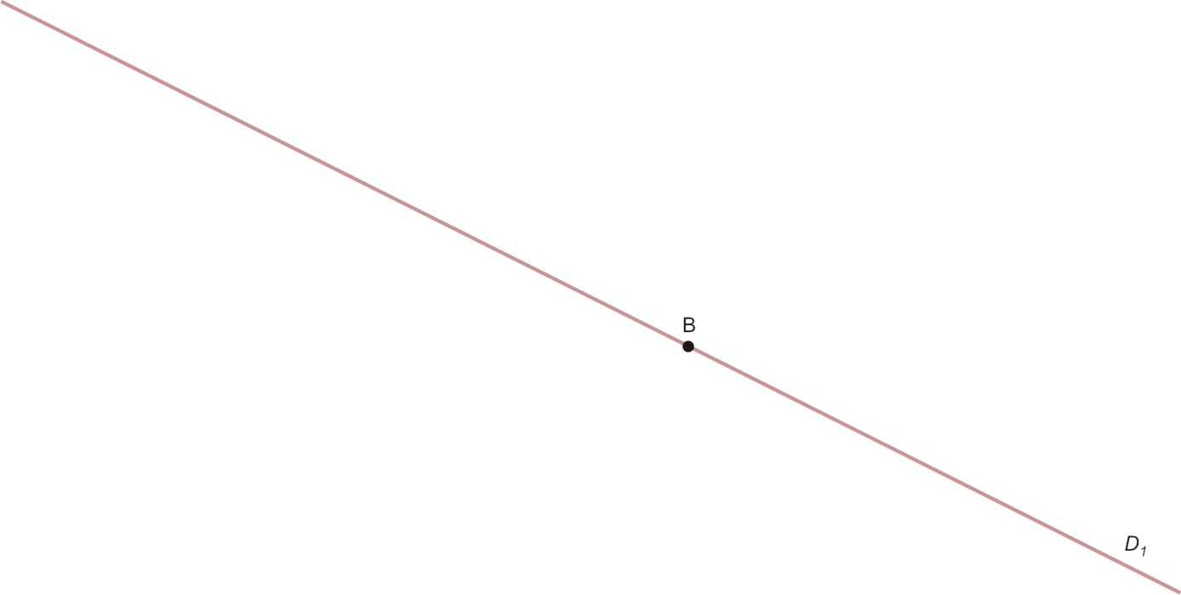
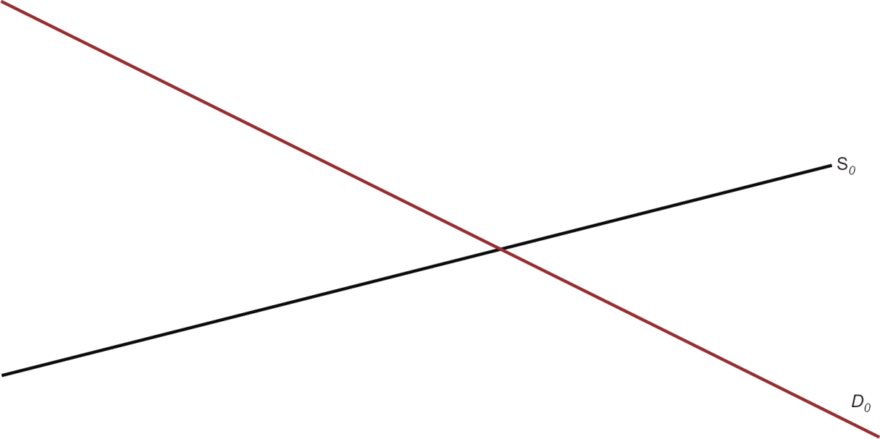
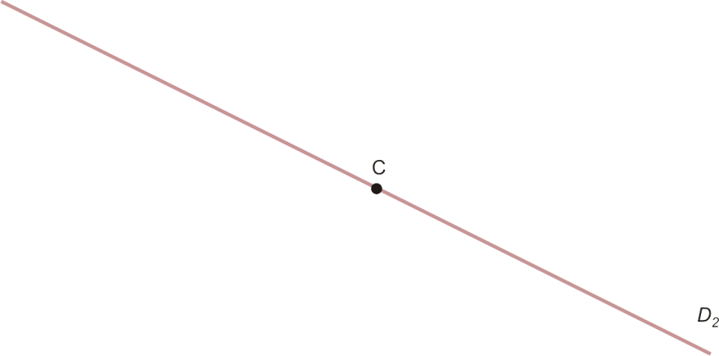


Demand Shifts (Supply Constant) (Figure 2.7)

Slide 30
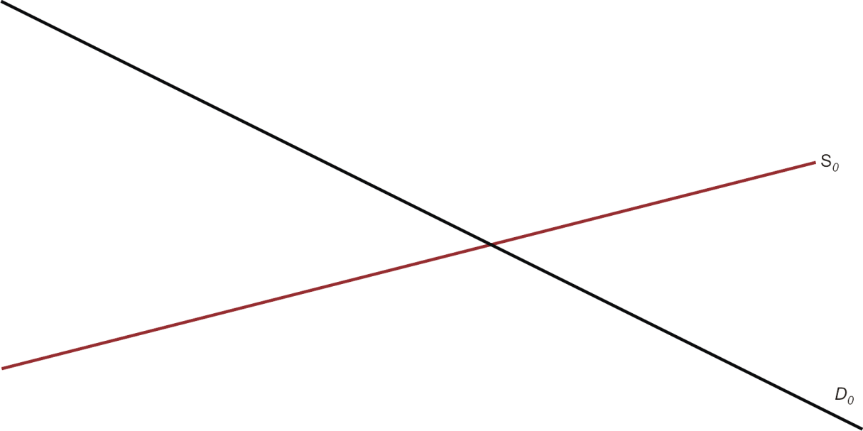
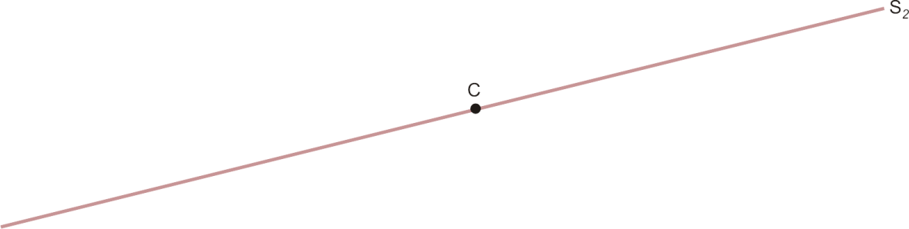
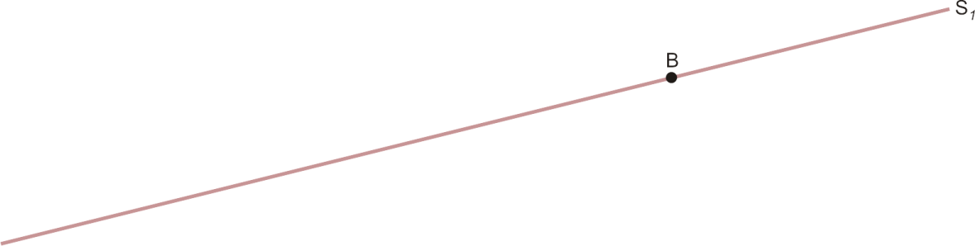

Supply Shifts (Demand Constant) (Figure 2.8)

Slide 31
Simultaneous Shifts
When demand & supply shift simultaneously
  Can predict either the direction in which price changes or the direction in which quantity changes, but not both
  The change in equilibrium price or quantity is said to be indeterminate when the direction of change depends on the relative magnitudes by which demand & supply shift

Slide 32




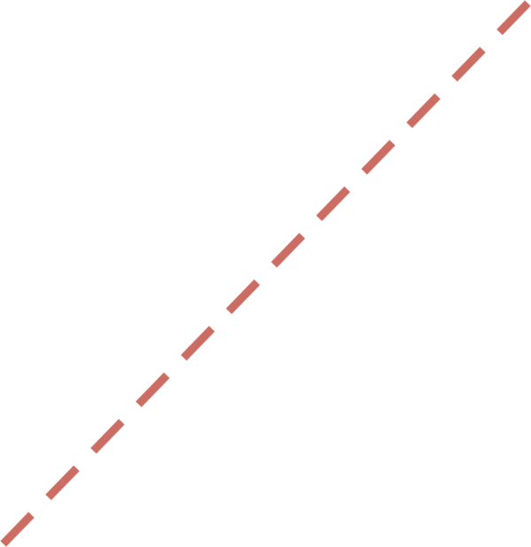
Simultaneous Shifts: (↑D, ↑S)
P
S
S′
S′′
B
P′
•
A
P
•
•
C
P′′
D′
D
Q
Q
Q′
Q′′
Price may rise or fall; Quantity rises

Slide 33
Simultaneous Shifts: (↓D, ↑S)
P
S
S′
S′
A
•
P
B
P′
•
•
C
P′′
D
D′
Q
Q′
Q
Q′′
Price falls; Quantity may rise or fall

Slide 34
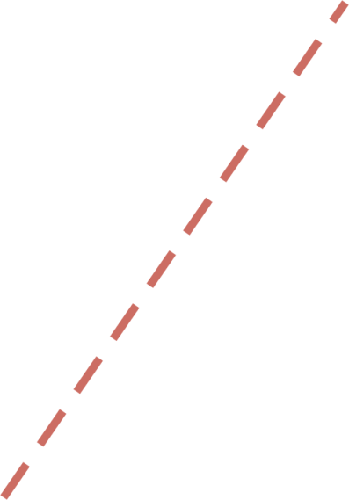
Simultaneous Shifts: (↑D, ↓S)
P
S′′
S′
•
S
P′′
C
B
•
P′
A
•
P
D′
D
Q
Q′′
Q′
Q
Price rises; Quantity may rise or fall

Slide 35
Simultaneous Shifts: (↓D, ↓S)
P
S′′
S′
S
P′′
•
C
A
P
•
•
B
P′
D
D′
Q
Q′′
Q′
Q
Price may rise or fall; Quantity falls

Slide 36
Beef Example (Spreadsheet)
Demand for Beef
  Price of Beef
  Price of Chicken
  Price of Pork
  Price of Vegetables
  Income (Budget)
  Taste for Beef
  Expectations about Beef
  Size of Market

Slide 37
Beef Example (Spreadsheet)
Q_{d} = a + b₁P_{b} + b₂P_{c} + b₃P_{p} + b₄P_{v} + b₅M + b₆E_{b} + b₇T_{b}
Q_{d}, the quantity demand for beef
P_{b}, Price Index of Beef
P_{c}, Price Index of Chicken
P_{p}, Price Index of Pork
P_{v}, Price Index of Vegetables
M, Household Income (000)
E_{b}, Expectations (Weekly Industry Ad spend) (000,000)
T_{b}, Tastes (Ratio of good Ads and Articles to Bad)
a, intercept constant
b₁, b₂, b₃, b₄, b₅, b₆, and b₇ are slope constants

Slide 38
Back to the Beef Example
Q_{d} = a + b₁P_{b} + b₂P_{c} + b₃P_{p} + b₄P_{v} + b₅M + b₆E_{b} + b₇T_{b}
Q_{d} = 41.2 – 3.4P_{b} + 5.2P_{c} + 2.8P_{p} – 5.5P_{v} + .32M + 1.2E_{b} + 1.6T_{b}
Q_{d} = 41.2 – 3.4P_{b} + 5.2($1.70) + 2.8($2) – 5.5($1) + .32(38) + 1.2(3) + 1.6(3)
Q_{d} = 41.2 – 3.4P_{b} + 30.06
Q_{d} = 71.26 – 3.4P_{b}
All else equal
Q_{s} = 62
Q_{s} = Q_{d}
62 = 71.26 – 3.4P_{b}
P_{b} = $2.72

Slide 39
Back to the Beef Example
Q_{d} = a + b₁P_{b} + b₂P_{c} + b₃P_{p} + b₄P_{v} + b₅M + b₆E_{b} + b₇T_{b}
Q_{d} = 41.2 – 3.4P_{b} + 5.2P_{c} + 2.8P_{p} – 5.5P_{v} + .32M + 1.2E_{b} + 1.6T_{b}
Q_{d} = 41.2 – 3.4P_{b} + 5.2($1.70) + 2.8($2) – 5.5($1) + .32(38) + 1.2(3) + 1.6(3)
Q_{d} = 41.2 – 3.4P_{b} + 30.06
Q_{d} = 71.26 – 3.4P_{b}
Price of Chicken increases to $2.00
Q_{d} = 41.2 – 3.4P_{b} + 5.2($2) + 2.8($2) – 5.5($1) + .32(38) + 1.2(3) + 1.6(3)
Q_{d} = 41.2 – 3.4P_{b} + 31.62
Q_{d} = 72.82 – 3.4P_{b}

