Slide 1
Chapter 5
Theory of Consumer Behavior

Slide 2
Utility
Benefits consumers obtain from goods & services they consume is utility
A utility function shows an individual’s perception of the utility level attained from consuming each conceivable bundle of goods

Slide 3
Theory of Consumer Behavior
Assume consumers have complete information about availability, prices, & utility levels of all goods & services
All bundles of goods can be ranked based on their ability to provide utility – for any pair of bundles A & B:
Prefer bundle A to bundle B
Prefer bundle B to bundle A
Indifferent between the two bundles

Slide 4
Indifference Curves
Locus of points representing different bundles of goods, each of which yields the same level of total utility
Negatively sloped & convex
Marginal rate of substitution (MRS)
Absolute value of the slope of the indifference curve
Diminishes along the indifference curve as X increases & Y decreases

Slide 5
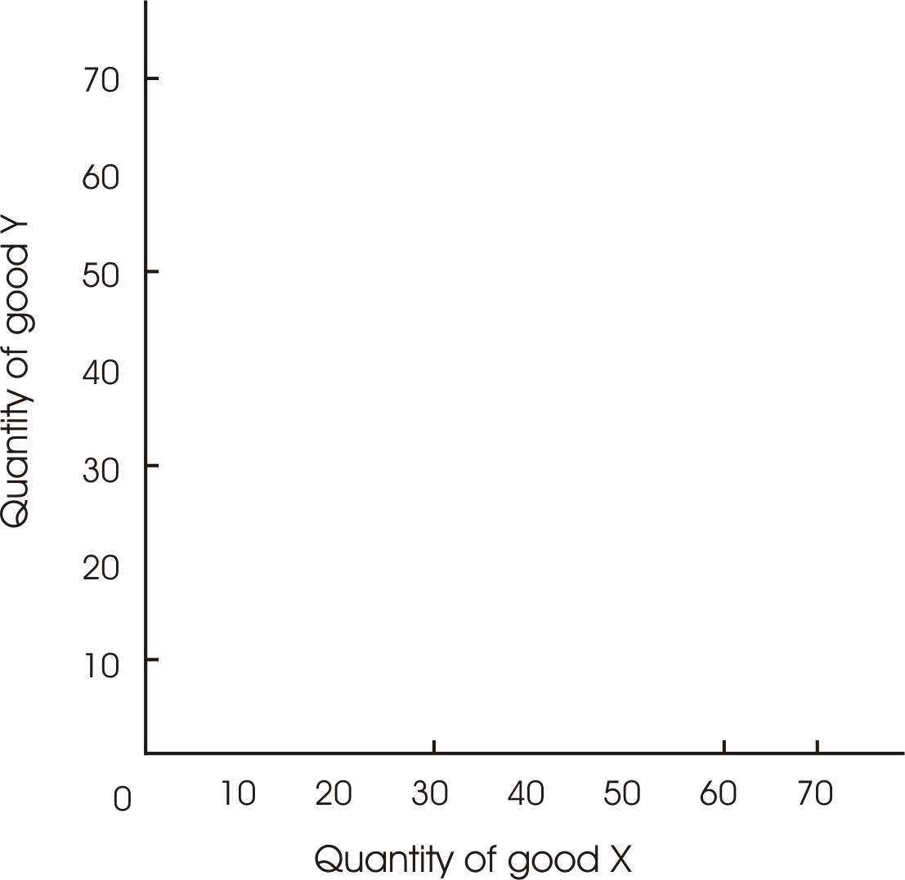

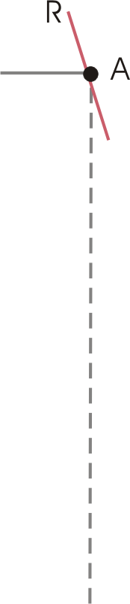
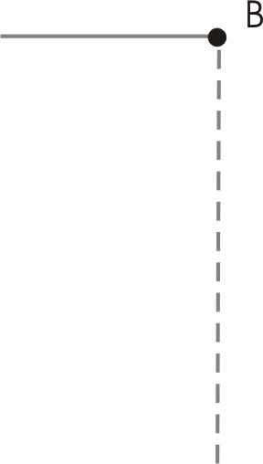


Typical Indifference Curve (Figure 5.1)

Slide 6

Indifference Map (Figure 5.3)
IV
Quantity of Y
III
II
I
Quantity of X

Slide 7
Marginal Utility
Addition to total utility attributable to the addition of one unit of a good to the current rate of consumption, holding constant the amounts of all other goods consumed

Slide 8
Marginal Rate of Substitution
MRS shows the rate at which one good can be substituted for another while keeping utility constant
Negative of the slope of the indifference curve
Ratio of the marginal utilities of the goods

Slide 9
Consumer’s Budget Line
Shows all possible commodity bundles that can be purchased at given prices with a fixed money income

Slide 10

Typical Budget Line (Figure 5.5)
•
A
Quantity of Y
B
•
Quantity of X

Slide 11





Shifting Budget Lines (Figure 5.6)
R
120
A
100
A
100
F
80
Quantity of Y
Quantity of Y
Z
B
N
C
B
D
160
200
240
125
200
250
Quantity of X
Quantity of X
Panel A – Changes in money income
Panel B – Changes in price of X

Slide 12
Utility Maximization
Utility maximization subject to a limited money income occurs at the combination of goods for which the indifference curve is just tangent to the budget line

Slide 13
Utility Maximization
Consumer allocates income so that the marginal utility per dollar spent on each good is the same for all commodities purchased

Slide 14





Constrained Utility Maximization (Figure 5.7)
50
•
A
Quantity of pizzas
45
•
40
B
•
D
E
R
•
IV
30
III
20
C
•
II
15
T
10
I
0
10
20
30
40
50
60
70
80
90
100
Quantity of burgers

Slide 15
Individual Consumer Demand
An individual’s demand curve for a specific commodity relates utility-maximizing quantities purchased to market prices
Money income & prices held constant
Slope of demand curve illustrates law of demand—quantity demanded varies inversely with price

Slide 16
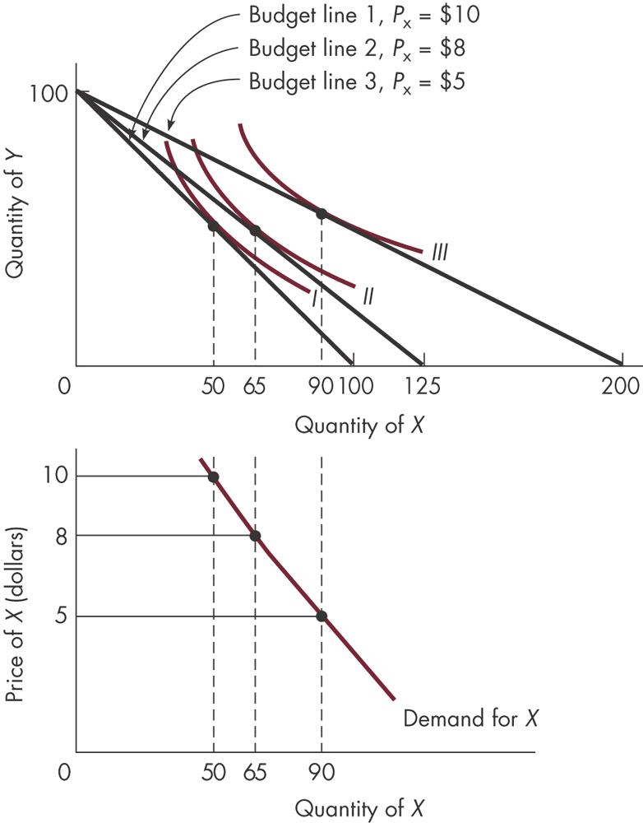
Fig. 5.8: Deriving a Demand Curve

Slide 17
Market Demand
List of prices & quantities consumers are willing & able to purchase at each price, all else constant
Derived by horizontally summing demand curves for all individuals in market

Slide 18
Derivation of Market Demand (Table 5.1)
Quantity demanded
Price | Consumer 1 | Consumer 2 | Consumer 3 | Market demand
$6
3
0
0
3
5
5
1
0
6
4
8
3
1
12
3
10
5
4
19
2
12
7
6
25
1
13
10
8
31

Slide 19
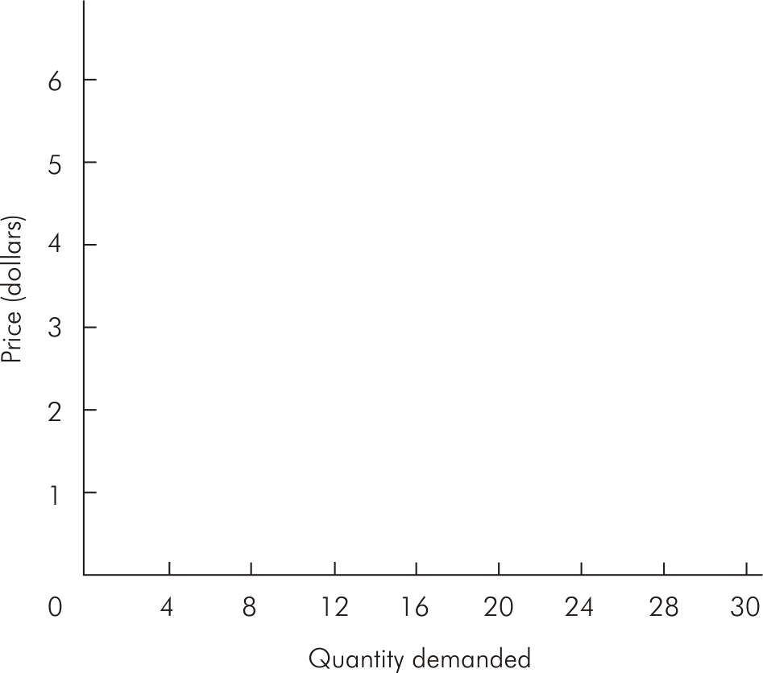




Derivation of Market Demand Figure (5.9)

Slide 20
Substitution & Income Effects
When price changes, total change in quantity demanded is composed of two parts
Substitution effect
Income effect

Slide 21
Substitution & Income Effects
Substitution effect
Change in consumption of a good after a change in its price, when the consumer is forced by a change in money income to consume at some point on the original indifference curve
Income effect
Change in consumption of a good resulting strictly from a change in purchasing power

Slide 22
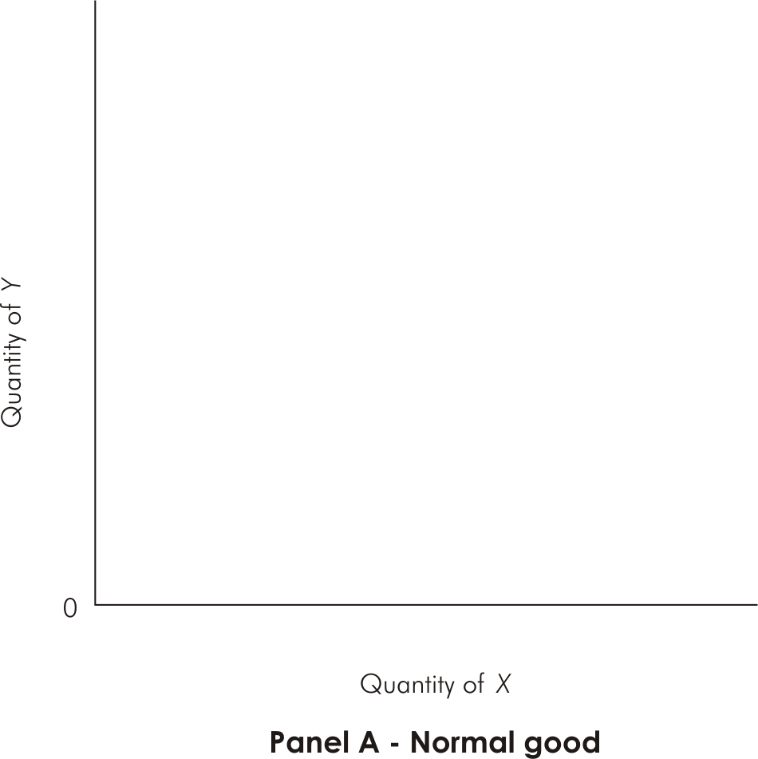
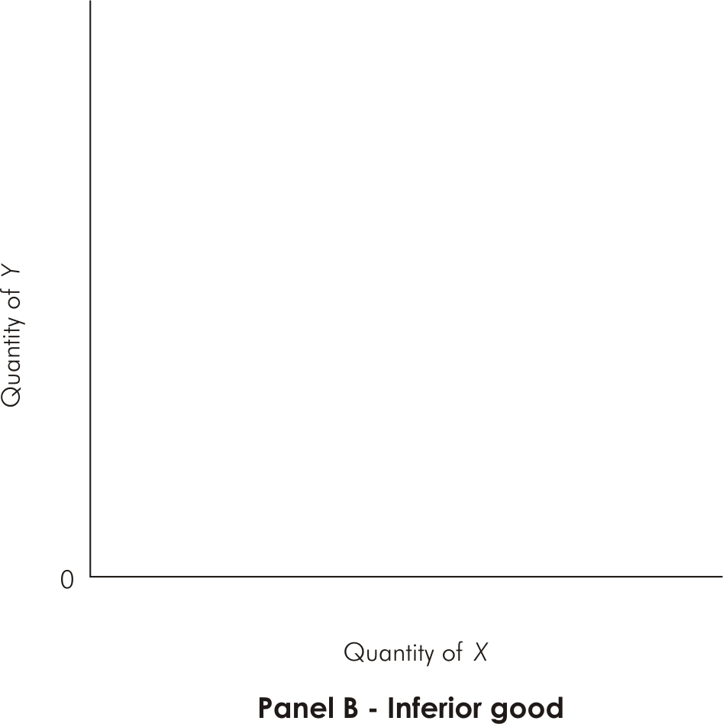
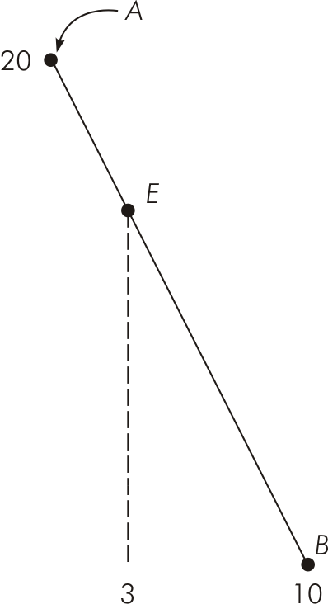
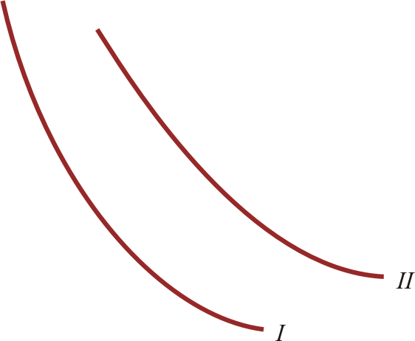
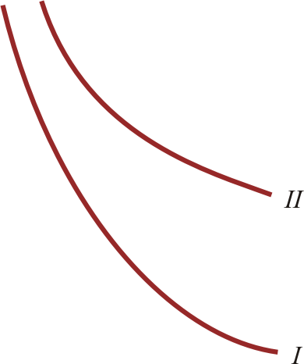
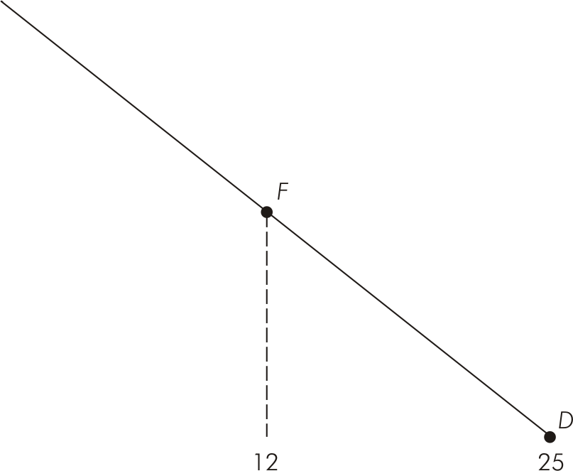
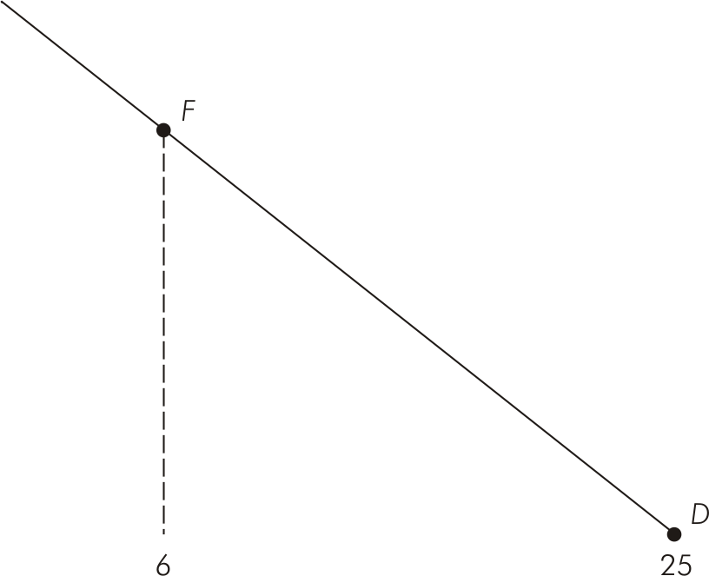
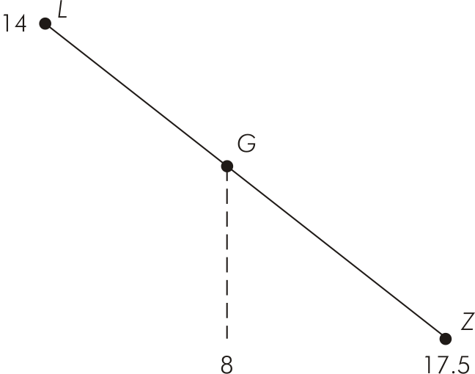






Income & Substitution Effects: A Decrease in P_{x} (Figure 5.11)
Total effect of price decrease
Substitution effect
Income effect
Total effect of price decrease
Substitution effect
Income effect
=
+
=
+
9
+
4
=
5
3
+
(-2)
=
5

Slide 23
Substitution & Income Effects
Consider the substitution effect alone:
Amount of good consumed must vary inversely with price
Income effect reinforces the substitution effect for a normal good & offsets it for an inferior good

