Slide 1
Chapter 8
Production & Cost in the Short Run

Slide 2
Basic Concepts of Production Theory
Production function
Maximum amount of output that can be produced from any specified set of inputs, given existing technology
Technical efficiency
Achieved when maximum amount of output is produced with a given combination of inputs
Economic efficiency
Achieved when firm is producing a given output at the lowest possible total cost

Slide 3
Basic Concepts of Production Theory
Inputs are considered variable or fixed depending on how readily their usage can be changed
Variable input
An input for which the level of usage may be changed quite readily
Fixed input
An input for which the level of usage cannot readily be changed

Slide 4
Basic Concepts of Production Theory
Short run
At least one input is fixed
All changes in output achieved by changing usage of variable inputs
Long run
All inputs are variable
Output changed by varying usage of all inputs

Slide 5
Short Run Production
In the short run, capital is fixed
Only changes in the variable labor input can change the level of output
Short run production function

Slide 6
Average & Marginal Products
Average product of labor
AP = Q/L
Marginal product of labor
MP = ΔQ/ΔL
Law of diminishing marginal product
As usage of a variable input increases, a point is reached beyond which its marginal product decreases

Slide 7
Total, Average, & Marginal Products of Labor, K = 2 (Table 8.2)
Number of workers (L) | Total product (Q) | Average product (AP=Q/L) | Marginal product (MP=ΔQ/ΔL)
0 | 0
1 | 52
2 | 112
3 | 170
4 | 220
5 | 258
6 | 286
7 | 304
8 | 314
9 | 318
10 | 314
--
--
52
52
56
60
56.7
58
55
50
51.6
38
47.7
28
43.4
18
39.3
10
35.3
4
31.4
-4

Slide 8
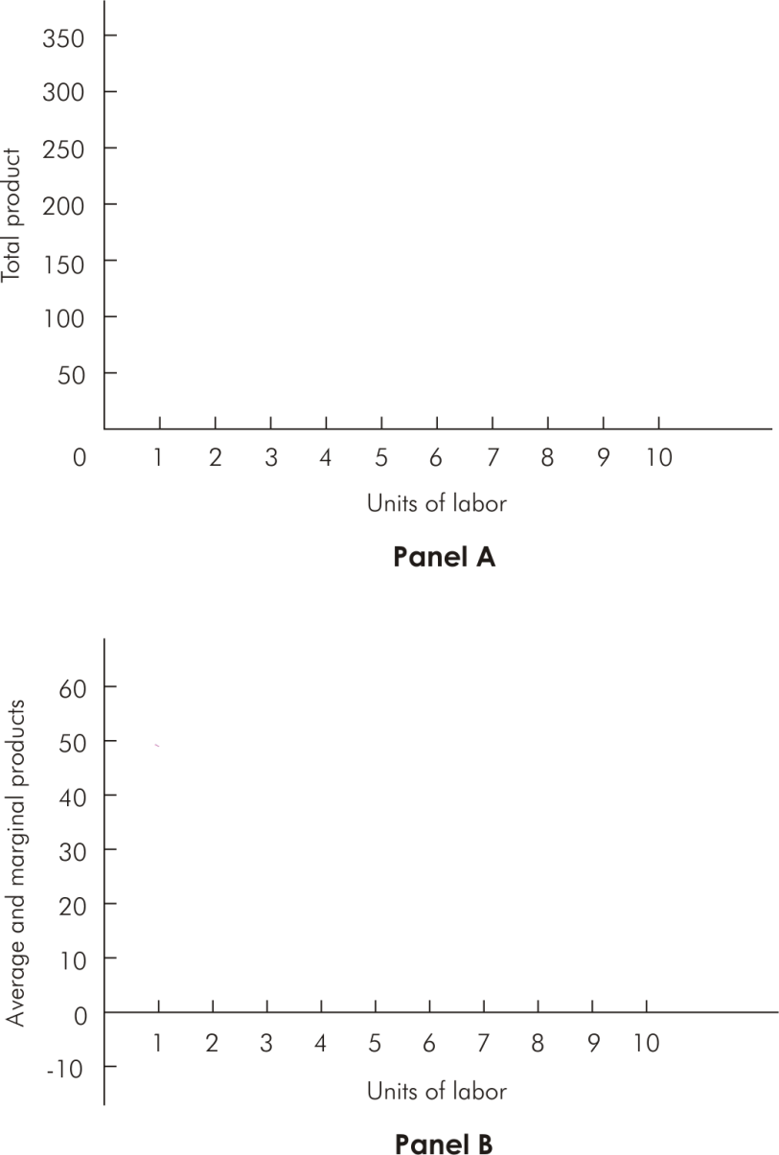

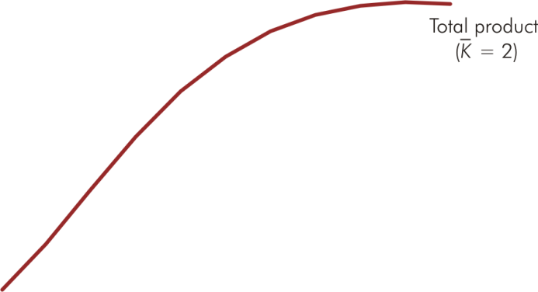
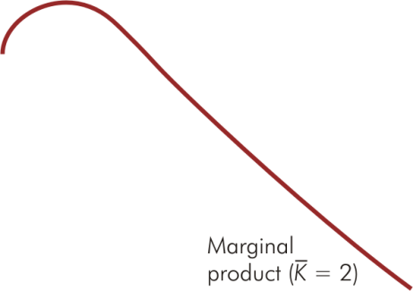


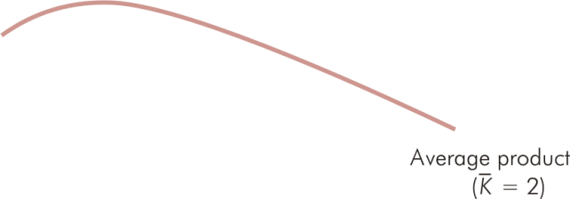
Total, Average & Marginal Products, K = 2 (Figure 8.1)

Slide 9
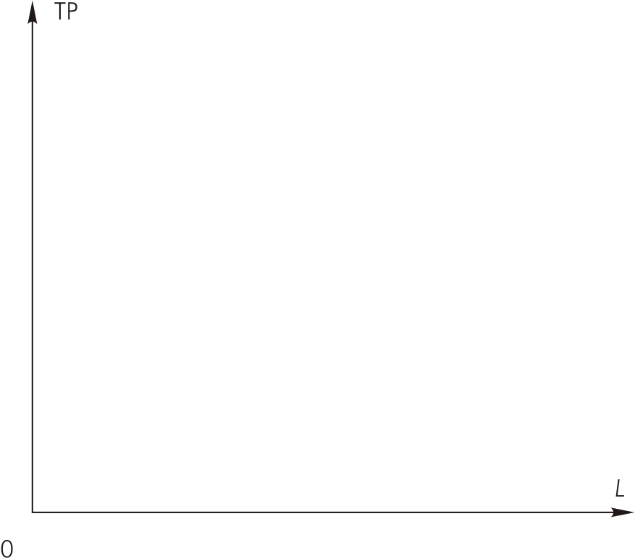
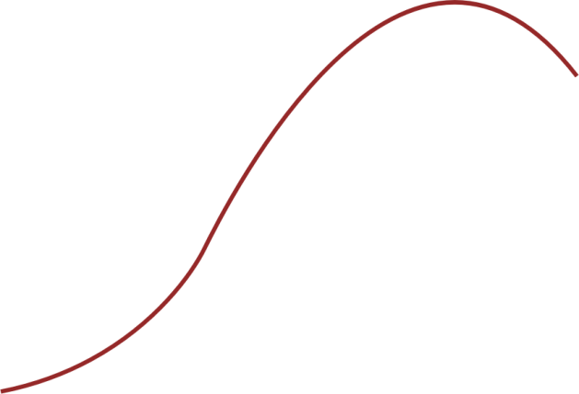
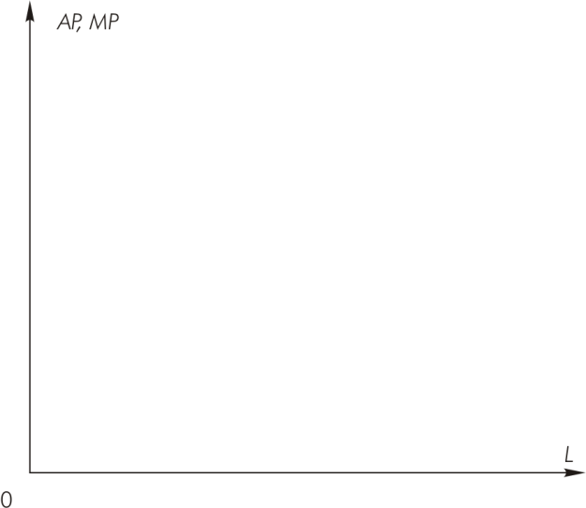
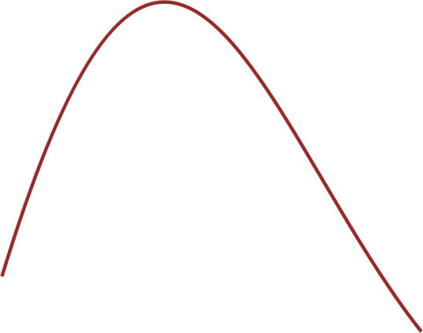
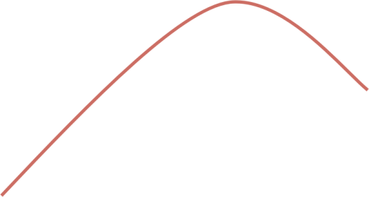
Total, Average & Marginal Product Curves
Q₂
Q₁
Total product
Panel A
Q₀
L₀
L₁
L₂
Panel B
Average product
L₀
L₁
L₂
Marginal product

Slide 10
Short Run Production Costs
Total variable cost (TVC)
Total amount paid for variable inputs
Increases as output increases
Total fixed cost (TFC)
Total amount paid for fixed inputs
Does not vary with output
Total cost (TC)
TC = TVC + TFC

Slide 11
Short-Run Total Cost Schedules (Table 8.4)
Output (Q) | Total fixed cost (TFC) | Total variable cost (TVC) | Total Cost (TC=TFC+TVC)
0 | $6,000
100 | 6,000
200 | 6,000
300 | 6,000
400 | 6,000
500 | 6,000
600 | 6,000
$ 0
$ 6,000
4,000
10,000
6,000
12,000
9,000
15,000
14,000
20,000
22,000
28,000
34,000
40,000

Slide 12
Average Costs
•
•
•

Slide 13
Short Run Marginal Cost
Short run marginal cost (SMC) measures rate of change in total cost (TC) as output varies

Slide 14
Average & Marginal Cost Schedules (Table 8.5)
Output (Q) | Average fixed cost (AFC=TFC/Q) | Average variable cost (AVC=TVC/Q) | Average total cost (ATC=TC/Q= AFC+AVC) | Short-run marginal cost (SMC=ΔTC/ΔQ)
0
100
200
300
400
500
600
--
--
--
--
$60
$40
$100
$40
30
30
60
20
20
30
50
30
15
35
50
50
12
44
56
80
10
56.7
66.7
120

Slide 15
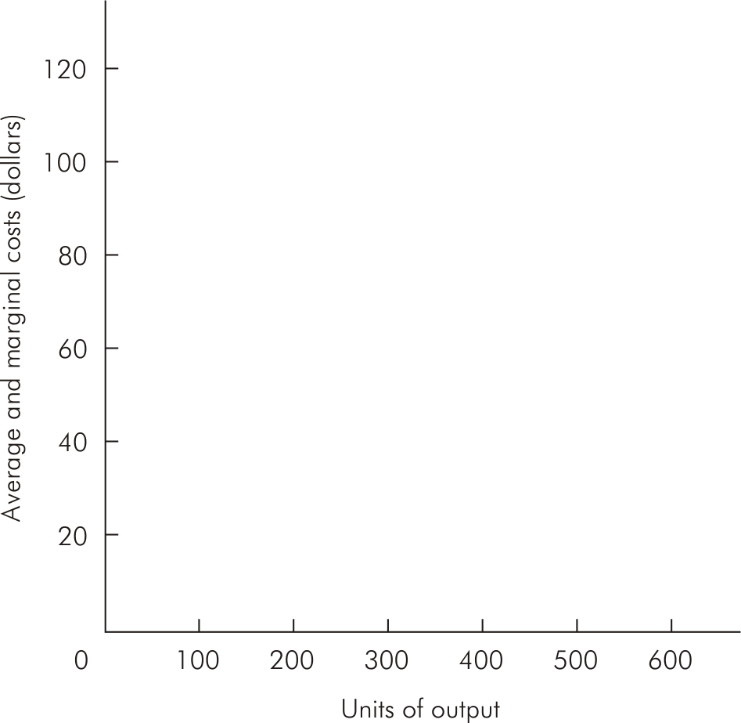
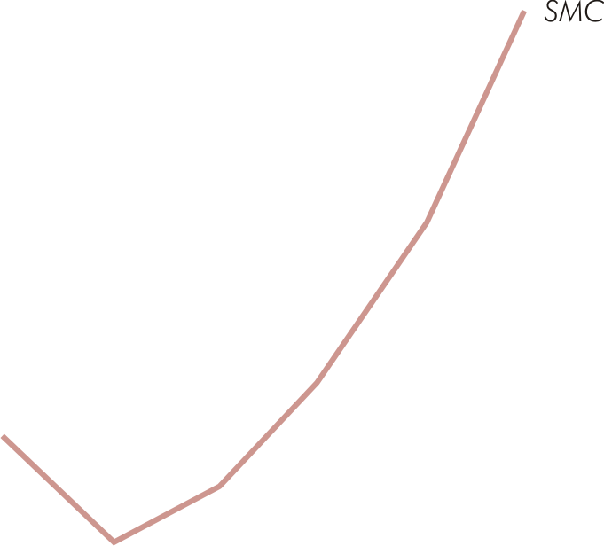


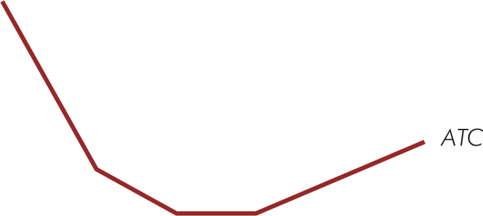
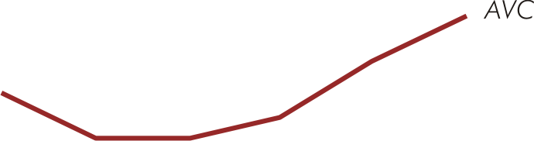

Average & Marginal Cost Curves (Figure 8.3)

Slide 16
Short Run Cost Curve Relations
AFC decreases continuously as output increases
Equal to vertical distance between ATC & AVC
AVC is U-shaped
Equals SMC at AVC’s minimum
ATC is U-shaped
Equals SMC at ATC’s minimum

Slide 17
Short Run Cost Curve Relations
SMC is U-shaped
Intersects AVC & ATC at their minimum points
Lies below AVC & ATC when AVC & ATC are falling
Lies above AVC & ATC when AVC & ATC are rising

Slide 18
Relations Between Short-Run Costs & Production
In the case of a single variable input, short-run costs are related to the production function by two relations
w
w
AVC
=
and
SMC
=
AP
MP

Slide 19
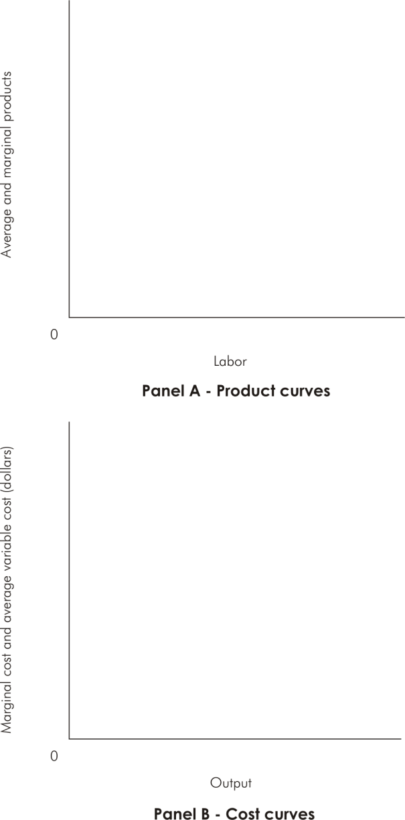
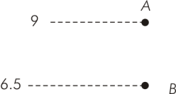
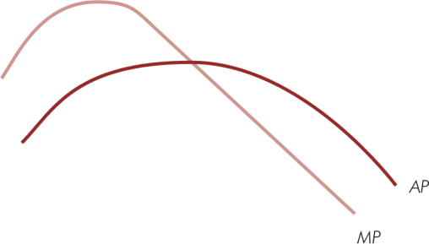


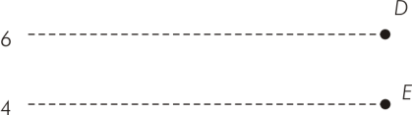

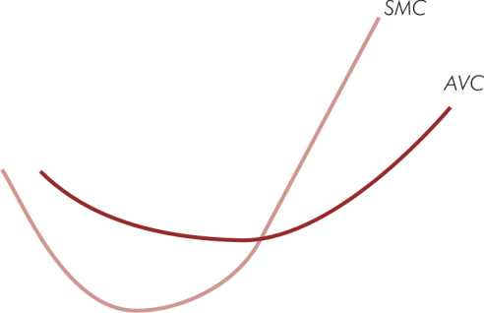
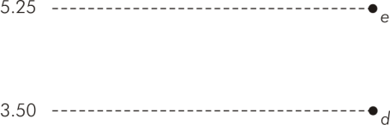

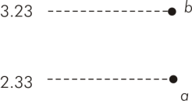


Short-Run Production & Cost Relations (Figure 8.6)

Slide 20
Relations Between Short-Run Costs & Production
When marginal product (average product) is increasing, marginal cost (average cost) is decreasing
When marginal product (average product) is decreasing, marginal cost (average variable cost) is increasing
When marginal product = average product at maximum AP, marginal cost = average variable cost at minimum AVC

