Slide 1
Chapter 9
Production & Cost in the Long Run

Slide 2
Production Isoquants
In the long run, all inputs are variable & isoquants are used to study production decisions
  An isoquant is a curve showing all possible input combinations capable of producing a given level of output
  Isoquants are downward sloping; if greater amounts of labor are used, less capital is required to produce a given output

Slide 3
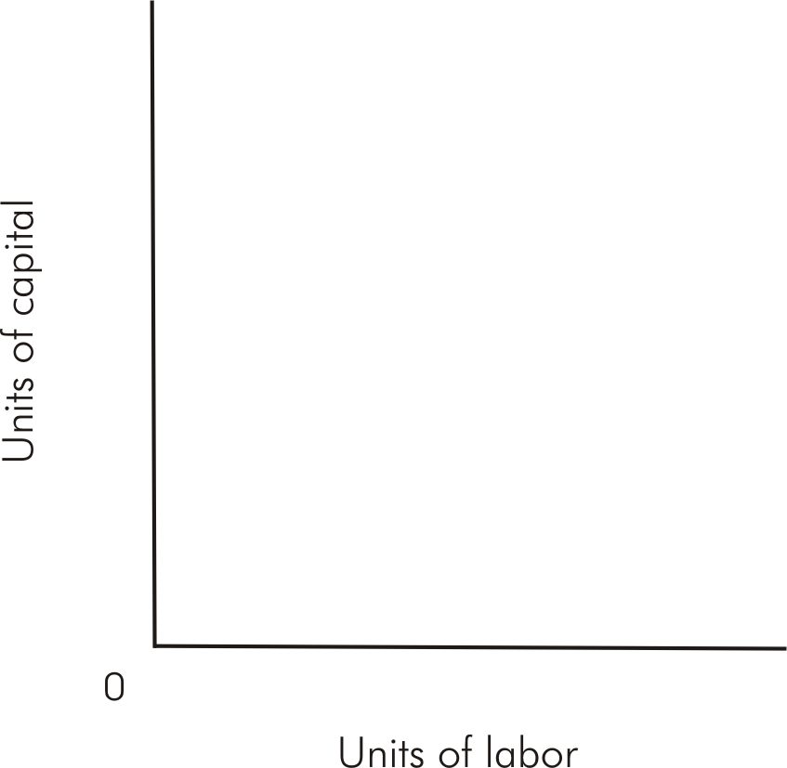
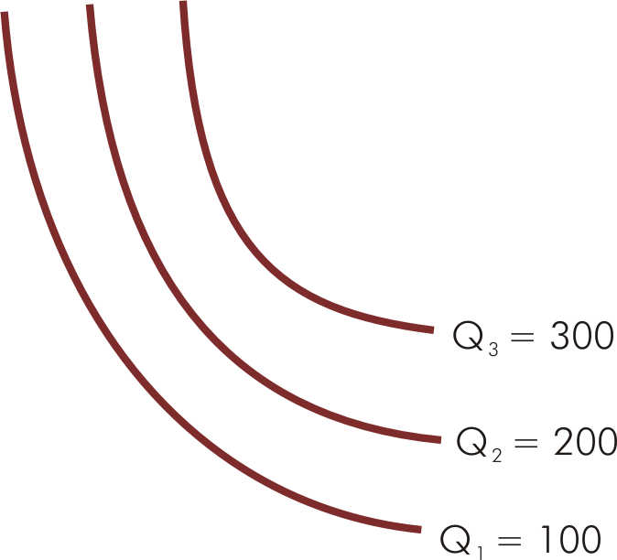
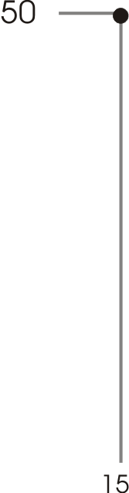
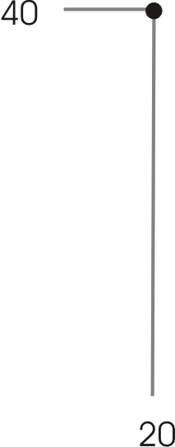
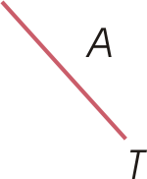
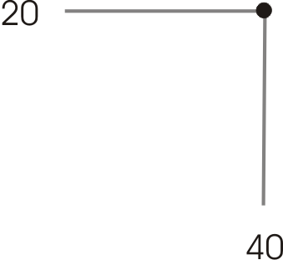
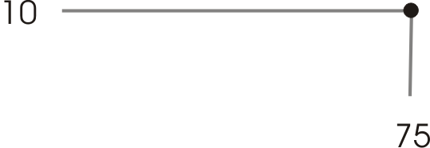
Typical Isoquants (Figure 9.1)

Slide 4
Marginal Rate of Technical Substitution
The MRTS is the slope of an isoquant & measures the rate at which the two inputs can be substituted for one another while maintaining a constant level of output

Slide 5
Marginal Rate of Technical Substitution
The MRTS can also be expressed as the ratio of two marginal products:

Slide 6
Isocost Curves
•
  Represents amount of capital that may be purchased if zero labor is purchased
•
•

Slide 7
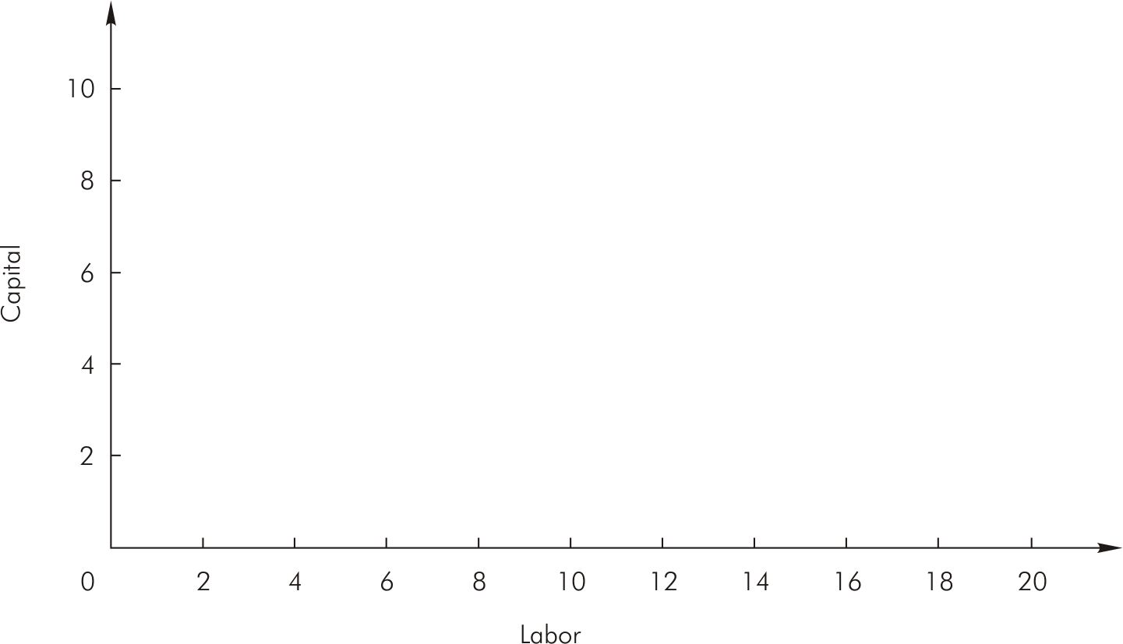


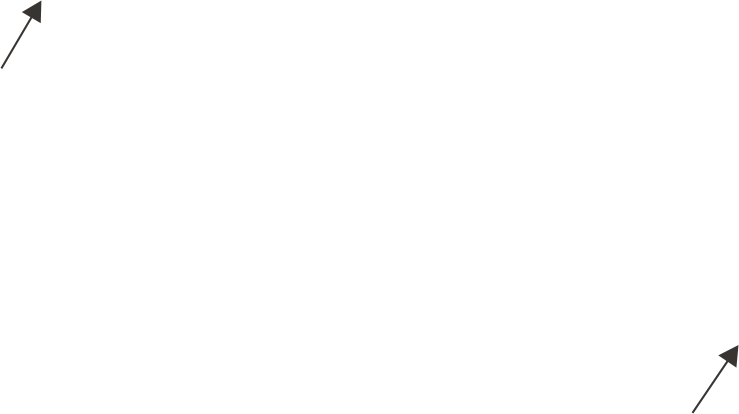
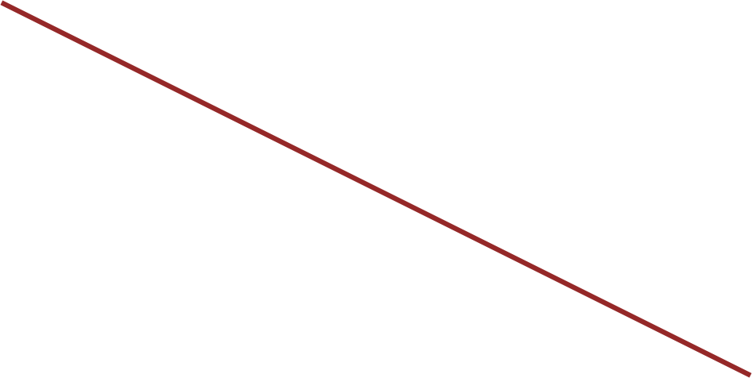
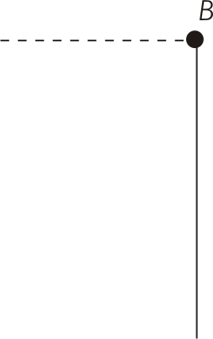

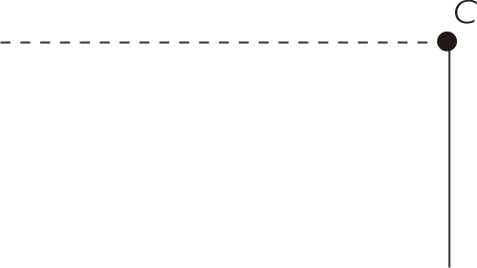


Isocost Curves (Figures 9.2 & 9.3)

Slide 8
Optimal Combination of Inputs
  Two slopes are equal in equilibrium
  Implies marginal product per dollar spent on last unit of each input is the same
•

Slide 9
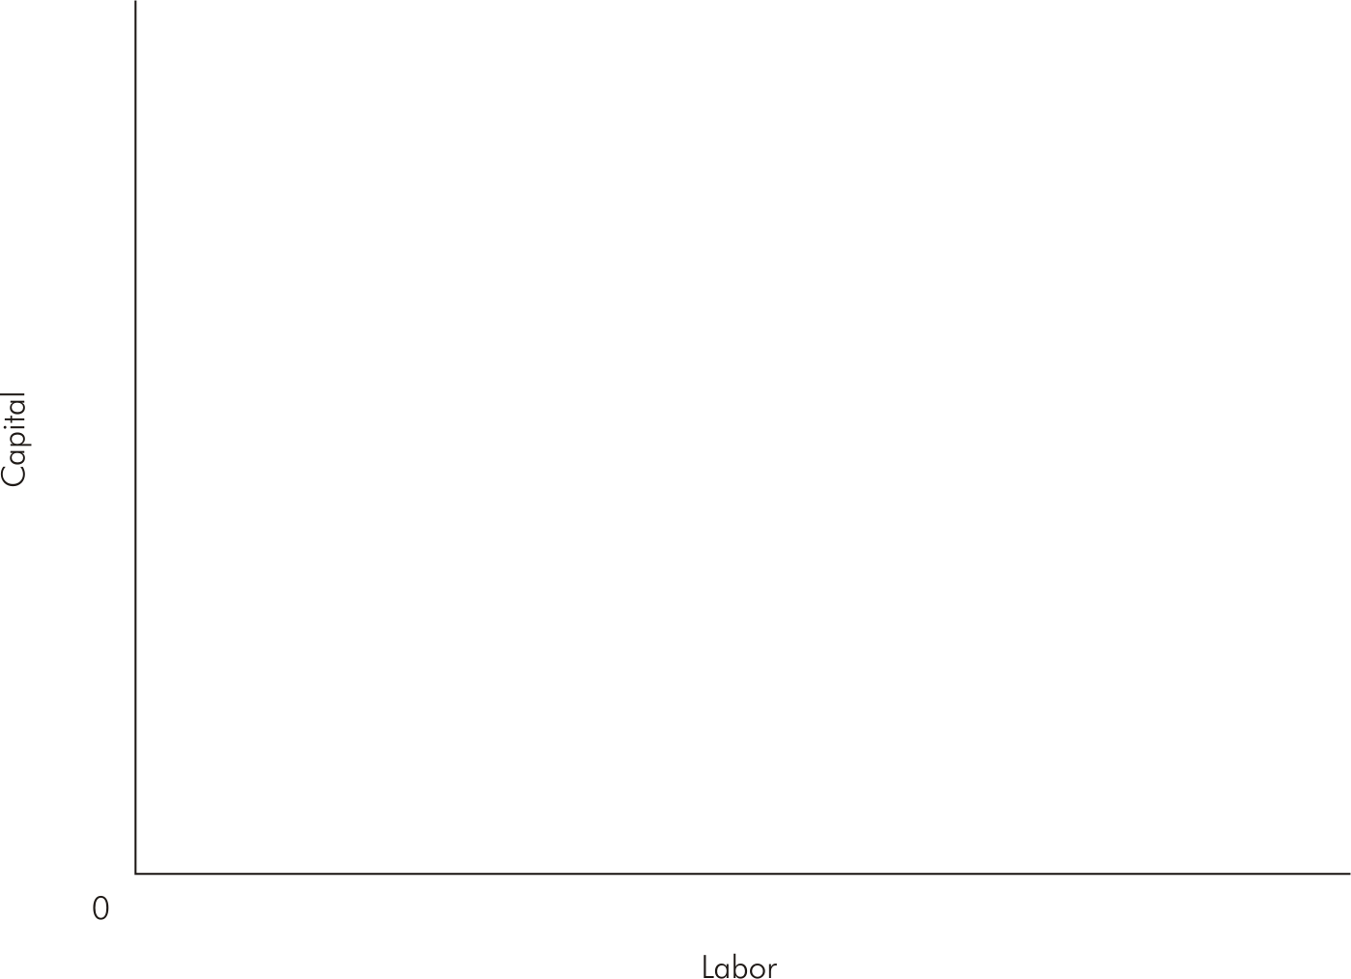
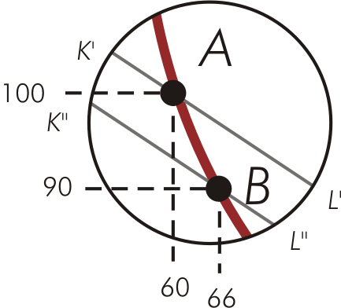
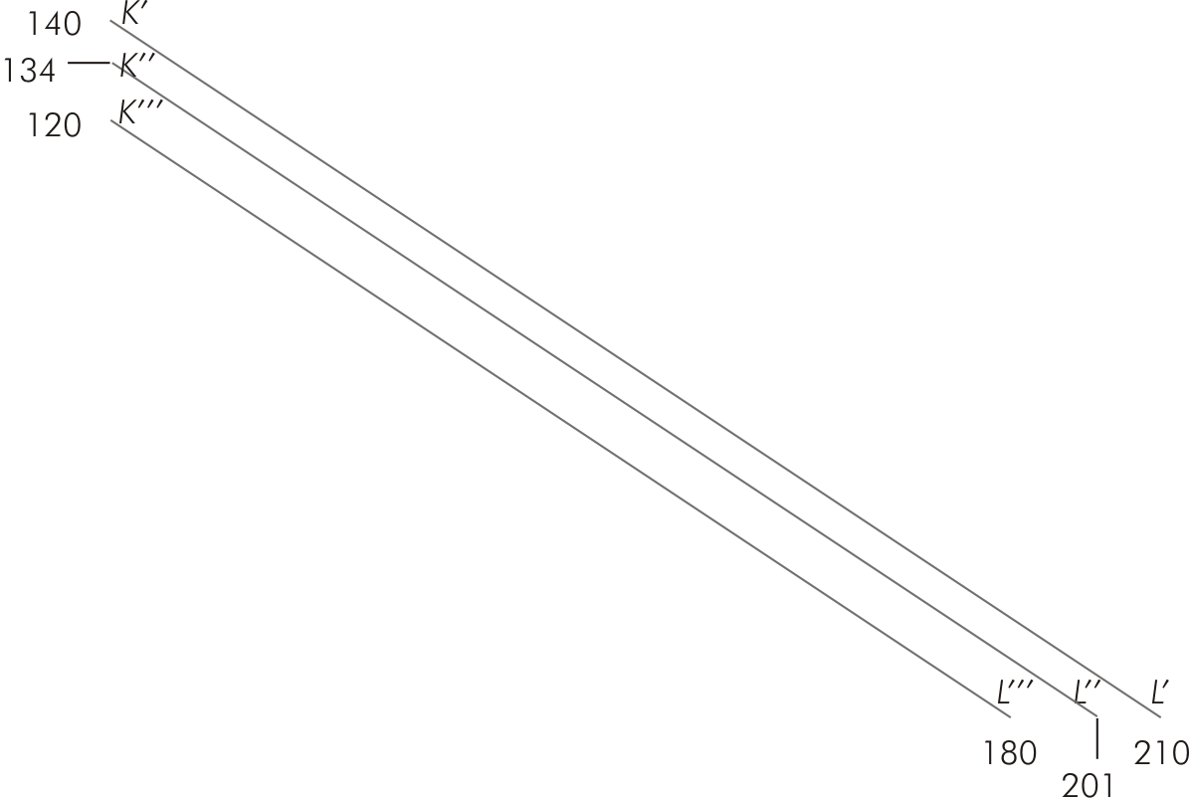
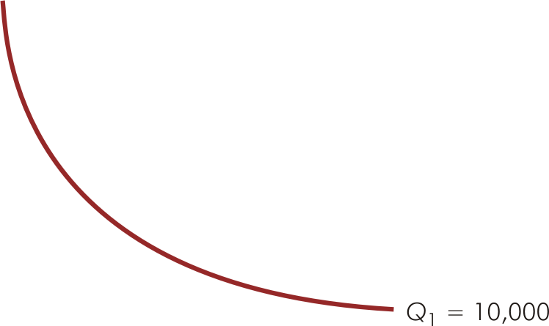

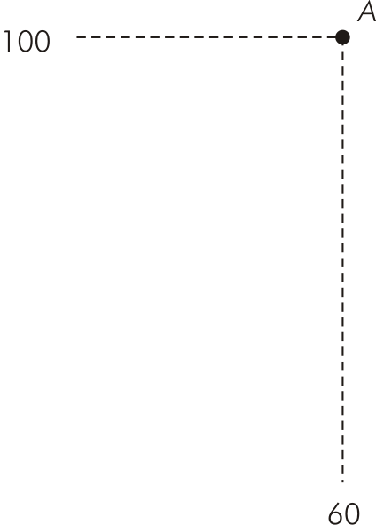
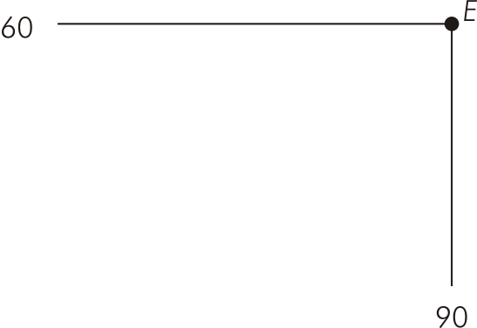
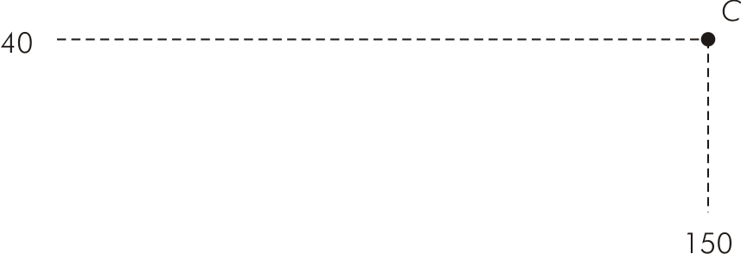
Optimal Input Combination to Minimize Cost for Given Output (Figure 9.4)

Slide 10
Optimization & Cost
Expansion path gives the efficient (least-cost) input combinations for every level of output
  Derived for a specific set of input prices
  Along expansion path, input-price ratio is constant & equal to the marginal rate of technical substitution

Slide 11
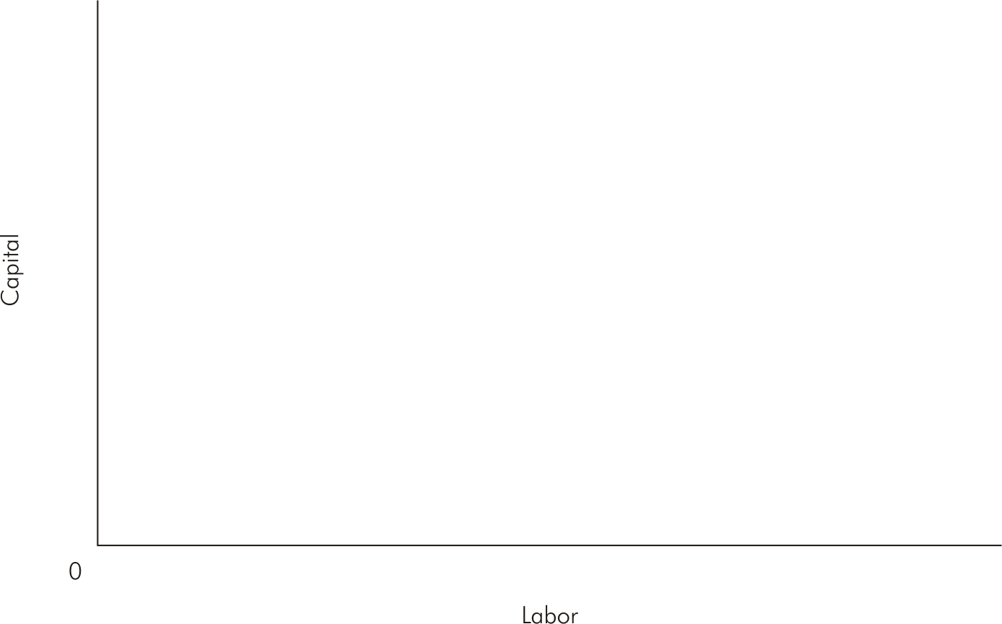
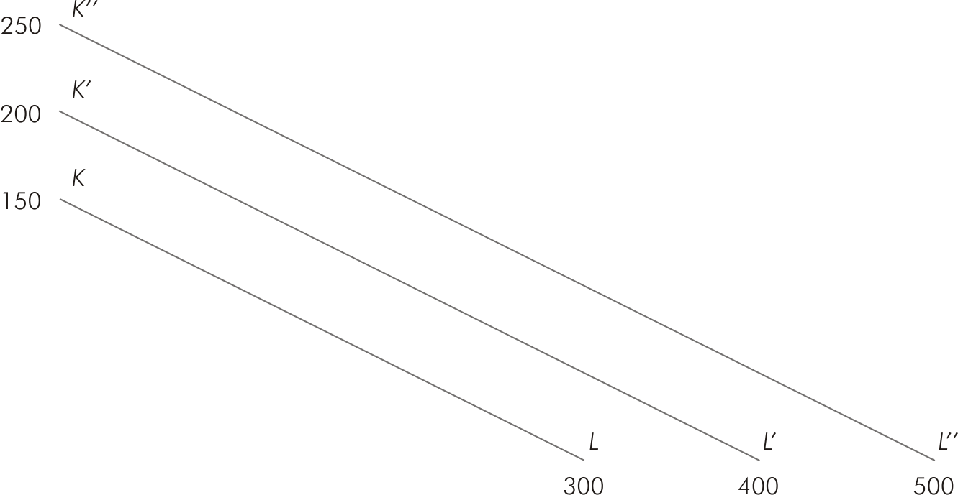
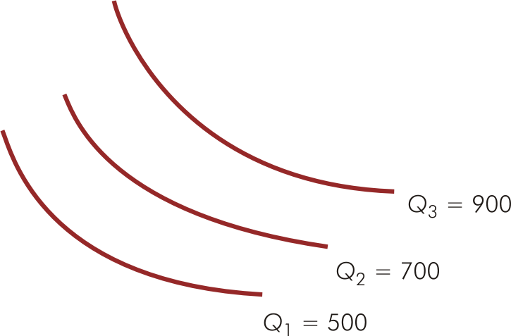
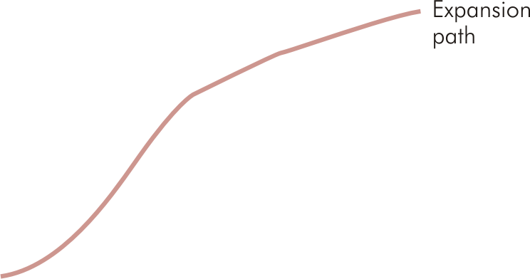
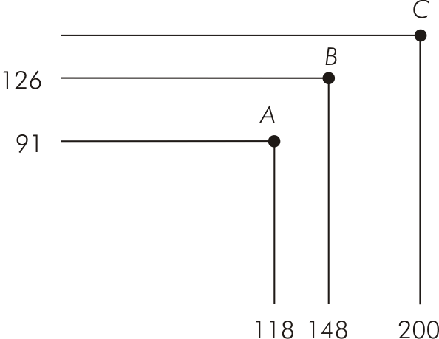
Expansion Path (Figure 9.6)

Slide 12
Returns to Scale
f(cL, cK) = zQ
If all inputs are increased by a factor of c & output goes up by a factor of z then, in general, a producer experiences:
  Increasing returns to scale if z > c; output goes up proportionately more than the increase in input usage
  Decreasing returns to scale if z < c; output goes up proportionately less than the increase in input usage
  Constant returns to scale if z = c; output goes up by the same proportion as the increase in input usage

Slide 13
Long-Run Costs
Long-run total cost (LTC) for a given level of output is given by:
  LTC = wL* + rK*
  Where w & r are prices of labor & capital, respectively, & (L*, K*) is the input combination on the expansion path that minimizes the total cost of producing that output

Slide 14
Long-Run Costs
  Cobb-Douglas Function
  Where L is labor and K is capital

Slide 15
Long-Run Costs
20 | 0.00 | 17.89 | 25.30 | 30.98 | 35.78 | 40.00 | 43.82 | 47.33 | 50.60 | 53.67 | 56.57 | 59.33 | 61.97 | 64.50
19 | 0.00 | 17.44 | 24.66 | 30.20 | 34.87 | 38.99 | 42.71 | 46.13 | 49.32 | 52.31 | 55.14 | 57.83 | 60.40 | 62.86
18 | 0.00 | 16.97 | 24.00 | 29.39 | 33.94 | 37.95 | 41.57 | 44.90 | 48.00 | 50.91 | 53.67 | 56.28 | 58.79 | 61.19
17 | 0.00 | 16.49 | 23.32 | 28.57 | 32.98 | 36.88 | 40.40 | 43.63 | 46.65 | 49.48 | 52.15 | 54.70 | 57.13 | 59.46
16 | 0.00 | 16.00 | 22.63 | 27.71 | 32.00 | 35.78 | 39.19 | 42.33 | 45.25 | 48.00 | 50.60 | 53.07 | 55.43 | 57.69
15 | 0.00 | 15.49 | 21.91 | 26.83 | 30.98 | 34.64 | 37.95 | 40.99 | 43.82 | 46.48 | 48.99 | 51.38 | 53.67 | 55.86
14 | 0.00 | 14.97 | 21.17 | 25.92 | 29.93 | 33.47 | 36.66 | 39.60 | 42.33 | 44.90 | 47.33 | 49.64 | 51.85 | 53.96
13 | 0.00 | 14.42 | 20.40 | 24.98 | 28.84 | 32.25 | 35.33 | 38.16 | 40.79 | 43.27 | 45.61 | 47.83 | 49.96 | 52.00
12 | 0.00 | 13.86 | 19.60 | 24.00 | 27.71 | 30.98 | 33.94 | 36.66 | 39.19 | 41.57 | 43.82 | 45.96 | 48.00 | 49.96
11 | 0.00 | 13.27 | 18.76 | 22.98 | 26.53 | 29.66 | 32.50 | 35.10 | 37.52 | 39.80 | 41.95 | 44.00 | 45.96 | 47.83
10 | 0.00 | 12.65 | 17.89 | 21.91 | 25.30 | 28.28 | 30.98 | 33.47 | 35.78 | 37.95 | 40.00 | 41.95 | 43.82 | 45.61
9 | 0.00 | 12.00 | 16.97 | 20.78 | 24.00 | 26.83 | 29.39 | 31.75 | 33.94 | 36.00 | 37.95 | 39.80 | 41.57 | 43.27
8 | 0.00 | 11.31 | 16.00 | 19.60 | 22.63 | 25.30 | 27.71 | 29.93 | 32.00 | 33.94 | 35.78 | 37.52 | 39.19 | 40.79
7 | 0.00 | 10.58 | 14.97 | 18.33 | 21.17 | 23.66 | 25.92 | 28.00 | 29.93 | 31.75 | 33.47 | 35.10 | 36.66 | 38.16
6 | 0.00 | 9.80 | 13.86 | 16.97 | 19.60 | 21.91 | 24.00 | 25.92 | 27.71 | 29.39 | 30.98 | 32.50 | 33.94 | 35.33
5 | 0.00 | 8.94 | 12.65 | 15.49 | 17.89 | 20.00 | 21.91 | 23.66 | 25.30 | 26.83 | 28.28 | 29.66 | 30.98 | 32.25
4 | 0.00 | 8.00 | 11.31 | 13.86 | 16.00 | 17.89 | 19.60 | 21.17 | 22.63 | 24.00 | 25.30 | 26.53 | 27.71 | 28.84
3 | 0.00 | 6.93 | 9.80 | 12.00 | 13.86 | 15.49 | 16.97 | 18.33 | 19.60 | 20.78 | 21.91 | 22.98 | 24.00 | 24.98
2 | 0.00 | 5.66 | 8.00 | 9.80 | 11.31 | 12.65 | 13.86 | 14.97 | 16.00 | 16.97 | 17.89 | 18.76 | 19.60 | 20.40
1 | 0.00 | 4.00 | 5.66 | 6.93 | 8.00 | 8.94 | 9.80 | 10.58 | 11.31 | 12.00 | 12.65 | 13.27 | 13.86 | 14.42
0 | 0.00 | 0.00 | 0.00 | 0.00 | 0.00 | 0.00 | 0.00 | 0.00 | 0.00 | 0.00 | 0.00 | 0.00 | 0.00 | 0.00
 | 0 | 1 | 2 | 3 | 4 | 5 | 6 | 7 | 8 | 9 | 10 | 11 | 12 | 13
Capital
Labor

Slide 16
Long-Run Costs
Long-run average cost (LAC) measures the cost per unit of output when production can be adjusted so that the optimal amount of each input is employed
  LAC is U-shaped
  Falling LAC indicates economies of scale
  Rising LAC indicates diseconomies of scale

Slide 17
Long-Run Costs
Long-run marginal cost (LMC) measures the rate of change in long-run total cost as output changes along expansion path
  LMC is U-shaped
  LMC lies below LAC when LAC is falling
  LMC lies above LAC when LAC is rising
  LMC = LAC at the minimum value of LAC

Slide 18
Derivation of a Long-Run Cost Schedule (Table 9.1)
 | Least-cost combination of
Output | Labor (units) | Capital (units) | Total cost (w = $5, r = $10) | LAC | LMC
LMC
100
10
7
$120
$1.20
$1.20
200
12
8
140
0.70
0.20
300
20
10
200
0.67
0.60
400
30
15
300
0.75
1.00
500
40
22
420
0.84
1.20
600
52
30
560
0.93
1.40
700
60
42
720
1.03
1.60

Slide 19
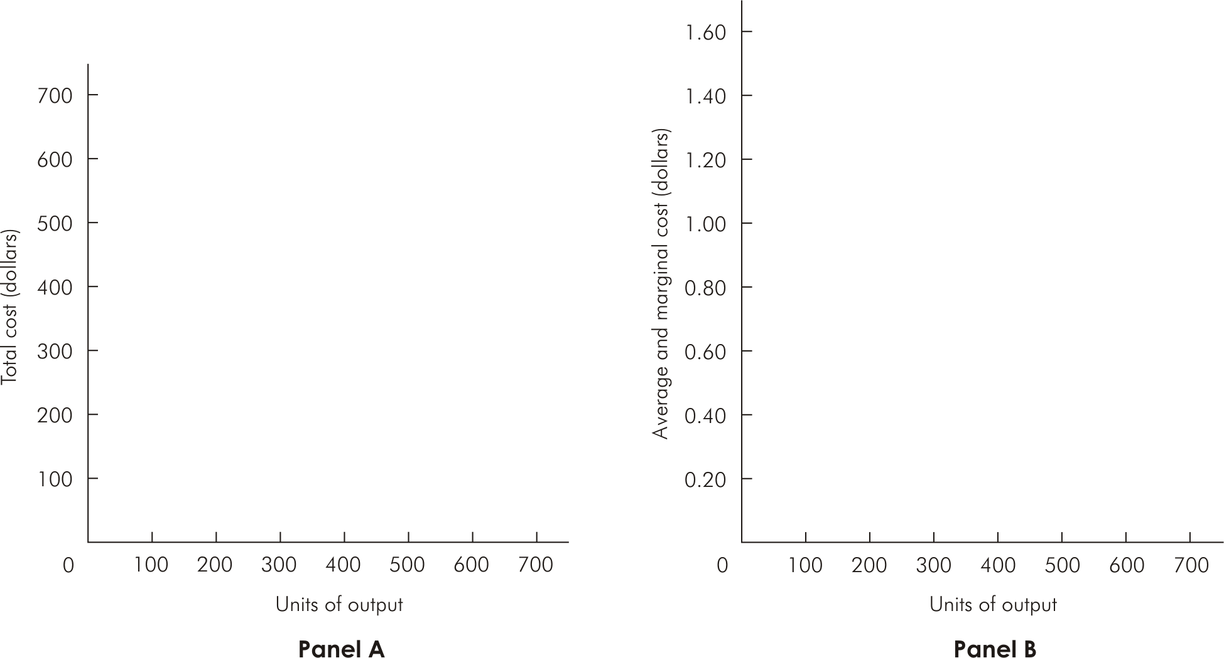
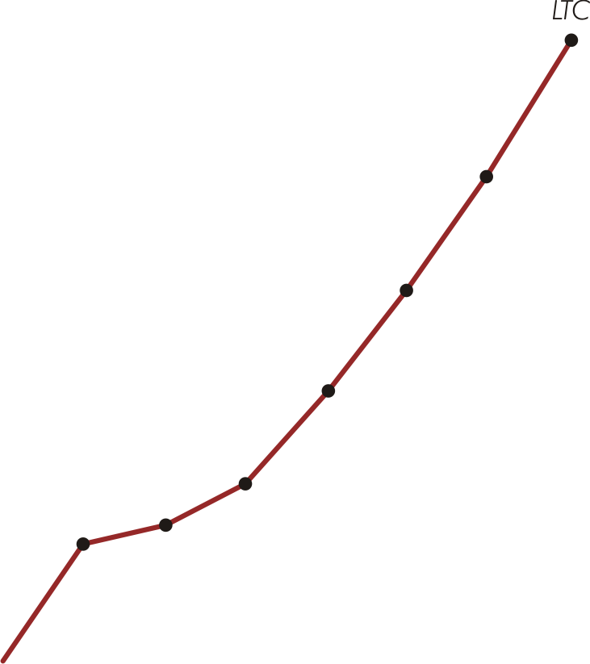
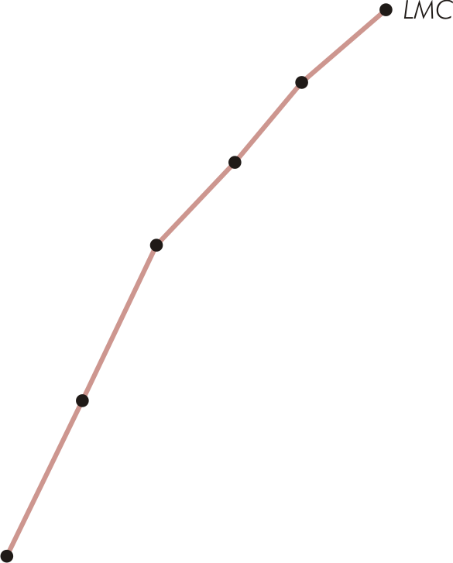
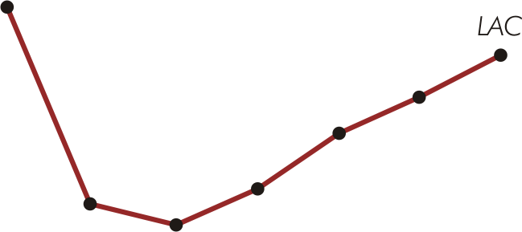

Long-Run Total, Average, & Marginal Cost (Figure 9.9)

Slide 20
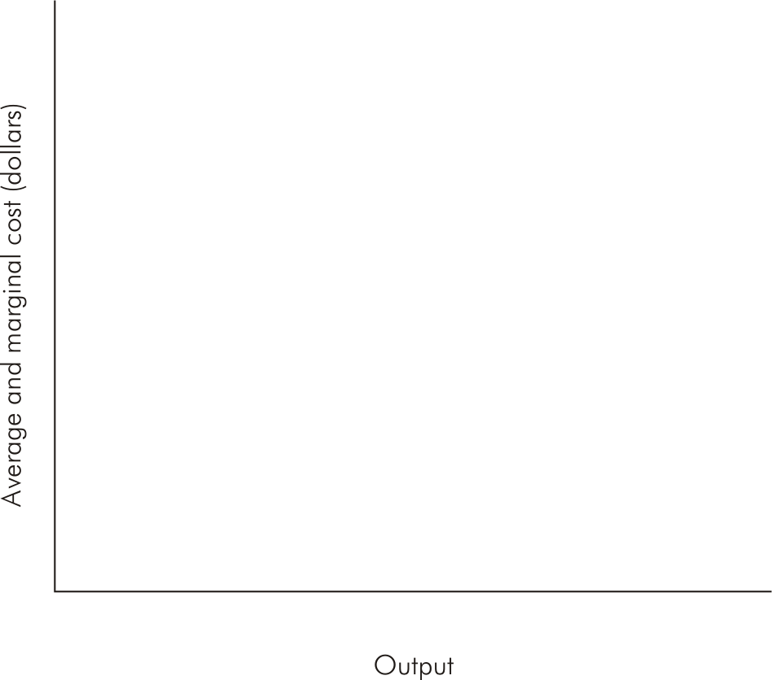
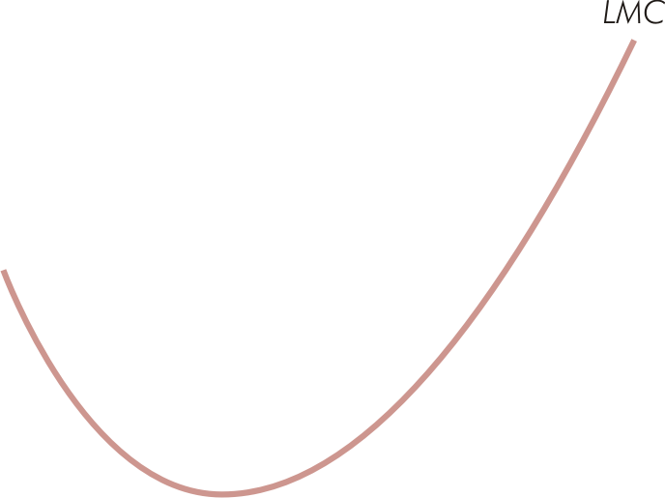
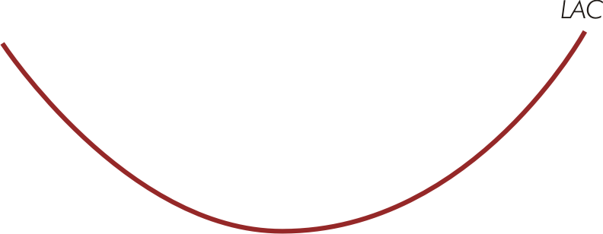
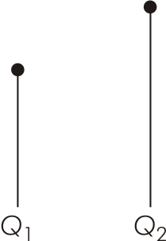
Long-Run Average & Marginal Cost Curves (Figure 9.10)

Slide 21
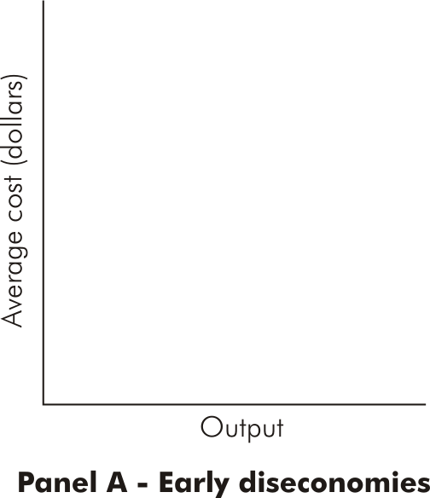
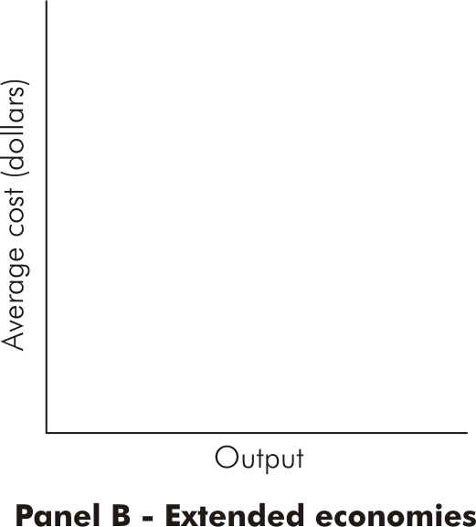
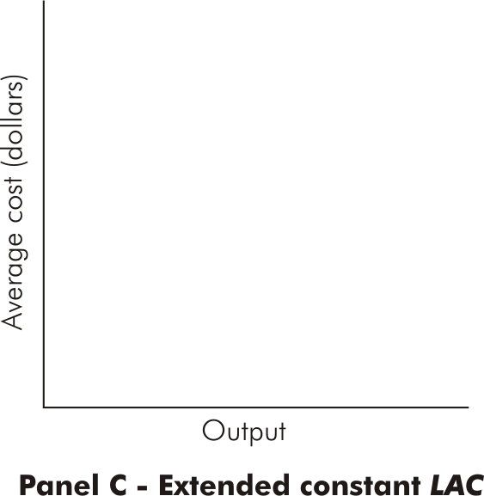
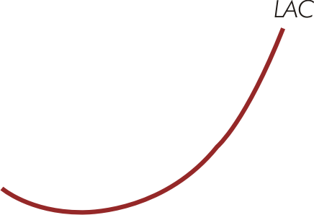
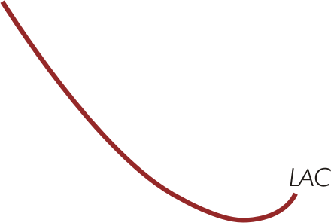

Various Shapes of LAC (Figure 9.11)

Slide 22
Constant Long-Run Costs
When constant returns to scale occur over entire range of output
  Firm experiences constant costs in the long run
  LAC curve is flat & equal to LMC at all output levels

Slide 23
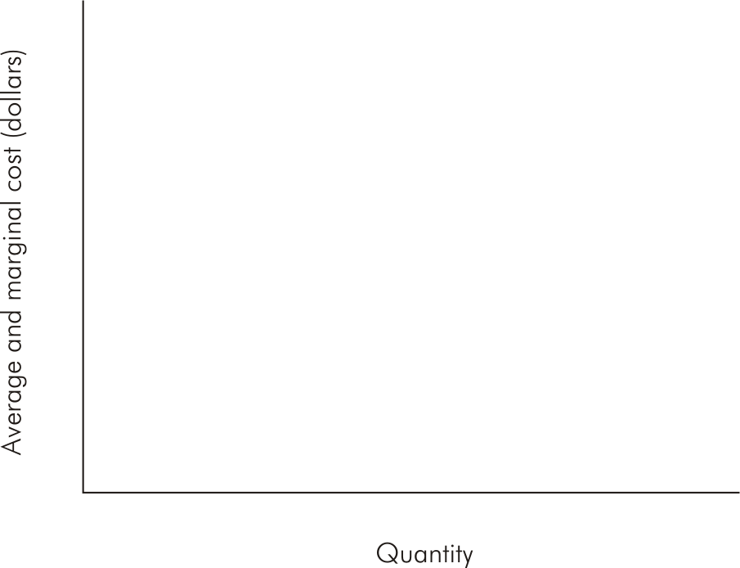
Constant Long-Run Costs (Figure 9.12)

Slide 24
Economies of Scope
Exist for a multi-product firm when the joint cost of producing two or more goods is less than the sum of the separate costs of producing the two goods
For two goods, X & Y, economies of scope are measured by:

Slide 25
Relations Between Short-Run & Long-Run Costs
LMC intersects LAC when the latter is at its minimum point
At each output where a particular ATC is tangent to LAC, the relevant SMC = LMC
For all ATC curves, point of tangency with LAC is at an output less (greater) than the output of minimum ATC if the tangency is at an output less (greater) than that associated with minimum LAC

Slide 26
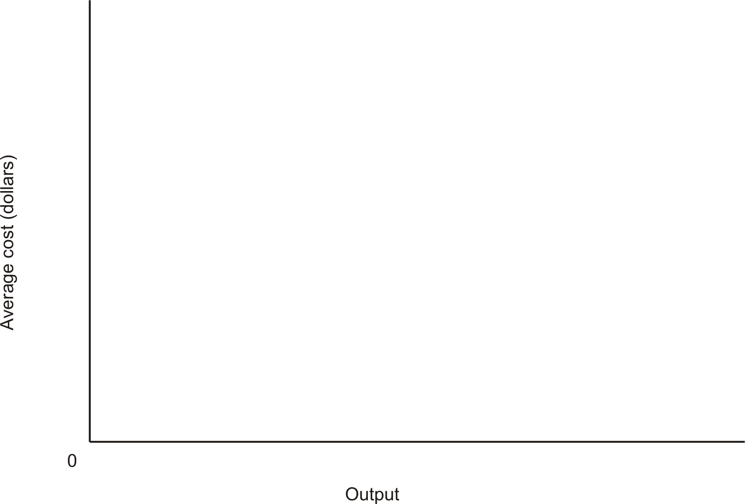
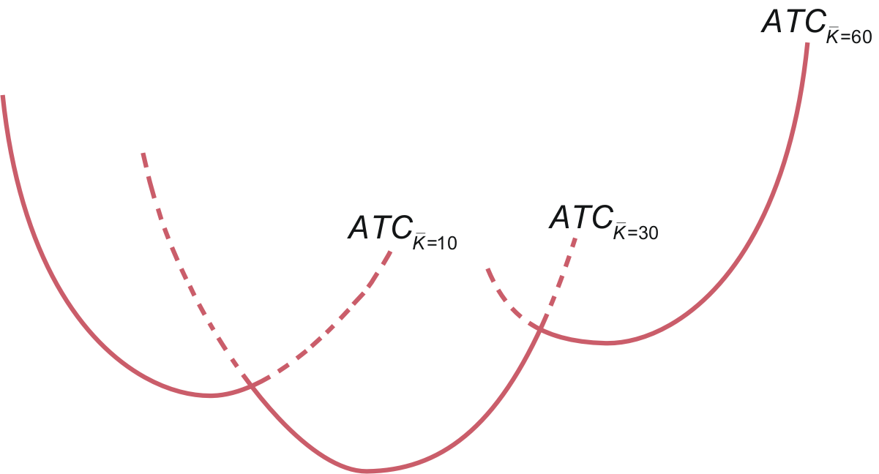
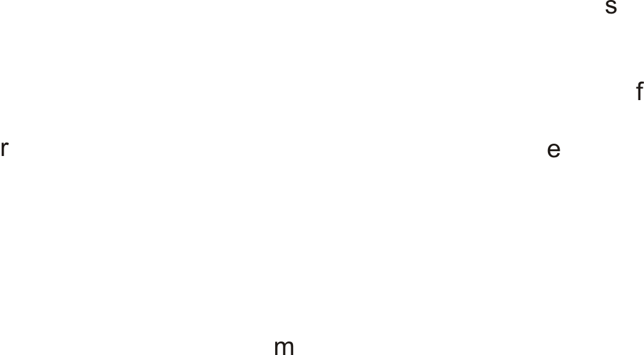
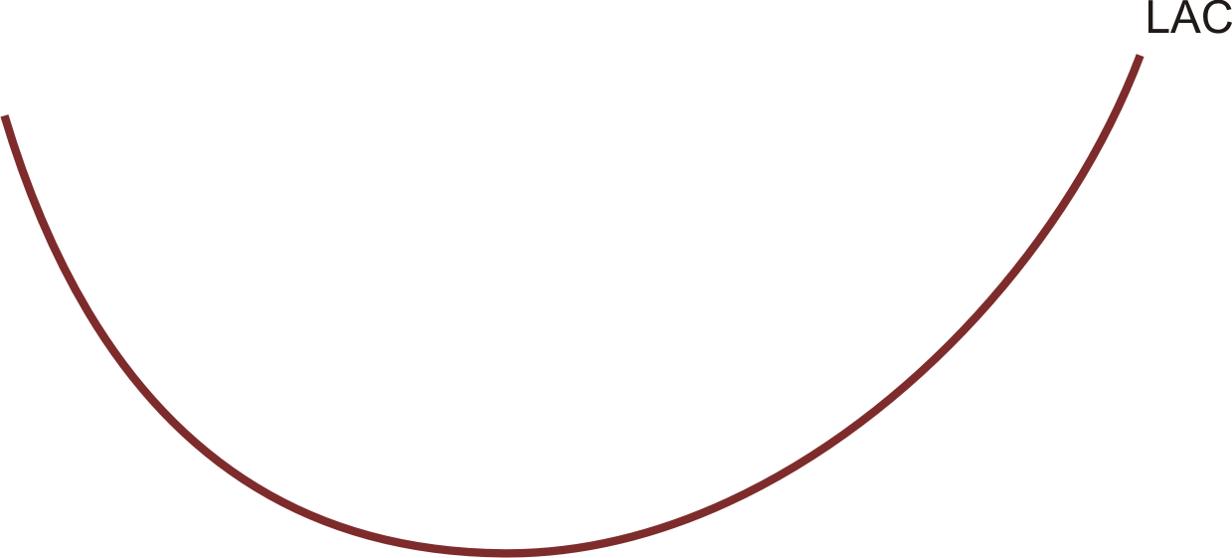

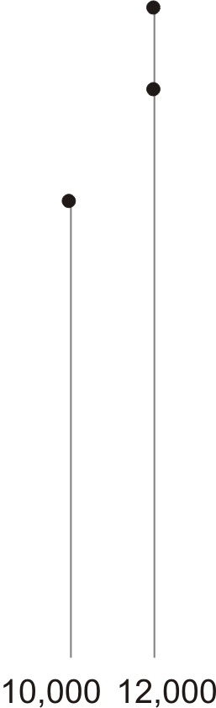
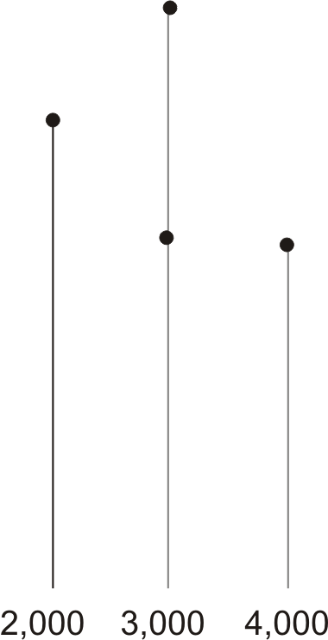
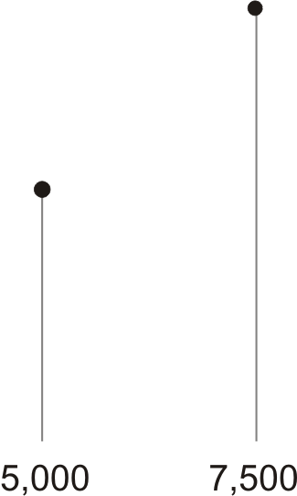
Long-Run Average Cost as the Planning Horizon (Figure 9.13)

Slide 27
Restructuring Short-Run Costs
Because managers have greatest flexibility to choose inputs in the long run, costs are lower in the long run than in the short run for all output levels except that for which the fixed input is at its optimal level
  Short-run costs can be reduced by adjusting fixed inputs to their optimal long-run levels when the opportunity arises

Slide 28
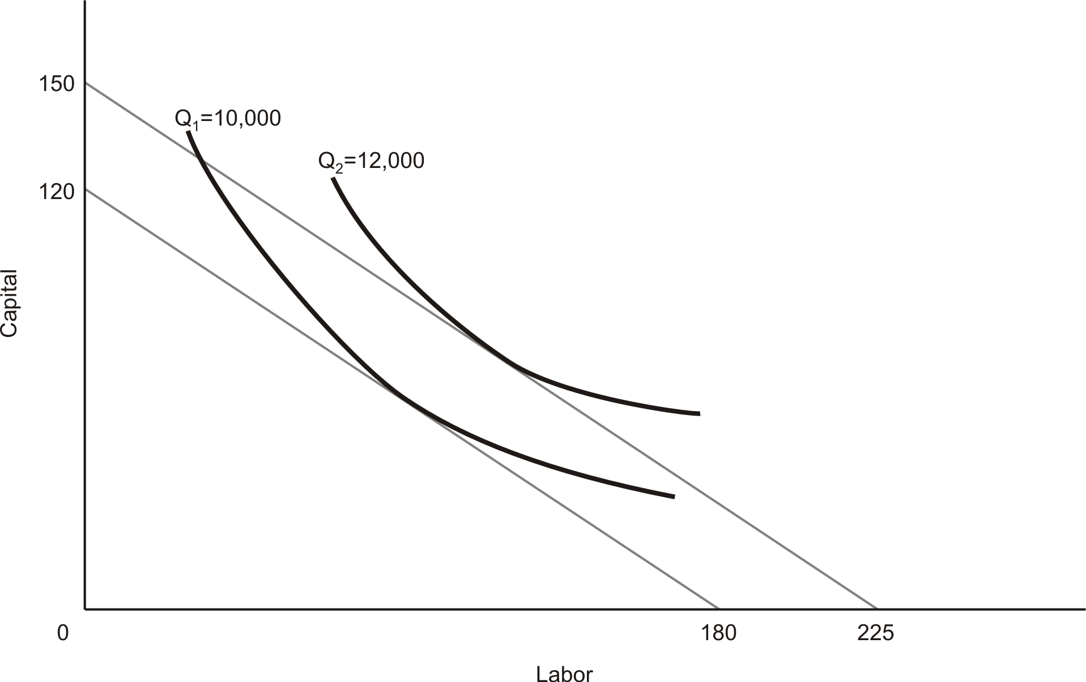
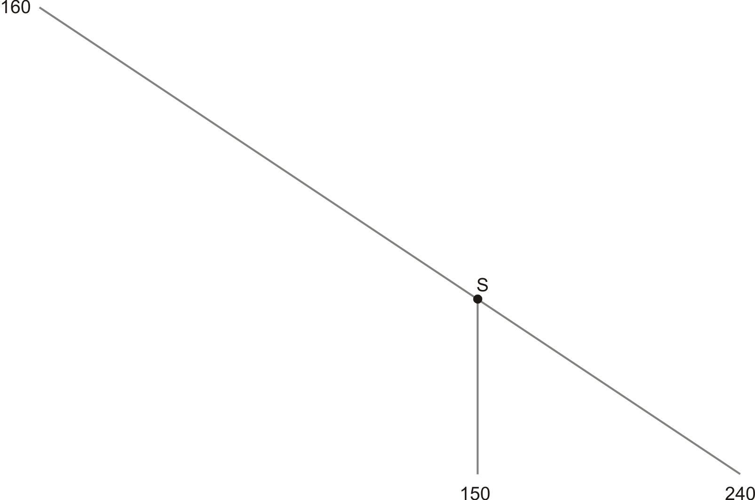
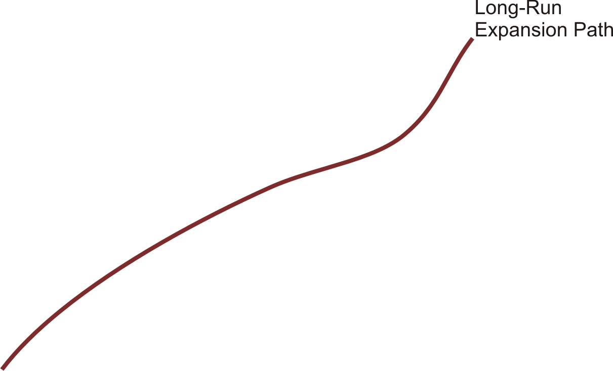
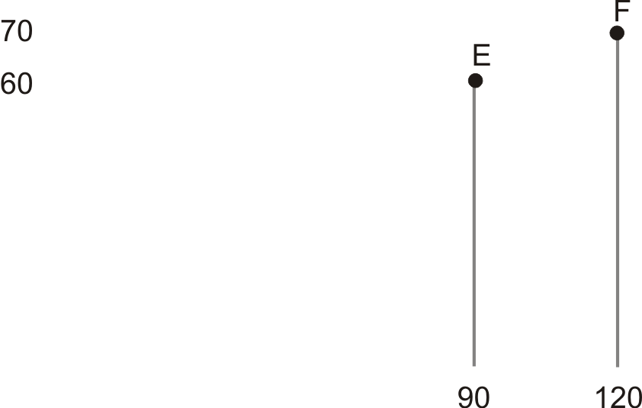
Restructuring Short-Run Costs (Figure 9.14)

