Slide 1
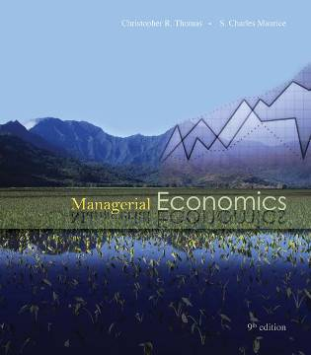
Chapter 15
Decisions Under Risk and Uncertainty

Slide 2
Risk vs. Uncertainty
Risk
Must make a decision for which the outcome is not known with certainty
Can list all possible outcomes & assign probabilities to the outcomes
Uncertainty
Cannot list all possible outcomes
Cannot assign probabilities to the outcomes

Slide 3
Measuring Risk with Probability Distributions
Table or graph showing all possible outcomes/payoffs for a decision & the probability each outcome will occur
To measure risk associated with a decision
Examine statistical characteristics of the probability distribution of outcomes for the decision

Slide 4
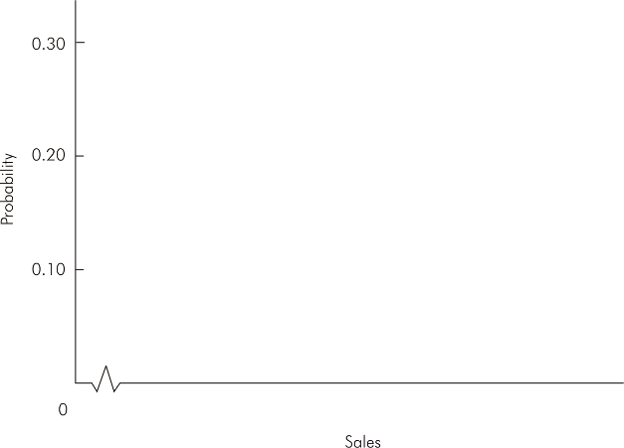





Probability Distribution for Sales (Figure 15.1)

Slide 5
Expected Value
Expected value (or mean) of a probability distribution is:
Where X_{i} is the i^{th} outcome of a decision,
p_{i} is the probability of the i^{th} outcome, and
n is the total number of possible outcomes

Slide 6
Expected Value
Does not give actual value of the random outcome
Indicates “average” value of the outcomes if the risky decision were to be repeated a large number of times
Sales | p
47,500 | 0.1 | 4,750
50,000 | 0.2 | 10,000
52,500 | 0.3 | 15,750
55,000 | 0.25 | 13,750
57,500 | 0.15 | 8,625
 |  | 52,875

Slide 7
Variance
Variance is a measure of absolute risk
Measures dispersion of the outcomes about the mean or expected outcome
The higher the variance, the greater the risk associated with a probability distribution
Sales | p
47,500 | 0.1 | 4,750 |  | 2,889,063
50,000 | 0.2 | 10,000 |  | 1,653,125
52,500 | 0.3 | 15,750 |  | 42,188
55,000 | 0.25 | 13,750 |  | 1,128,906
57,500 | 0.15 | 8,625 |  | 3,208,594
 | E(X)= | 52,875 | Var= | 8,921,875

Slide 8
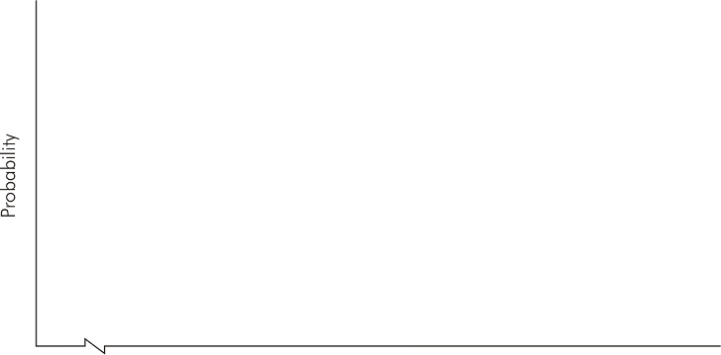

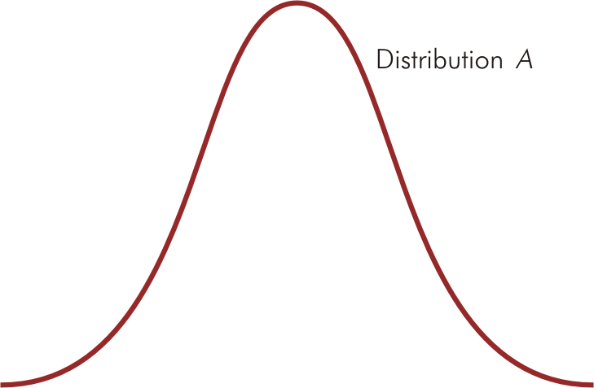
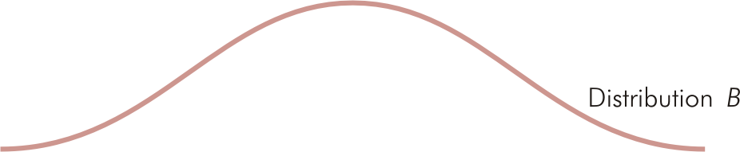
Identical Means but Different Variances (Figure 15.2)

Slide 9
Standard Deviation
Standard deviation is the square root of the variance
The higher the standard deviation, the greater the risk

Slide 10
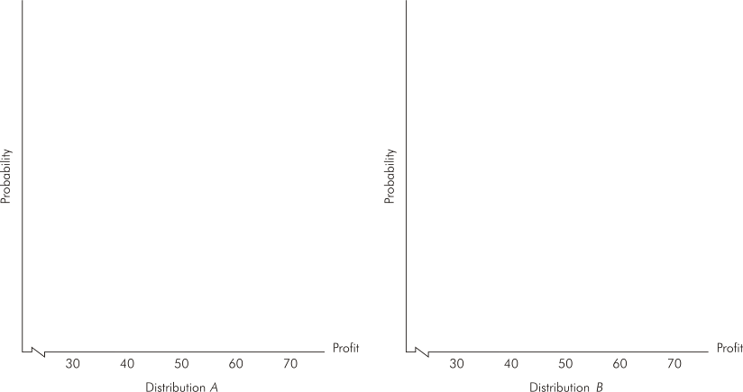


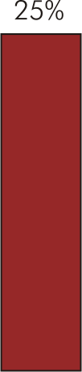
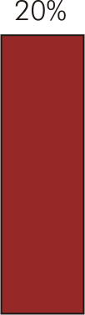
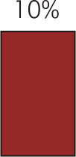
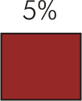
Probability Distributions with Different Variances (Figure 15.3)

Slide 11
Coefficient of Variation
When expected values of outcomes differ substantially, managers should measure riskiness of a decision relative to its expected value using the coefficient of variation
A measure of relative risk

Slide 12
Decisions Under Risk
No single decision rule guarantees profits will actually be maximized
Decision rules do not eliminate risk
Provide a method to systematically include risk in the decision making process

Slide 13
Summary of Decision Rules Under Conditions of Risk
Choose decision with highest expected value
Expected value rule
Mean-variance rules
Coefficient of variation rule
Given two risky decisions A & B:
If A has higher expected outcome & lower variance than B, choose decision A
If A & B have identical variances (or standard deviations), choose decision with higher expected value
If A & B have identical expected values, choose decision with lower variance (standard deviation)
Choose decision with smallest coefficient of variation

Slide 14
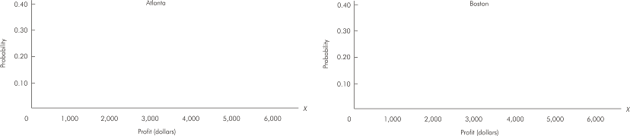




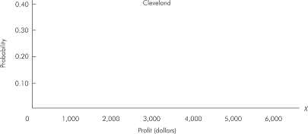
Probability Distributions for Weekly Profit (Figure 15.4)
E(X) = 3,500
σ_{A} = 1,025
υ = 0.29
E(X) = 3,750 σ_{B} = 1,545
υ = 0.41
E(X) = 3,500 σ_{C} = 2,062
υ = 0.59

Slide 15
Which Rule is Best?
For a repeated decision, with identical probabilities each time
Expected value rule is most reliable to maximizing (expected) profit
Average return of a given risky course of action repeated many times approaches the expected value of that action

Slide 16
Which Rule is Best?
For a one-time decision under risk
No repetitions to “average out” a bad outcome
No best rule to follow
Rules should be used to help analyze & guide decision making process

Slide 17
Expected Utility Theory
Actual decisions made depend on the willingness to accept risk
Expected utility theory allows for different attitudes toward risk-taking in decision making
Managers are assumed to derive utility from earning profits

Slide 18
Expected Utility Theory
Managers make risky decisions in a way that maximizes expected utility of the profit outcomes
Utility function measures utility associated with a particular level of profit
Index to measure level of utility received for a given amount of earned profit

Slide 19
Manager’s Attitude Toward Risk
Determined by manager’s marginal utility of profit:
Marginal utility (slope of utility curve) determines attitude toward risk

Slide 20
Manager’s Attitude Toward Risk
Risk averse
If faced with two risky decisions with equal expected profits, the less risky decision is chosen
Risk loving
Expected profits are equal & the more risky decision is chosen
Risk neutral
Indifferent between risky decisions that have equal expected profit

Slide 21
Manager’s Attitude Toward Risk
Can relate to marginal utility of profit
Diminishing MU_{profit}
Risk averse
Increasing MU_{profit}
Risk loving
Constant MU_{profit}
Risk neutral

Slide 22
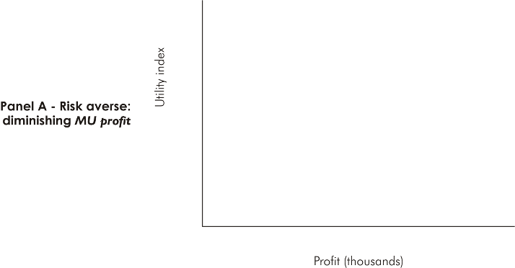
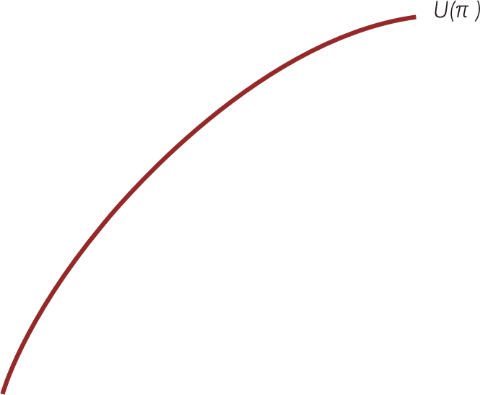
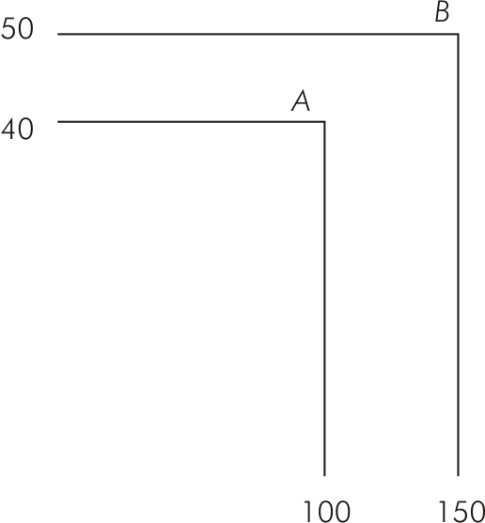
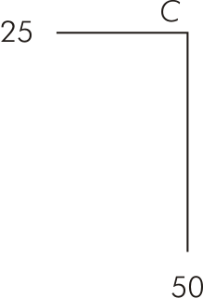
Manager’s Attitude Toward Risk (Figure 15.5)

Slide 23
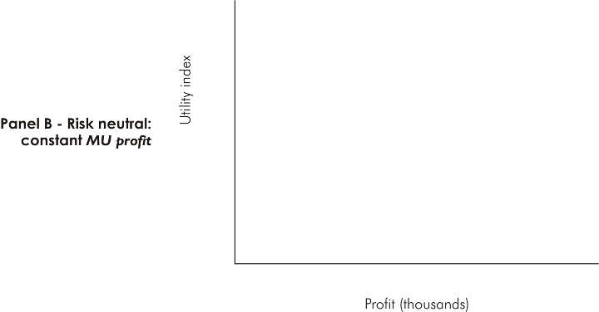
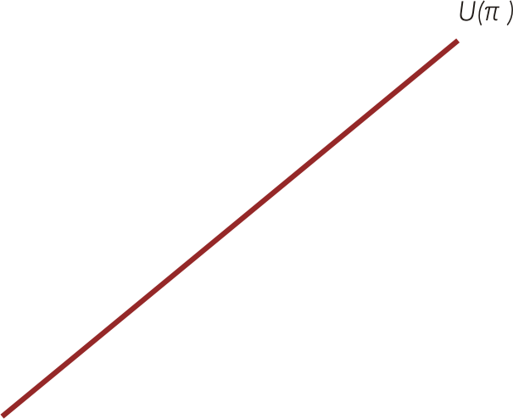
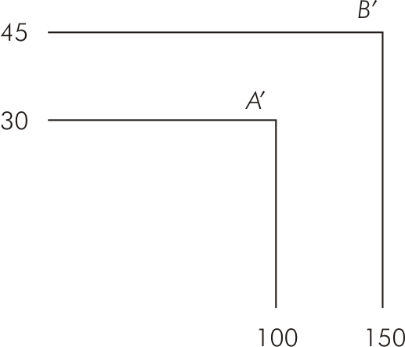
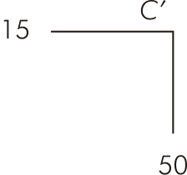
Manager’s Attitude Toward Risk (Figure 15.5)

Slide 24
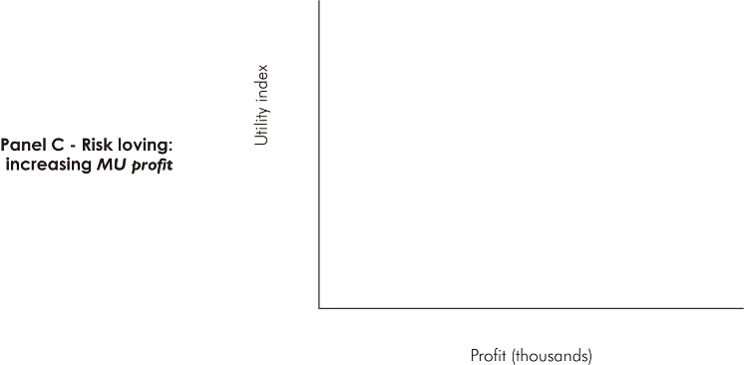
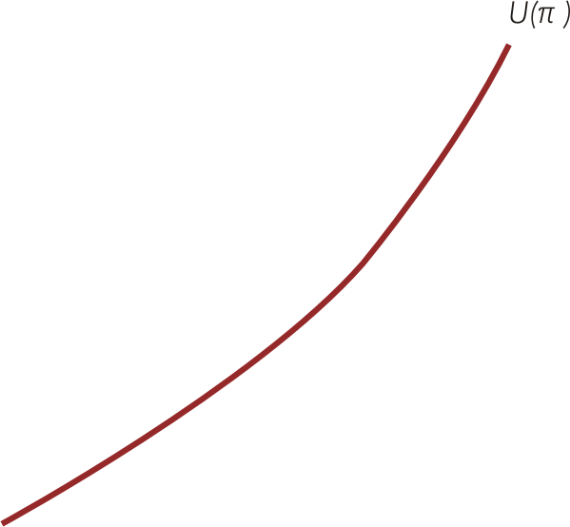
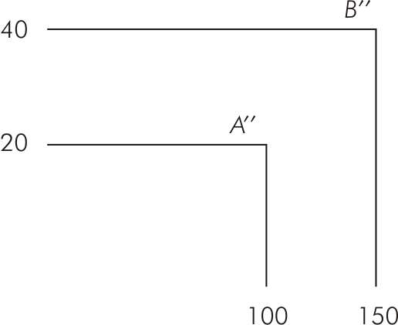
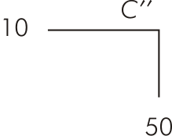
Manager’s Attitude Toward Risk (Figure 15.5)

Slide 25


Finding a Certainty Equivalent for a Risky Decision (Figure 15.6)

Slide 26
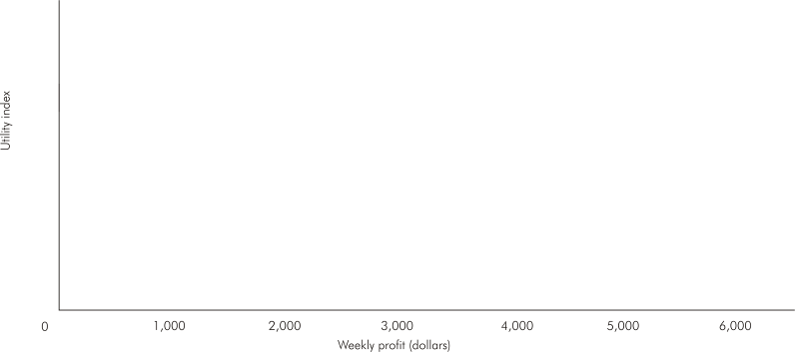
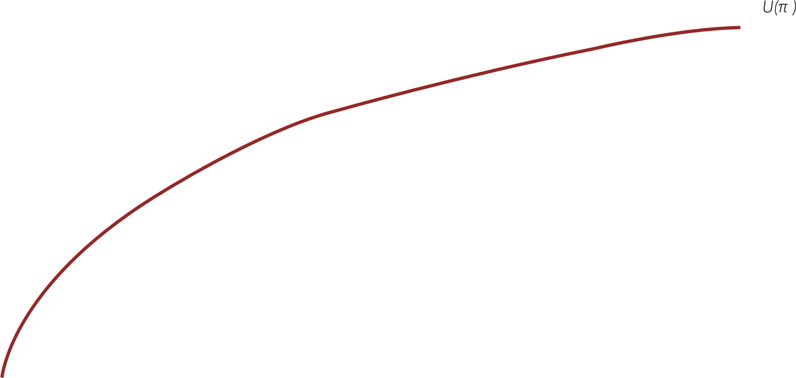
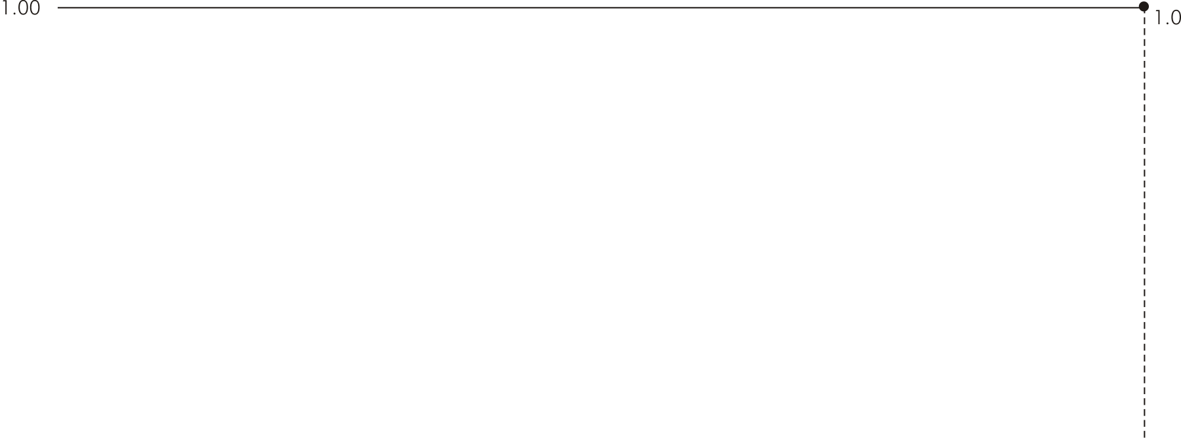

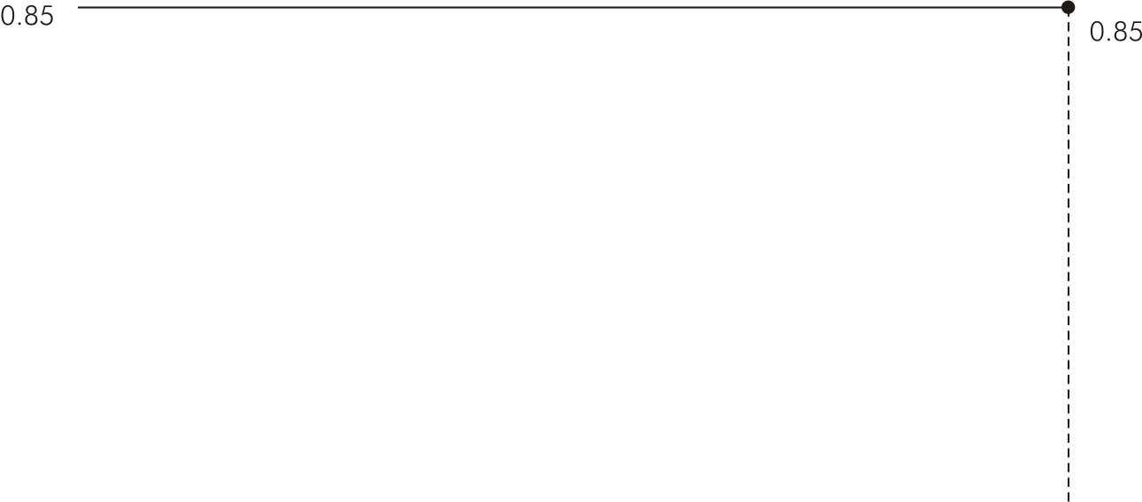
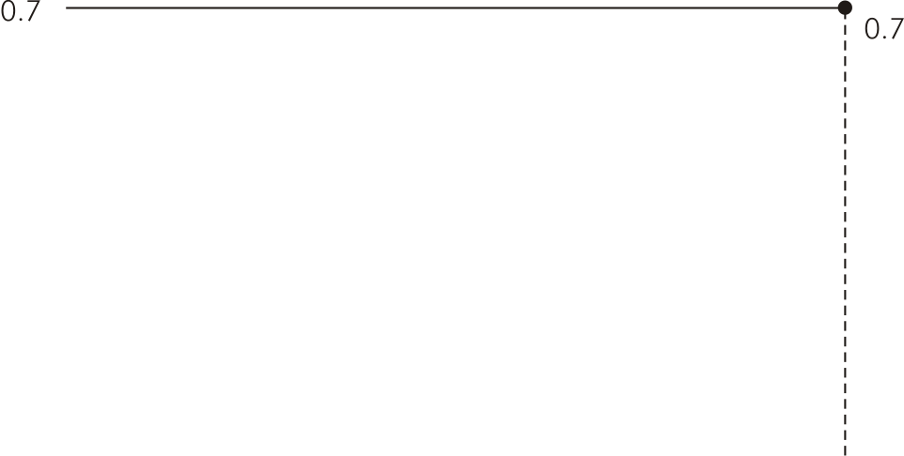
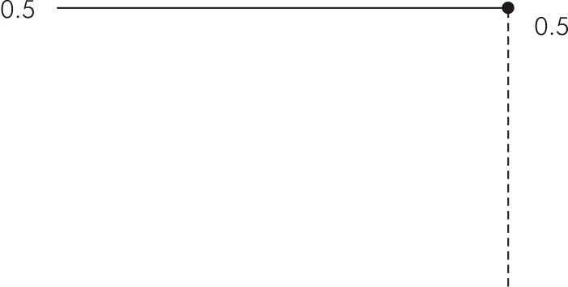
Manager’s Utility Function for Profit (Figure 15.7)

Slide 27
Expected Utility of Profits
According to expected utility theory, decisions are made to maximize manager’s expected utility of profits
Such decisions reflect risk-taking attitude
Generally differ from those reached by decision rules that do not consider risk
For a risk-neutral manager, decisions are identical under maximization of expected utility or maximization of expected profit

Slide 28
Decisions Under Uncertainty
With uncertainty, decision science provides little guidance
Four basic decision rules are provided to aid managers in analysis of uncertain situations

Slide 29
Summary of Decision Rules Under Conditions of Uncertainty
Identify best outcome for each possible decision & choose decision with maximum payoff.
Maximax rule
Maximin rule
Minimax regret rule
Equal probability rule
Identify worst outcome for each decision & choose decision with maximum worst payoff.
Determine worst potential regret associated with each decision, where potential regret with any decision & state of nature is the improvement in payoff the manager could have received had the decision been the best one when the state of nature actually occurred. Manager chooses decision with minimum worst potential regret.
Assume each state of nature is equally likely to occur & compute average payoff for each. Choose decision with highest average payoff.

Slide 30
Technical Problem 9
 | Profit (loss) when price is:
 | $15 |  | $20
Produce 7,100 | ($3,750) |  | $31,770
Produce 8,000 | ($8,000) |  | $34,000
Minimax regret
$15 |  | $20
$0 |  | ($2,230)
($4,250) |  | $0
Maximax:
Maximin:
Minimax regret:
Equal Probablity:
Produce 8,000
Produce 7,100
Produce 7,100
Produce 7,100
-$3,750(.5) + $31,770(.5) = $14,010
-$8,000(.5) + $34,000(.5) = $13,000

