Slide 1
Monopolistic Competition

Slide 2
Monopolistic Competition
Market Structure – A classification system for the key traits of a market, including
the number of firms,
the similarity of the products they sell, and
the ease of entry and exit
Monopolistic Competition
  Many sellers
  Product differentiation
    Not price takers
    Downward sloping demand curve
  Free entry and exit

Slide 3
Market Structure
Economists who study industrial organization divide markets into four types: monopoly, oligopoly, monopolistic competition, and perfect competition.
Number of Firms
Many Firms
One Firm
Product Type
Few Firms
Differentiated
Identical
Monopoly
Oligopoly
Monopolistic Competition
Perfect
Competition
Tap Water
Sewer Services
½ ton trucks
Wireless phones
Novels
Movies
Wheat
Corn
Imperfect Competition

Slide 4
Monopolistic Competition
Firms operating in “Monopolistic Competition” need product differentiation to offer different prices and face a downward sloping firm demand curve.
Example: The bar soap industry is differentiated with easy entry.
Characteristics
Brands
Sales Outlets
Color
Scent
Size
Packaging
Texture
Antibacterial
Allergenic
Irish Spring
Dove
Dial
Zest
Lava
Coast
Unbranded
Grocery Stores
Big Box Stores
Convenience Stores
Specialty Stores
Department Stores
On-line
Flea Markets

Slide 5
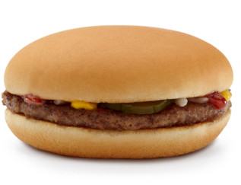

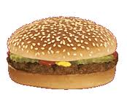
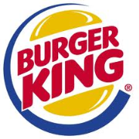
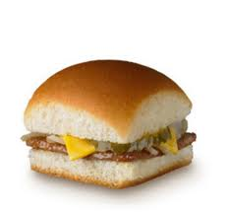

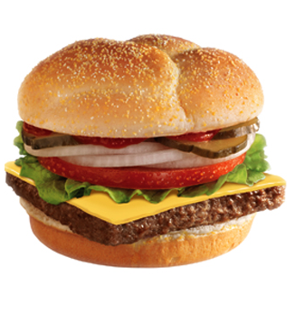
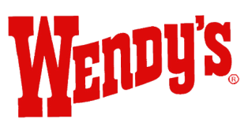
Monopolistic Competition
Example: Fast food hamburger
Sales Outlets
Are hamburgers differentiated?
McDonalds
Burger King
Dairy Queen
White Castle
Hardees
Rally’s
Wendy’s
Only represents half the market
Mom and Pops make up the other half
Again, in Monopolistic Competition product differentiation is critical otherwise firms have no control over price

Slide 6
Short Run
Firm makes profit
Firm makes losses
Price
Price
MC
MC
ATC
Price
ATC
ATC
ATC
Price
Profit
Demand
Loss
Demand
MR
MR
0
Q*
Quantity
0
Q*
Quantity
Monopolistic competitors maximize profit by producing the quantity at which marginal revenue equals marginal cost.
The firm to the left makes a profit because, at this quantity, price is above average total cost.
The firm to the right makes losses because, at this quantity, price is less than average total cost.

Slide 7
Short Run
Monopolistically competitive firms in short run maximizes profit at quantity consistent with
MR = MC
  Price on the demand curve
  If P > ATC: profit
  If P < ATC: loss

Slide 8
Long Run Equilibrium
When firms are earning an economic profit
  New firms enter the market
  Increase number of products
  Reduces demand faced by each firm
    Each firm’s demand curve shifts left
  Each firm’s profit declines until zero economic profit
When firms experiencing economic lose
  Firms have incentive to exit the market
  Decrease number of products
  Increases demand faced by each firm
    Each firm’s demand curve shifts right
  Each firm’s loss declines until zero economic profit

Slide 9
Long Run Equilibrium
Price
A Single Firm
MC
ATC
Price = ATC
Demand
MR
0
Q*
Quantity
In the long run if firms are making profit, new firms enter, and the demand curves for the incumbent firms shift to the left.
If firms are making losses, old firms exit, and the demand curves of the remaining firms shift to the right.
Because of these shifts in demand, a monopolistically competitive firm eventually finds itself in the long-run equilibrium where price equals average total cost, and the firm earns zero economic profit.

Slide 10
Long Run Equilibrium
Zero economic profit
Demand curve is tangent to average total cost curve
  At quantity where marginal revenue = marginal cost
  Price = average total cost

Slide 11
Inefficiencies
Perfectly Competitive Firm
Monopolistically Competitive Firm
Price
Price
MC
MC
ATC
Price
ATC
P=MC
Demand
Markup
MC
Demand
MR
0
Quantity produced
at efficient scale
Quantity
0
Quantity
produced
Efficient
scale
Quantity
Excess capacity
The right graph shows the long-run equilibrium in a perfectly competitive market while the left graph shows the long-run equilibrium in a monopolistically competitive market.
Note the perfectly competitive firm produces at the efficient scale, where average total cost is minimized while the monopolistically competitive firm produces at less than the efficient scale.
Also price equals marginal cost under perfect competition, but price is above marginal cost under monopolistic competition.

Slide 12
Summary
Monopolistic competition, inefficiency and society welfare
  Produces a quantity where price is greater then marginal cost
    Price is higher than perfect competition
  Quantity produced is lower than perfect competition
    Excess capacity
    Quantity is not at minimum ATC (inefficient scale)
  Too much or too little entry
  Product variety
    Positive externality on consumers (more choice)
    Negative externality on producers (business stealing)

Slide 13
Advertising
When firms sell differentiated products at price above marginal cost they have incentive to advertise and attract more buyers
  Provide information to customers
    Customers make better choices
    Enhances the ability of markets to allocate resources efficiently
  Promotes competition
    Customers have more information to take advantage of price differences
    Firm demand curve become more elastic
  Incents firms to maintain a quality product
  Allows new firms to enter more easily

Slide 14
Advertising
Critiques of advertising
  Firms advertise to manipulate people’s tastes
    Psychological rather than informational
    Creates a desire that otherwise might not exist
  Impedes competition by increasing the perception of product differentiation
    Fosters brand loyalty
  Makes buyers less concerned with price differences among similar goods
    Firm demand curves become less elastic
    Firms then charge higher prices

Slide 15
Advertising and Eyeglasses
1963, Test: advertising by optometrists
States that prohibited advertising
  Average price paid for a pair of eyeglasses = $33
States that did not restrict advertising
  Average price = $26
Advertising
  Reduced average prices
  Fosters competition

Slide 16
Brand Names
Firms with a brand name
  Spend more on advertising
  Often charge higher prices than generic substitutes
Defenders of brand names
  Incentive to provide high quality
  Provide consumers information about quality
  Firms has incentive to maintain high quality
Critics of brand names
  Products are not differentiated
  Consumer irrationality: willing to pay more for brand names

Slide 17
Monopolistic competition: between perfect competition & monopoly
 | Market structure
 | Perfect competition | Monopolistic competition | Monopoly
Features that all three market structures share Goal of firms Rule for maximizing Can earn economic profits in the short run? Features that monopolistic competition shares with monopoly Price taker? Price Produces welfare-maximizing level of output? Features that monopolistic competition shares with competition Number of firms Entry in long run? Can earn economic profits in long run? | Maximize profits MR = MC Yes Yes P = MC Yes Many Yes No | Maximize profits MR = MC Yes No P > MC No Many Yes No | Maximize profits MR = MC Yes No P > MC No One No Yes

