Slide 1
Analyzing Missing Data
Introduction
Problems
Using Scripts

Slide 2
Missing data and data analysis
Missing data is a problem in multivariate data because a case will be excluded from the analysis if it is missing data for any variable included in the analysis.
If our sample is large, we may be able to allow cases to be excluded.
If our sample is small, we will try to use a substitution method so that we can retain enough cases to have sufficient power to detect effects.
In either case, we need to make certain that we understand the potential impact that missing data may have on our analysis.

Slide 3
Tools for evaluating missing data
SPSS has a specific package for evaluating missing data, but it is included under the UT license.
In place of this package, we will first examine missing data using SPSS statistics and procedures.
After studying the standard SPSS procedures that we can use to examine missing data, we will use an SPSS script that will produce the output needed for missing data analysis without requiring us to issue all of the SPSS commands individually.

Slide 4
Key issues in missing data analysis
We will focus on three key issues for evaluating missing data:
The number of cases missing per variable
The number of variables missing per case
The pattern of correlations among variables created to represent missing and valid data.
Further analysis may be required depending on the problems identified in these analyses.

Slide 5
Problem 1
1. Based on a missing data analysis for the variables "employment status," "number of hours worked in the past week," "self employment," "governmental employment," and "occupational prestige score" in the dataset GSS2000.sav, is the following statement true, false, or an incorrect application of a statistic?
The variables "number of hours worked in the past week" and "employment status" are missing data for more than half of the cases in the data set and should be examined carefully before deciding how to handle missing data.
1. True
2. True with caution
3. False
4. Incorrect application of a statistic

Slide 6
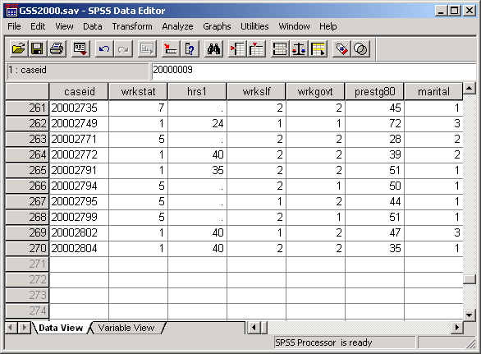
Identifying the number of cases in the data set
This problem wants to know if a variable is missing data for more than half the cases.
Our first task is to identify the number of cases that meets that criterion.
If we scroll to the bottom of the data set, we see than there are 270 cases in the data set.
270 ÷ 2 = 135.
If any variable included in the analysis has more than 135 missing cases, the answer to the problem will be true.

Slide 7
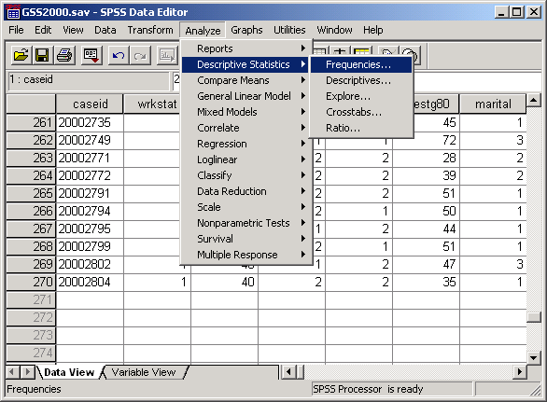
Request frequency distributions
We will use the output for frequency distributions to find the number of missing cases for each variable.
Select the Frequencies… | Descriptive Statistics command from the Analyze menu.

Slide 8
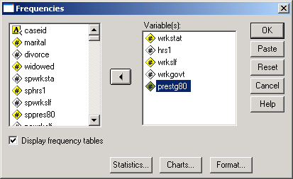
Completing the specification for frequencies
First, move the five variables included in the problem statement to the list box for variables.
Second, click on the OK button to complete the request for statistical output.

Slide 9
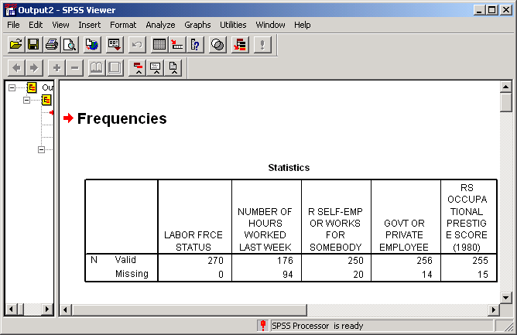
Number of missing cases for each variable
In the table of statistics at the top of the Frequencies output, there is a table detailing the number of missing cases for each variable in the analysis.
None of the variables has more than 135 missing cases, although number of hours worked in the past week comes close.
The answer to the question is false.

Slide 10
Problem 2
2. Based on a missing data analysis for the variables "employment status," "number of hours worked in the past week," "self employment," "governmental employment," and "occupational prestige score" in the dataset GSS2000.sav, is the following statement true, false, or an incorrect application of a statistic?
14 cases are missing data for more than half of the variables in the analysis and should be examined carefully before deciding how to handle missing data.
1. True
2. True with caution
3. False
4. Incorrect application of a statistic

Slide 11
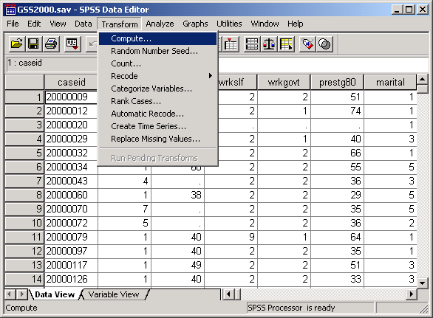
Create a variable that counts missing data
We want to know how many of the five variables in the analysis had missing data for each case in the data set.
We will create a variable containing this information that uses an SPSS function to count the number of variables with missing data.
To compute a new variable, select the Compute… command from the Transform menu.

Slide 12
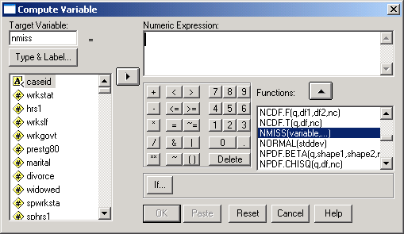
Enter specifications for new variable
First, type in the name for the new variable nmiss in the Target variable text box.
Third, click on the up arrow button to move the NMISS function into the Numeric Expression text box.
Second, scroll down the list of functions and highlight the NMISS function.

Slide 13
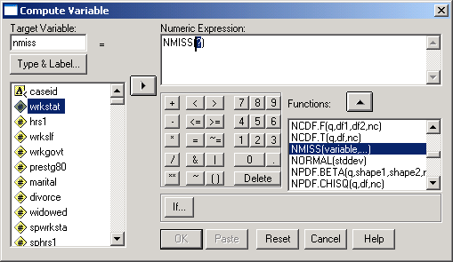
Enter specifications for new variable
The NMISS function is moved into the Numeric Expression text box.
To add the list of variables to count missing data for, we first highlight the first variable to include in the function, wrkstat.
Second, click on the right arrow button to move the variable name into the function arguments.

Slide 14
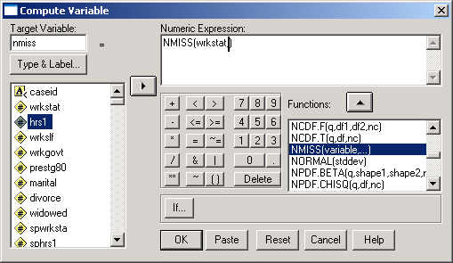
Enter specifications for new variable
First, before we add another variable to the function, we type a comma to separate the names of the variables.
Second, to add the next variable we highlight the second variable to include in the function, hrs1.
Third, click on the right arrow button to move the variable name into the function arguments.

Slide 15
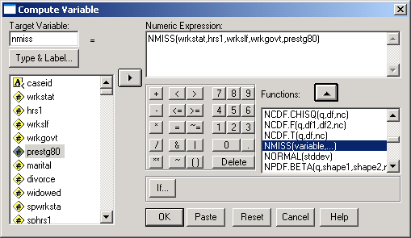
Complete specifications for new variable
Continue adding variables to function until all of the variables specified in the problem have been added.
Be sure to type a comma between the variable names.
When all of the variables have been added to the function, click on the OK button to complete the specifications.

Slide 16
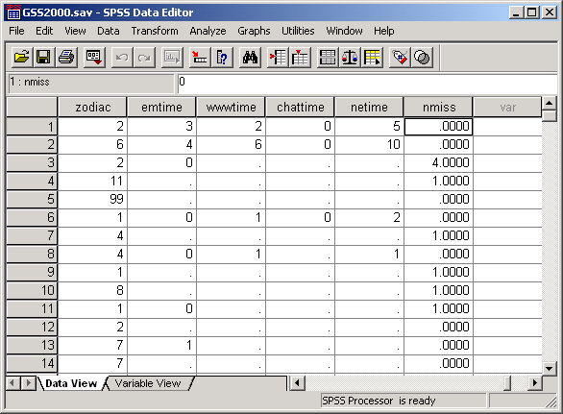
The nmiss variable in the data editor
If we scroll the worksheet to the right, we see the new variable that SPSS has just computed for us.

Slide 17
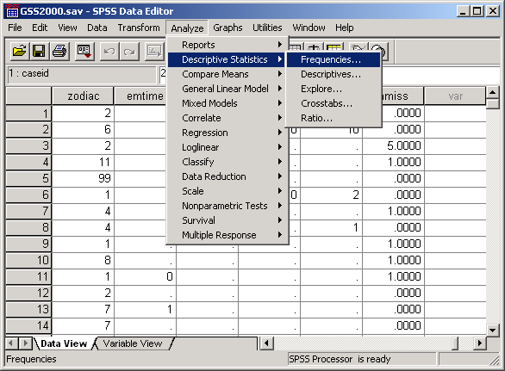
A frequency distribution for nmiss
To answer the question of how many cases had each of the possible numbers of missing value, we create a frequency distribution.
Select the Frequencies… | Descriptive Statistics command from the Analyze menu.

Slide 18
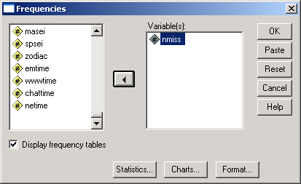
Completing the specification for frequencies
First, move the nmiss variable to the list of variables.
Second, click on the OK button to complete the request for statistical output.

Slide 19
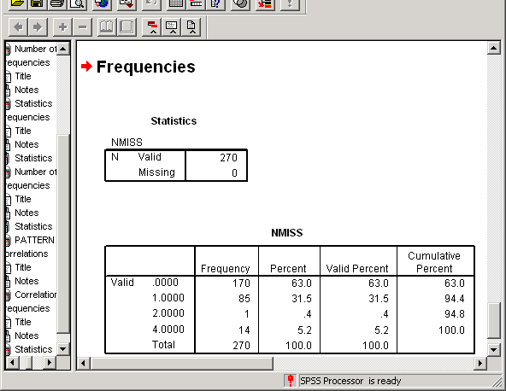
The frequency distribution
SPSS produces a frequency distribution for the nmiss variable.
170 cases had valid, non-missing values for all 5 variables. 85 cases had one missing value; 1 case had 2 missing values; and 14 cases had missing values for 4 variables.

Slide 20
Answering the problem
The problem asked whether or not 14 cases had missing data for more than half the variables. For a set of five variables, cases that had 3, 4, or 5 missing values would meet this requirement.
The number of cases with 3, 4, or 5 missing values is 14.
The answer to the problem is true.

Slide 21
Problem 3
3. Based on a missing data analysis for the variables "employment status," "number of hours worked in the past week," "self employment," "governmental employment," and "occupational prestige score" in the dataset GSS2000.sav, is the following statement true, false, or an incorrect application of a statistic? Use 0.01 as the level of significance.
After excluding cases with missing data for more than half of the variables from the analysis if necessary, the presence of statistically significant correlations in the matrix of dichotomous missing/valid variables suggests that the missing data pattern may not be random.
1. True
2. True with caution
3. False
4. Incorrect application of a statistic

Slide 22
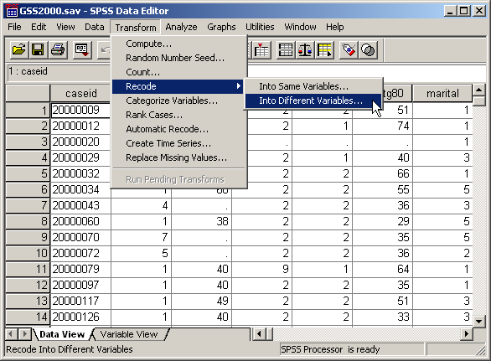
Compute valid/missing dichotomous variables
To evaluate the pattern of missing data, we need to compute dichotomous valid/missing variables for each of the five variables included in the analysis.
We will compute the new variable using the Recode command.
To create the new variable, select the Recode | Into Different Variables…
from the Transform menu.

Slide 23
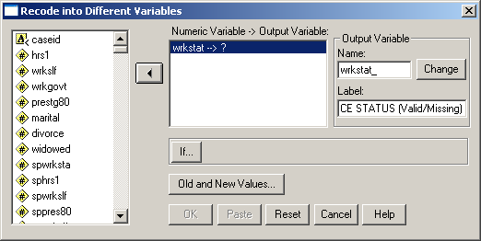
Enter specifications for new variable
First, move the first variable in the analysis, wrkstat, into the Numeric Variable -> Output Variable text box.
Second, type the name for the new variable into the Name text box. My convention is to add an underscore character to the end of the variable name.
If this would make the variable more than 8 characters long, delete characters from the end of the original variable name.

Slide 24
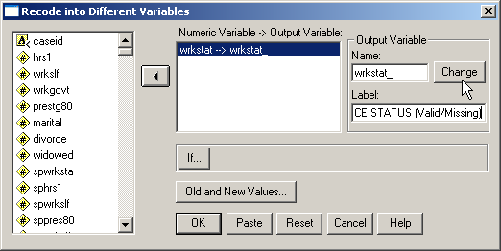
Enter specifications for new variable
Finally, click on the Change button to add the name of the dichotomous variable to the Numeric Variable -> Output Variable text box.
Next, type the label for the new variable into the Label text box. My convention is to add the phrase (Valid/Missing) to the end of the variable label for the original variable.

Slide 25
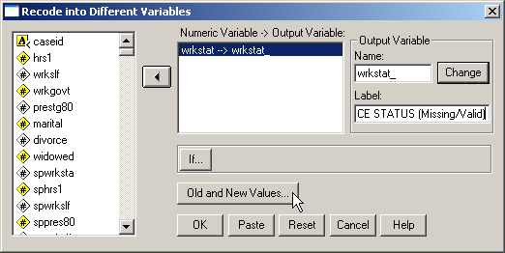
Enter specifications for new variable
To specify the values for the new variable, click on the Old and New Values… button.

Slide 26
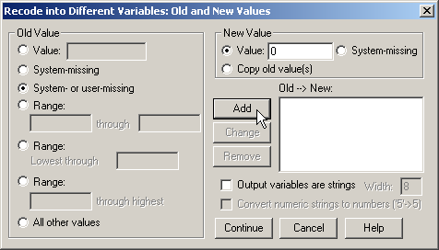
Change the value for missing data
The dichotomous variable should be coded 1 if the variable has a valid value, 0 if the variable has a missing value.
First, mark the System- or user-missing option button.
Second, type 0 in the Value text box.
Third, click on the Add button to include this change in the list of Old->New list box.

Slide 27
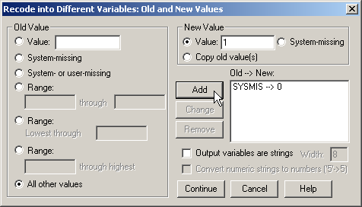
Change the value for valid data
Second, type 1 in the Value text box.
First, mark the All other values option button.
Third, click on the Add button to include this change in the list of Old->New list box.

Slide 28
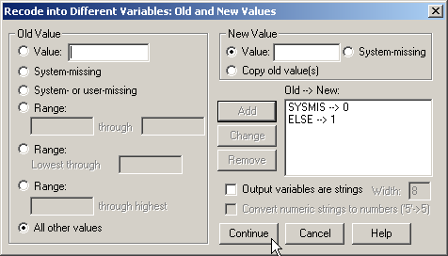
Complete the value specifications
Having entered the values for recoding the variable into dichotomous values, we click on the Continue button to complete this dialog box.

Slide 29
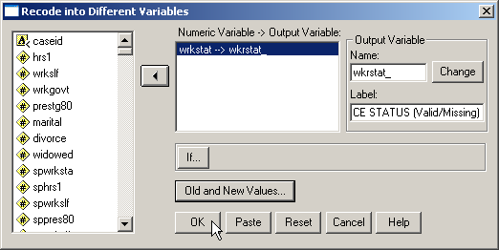
Complete the recode specifications
Having entered specifications for the new variable and the values for recoding the variable into dichotomous values, we click on the OK button to produce the new variable.

Slide 30
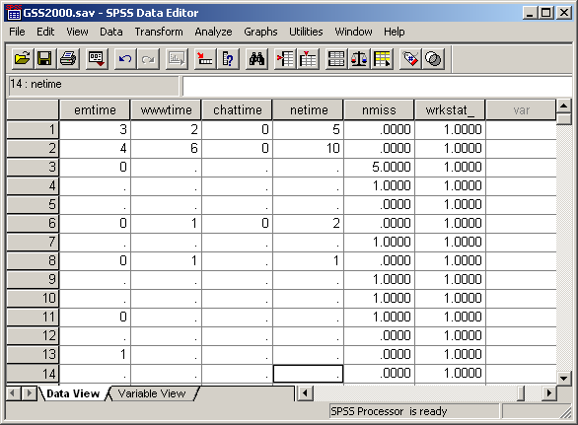
The dichotomous variable
The procedure for creating a dichotomous valid/missing variable is repeated for the four other variables in the analysis: hrs1, wrkslf, wrkgovt, and prestg80.

Slide 31
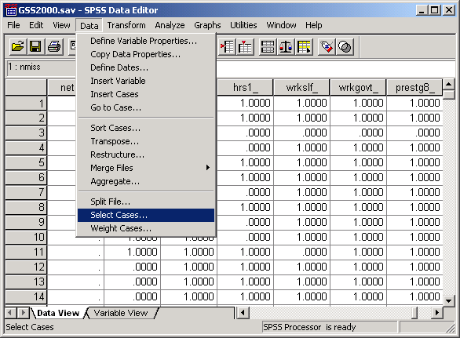
Filtering cases with excessive missing variables
The problem calls for us to exclude cases that have missing data for more than half of the variables.
We do this by selecting in, or filtering, cases that have fewer than half missing variables, i.e. less than 3 missing variables.
To filter cases included in further analysis, we choose the Select Cases… command from the Data menu.

Slide 32
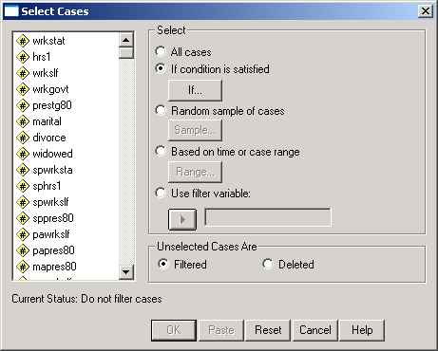
Enter specifications for selecting cases
First, click on the If condition is satisfied option button on the Select panel.
Second, click on the If… button to enter the criteria for including cases.

Slide 33
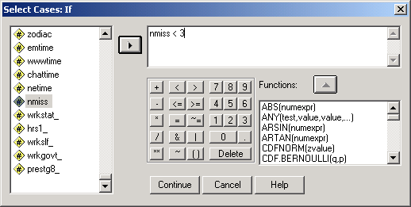
Enter specifications for selecting cases
First, enter the criteria for including cases:
nmiss < 3
Second, click on the Continue button to complete the If specification.

Slide 34
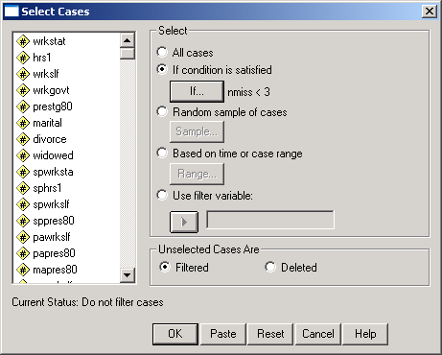
Complete the specifications for selecting cases
To complete the specifications, click on the OK button.

Slide 35
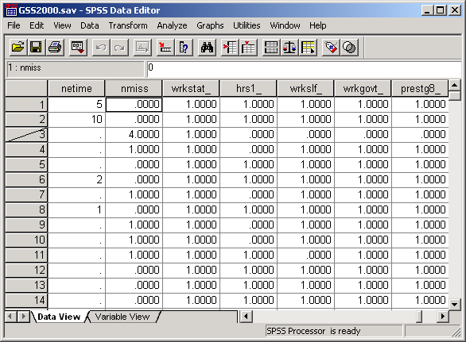
Cases excluded from further analyses
SPSS marks the cases that will not be included in further analyses by drawing a slash mark through the case number.
We can verify that the selection is working correctly by noting that the case which is omitted had 4 missing variables.

Slide 36
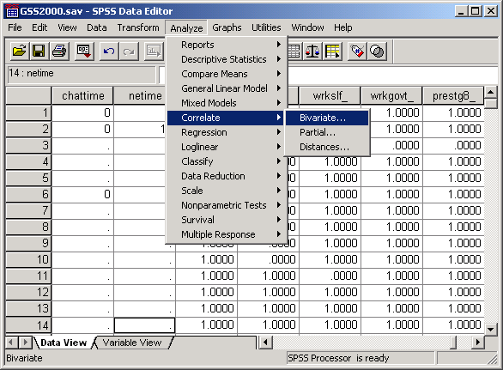
Correlating the dichotomous variables
To compute a correlation matrix for the dichotomous variables, select the Correlate command from the Analyze menu.

Slide 37
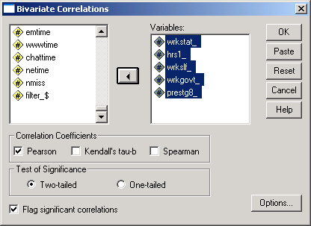
Specifications for correlations
First, move the dichotomous variables to the variables list box.
Second, click on the OK button to complete the request.

Slide 38
The correlation matrix
The correlation matrix is symmetric along the diagonal (shown by the blue line). The correlation for any pair of variables is included twice in the table. So we only count the correlations below the diagonal (the cells with the yellow background).

Slide 39
The correlation matrix
The correlations marked with footnote a could not be computed because one of the variables was a constant, i.e. the dichotomous variable has the same value for all cases.
This happens when one of the valid/missing variables has no missing cases, so that all of the cases have a value of 1 and none have a value of 0.

Slide 40
The correlation matrix
In the cells for which the correlation could be computed, the probabilities indicating significance are 0.437, 0.501, and 0.877.
None of the correlations are statistically significant. The answer to the question is false. We do not need to be concerned about a missing data problem for this set of variables.

Slide 41
Using scripts
The process of evaluating missing data requires numerous SPSS procedures and outputs that are time consuming to produce.
These procedures can be automated by creating an SPSS script. A script is a program that executes a sequence of SPSS commands.
Thought writing scripts is not part of this course, we can take advantage of scripts that I use to reduce the burdensome tasks of evaluating missing data.

Slide 42
Using a script for missing data
The script “MissingDataCheck.sbs” will produce all of the output we have used for evaluating missing data, as well as other outputs described in the textbook.
Navigate to the link “SPSS Scripts and Syntax” on the course web page.
Download the script file “MissingDataCheck.exe” to your computer and install it, following the directions on the web page.

Slide 43
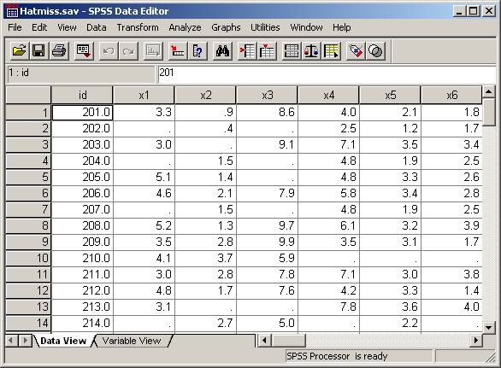
Open the data set in SPSS
Before using a script, a data set should be open in the SPSS data editor.

Slide 44
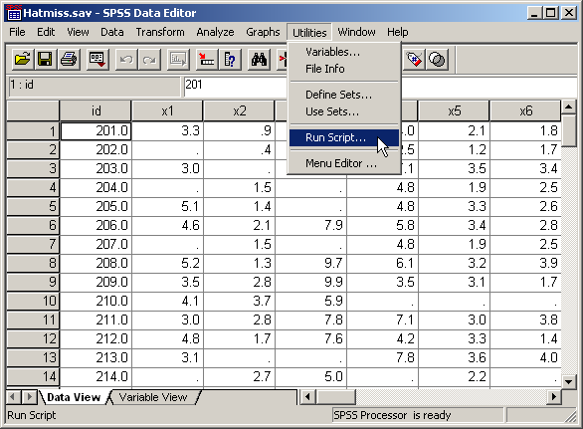
Invoke the script
To invoke the script, select the Run Script… command in the Utilities menu.

Slide 45
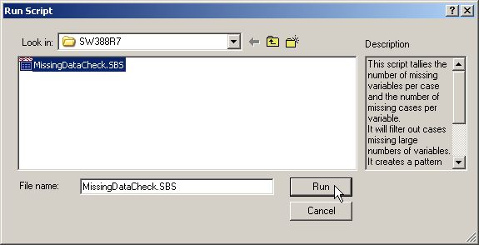
Select the missing data script
First, navigate to the folder where you put the script. If you followed the directions, you will have a file with an ".SBS" extension in the C:\SW388R7 folder.
If you only see a file with an “.EXE” extension in the folder, you should double click on that file to extract the script file to the C:\SW388R7 folder.
Second, click on the script name to highlight it.
Third, click on Run button to start the script.

Slide 46
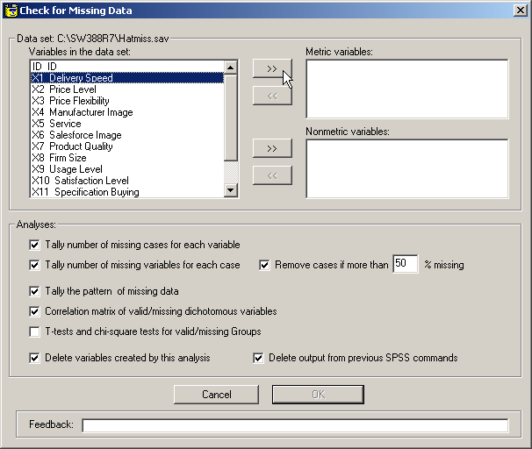
The script dialog
The script dialog box acts similarly to SPSS dialog boxes. You select the variables to include in the analysis and choose options for the output.

Slide 47
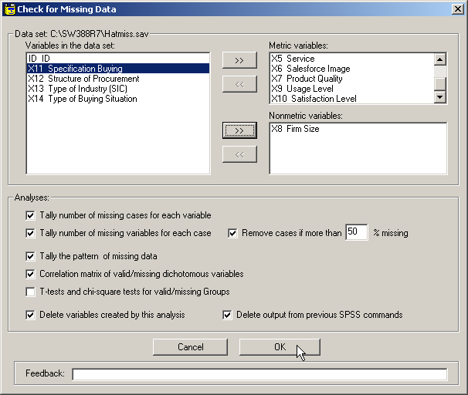
Complete the specifications
The checkboxes are marked to produce the output we need for our problems. The only additional option is to compute the t-tests and chi-square tests for all of the variables.
Select the variables for the analysis. This analysis uses the variables for the example on page 56 in the textbook.
Click on the OK button to produce the output.

Slide 48
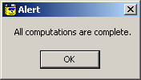
The script finishes
If you SPSS output viewer is open, you will see the output produced in that window.
Since it may take a while to produce the output, and since there are times when it appears that nothing is happening, there is an alert to tell you when the script is finished.
Unless you are absolutely sure something has gone wrong, let the script run until you see this alert.
When you see this alert, click on the OK button.

Slide 49
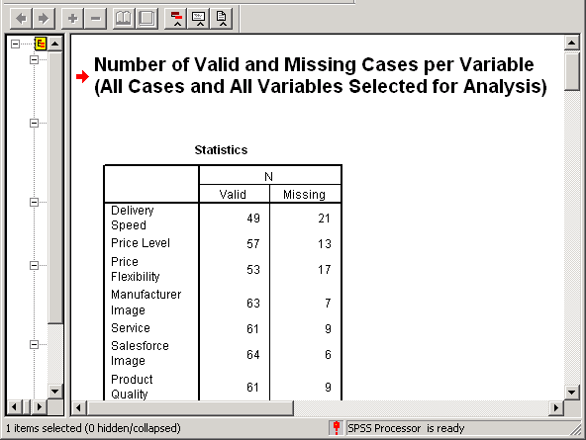
Output from the script
The script will produce lots of output. Additional descriptive material in the titles should help link specific outputs to specific tasks.

