Slide 1
Assumption of normality
Assumption of normality
Transformations
Assumption of normality script
Practice problems

Slide 2
Assumption of Normality
Many of the statistical methods that we will apply require the assumption that a variable or variables are normally distributed.
With multivariate statistics, the assumption is that the combination of variables follows a multivariate normal distribution.
Since there is not a direct test for multivariate normality, we generally test each variable individually and assume that they are multivariate normal if they are individually normal, though this is not necessarily the case.

Slide 3
Evaluating normality
There are both graphical and statistical methods for evaluating normality.
Graphical methods include the histogram and normality plot.
Statistical methods include diagnostic hypothesis tests for normality, and a rule of thumb that says a variable is reasonably close to normal if its skewness and kurtosis have values between –1.0 and +1.0.
None of the methods is absolutely definitive.

Slide 4
Transformations
When a variable is not normally distributed, we can create a transformed variable and test it for normality. If the transformed variable is normally distributed, we can substitute it in our analysis.
Three common transformations are: the logarithmic transformation, the square root transformation, and the inverse transformation.
All of these change the measuring scale on the horizontal axis of a histogram to produce a transformed variable that is mathematically equivalent to the original variable.

Slide 5
When transformations do not work
When none of the transformations induces normality in a variable, including that variable in the analysis will reduce our effectiveness at identifying statistical relationships, i.e. we lose power.
We do have the option of changing the way the information in the variable is represented, e.g. substitute several dichotomous variables for a single metric variable.

Slide 6
Problem 1
In the dataset GSS2000.sav, is the following statement true, false, or an incorrect application of a statistic? Use 0.01 as the level of significance.
Based on a diagnostic hypothesis test of normality, total hours spent on the Internet is normally distributed.
1. True
2. True with caution
3. False
4. Incorrect application of a statistic

Slide 7
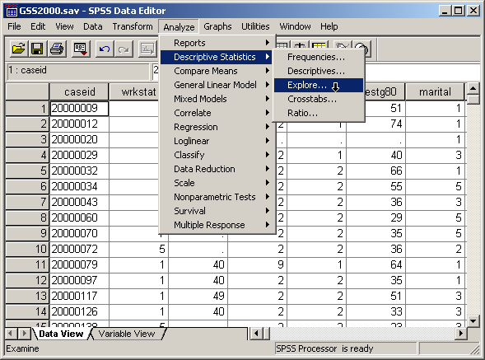
Computing “Explore” descriptive statistics
To compute the statistics needed for evaluating the normality of a variable, select the Explore… command from the Descriptive Statistics menu.

Slide 8
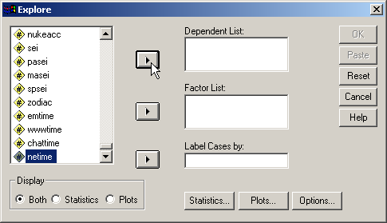
Adding the variable to be evaluated
Second, click on right arrow button to move the highlighted variable to the Dependent List.
First, click on the variable to be included in the analysis to highlight it.

Slide 9
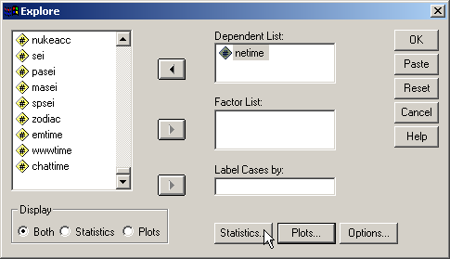
Selecting statistics to be computed
To select the statistics for the output, click on the Statistics… command button.

Slide 10
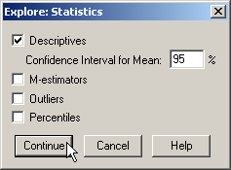
Including descriptive statistics
First, click on the Descriptives checkbox to select it. Clear the other checkboxes.
Second, click on the Continue button to complete the request for statistics.

Slide 11
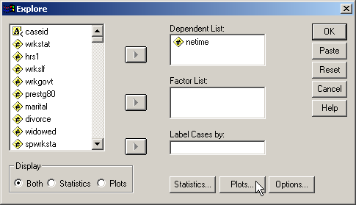
Selecting charts for the output
To select the diagnostic charts for the output, click on the Plots… command button.

Slide 12
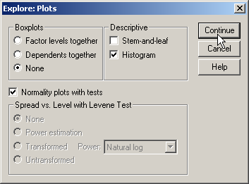
Including diagnostic plots and statistics
First, click on the None option button on the Boxplots panel since boxplots are not as helpful as other charts in assessing normality.
Finally, click on the Continue button to complete the request.
Second, click on the Normality plots with tests checkbox to include normality plots and the hypothesis tests for normality.
Third, click on the Histogram checkbox to include a histogram in the output. You may want to examine the stem-and-leaf plot as well, though I find it less useful.

Slide 13

Completing the specifications for the analysis
Click on the OK button to complete the specifications for the analysis and request SPSS to produce the output.

Slide 14
The histogram
An initial impression of the normality of the distribution can be gained by examining the histogram.
In this example, the histogram shows a substantial violation of normality caused by a extremely large value in the distribution.

Slide 15
The normality plot
The problem with the normality of this variable’s distribution is reinforced by the normality plot.
If the variable were normally distributed, the red dots would fit the green line very closely. In this case, the red points in the upper right of the chart indicate the severe skewing caused by the extremely large data values.

Slide 16
The test of normality
Problem 1 asks about the results of the test of normality. Since the sample size is larger than 50, we use the Kolmogorov-Smirnov test. If the sample size were 50 or less, we would use the Shapiro-Wilk statistic instead.
The null hypothesis for the test of normality states that the actual distribution of the variable is equal to the expected distribution, i.e., the variable is normally distributed. Since the probability associated with the test of normality is < 0.001 is less than or equal to the level of significance (0.01), we reject the null hypothesis and conclude that total hours spent on the Internet is not normally distributed. (Note: we report the probability as <0.001 instead of .000 to be clear that the probability is not really zero.)
The answer to problem 1 is false.

Slide 17
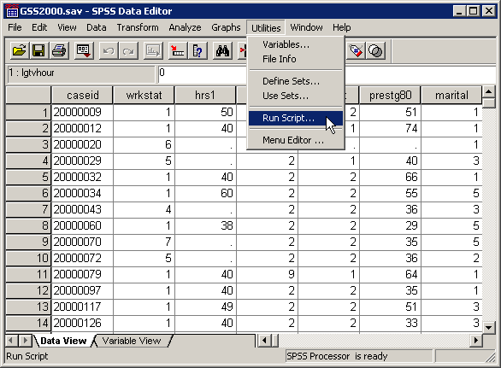
The assumption of normality script
An SPSS script to produce all of the output that we have produced manually is available on the course web site.
After downloading the script, run it to test the assumption of linearity.
Select Run Script… from the Utilities menu.

Slide 18
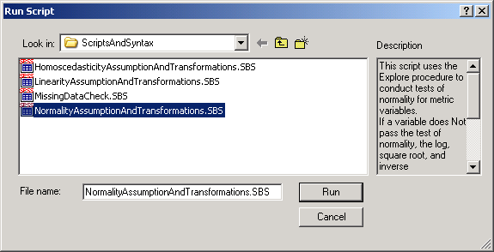
Selecting the assumption of normality script
First, navigate to the folder containing your scripts and highlight the NormalityAssumptionAndTransformations.SBS script.
Second, click on the Run button to activate the script.

Slide 19
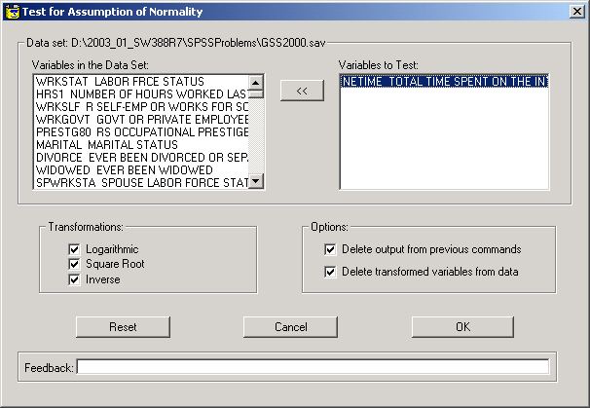
Specifications for normality script
First, move variables from the list of variables in the data set to the Variables to Test list box.
The default output is to do all of the transformations of the variable. To exclude some transformations from the calculations, clear the checkboxes.
Third, click on the OK button to run the script.

Slide 20
The test of normality
The script produces the same output that we computed manually, in this example, the tests of normality.

Slide 21
Problem 2
In the dataset GSS2000.sav, is the following statement true, false, or an incorrect application of a statistic?
Based on the rule of thumb for the allowable magnitude of skewness and kurtosis, total hours spent on the Internet is normally distributed.
1. True
2. True with caution
3. False
4. Incorrect application of a statistic

Slide 22
Table of descriptive statistics
To answer problem 2, we look at the values for skewness and kurtosis in the Descriptives table.
The skewness and kurtosis for the variable both exceed the rule of thumb criteria of 1.0. The variable is not normally distributed.
The answer to problem 2 if false.

Slide 23
Problem 3
In the dataset GSS2000.sav, is the following statement true, false, or an incorrect application of a statistic? Use 0.01 as the level of significance.
Based on a diagnostic hypothesis test of normality, "total hours spent on the Internet" is not normally distributed. A logarithmic transformation of "total hours spent on the Internet" results in a variable that is normally distributed.
1. True
2. True with caution
3. False
4. Incorrect application of a statistic

Slide 24
The test of normality
Problem 3 specifically asks about the results of the test of normality for the logarithmic transformation. Since our sample size is larger than 50, we use the Kolmogorov-Smirnov test.
The null hypothesis for the Kolmogorov-Smirnov test of normality states that the actual distribution of the transformed variable is equal to the expected distribution, i.e., the transformed variable is normally distributed. Since the probability associated with the test of normality (0.200) is greater than the level of significance, we fail to reject the null hypothesis and conclude that the logarithmic transformation of total hours spent on the Internet is normally distributed.
The answer to problem 3 is true.

Slide 25
Other problems on assumption of normality
A problem may ask about the assumption of normality for a nominal level variable. The answer will be “An inappropriate application of a statistic” since there is no expectation that a nominal variable be normal.
A problem may ask about the assumption of normality for an ordinal level variable. If the variable or transformed variable is normal, the correct answer to the question is “True with caution” since we may be required to defend treating an ordinal variable as metric.
Questions will specify a level of significance to use and the statistical evidence upon which you should base your answer.

Slide 26
Steps in answering questions about the assumption of normality – question 1
The following is a guide to the decision process for answering
problems about the normality of a variable:
Is the variable to be evaluated metric?
No
Incorrect application of a statistic
Yes
Does the statistical evidence support normality assumption?
No
False
Yes
Are any of the metric variables ordinal level?
No
True
Yes
True with caution

Slide 27
Steps in answering questions about the assumption of normality – question 2
The following is a guide to the decision process for answering
problems about the normality of a transformation:
Is the variable to be evaluated metric?
No
Incorrect application of a statistic
Yes
Statistical evidence supports normality?
Statistical evidence
for transformation supports normality?
No
No
False
Yes
Either variable ordinal level?
No
True
Yes
True with caution

