Slide 1
Detecting Outliers
Detecting univariate outliers
Detecting multivariate outliers

Slide 2
Outliers
Outliers are cases that have data values that are very different from the data values for the majority of cases in the data set.
Outliers are important because they can change the results of our data analysis.
Whether we include or exclude outliers from a data analysis depends on the reason why the case is an outlier and the purpose of the analysis.

Slide 3
Univariate and Multivariate Outliers
Univariate outliers are cases that have an unusual value for a single variable. In our analyses, we will be concerned with univariate outliers for the dependent variable in our data analysis.
Multivariate outliers are cases that have an unusual combination of values for a number of variables. The value for any of the indvidual variables may not be a univariate outlier, but, in combination with other variables, is a case that occurs very rarely. In our analyses, we will be concerned with multivariate outliers for the set of independent variables in our data analysis.

Slide 4
Standard Scores Detect Univariate Outliers
One way to identify univariate outliers is to convert all of the scores for a variable to standard scores.
If the sample size is small (80 or fewer cases), a case is an outlier if its standard score is ±2.5 or beyond.
If the sample size is larger than 80 cases, a case is an outlier if its standard score is ±3.0 or beyond
This method applies to interval level variables, and to ordinal level variables that are treated as metric. It does not apply to nominal level variables.

Slide 5
Mahalanobis D² and Multivariate Outliers
Mahalanobis D² is a multidimensional version of a z-score. It measures the distance of a case from the centroid (multidimensional mean) of a distribution, given the covariance (multidimensional variance) of the distribution.
A case is a multivariate outlier if the probability associated with its D² is 0.001 or less. D² follows a chi-square distribution with degrees of freedom equal to the number of variables included in the calculation.
Mahalanobis D² requires that the variables be metric, i.e. interval level or ordinal level variables that are treated as metric.

Slide 6
Problem 1
In the dataset GSS2000.sav, is the following statement true, false, or an incorrect application of a statistic?
In the dataset, there are 2 cases that should be evaluated as univariate outliers for highest year of school completed.
1. True
2. True with caution
3. False
4. Incorrect application of a statistic

Slide 7
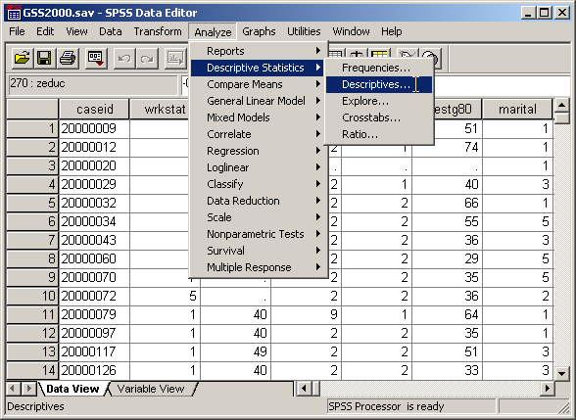
Descriptive statistics compute standard scores
To compute standard scores in SPSS, select the Descriptive Statistics | Descriptives… command from the Analyze menu.

Slide 8
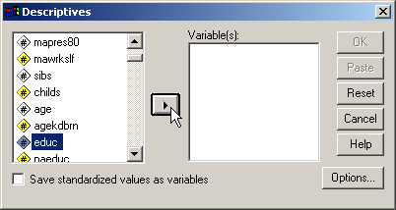
Select the variable(s) for the analysis
First, click on the variable to be included in the analysis to highlight it.
Second, click on right arrow button to move the highlighted variable to the list of variables.

Slide 9
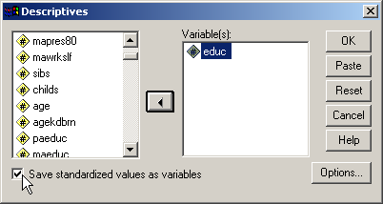
Mark the option for computing standard scores
Second, click on the OK button to complete the analysis request.
First, click on the checkbox to save standard score values as a new variable in the dataset.
The new variable will have the letter z prepended to its name, e.g. the standard score variable for “educ” will be “zeduc”.

Slide 10
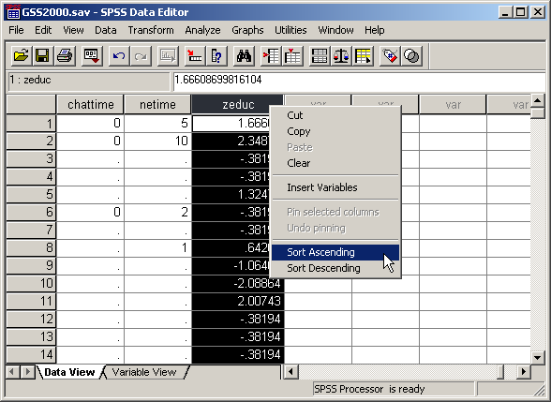
The z-score variable in the data editor
The variable containing the standard scores will be added to the list of variables in the data editor.
To identify outliers below –3.0, we sort the database in ascending order.
Right click on the variable header zeduc and select the Sort Ascending command from the popup menu.

Slide 11
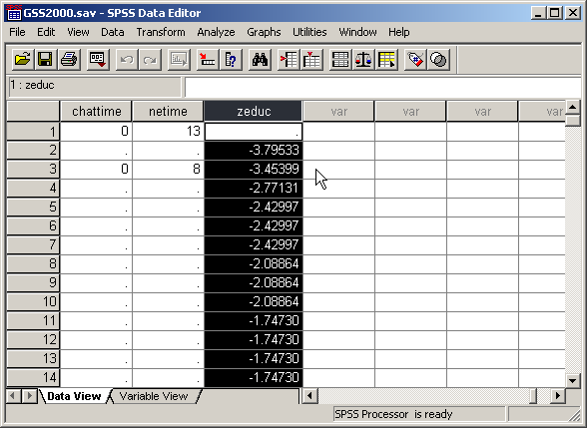
Outliers with unusually low scores
Cases that are outliers because they have unusually low scores for the variable will appear at the top of the sorted list.
Since there are 269 cases with valid data for the variable, the criterion for identifying an outlier is ±3.0.
In this example, we have two outliers with z-scores less than –3.0.

Slide 12
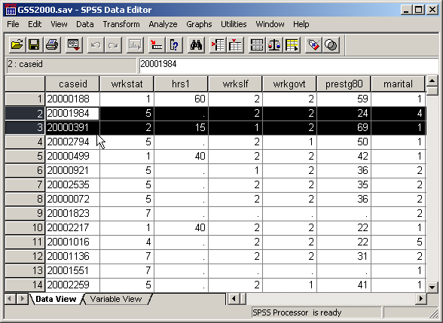
Additional information about the outliers
To see additional information about the outliers, we highlight the rows containing the outliers and scroll horizontally to other variables in which we are interested, for example, the id numbers for the cases.

Slide 13
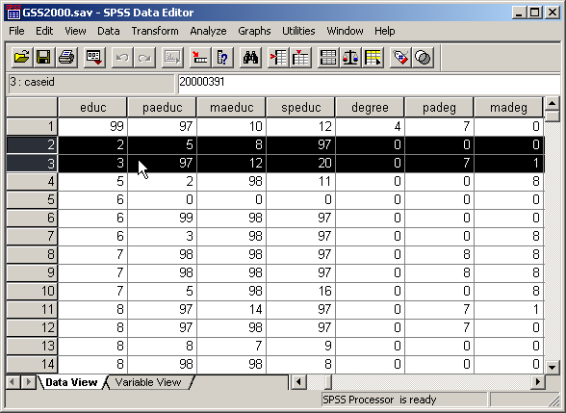
The raw data scores for the outliers
Before deciding whether we retain or omit outliers from the analysis, we should examine the raw scores that made these cases outliers.
In this example, one of our subjects had completed only 2 years of school and another had completed only 3 years.

Slide 14
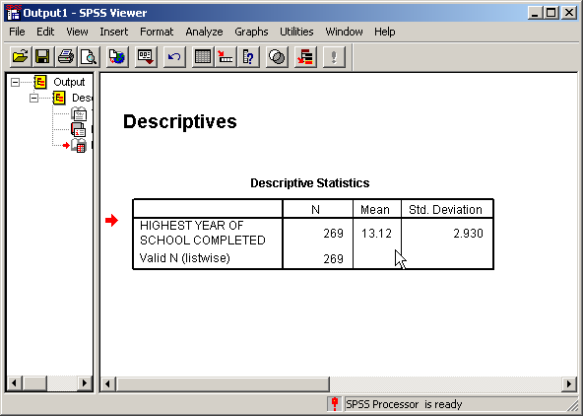
Comparing the raw scores to the mean
The Descriptives output helps us in evaluating the raw data scores for the outliers.
When we compare the raw data values of 2 and 3 to the mean (13.12) and standard deviation (2.930) of the distribution for the variable, we see why these cases are outliers for this distribution. Completing 2 and 3 years of school is unusual in a distribution that had a mean of 13 years.

Slide 15
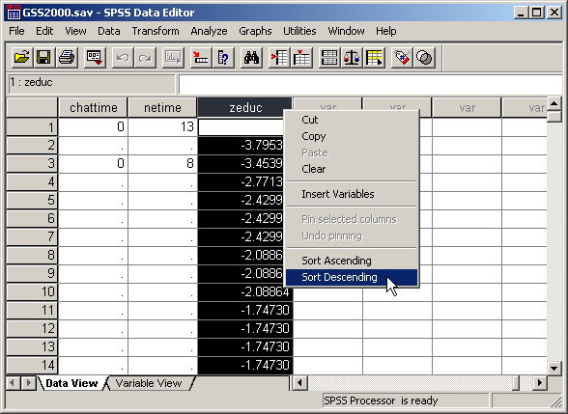
Outliers with unusually high scores
To identify outliers above +3.0, we sort the database in descending order.
Right click on the variable header zeduc and select the Sort Descending command from the popup menu.

Slide 16

Descriptive statistics compute standard scores
Cases that are outliers because they have unusually high scores for the variable will now appear at the top of the sorted list. In this example, there are no outliers with extremely large values.
The answer to this problem is True.
Univariate outliers are detected by computing standard scores for the variable. Computing standardard scores requires that the variable be metric.Highest year of school completed (educ) is an interval level or metric variable, satisfying the requirement for computing standard scores.
Since there are 269 cases with valid data for the variable, the criterion for identifying an outlier is ±3.0. In this dataset, 2 cases have a z-score value outside this range (20000391: -3.45; 20001984: -3.80).

Slide 17
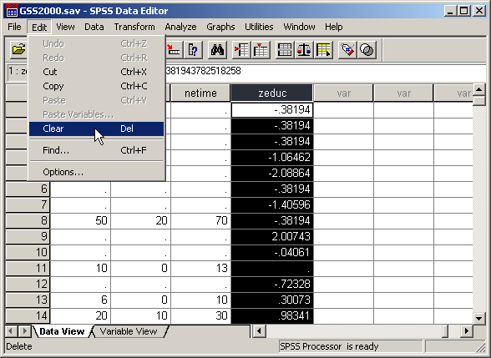
Deleting the z-score variable
Once we are finished with the outlier analysis, we should delete the variables that were added to the data set.
First, click on the zeduc column header to select the entire column.
Second, select the Clear command from the Edit menu to delete the column from the dataset.

Slide 18
Other problems on univariate outliers
A problem may ask about outliers for a nominal level variable. The answer will be “An inappropriate application of a statistic” since z-scores cannot be computed for nominal level variables.
A problem may ask about outliers for an ordinal level variable. If the number of outliers in the problem statement is accurate, the correct answer to the question is “True with caution” since we may be required to defend treating an ordinal variable as metric.
A problem may contain an inaccurate number of outliers for the variable. The answer will be “False.”

Slide 19
Problem 2
In the dataset GSS2000.sav, is the following statement true, false, or an incorrect application of a statistic? Use 0.001 as the level of significance.
In the dataset, there is 1 case that should be evaluated as a multivariate outlier for the combination of: number of hours worked in the past week, occupational prestige score, and highest year of school completed.
1. True
2. True with caution
3. False
4. Incorrect application of a statistic

Slide 20
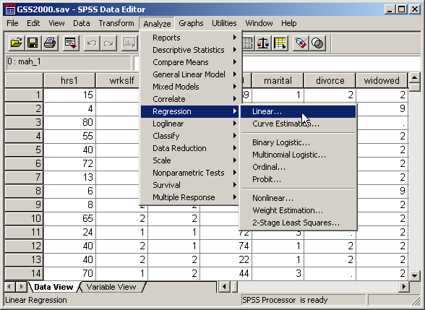
Mahalanobis D² is computed by Regression
To compute Mahalanobis D² in SPSS, select the Regression | Linear… command from the Analyze menu.

Slide 21
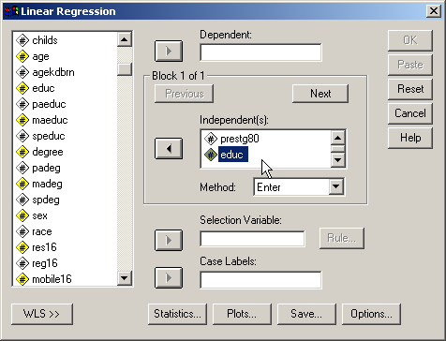
Adding the independent variables
The SPSS Linear Regression procedure computes Mahalanobis D² for the set of independent variables entered into the dialog box.
Move the variables: hrs1, prestg80, and educ to the list of independent variables.

Slide 22
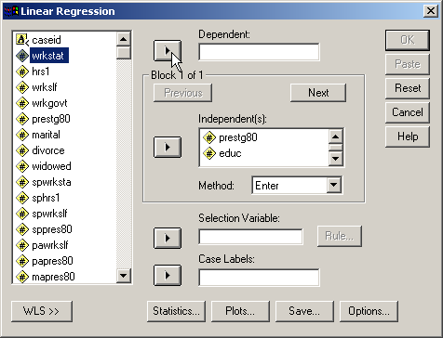
Adding an arbitrary dependent variable
SPSS will not compute the Regression unless we specify a dependent variable, even though the dependent variable is not used in the analysis of multivariate outliers.
First, arbitrarily select a variable to use as the dependent variable. The variable should a numeric variable that does not have any missing cases.
For example, click on the first numeric variable in the list of variables: wrkstat.
Second, click on the right arrow button to move wrkstat to the text box for the dependent variable.

Slide 23
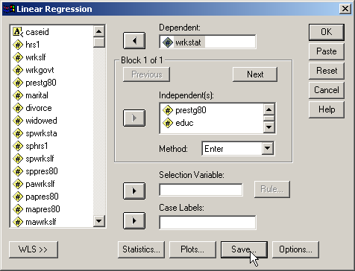
Adding Mahalanobis D² to the dataset
To request that SPSS add the value of Mahalanobis D² to the data set, click on the Save button to open the save dialog box.

Slide 24
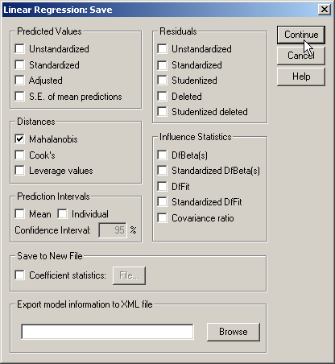
Specify saving Mahalanobis D² distance
First, mark the checkbox for Mahalanobis in the Distances panel. All other checkboxes can be unchecked.
Second, complete the request for Mahalanobis distance by clicking on the Continue button.

Slide 25
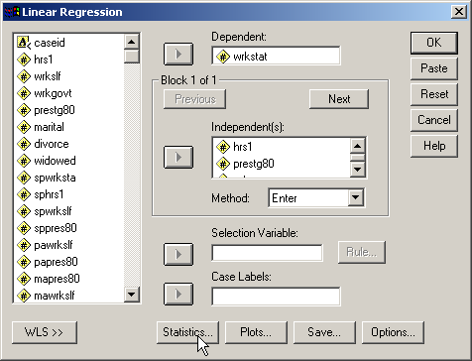
Specify the statistics output needed
To understand why a particular case is an outlier, we want to examine the descriptive statistics for each variable.
Click on the Statistics… button to request the statistics.

Slide 26
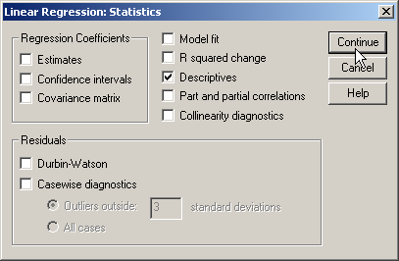
Request descriptive statistics
First, mark the checkbox for Descriptives. All other checkboxes can be unchecked.
Second, complete the request for descriptive statistics by clicking on the Continue button.

Slide 27

Complete the request for Mahalanobis D²
To complete the request for the regression analysis that will compute Mahalanobis D², click on the OK button.

Slide 28
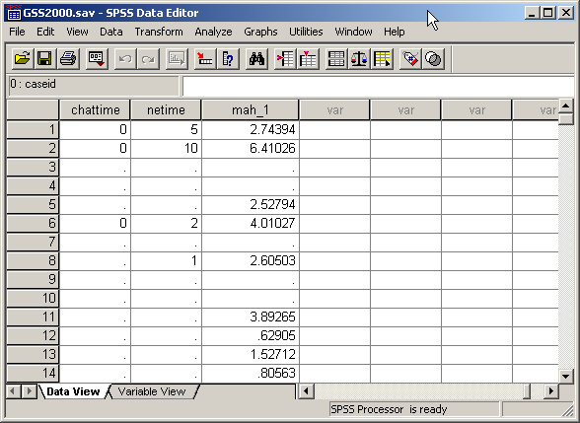
Mahalanobis D² scores in the data editor
If we look in the column farthest to the right in the data editor, we see that SPSS has calculated the Mahalanobis D² scores for us in a variable it has named "mah_1."
The evaluation for outliers, however, requires the probability for the Mahalanobis D² and not the scores themselves.

Slide 29
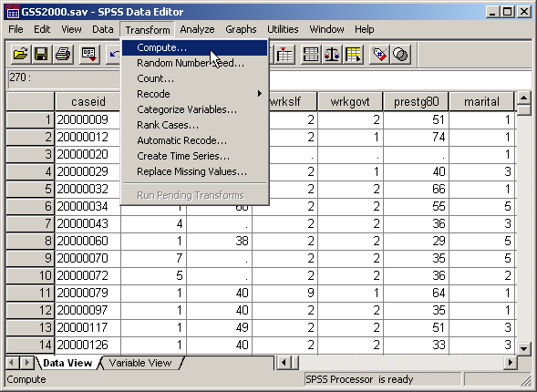
Computing the probability of D²
To compute the probability of D², we will use an SPSS function in a Compute command.
First, select the Compute… command from the Transform menu.

Slide 30
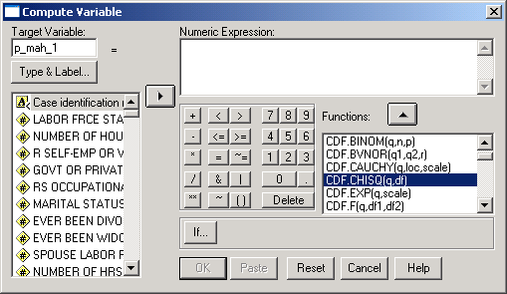
Specifying the variable name and function
First, in the target variable text box, type the name "p_mah_1" as an acronym for the probability of the mah_1, the Mahalanobis D² score.
Third, click on the up arrow button to move the highlighted function to the Numeric Expression text box.
Second, scroll down the list of functions to find CDF.CHISQ, which calculates the probability of a variable which follows as chi-square distribution, like Mahalanobis D².

Slide 31
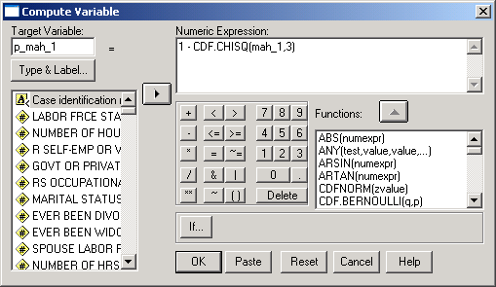
Completing the specifications for the function
First, to complete the specifications for the CDF.CHISQ function, type the name of the variable containing the D² scores, mah_1, followed by a comma, followed by the number of variables used in the calculations, 3.
Since the CDF function (cumulative density function) computes the cumulative probability from the left end of the distribution up through a given value, we subtract it from 1 to obtain the probability in the upper tail of the distribution.
Second, click on the OK command to signal completion of the computer variable dialog.

Slide 32
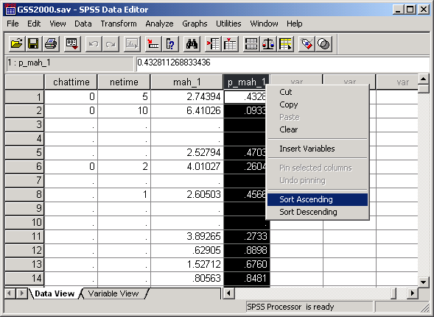
Probabilities for D² in the data editor
SPSS used the compute command to calculate the probabilities for the D²
scores and list them in the data editor.
To find the smallest probability value, we will sort the data set in ascending order.
To sort the data set, right click on the column header p_mah_1, and select Sort Ascending from the popup menu.

Slide 33
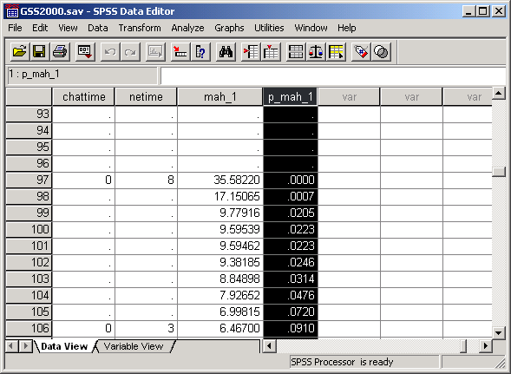
Identifying outliers
Scroll down the data editor past the probabilities with missing values, which are the result of the compute command when one or more variables has missing data.
There are two values less than 0.001, displayed as .0000 and .0007.
Two cases had an unusual combination of values on the three variables resulting in their designation as outliers.

Slide 34
Answering the original question
The original question asked if the number of outliers for the combination of three variables is 1.
The answer to this question is false because there are two outliers.
In this dataset, 2 cases have a Mahalanobis D² with a probability less than or equal to 0.001 (20000391: D²=35.58, p<0.0001; 20001785: D²=17.15, p=0.0007).

Slide 35
Evaluating Mulitivariate Outliers
Before we can decide whether we should omit or retain an outlier in our data analysis, we need to understand why it is an outlier.
To accomplish this, we will move the columns for the variables adjacent to each other in the data editor so that we can compare the values for each case.
We will compare the values for each case to the mean and standard deviation for each variable, computed in the descriptive statistics section of the regression output.

Slide 36
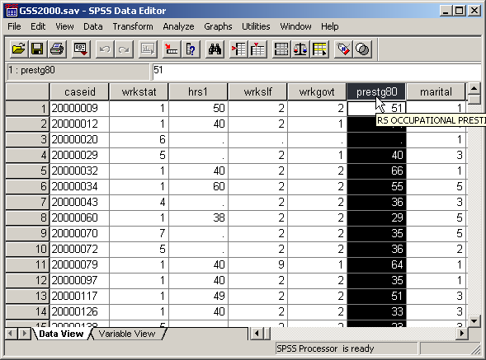
Moving columns in the data editor – step 1
We will move the column for the variable prestg80 next to the column for hrs1.
First, click on the column header prestg80 for the variable we want to move, so that the column is selected.

Slide 37
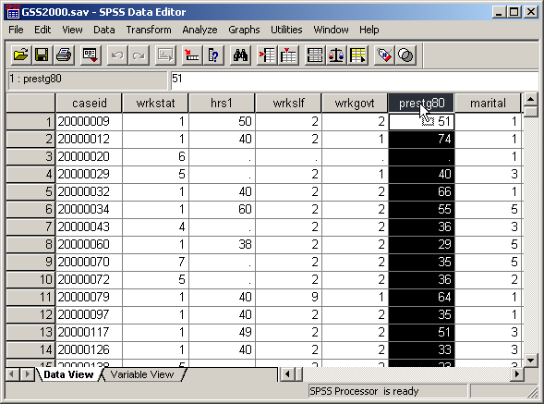
Moving columns in the data editor – step 2
Next, click and hold the left mouse button down on the column header of the variable we want to move.
A box outline will appear at the bottom of the arrow cursor, indicating that SPSS is prepared to move the column.

Slide 38
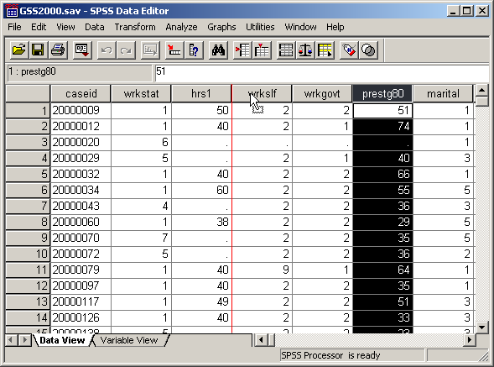
Moving columns in the data editor – step 3
Next, while holding the mouse button down, move the arrow cursor over columns to the left or right.
A vertical red line will appear between the columns to indicate where the column will be relocated.
When the red line is located where we want to position the column we are moving, release the mouse button. The column will now be relocated.

Slide 39
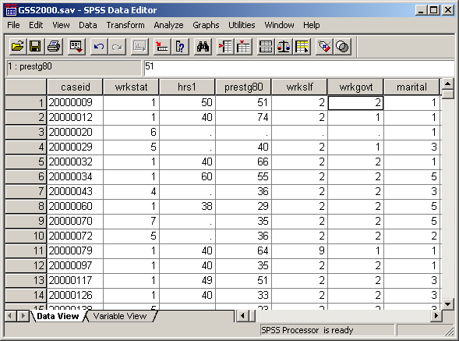
Moving columns in the data editor – step 4
The columns for the variables are now adjacent to one another, making it easier to compare values.
Hint: when we move a column, the command “Undo Move Variables” will appear at the top of the Edit menu. I find this command the easiest way to return the columns to their original locations in the data editor. Leaving columns in different locations can make it harder to find a variable we are looking for.

Slide 40
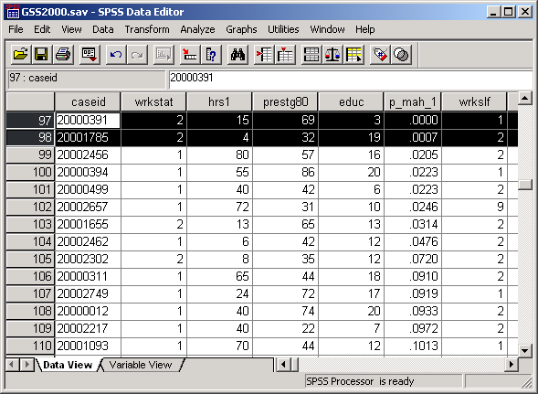
Highlighting the outliers for analysis
When I finished relocating the three variables, I moved the p_mah_1 column also, so I could easily identify which cases were outliers. Then I highlighted the outlier rows and scrolled them to the top row in the data editor.
I can now compare the values for these two cases to the mean and standard deviation of the distribution for the three variables.

Slide 41
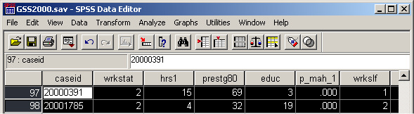
Evaluating the outlier cases
The number of hours worked for both cases is well below the average for the sample. The first case has an above average occupational prestige score combined with below average years of education. The second case has a below average occupational prestige score combined with above average education.

Slide 42
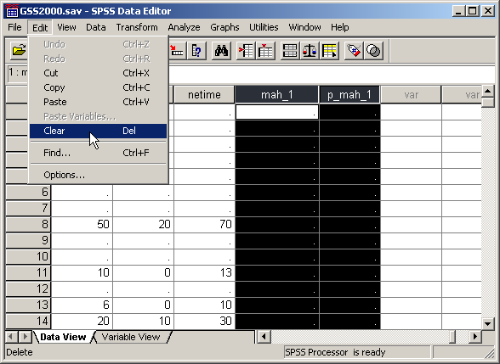
Deleting variables added to dataset
Once we are finished with the outlier analysis, we should delete the variables that were added to the data set.
First, select the mah_1 and p_mah_1 columns.
Second, select the Clear command from the Edit menu to delete the column from the dataset.

Slide 43
Other problems on multivariate outliers
A problem may ask about outliers for variables that include a nominal level variable. The answer will be “An inappropriate application of a statistic” since Mahalanobis D² cannot be computed unless all variables are metric.
A problem may ask about outliers for variables that include an ordinal level variable. If the number of outliers in the problem statement is accurate, the correct answer to the question is “True with caution” since we may be required to defend treating an ordinal variable as metric.
A problem may contain an inaccurate number of outliers for the variable. The answer will be “False.”

Slide 44
Steps in evaluating outliers
The following is a guide to the decision process for answering
problems about outliers:
Are all of the variables to be evaluated metric?
No
Incorrect application of a statistic
Yes
Is the number of outliers stated in the problem the correct number?
No
False
Yes
Are any of the metric variables ordinal level?
No
True
Yes
True with caution

