Slide 1
Discriminant Analysis – Basic Relationships
Discriminant Functions and Scores
Describing Relationships
Classification Accuracy
Sample Problems

Slide 2
Discriminant analysis
Discriminant analysis is used to analyze relationships between a non-metric dependent variable and metric or dichotomous independent variables.
Discriminant analysis attempts to use the independent variables to distinguish among the groups or categories of the dependent variable.
The usefulness of a discriminant model is based upon its accuracy rate, or ability to predict the known group memberships in the categories of the dependent variable.

Slide 3
Discriminant scores
Discriminant analysis works by creating a new variable called the discriminant function score which is used to predict to which group a case belongs.
Discriminant function scores are computed similarly to factor scores, i.e. using eigenvalues. The computations find the coefficients for the independent variables that maximize the measure of distance between the groups defined by the dependent variable.
The discriminant function is similar to a regression equation in which the independent variables are multiplied by coefficients and summed to produce a score.

Slide 4
Discriminant functions
Conceptually, we can think of the discriminant function or equation as defining the boundary between groups.
Discriminant scores are standardized, so that if the score falls on one side of the boundary (standard score less than zero, the case is predicted to be a member of one group) and if the score falls on the other side of the boundary (positive standard score), it is predicted to be a member of the other group.

Slide 5
Number of functions
If the dependent variable defines two groups, one statistically significant discriminant function is required to distinguish the groups; if the dependent variable defines three groups, two statistically significant discriminant functions are required to distinguish among the three groups; etc.
If a discriminant function is able to distinguish among groups, it must have a strong relationship to at least one of the independent variables.
The number of possible discriminant functions in an analysis is limited to the smaller of the number of independent variables or one less than the number of groups defined by the dependent variable.

Slide 6
Overall test of relationship
The overall test of relationship among the independent variables and groups defined by the dependent variable is a series of tests that each of the functions needed to distinguish among the groups is statistically significant.
In some analyses, we might discover that two or more of the groups defined by the dependent variable cannot be distinguished using the available independent variables. While it is reasonable to interpret a solution in which there are fewer significant discriminant functions than the maximum number possible, our problems will require that all of the possible discriminant functions be significant.

Slide 7
Interpreting the relationship between independent and dependent variables
The interpretative statement about the relationship between the independent variable and the dependent variable is a statement like: cases in group A tended to have higher scores on variable X than cases in group B or group C.
This interpretation is complicated by the fact that the relationship is not direct, but operates through the discriminant function.
Dependent variable groups are distinguished by scores on discriminant functions, not on values of independent variables. The scores on functions are based on the values of the independent variables that are multiplied by the function coefficients.

Slide 8
Groups, functions, and variables
To interpret the relationship between an independent variable and the dependent variable, we must first identify how the discriminant functions separate the groups, and then the role of the independent variable is for each function.
SPSS provides a table called "Functions at Group Centroids" (multivariate means) that indicates which groups are separated by which functions.
SPSS provides another table called the "Structure Matrix" which, like its counterpart in factor analysis, identifies the loading, or correlation, between each independent variable and each function. This tells us which variables to interpret for each function. Each variable is interpreted on the function that it loads most highly on.

Slide 9
Functions at Group Centroids
In order to specify the role that each independent variable plays in predicting group membership on the dependent variable, we must link together the relationship between the discriminant functions and the groups defined by the dependent variable, the role of the significant independent variables in the discriminant functions, and the differences in group means for each of the variables.
Function 2 separates survey respondents who thought we spend too little money on welfare (positive value of 0.235) from survey respondents who thought we spend too much money (negative value of -0.362) on welfare. We ignore the second group (-0.031) in this comparison because it was distinguished from the other two groups by function 1.
Function 1 separates survey respondents who thought we spend about the right amount of money on welfare (the positive value of 0.446) from survey respondents who thought we spend too much (negative value of -0.311) or little money (negative value of -0.220) on welfare.

Slide 10
Structure Matrix
Based on the structure matrix, the predictor variables strongly associated with discriminant function 1 which distinguished between survey respondents who thought we spend about the right amount of money on welfare and survey respondents who thought we spend too much or little money on welfare were number of hours worked in the past week (r=-0.582) and highest year of school completed (r=0.687).
We do not interpret loadings in the structure matrix unless they are 0.30 or higher.
Based on the structure matrix, the predictor variable strongly associated with discriminant function 2 which distinguished between survey respondents who thought we spend too little money on welfare and survey respondents who thought we spend too much money on welfare was self-employment (r=0.889).

Slide 11
Group Statistics
The average number of hours worked in the past week for survey respondents who thought we spend about the right amount of money on welfare (mean=37.90) was lower than the average number of hours worked in the past weeks for survey respondents who thought we spend too much money on welfare (mean=43.96) and survey respondents who thought we spend too little money on welfare (mean=42.03).
This enables us to make the statement: "survey respondents who thought we spend about the right amount of money on welfare worked fewer hours in the past week than survey respondents who thought we spend too much or little money on welfare."

Slide 12
Which independent variables to interpret
In a simultaneous discriminant analysis, in which all independent variables are entered together, we only interpret the relationships for independent variables that have a loading of 0.30 or higher one or more discriminant functions. A variable can have a high loading on more than one function, which complicates the interpretation. We will interpret the variable for the function on which it has the highest loading.
In a stepwise discriminant analysis, we limit the interpretation of relationships between independent variables and groups defined by the dependent variable to those independent variables that met the statistical test for inclusion in the analysis.

Slide 13
Discriminant analysis and classification
Discriminant analysis consists of two stages: in the first stage, the discriminant functions are derived; in the second stage, the discriminant functions are used to classify the cases.
While discriminant analysis does compute correlation measures to estimate the strength of the relationship, these correlations measure the relationship between the independent variables and the discriminant scores.
A more useful measure to assess the utility of a discriminant model is classification accuracy, which compares predicted group membership based on the discriminant model to the actual, known group membership which is the value for the dependent variable.

Slide 14
Evaluating usefulness for discriminant models
The benchmark that we will use to characterize a discriminant model as useful is a 25% improvement over the rate of accuracy achievable by chance alone.
Even if the independent variables had no relationship to the groups defined by the dependent variable, we would still expect to be correct in our predictions of group membership some percentage of the time. This is referred to as by chance accuracy.
The estimate of by chance accuracy that we will use is the proportional by chance accuracy rate, computed by summing the squared percentage of cases in each group.

Slide 15
Comparing accuracy rates
To characterize our model as useful, we compare the cross-validated accuracy rate produced by SPSS to 25% more than the proportional by chance accuracy.
The cross-validated accuracy rate is a one-at-a-time hold out method that classifies each case based on a discriminant solution for all of the other cases in the analysis. It is a more realistic estimate of the accuracy rate we should expect in the population because discriminant analysis inflates accuracy rates when the cases classified are the same cases used to derive the discriminant functions.
Cross-validated accuracy rates are not produced by SPSS when separate covariance matrices are used in the classification, which we address more next week.

Slide 16
Computing by chance accuracy
The percentage of cases in each group defined by the dependent variable are reported in the table "Prior Probabilities for Groups"
The proportional by chance accuracy rate was computed by squaring and summing the proportion of cases in each group from the table of prior probabilities for groups (0.406² + 0.362² + 0.232² = 0.350).
A 25% increase over this would require that our cross-validated accuracy be 43.7% (1.25 x 35.0% = 43.7%).

Slide 17
Comparing the cross-validated accuracy rate
SPSS reports the cross-validated accuracy rate in the footnotes to the table "Classification Results." The cross-validated accuracy rate computed by SPSS was 50.0% which was greater than or equal to the proportional by chance accuracy criteria of 43.7%.

Slide 18
Problem 1
1. In the dataset GSS2000.sav, is the following statement true, false, or an incorrect application of a statistic? Assume that there is no problem with missing data, violation of assumptions, or outliers. Use a level of significance of 0.05 for evaluating the statistical relationship.
The variables "age" [age], "highest year of school completed" [educ], "sex" [sex], and "income" [rincom98] are useful in distinguishing between groups based on responses to "seen x-rated movie in last year" [xmovie]. These predictors differentiate survey respondents who had seen an x-rated movie in the last year from survey respondents who had not seen an x-rated movie in the last year.
Survey respondents who had seen an x-rated movie in the last year were younger than survey respondents who had not seen an x-rated movie in the last year. Survey respondents who had seen an x-rated movie in the last year were more likely to be male than survey respondents who had not seen an x-rated movie in the last year.
1. True
2. True with caution
3. False
4. Inappropriate application of a statistic

Slide 19
Dissecting problem 1 - 1
In the dataset GSS2000.sav, is the following statement true, false, or an incorrect application of a statistic? Assume that there is no problem with missing data, violation of assumptions, or outliers. Use a level of significance of 0.05 for evaluating the statistical relationship.
The variables "age" [age], "highest year of school completed" [educ], "sex" [sex], and "income" [rincom98] are useful in distinguishing between groups based on responses to "seen x-rated movie in last year" [xmovie]. These predictors differentiate survey respondents who had seen an x-rated movie in the last year from survey respondents who had not seen an x-rated movie in the last year.
Survey respondents who had seen an x-rated movie in the last year were younger than survey respondents who had not seen an x-rated movie in the last year. Survey respondents who had seen an x-rated movie in the last year were more likely to be male than survey respondents who had not seen an x-rated movie in the last year.
1. True
2. True with caution
3. False
4. Inappropriate application of a statistic
For these problems, we will assume that there is no problem with missing data, violation of assumptions, or outliers.
In this problem, we are told to use 0.05 as alpha for the discriminant analysis.

Slide 20
Dissecting problem 1 - 2
The variables listed first in the problem statement are the independent variables (IVs): "age" [age], "highest year of school completed" [educ], "sex" [sex], and "income" [rincom98].
1. In the dataset GSS2000.sav, is the following statement true, false, or an incorrect application of a statistic? Assume that there is no problem with missing data, violation of assumptions, or outliers. Use a level of significance of 0.05 for evaluating the statistical relationship.
The variables "age" [age], "highest year of school completed" [educ], "sex" [sex], and "income" [rincom98] are useful in distinguishing between groups based on responses to "seen x-rated movie in last year" [xmovie]. These predictors differentiate survey respondents who had seen an x-rated movie in the last year from survey respondents who had not seen an x-rated movie in the last year.
Survey respondents who had seen an x-rated movie in the last year were younger than survey respondents who had not seen an x-rated movie in the last year. Survey respondents who had seen an x-rated movie in the last year were more likely to be male than survey respondents who had not seen an x-rated movie in the last year.
The variable used to define groups is the dependent variable (DV): "seen x-rated movie in last year" [xmovie].
When a problem states that a list of independent variables can distinguish among groups, we do a discriminant analysis entering all of the variables simultaneously.

Slide 21
Dissecting problem 1 - 3
In the dataset GSS2000.sav, is the following statement true, false, or an incorrect application of a statistic? Assume that there is no problem with missing data, violation of assumptions, or outliers. Use a level of significance of 0.05 for evaluating the statistical relationship.
The variables "age" [age], "highest year of school completed" [educ], "sex" [sex], and "income" [rincom98] are useful in distinguishing between groups based on responses to "seen x-rated movie in last year" [xmovie]. These predictors differentiate survey respondents who had seen an x-rated movie in the last year from survey respondents who had not seen an x-rated movie in the last year.
Survey respondents who had seen an x-rated movie in the last year were younger than survey respondents who had not seen an x-rated movie in the last year. Survey respondents who had seen an x-rated movie in the last year were more likely to be male than survey respondents who had not seen an x-rated movie in the last year.
1. True
2. True with caution
3. False
4. Inappropriate application of a statistic
The problem identifies two groups for the dependent variable:
  survey respondents who had seen an x-rated movie in the last year
  survey respondents who had not seen an x-rated movie in the last year
To distinguish among two groups, the analysis will be required to find one statistically significant discriminant function.

Slide 22
Dissecting problem 1 - 4
The specific relationships listed in the problem indicate how the independent variable relates to groups of the dependent variable, i.e., the mean for age will be lower for respondents who had seen an x-rated movie in the last year.
The variables "age" [age], "highest year of school completed" [educ], "sex" [sex], and "income" [rincom98] are useful in distinguishing between groups based on responses to "seen x-rated movie in last year" [xmovie]. These predictors differentiate survey respondents who had seen an x-rated movie in the last year from survey respondents who had not seen an x-rated movie in the last year.
Survey respondents who had seen an x-rated movie in the last year were younger than survey respondents who had not seen an x-rated movie in the last year. Survey respondents who had seen an x-rated movie in the last year were more likely to be male than survey respondents who had not seen an x-rated movie in the last year.
1. True
2. True with caution
3. False
4. Inappropriate application of a statistic
In order for the discriminant analysis to be true, we must have enough statistically significant functions to distinguish among the groups, the classification accuracy rate must be substantially better than could be obtained by chance alone, and each significant relationship must be interpreted correctly.

Slide 23
LEVEL OF MEASUREMENT - 1
In the dataset GSS2000.sav, is the following statement true, false, or an incorrect application of a statistic? Assume that there is no problem with missing data, violation of assumptions, or outliers. Use a level of significance of 0.05 for evaluating the statistical relationship.
The variables "age" [age], "highest year of school completed" [educ], "sex" [sex], and "income" [rincom98] are useful in distinguishing between groups based on responses to "seen x-rated movie in last year" [xmovie]. These predictors differentiate survey respondents who had seen an x-rated movie in the last year from survey respondents who had not seen an x-rated movie in the last year.
Survey respondents who had seen an x-rated movie in the last year were younger than survey respondents who had not seen an x-rated movie in the last year. Survey respondents who had seen an x-rated movie in the last year were more likely to be male than survey respondents who had not seen an x-rated movie in the last year.
1. True
2. True with caution
3. False
4. Inappropriate application of a statistic
Discriminant analysis requires that the dependent variable be non-metric and the independent variables be metric or dichotomous. "seen x-rated movie in last year" [xmovie] is an dichotomous variable, which satisfies the level of measurement requirement.
It contains two categories: survey respondents who had seen an x-rated movie in the last year and survey respondents who had not seen an x-rated movie in the last year.

Slide 24
LEVEL OF MEASUREMENT - 2
In the dataset GSS2000.sav, is the following statement true, false, or an incorrect application of a statistic? Assume that there is no problem with missing data, violation of assumptions, or outliers. Use a level of significance of 0.05 for evaluating the statistical relationship.
The variables "age" [age], "highest year of school completed" [educ], "sex" [sex], and "income" [rincom98] are useful in distinguishing between groups based on responses to "seen x-rated movie in last year" [xmovie]. These predictors differentiate survey respondents who had seen an x-rated movie in the last year from survey respondents who had not seen an x-rated movie in the last year.
Survey respondents who had seen an x-rated movie in the last year were younger than survey respondents who had not seen an x-rated movie in the last year. Survey respondents who had seen an x-rated movie in the last year were more likely to be male than survey respondents who had not seen an x-rated movie in the last year.
1. True
2. True with caution
3. False
4. Inappropriate application of a statistic
"Age" [age] and "highest year of school completed" [educ] are interval level variables, which satisfies the level of measurement requirements for discriminant analysis.
"Income" [rincom98] is an ordinal level variable. If we follow the convention of treating ordinal level variables as metric variables, the level of measurement requirement for discriminant analysis is satisfied. Since some data analysts do not agree with this convention, a note of caution should be included in our interpretation.
"Sex" [sex] is a dichotomous or dummy-coded nominal variable which may be included in discriminant analysis.

Slide 25
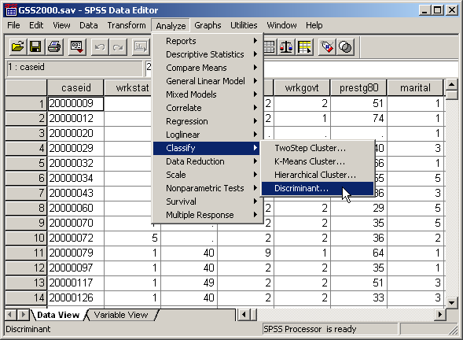
Request simultaneous discriminant analysis
Select the Classify | Discriminant… command from the Analyze menu.

Slide 26
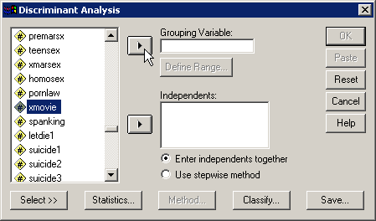
Selecting the dependent variable
First, highlight the dependent variable xmovie in the list of variables.
Second, click on the right arrow button to move the dependent variable to the Grouping Variable text box.

Slide 27
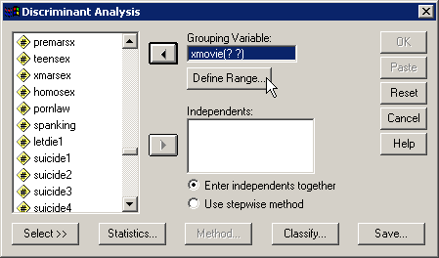
Defining the group values
When SPSS moves the dependent variable to the Grouping Variable textbox, it puts two question marks in parentheses after the variable name. This is a reminder that we have to enter the number that represent the groups we want to include in the analysis.
First, to specify the group numbers, click on the Define Range… button.

Slide 28
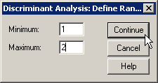
Completing the range of group values
The value labels for xmovie show two categories:
  1 = YES
  2 = NO
The range of values that we need to enter goes from 1 as the minimum and 2 as the maximum.
First, type in 1 in the Minimum text box.
Second, type in 2 in the Maximum text box.
Third, click on the Continue button to close the dialog box.

Slide 29
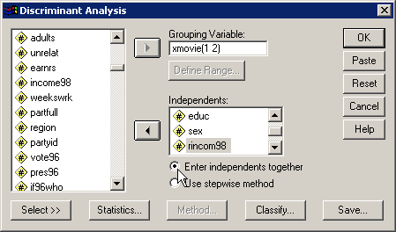
Selecting the independent variables
Move the independent variables listed in the problem to the Independents list box.

Slide 30
Specifying the method for including variables
SPSS provides us with two methods for including variables: to enter all of the independent variables at one time, and a stepwise method for selecting variables using a statistical test to determine the order in which variables are included.
Since the problem states that there is a relationship without requesting the best predictors, we accept the default to Enter independents together.

Slide 31
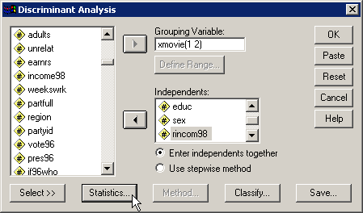
Requesting statistics for the output
Click on the Statistics… button to select statistics we will need for the analysis.

Slide 32
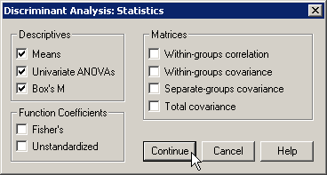
Specifying statistical output
First, mark the Means checkbox on the Descriptives panel. We will use the group means in our interpretation.
Second, mark the Univariate ANOVAs checkbox on the Descriptives panel. Perusing these tests suggests which variables might be useful descriminators.
Third, mark the Box’s M checkbox. Box’s M statistic evaluates conformity to the assumption of homogeneity of group variances.
Fourth, click on the Continue button to close the dialog box.

Slide 33
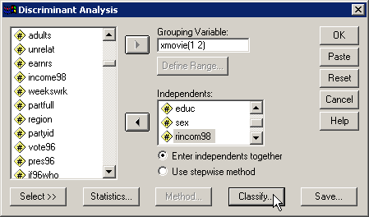
Specifying details for classification
Click on the Classify… button to specify details for the classification phase of the analysis.

Slide 34
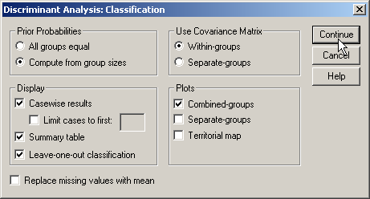
Details for classification - 1
First, mark the option button to Compute from group sizes on the Prior Probabilities panel. This incorporates the size of the groups defined by the dependent variable into the classification of cases using the discriminant functions.
Second, mark the Casewise results checkbox on the Display panel to include classification details for each case in the output.
Third, mark the Summary table checkbox to include summary tables comparing actual and predicted classification.

Slide 35
Details for classification - 2
Fourth, mark the Leave-one-out classification checkbox to request SPSS to include a cross-validated classification in the output. This option produces a less biased estimate of classification accuracy by sequentially holding each case out of the calculations for the discriminant functions, and using the derived functions to classify the case held out.

Slide 36
Details for classification - 3
Fifth, accept the default of Within-groups option button on the Use Covariance Matrix panel. The Covariance matrices are the measure of the dispersion in the groups defined by the dependent variable. If we fail the homogeneity of group variances test (Box’s M), our option is use Separate groups covariance in classification.
Seventh, click on the Continue button to close the dialog box.
Sixth, mark the Combines-groups checkbox on the Plots panel to obtain a visual plot of the relationship between functions and groups defined by the dependent variable.

Slide 37

Completing the discriminant analysis request
Click on the OK button to request the output for the disciminant analysis.

Slide 38
Sample size – ratio of cases to variables
The minimum ratio of valid cases to independent variables for discriminant analysis is 5 to 1, with a preferred ratio of 20 to 1. In this analysis, there are 119 valid cases and 4 independent variables. The ratio of cases to independent variables is 29.75 to 1, which satisfies the minimum requirement. In addition, the ratio of 29.75 to 1 satisfies the preferred ratio of 20 to 1.

Slide 39
Sample size – minimum group size
In addition to the requirement for the ratio of cases to independent variables, discriminant analysis requires that there be a minimum number of cases in the smallest group defined by the dependent variable. The number of cases in the smallest group must be larger than the number of independent variables, and preferably contains 20 or more cases.
The number of cases in the smallest group in this problem is 37, which is larger than the number of independent variables (4), satisfying the minimum requirement. In addition, the number of cases in the smallest group satisfies the preferred minimum of 20 cases.
If the sample size did not initially satisfy the minimum requirements, discriminant analysis is not appropriate.

Slide 40
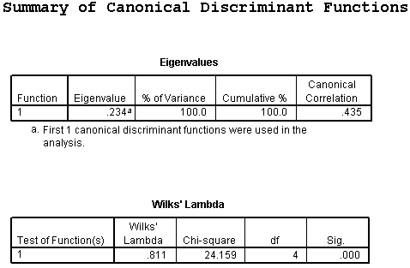
NUMBER OF DISCRIMINANT FUNCTIONS - 1
The maximum possible number of discriminant functions is the smaller of one less than the number of groups defined by the dependent variable and the number of independent variables.
In this analysis there were 2 groups defined by seen x-rated movie in last year and 4 independent variables, so the maximum possible number of discriminant functions was 1.

Slide 41
NUMBER OF DISCRIMINANT FUNCTIONS - 2
In the table of Wilks' Lambda which tested functions for statistical significance, the direct analysis identified 1 discriminant functions that were statistically significant. The Wilks' lambda statistic for the test of function 1 (chi-square=24.159) had a probability of <0.001 which was less than or equal to the level of significance of 0.05. The significance of the maximum possible number of discriminant functions supports the interpretation of a solution using 1 discriminant function.

Slide 42
Independent variables and group membership: relationship of functions to groups
In order to specify the role that each independent variable plays in predicting group membership on the dependent variable, we must link together the relationship between the discriminant functions and the groups defined by the dependent variable, the role of the significant independent variables in the discriminant functions, and the differences in group means for each of the variables.
Each function divides the groups into two subgroups by assigning negative values to one subgroup and positive values to the other subgroup. Function 1 separates survey respondents who had seen an x-rated movie in the last year (-.714) from survey respondents who had not seen an x-rated movie in the last year (.322).

Slide 43
Independent variables and group membership: predictor loadings on functions
We do not interpret loadings in the structure matrix unless they are 0.30 or higher.
Based on the structure matrix, the predictor variables strongly associated with discriminant function 1 which distinguished between survey respondents who had seen an x-rated movie in the last year and survey respondents who had not seen an x-rated movie in the last year were age (r=0.467) and sex (r=0.770).

Slide 44
Independent variables and group membership: predictors associated with first function - 1
The average age for survey respondents who had seen an
x-rated movie in the last year (mean=37.24) was lower than the average age for survey respondents who had not seen an x-rated movie in the last year (mean=42.70).
This supports the relationship that "survey respondents who had seen an x-rated movie in the last year were younger than survey respondents who had not seen an x-rated movie in the last year."

Slide 45
Independent variables and group membership: predictors associated with first function - 2
Since sex is a dichotomous variable, the mean is not directly interpretable. Its interpretation must take into account the coding by which 1 corresponds to male and 2 corresponds to female. The lower mean for survey respondents who had seen an x-rated movie in the last year (mean=1.27), when compared to the mean for survey respondents who had not seen an x-rated movie in the last year (mean=1.65), implies that the group contained more survey respondents who were male and fewer survey respondents who were female.
This supports the relationship that "survey respondents who had seen an x-rated movie in the last year were more likely to be male than survey respondents who had not seen an x-rated movie in the last year."

Slide 46
CLASSIFICATION USING THE DISCRIMINANT MODEL: by chance accuracy rate
The independent variables could be characterized as useful predictors of membership in the groups defined by the dependent variable if the cross-validated classification accuracy rate was significantly higher than the accuracy attainable by chance alone. Operationally, the cross-validated classfication accuracy rate should be 25% or more higher than the proportional by chance accuracy rate.
The proportional by chance accuracy rate was computed by squaring and summing the proportion of cases in each group from the table of prior probabilities for groups (0.311² + 0.689² = 0.571).

Slide 47
CLASSIFICATION USING THE DISCRIMINANT MODEL: criteria for classification accuracy
The cross-validated accuracy rate computed by SPSS was 71.4% which was greater than or equal to the proportional by chance accuracy criteria of 71.4% (1.25 x 57.1% = 71.4%).
The criteria for classification accuracy is satisfied.

Slide 48
Answering the question in problem 1 - 1
In the dataset GSS2000.sav, is the following statement true, false, or an incorrect application of a statistic? Assume that there is no problem with missing data, violation of assumptions, or outliers. Use a level of significance of 0.05 for evaluating the statistical relationship.
The variables "age" [age], "highest year of school completed" [educ], "sex" [sex], and "income" [rincom98] are useful in distinguishing between groups based on responses to "seen x-rated movie in last year" [xmovie]. These predictors differentiate survey respondents who had seen an x-rated movie in the last year from survey respondents who had not seen an x-rated movie in the last year.
Survey respondents who had seen an x-rated movie in the last year were younger than survey respondents who had not seen an x-rated movie in the last year. Survey respondents who had seen an x-rated movie in the last year were more likely to be male than survey respondents who had not seen an x-rated movie in the last year.
1. True
2. True with caution
3. False
4. Inappropriate application of a statistic
We found one statistically significant discriminant function, making it possible to distinguish among the two groups defined by the dependent variable.
Moreover, the cross-validated classification accuracy surpassed the by chance accuracy criteria, supporting the utility of the model.

Slide 49
Answering the question in problem 1 - 2
In the dataset GSS2000.sav, is the following statement true, false, or an incorrect application of a statistic? Assume that there is no problem with missing data, violation of assumptions, or outliers. Use a level of significance of 0.05 for evaluating the statistical relationship.
The variables "age" [age], "highest year of school completed" [educ], "sex" [sex], and "income" [rincom98] are useful in distinguishing between groups based on responses to "seen x-rated movie in last year" [xmovie]. These predictors differentiate survey respondents who had seen an x-rated movie in the last year from survey respondents who had not seen an x-rated movie in the last year.
Survey respondents who had seen an x-rated movie in the last year were younger than survey respondents who had not seen an x-rated movie in the last year. Survey respondents who had seen an x-rated movie in the last year were more likely to be male than survey respondents who had not seen an x-rated movie in the last year.
1. True
2. True with caution
3. False
4. Inappropriate application of a statistic
We verified that each statement about the relationship between predictors and groups was correct.
The answer to the question is true with caution.
A caution is added because of the inclusion of ordinal level variables.

Slide 50
Problem 2
In the dataset GSS2000.sav, is the following statement true, false, or an incorrect application of a statistic? Assume that there is no problem with missing data, violation of assumptions, or outliers. Use a level of significance of 0.05 for evaluating the statistical relationship.
From the list of variables "respondent's degree of religious fundamentalism" [fund], "frequency of prayer" [pray], and "frequency of attendance at religious services" [attend], the most useful predictor for distinguishing between groups based on responses to "attitude toward abortion when there is a strong chance of serious defect in the baby" [abdefect] is "frequency of prayer" [pray]. These predictors differentiate survey respondents who thought it should be possible for a woman to obtain a legal abortion if there is a strong chance of a serious defect in the baby from survey respondents who didn't think it should be possible for a woman to obtain a legal abortion if there is a strong chance of a serious defect in the baby.
The most important predictor of groups based on responses to attitude toward abortion when there is a strong chance of serious defect in the baby was frequency of prayer.
Survey respondents who didn't think it should be possible for a woman to obtain a legal abortion if there is a strong chance of a serious defect in the baby prayed more often than survey respondents who thought it should be possible for a woman to obtain a legal abortion if there is a strong chance of a serious defect in the baby.
1. True
2. True with caution
3. False
4. Inappropriate application of a statistic

Slide 51
Dissecting problem 2 - 1
The variables listed first in the problem statement are the independent variables (IVs): "respondent's degree of religious fundamentalism" [fund], "frequency of prayer" [pray], and "frequency of attendance at religious services" [attend].
In the dataset GSS2000.sav, is the following statement true, false, or an incorrect application of a statistic? Assume that there is no problem with missing data, violation of assumptions, or outliers. Use a level of significance of 0.05 for evaluating the statistical relationship.
From the list of variables "respondent's degree of religious fundamentalism" [fund], "frequency of prayer" [pray], and "frequency of attendance at religious services" [attend], the most useful predictor for distinguishing between groups based on responses to "attitude toward abortion when there is a strong chance of serious defect in the baby" [abdefect] is "frequency of prayer" [pray]. These predictors differentiate survey respondents who thought it should be possible for a woman to obtain a legal abortion if there is a strong chance of a serious defect in the baby from survey respondents who didn't think it should be possible for a woman to obtain a legal abortion if there is a strong chance of a serious defect in the baby.
The most important predictor of groups based on responses to attitude toward abortion when there is a strong chance of serious defect in the baby was frequency of prayer.
The variable used to define groups is the dependent variable (DV): "attitude toward abortion when there is a strong chance of serious defect in the baby" [abdefect]
When a problem asks us to identify the best or most useful predictors from a list of independent variables, we do stepwise discriminant analysis.

Slide 52
Dissecting problem 2 - 2
The problem identifies two groups for the dependent variable:
  survey respondents who thought it should be possible for a woman to obtain a legal abortion if there is a strong chance of a serious defect in the baby
  survey respondents who didn't think it should be possible for a woman to obtain a legal abortion if there is a strong chance of a serious defect in the baby.
To distinguish among two groups, the analysis will be required to find one statistically significant discriminant functions.
In the dataset GSS2000.sav, is the following statement true, false, or an incorrect application of a statistic? Assume that there is no problem with missing data, violation of assumptions, or outliers. Use a level of significance of 0.05 for evaluating the statistical relationship.
From the list of variables "respondent's degree of religious fundamentalism" [fund], "frequency of prayer" [pray], and "frequency of attendance at religious services" [attend], the most useful predictor for distinguishing between groups based on responses to "attitude toward abortion when there is a strong chance of serious defect in the baby" [abdefect] is "frequency of prayer" [pray]. These predictors differentiate survey respondents who thought it should be possible for a woman to obtain a legal abortion if there is a strong chance of a serious defect in the baby from survey respondents who didn't think it should be possible for a woman to obtain a legal abortion if there is a strong chance of a serious defect in the baby.
The most important predictor of groups based on responses to attitude toward abortion when there is a strong chance of serious defect in the baby was frequency of prayer.
The importance of predictors is based upon the stepwise addition of variables to the analysis.

Slide 53
Dissecting problem 2 - 3
The specific relationships listed in the problem indicate how the independent variable relates to groups of the dependent variable, i.e., the mean for frequency of prayer will be lower for respondents who thought it should be possible for a woman to obtain a legal abortion if there is a strong chance of a serious defect in the baby compared to survey respondents who didn't think it should be possible for a woman to obtain a legal abortion if there is a strong chance of a serious defect in the baby.
From the list of variables "respondent's degree of religious fundamentalism" [fund], "frequency of prayer" [pray], and "frequency of attendance at religious services" [attend], the most useful predictor for distinguishing between groups based on responses to "attitude toward abortion when there is a strong chance of serious defect in the baby" [abdefect] is "frequency of prayer" [pray]. These predictors differentiate survey respondents who thought it should be possible for a woman to obtain a legal abortion if there is a strong chance of a serious defect in the baby from survey respondents who didn't think it should be possible for a woman to obtain a legal abortion if there is a strong chance of a serious defect in the baby.
The most important predictor of groups based on responses to attitude toward abortion when there is a strong chance of serious defect in the baby was frequency of prayer.
Survey respondents who didn't think it should be possible for a woman to obtain a legal abortion if there is a strong chance of a serious defect in the baby prayed more often than survey respondents who thought it should be possible for a woman to obtain a legal abortion if there is a strong chance of a serious defect in the baby.
1. True
2. True with caution
3. False
4. Inappropriate application of a statistic
In a stepwise analysis, we only interpret the independent variables that are entered in the stepwise analysis.
In order for a stepwise analysis to be true, we must have enough statistically significant functions to distinguish among the groups, the order of entry must be correct, and each significant relationship must be interpreted correctly.

Slide 54
LEVEL OF MEASUREMENT - 1
In the dataset GSS2000.sav, is the following statement true, false, or an incorrect application of a statistic? Assume that there is no problem with missing data, violation of assumptions, or outliers. Use a level of significance of 0.05 for evaluating the statistical relationship.
From the list of variables "respondent's degree of religious fundamentalism" [fund], "frequency of prayer" [pray], and "frequency of attendance at religious services" [attend], the most useful predictor for distinguishing between groups based on responses to "attitude toward abortion when there is a strong chance of serious defect in the baby" [abdefect] is "frequency of prayer" [pray]. These predictors differentiate survey respondents who thought it should be possible for a woman to obtain a legal abortion if there is a strong chance of a serious defect in the baby from survey respondents who didn't think it should be possible for a woman to obtain a legal abortion if there is a strong chance of a serious defect in the baby.
The most important predictor of groups based on responses to attitude toward abortion when there is a strong chance of serious defect in the baby was frequency of prayer.
Survey respondents who didn't think it should be possible for a woman to obtain a legal abortion if there is a strong chance of a serious defect in the baby prayed more often than survey respondents who thought it should be possible for a woman to obtain a legal abortion if there is a strong chance of a serious defect in the baby.
Discriminant analysis requires that the dependent variable be non-metric and the independent variables be metric or dichotomous.
"Attitude toward abortion when there is a strong chance of serious defect in the baby" [abdefect] is a nominal level variable, which satisfies the level of measurement requirement.

Slide 55
LEVEL OF MEASUREMENT - 2
In the dataset GSS2000.sav, is the following statement true, false, or an incorrect application of a statistic? Assume that there is no problem with missing data, violation of assumptions, or outliers. Use a level of significance of 0.05 for evaluating the statistical relationship.
From the list of variables "respondent's degree of religious fundamentalism" [fund], "frequency of prayer" [pray], and "frequency of attendance at religious services" [attend], the most useful predictor for distinguishing between groups based on responses to "attitude toward abortion when there is a strong chance of serious defect in the baby" [abdefect] is "frequency of prayer" [pray]. These predictors differentiate survey respondents who thought it should be possible for a woman to obtain a legal abortion if there is a strong chance of a serious defect in the baby from survey respondents who didn't think it should be possible for a woman to obtain a legal abortion if there is a strong chance of a serious defect in the baby.
The most important predictor of groups based on responses to attitude toward abortion when there is a strong chance of serious defect in the baby was frequency of prayer.
Survey respondents who didn't think it should be possible for a woman to obtain a legal abortion if there is a strong chance of a serious defect in the baby prayed more often than survey respondents who thought it should be possible for a woman to obtain a legal abortion if there is a strong chance of a serious defect in the baby.
"Respondent's degree of religious fundamentalism" [fund], "frequency of prayer" [pray], and "frequency of attendance at religious services" [attend] are ordinal level variables. If we follow the convention of treating ordinal level variables as metric variables, the level of measurement requirement for discriminant analysis is satisfied. Since some data analysts do not agree with this convention, a note of caution should be included in our interpretation.

Slide 56
Request stepwise discriminant analysis
Select the Classify | Discriminant… command from the Analyze menu.

Slide 57
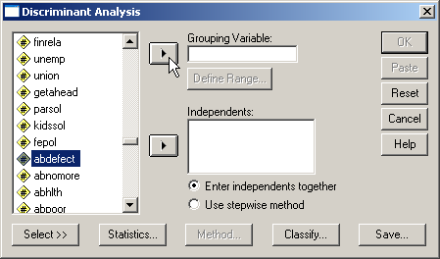
Selecting the dependent variable
First, highlight the dependent variable abdefect in the list of variables.
Second, click on the right arrow button to move the dependent variable to the Grouping Variable text box.

Slide 58
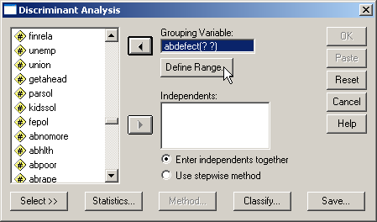
Defining the group values
When SPSS moves the dependent variable to the Grouping Variable textbox, it puts two question marks in parentheses after the variable name. This is a reminder that we have to enter the number that represent the groups we want to include in the analysis.
First, to specify the group numbers, click on the Define Range… button.

Slide 59
Completing the range of group values
The value labels for abdefect show two categories:
  1 = YES
  2 = NO
The range of values that we need to enter goes from 1 as the minimum and 2 as the maximum.
First, type in 1 in the Minimum text box.
Second, type in 2 in the Maximum text box.
Third, click on the Continue button to close the dialog box.

Slide 60
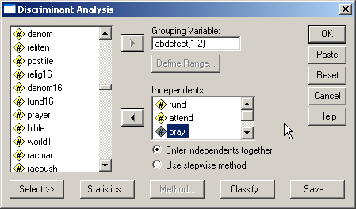
Selecting the independent variables
Move the independent variables listed in the problem to the Independents list box.

Slide 61
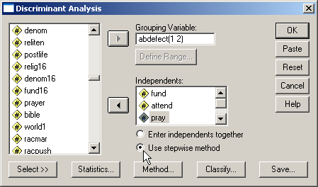
Specifying the method for including variables
SPSS provides us with two methods for including variables: to enter all of the independent variables at one time, and a stepwise method for selecting variables using a statistical test to determine the order in which variables are included.
Since the problem calls for identifying the best predictors, we click on the option button to Use stepwise method.

Slide 62
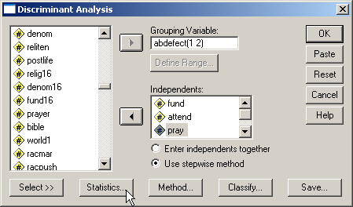
Requesting statistics for the output
Click on the Statistics… button to select statistics we will need for the analysis.

Slide 63
Specifying statistical output
First, mark the Means checkbox on the Descriptives panel. We will use the group means in our interpretation.
Second, mark the Univariate ANOVAs checkbox on the Descriptives panel. Perusing these tests suggests which variables might be useful descriminators.
Third, mark the Box’s M checkbox. Box’s M statistic evaluates conformity to the assumption of homogeneity of group variances.
Fourth, click on the Continue button to close the dialog box.

Slide 64
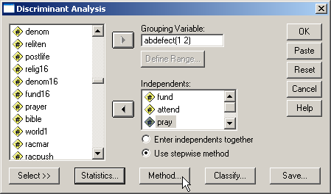
Specifying details for the stepwise method
Click on the Method… button to specify the specific statistical criteria to use for including variables.

Slide 65
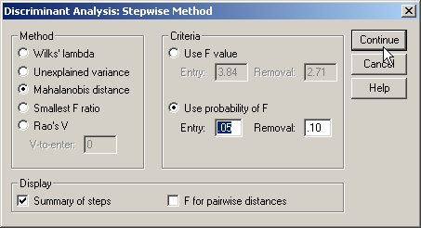
Details for the stepwise method
First, mark the Mahalanobis distance option button on the Method panel.
Second, mark the Summary of steps checkbox to produce a summary table when a new variable is added.
Third, click on the Continue button to close the dialog box.
Third, click on the option button Use probability of F so that we can incorporate the level of significance specified in the problem.
Fourth, type the level of significance in the Entry text box. The Removal value is twice as large as the entry value.

Slide 66
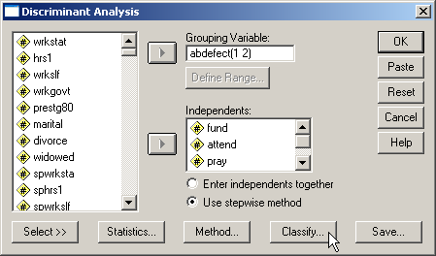
Specifying details for classification
Click on the Classify… button to specify details for the classification phase of the analysis.

Slide 67
Details for classification - 1
First, mark the option button to Compute from group sizes on the Prior Probabilities panel. This incorporates the size of the groups defined by the dependent variable into the classification of cases using the discriminant functions.
Second, mark the Casewise results checkbox on the Display panel to include classification details for each case in the output.
Third, mark the Summary table checkbox to include summary tables comparing actual and predicted classification.

Slide 68
Details for classification - 2
Fourth, mark the Leave-one-out classification checkbox to request SPSS to include a cross-validated classification in the output. This option produces a less biased estimate of classification accuracy by sequentially holding each case out of the calculations for the discriminant functions, and using the derived functions to classify the case held out.

Slide 69
Details for classification - 3
Fifth, accept the default of Within-groups option button on the Use Covariance Matrix panel. The Covariance matrices are the measure of the dispersion in the groups defined by the dependent variable. If we fail the homogeneity of group variances test (Box’s M), our option is use Separate groups covariance in classification.
Seventh, click on the Continue button to close the dialog box.
Sixth, mark the Combines-groups checkbox on the Plots panel to obtain a visual plot of the relationship between functions and groups defined by the dependent variable.

Slide 70
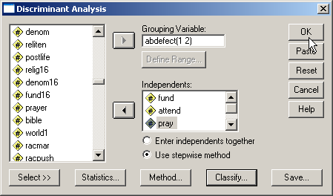
Completing the discriminant analysis request
Click on the OK button to request the output for the disciminant analysis.

Slide 71
Sample size – ratio of cases to variables
The minimum ratio of valid cases to independent variables for discriminant analysis is 5 to 1, with a preferred ratio of 20 to 1. In this analysis, there are 77 valid cases and 3 independent variables. The ratio of cases to independent variables is 25.67 to 1, which satisfies the minimum requirement. In addition, the ratio of 25.67 to 1 satisfies the preferred ratio of 20 to 1.

Slide 72
Sample size – minimum group size
In addition to the requirement for the ratio of cases to independent variables, discriminant analysis requires that there be a minimum number of cases in the smallest group defined by the dependent variable. The number of cases in the smallest group must be larger than the number of independent variables, and preferably contains 20 or more cases.
The number of cases in the smallest group in this problem is 13, which is larger than the number of independent variables (3), satisfying the minimum requirement. However, the number of cases in the smallest group is less than the preferred minimum of 20 cases. A caution should be added to the interpretation of the analysis.
If the sample size did not initially satisfy the minimum requirements, discriminant analysis is not appropriate.

Slide 73
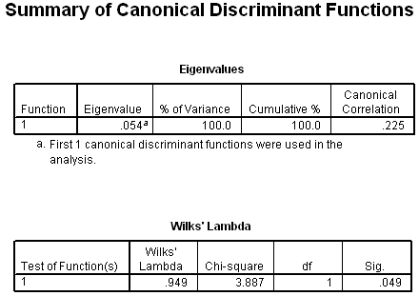
NUMBER OF DISCRIMINANT FUNCTIONS - 1
The maximum possible number of discriminant functions is the smaller of one less than the number of groups defined by the dependent variable and the number of independent variables.
In this analysis there were 2 groups defined by seen x-rated movie in last year and 3 independent variables, so the maximum possible number of discriminant functions was 1.

Slide 74
NUMBER OF DISCRIMINANT FUNCTIONS - 2
In the table of Wilks' Lambda which tested functions for statistical significance, the stepwise analysis identified 1 discriminant functions that were statistically significant. The Wilks' lambda statistic for the test of function 1 (chi-square=3.887) had a probability of 0.049 which was less than or equal to the level of significance of 0.05.
The significance of the maximum possible number of discriminant functions supports the interpretation of a solution using 1 discriminant function.

Slide 75
Independent variables and group membership: relationship of functions to groups
In order to specify the role that each independent variable plays in predicting group membership on the dependent variable, we must link together the relationship between the discriminant functions and the groups defined by the dependent variable, the role of the significant independent variables in the discriminant functions, and the differences in group means for each of the variables.
Each function divides the groups into two subgroups by assigning negative values to one subgroup and positive values to the other subgroup. Function 1 separates survey respondents who didn't think it should be possible for a woman to obtain a legal abortion if there is a strong chance of a serious defect in the baby (-.507) from survey respondents who thought it should be possible for a woman to obtain a legal abortion if there is a strong chance of a serious defect in the baby (.103).

Slide 76
Independent variables and group membership: which predictors to interpret
When we use the stepwise method of variable inclusion, we limit our interpretation of independent variable predictors to those listed as statistically significant in the table of Variables Entered/Removed.
The stepwise method of variable selection identified 1 variable that satisfied the level of significance of 0.05. The most important predictor of groups based on responses to attitude toward abortion when there is a strong chance of serious defect in the baby was:
  frequency of prayer.
Had we use simultaneous entry of all variables, we would not have imposed this limitation.

Slide 77
Independent variables and group membership: predictor loadings on functions
Based on the structure matrix, the predictor variable strongly associated with discriminant function 1 which distinguished between survey respondents who didn't think it should be possible for a woman to obtain a legal abortion if there is a strong chance of a serious defect in the baby and survey respondents who thought it should be possible for a woman to obtain a legal abortion if there is a strong chance of a serious defect in the baby was frequency of prayer (r=1.000).
The correlation of 1.0 is an artifact of having only one statistically significant variable.
While we would normally interpret loadings in the structure matrix if they are 0.30 or higher, when we do stepwise analysis, we limit ourselves to the variables that were statistically significant.

Slide 78
Independent variables and group membership: predictors associated with first function - 1
The average frequency of prayer for survey respondents who didn't think it should be possible for a woman to obtain a legal abortion if there is a strong chance of a serious defect in the baby (mean=2.08) was lower than the average frequency of prayer for survey respondents who thought it should be possible for a woman to obtain a legal abortion if there is a strong chance of a serious defect in the baby (mean=3.05). Frequency of prayer is an ordinal level variable that is coded so that higher numeric values are associated with survey respondents who prayed less often.
The relationship that "survey respondents who didn't think it should be possible for a woman to obtain a legal abortion if there is a strong chance of a serious defect in the baby prayed more often than survey respondents who thought it should be possible for a woman to obtain a legal abortion if there is a strong chance of a serious defect in the baby" is supported.

Slide 79
CLASSIFICATION USING THE DISCRIMINANT MODEL: by chance accuracy rate
The independent variables could be characterized as useful predictors of membership in the groups defined by the dependent variable if the cross-validated classification accuracy rate was significantly higher than the accuracy attainable by chance alone. Operationally, the cross-validated classification accuracy rate should be 25% or more higher than the proportional by chance accuracy rate.
The proportional by chance accuracy rate of was computed by squaring and summing the proportion of cases in each group from the table of prior probabilities for groups (0.831² + 0.169² = 0.719).

Slide 80
CLASSIFICATION USING THE DISCRIMINANT MODEL: criteria for classification accuracy
The cross-validated accuracy rate computed by SPSS was 82.8% which was less than the proportional by chance accuracy criteria of 89.9% (1.25 x 71.9% = 89.9%).
The criteria for classification accuracy is not satisfied.

Slide 81
Answering the question in problem 2
From the list of variables "respondent's degree of religious fundamentalism" [fund], "frequency of prayer" [pray], and "frequency of attendance at religious services" [attend], the most useful predictor for distinguishing between groups based on responses to "attitude toward abortion when there is a strong chance of serious defect in the baby" [abdefect] is "frequency of prayer" [pray]. These predictors differentiate survey respondents who thought it should be possible for a woman to obtain a legal abortion if there is a strong chance of a serious defect in the baby from survey respondents who didn't think it should be possible for a woman to obtain a legal abortion if there is a strong chance of a serious defect in the baby.
The most important predictor of groups based on responses to attitude toward abortion when there is a strong chance of serious defect in the baby was frequency of prayer.
Survey respondents who didn't think it should be possible for a woman to obtain a legal abortion if there is a strong chance of a serious defect in the baby prayed more often than survey respondents who thought it should be possible for a woman to obtain a legal abortion if there is a strong chance of a serious defect in the baby.
1. True
2. True with caution
3. False
4. Inappropriate application of a statistic
We found one statistically significant discriminant function, making it possible to distinguish among the two groups defined by the dependent variable.
However, the cross-validated classification accuracy was not 25% greater than the by chance accuracy rate, failing to support the utility of the model.
The answer to the question is false.

Slide 82
Problem 3
In the dataset GSS2000.sav, is the following statement true, false, or an incorrect application of a statistic? Assume that there is no problem with missing data. Use a level of significance of 0.01 for evaluating assumptions. Use a level of significance of 0.05 for evaluating the statistical relationship.
From the list of variables "number of hours worked in the past week" [hrs1], "self-employment" [wrkslf], "highest year of school completed" [educ], and "income" [rincom98], the most useful predictors for distinguishing among groups based on responses to "opinion about spending on welfare" [natfare] are "number of hours worked in the past week" [hrs1], "self-employment" [wrkslf], and "highest year of school completed" [educ]. These predictors differentiate survey respondents who thought we spend too much money on welfare from survey respondents who thought we spend about the right amount of money on welfare who, in turn, are differentiated from survey respondents who thought we spend too little money on welfare.
The most important predictor of groups based on responses to opinion about spending on welfare was number of hours worked in the past week. The second most important predictor of groups based on responses to opinion about spending on welfare was self-employment. The third most important predictor of groups based on responses to opinion about spending on welfare was highest year of school completed.
Survey respondents who thought we spend about the right amount of money on welfare worked fewer hours in the past week than survey respondents who thought we spend too much or little money on welfare. Survey respondents who thought we spend about the right amount of money on welfare had completed more years of school than survey respondents who thought we spend too much or little money on welfare. Survey respondents who thought we spend too much money on welfare were more likely to be self-employed than survey respondents who thought we spend too little money on welfare.
1. True
2. True with caution
3. False
4. Inappropriate application of a statistic

Slide 83
Dissecting problem 3 - 1
The variables listed first in the problem statement are the independent variables (IVs): "number of hours worked in the past week" [hrs1], "self-employment" [wrkslf], "highest year of school completed" [educ], and "income" [rincom98].
In the dataset GSS2000.sav, is the following statement true, false, or an incorrect application of a statistic? Assume that there is no problem with missing data. Use a level of significance of 0.01 for evaluating assumptions. Use a level of significance of 0.05 for evaluating the statistical relationship.
From the list of variables "number of hours worked in the past week" [hrs1], "self-employment" [wrkslf], "highest year of school completed" [educ], and "income" [rincom98], the most useful predictors for distinguishing among groups based on responses to "opinion about spending on welfare" [natfare] are "number of hours worked in the past week" [hrs1], "self-employment" [wrkslf], and "highest year of school completed" [educ]. These predictors differentiate survey respondents who thought we spend too much money on welfare from survey respondents who thought we spend about the right amount of money on welfare who, in turn, are differentiated from survey respondents who thought we spend too little money on welfare.
The most important predictor of groups based on responses to opinion about spending on welfare was number of hours worked in the past week. The second most important predictor of groups based on responses to opinion about spending on welfare was self-employment. The third most important predictor of groups based on responses to opinion about spending on welfare was highest year of school completed.
The variable used to define groups is the dependent variable (DV): "opinion about spending on welfare" [natfare].
When a problem asks us to identify the best or most useful predictors from a list of independent variables, we do stepwise discriminant analysis.

Slide 84
Dissecting problem 3 - 2
The problem identifies three groups for the dependent variable:
survey respondents who thought we spend too much money on welfare
survey respondents who thought we spend about the right amount of money on welfare
survey respondents who thought we spend too little money on welfare.
To distinguish among three groups, the analysis will be required to find two statistically significant discriminant functions.
In the dataset GSS2000.sav, is the following statement true, false, or an incorrect application of a statistic? Assume that there is no problem with missing data. Use a level of significance of 0.01 for evaluating assumptions. Use a level of significance of 0.05 for evaluating the statistical relationship.
From the list of variables "number of hours worked in the past week" [hrs1], "self-employment" [wrkslf], "highest year of school completed" [educ], and "income" [rincom98], the most useful predictors for distinguishing among groups based on responses to "opinion about spending on welfare" [natfare] are "number of hours worked in the past week" [hrs1], "self-employment" [wrkslf], and "highest year of school completed" [educ]. These predictors differentiate survey respondents who thought we spend too much money on welfare from survey respondents who thought we spend about the right amount of money on welfare who, in turn, are differentiated from survey respondents who thought we spend too little money on welfare.
The most important predictor of groups based on responses to opinion about spending on welfare was number of hours worked in the past week. The second most important predictor of groups based on responses to opinion about spending on welfare was self-employment. The third most important predictor of groups based on responses to opinion about spending on welfare was highest year of school completed.
The importance of predictors is based upon the stepwise addition of variables to the analysis.

Slide 85
Dissecting problem 3 - 3
In a stepwise analysis, we only interpret the independent variables that are entered in the stepwise analysis.
The specific relationships listed in the problem indicate how the independent variable relates to groups of the dependent variable, i.e., the mean for hours worked in the past week will be lower for respondents who think we spend the right amount of money versus respondents who think we spend too much or too little.
The most important predictor of groups based on responses to opinion about spending on welfare was number of hours worked in the past week. The second most important predictor of groups based on responses to opinion about spending on welfare was self-employment. The third most important predictor of groups based on responses to opinion about spending on welfare was highest year of school completed.
Survey respondents who thought we spend about the right amount of money on welfare worked fewer hours in the past week than survey respondents who thought we spend too much or little money on welfare. Survey respondents who thought we spend about the right amount of money on welfare had completed more years of school than survey respondents who thought we spend too much or little money on welfare. Survey respondents who thought we spend too much money on welfare were more likely to be self-employed than survey respondents who thought we spend too little money on welfare.
1. True
2. True with caution
3. False
4. Inappropriate application of a statistic
In order for a stepwise analysis to be true, we must have enough statistically significant functions to distinguish among the groups, the order of entry must be correct, and each significant relationship must be interpreted correctly.

Slide 86
LEVEL OF MEASUREMENT - 1
From the list of variables "number of hours worked in the past week" [hrs1], "self-employment" [wrkslf], "highest year of school completed" [educ], and "income" [rincom98], the most useful predictors for distinguishing among groups based on responses to "opinion about spending on welfare" [natfare] are "number of hours worked in the past week" [hrs1], "self-employment" [wrkslf], and "highest year of school completed" [educ]. These predictors differentiate survey respondents who thought we spend too much money on welfare from survey respondents who thought we spend about the right amount of money on welfare who, in turn, are differentiated from survey respondents who thought we spend too little money on welfare.
The most important predictor of groups based on responses to opinion about spending on welfare was number of hours worked in the past week. The second most important predictor of groups based on responses to opinion about spending on welfare was self-employment. The third most important predictor of groups based on responses to opinion about spending on welfare was highest year of school completed.
Survey respondents who thought we spend about the right amount of money on welfare worked fewer hours in the past week than survey respondents who thought we spend too much or little money on welfare. Survey respondents who thought we spend about the right amount of money on welfare had completed more years of school than survey respondents who thought we spend too much or little money on welfare. Survey respondents who thought we spend too much money on welfare were more likely to be self-employed than survey respondents who thought we spend too little money on welfare.
Discriminant analysis requires that the dependent variable be non-metric and the independent variables be metric or dichotomous. "Opinion about spending on welfare" [natfare] is an ordinal level variable, which satisfies the level of measurement requirement.
It contains three categories: survey respondents who thought we spend too much money on welfare, survey respondents who thought we spend about the right amount of money on welfare, and survey respondents who thought we spend too little money on welfare.

Slide 87
LEVEL OF MEASUREMENT - 2
From the list of variables "number of hours worked in the past week" [hrs1], "self-employment" [wrkslf], "highest year of school completed" [educ], and "income" [rincom98], the most useful predictors for distinguishing among groups based on responses to "opinion about spending on welfare" [natfare] are "number of hours worked in the past week" [hrs1], "self-employment" [wrkslf], and "highest year of school completed" [educ]. These predictors differentiate survey respondents who thought we spend too much money on welfare from survey respondents who thought we spend about the right amount of money on welfare who, in turn, are differentiated from survey respondents who thought we spend too little money on welfare.
The most important predictor of groups based on responses to opinion about spending on welfare was number of hours worked in the past week. The second most important predictor of groups based on responses to opinion about spending on welfare was self-employment. The third most important predictor of groups based on responses to opinion about spending on welfare was highest year of school completed.
Survey respondents who thought we spend about the right amount of money on welfare worked fewer hours in the past week than survey respondents who thought we spend too much or little money on welfare. Survey respondents who thought we spend about the right amount of money on welfare had completed more years of school than survey respondents who thought we spend too much or little money on welfare. Survey respondents who thought we spend too much money on welfare were more likely to be self-employed than survey respondents who thought we spend too little money on welfare.
"Number of hours worked in the past week" [hrs1] and "highest year of school completed" [educ] are interval level variables, which satisfies the level of measurement requirements for discriminant analysis.
"Income" [rincom98] is an ordinal level variable. If we follow the convention of treating ordinal level variables as metric variables, the level of measurement requirement for discriminant analysis is satisfied. Since some data analysts do not agree with this convention, a note of caution should be included in our interpretation.
"Self-employment" [wrkslf] is a dichotomous or dummy-coded nominal variable which may be included in discriminant analysis.

Slide 88
The stepwise discriminant analysis
To answer the question, we do a stepwise discriminant analysis with natfare as the dependent variable and hrs1, wkrslf, educ, and rincom98, and as the independent variables.
Select the Classify | Discriminant… command from the Analyze menu.

Slide 89
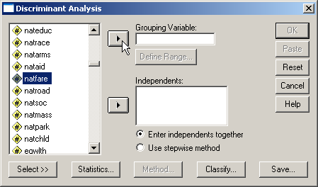
Selecting the dependent variable
First, highlight the dependent variable natfare in the list of variables.
Second, click on the right arrow button to move the dependent variable to the Grouping Variable text box.

Slide 90

Defining the group values
When SPSS moves the dependent variable to the Grouping Variable textbox, it puts two question marks in parentheses after the variable name. This is a reminder that we have to enter the number that represent the groups we want to include in the analysis.
First, to specify the group numbers, click on the Define Range… button.

Slide 91
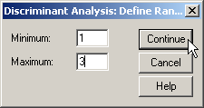
Completing the range of group values
The value labels for natfare show three categories:
  1 = TOO LITTLE
  2 = ABOUT RIGHT
  3 = TOO MUCH
The range of values that we need to enter goes from 1 as the minimum and 3 as the maximum.
First, type in 1 in the Minimum text box.
Second, type in 3 in the Maximum text box.
Third, click on the Continue button to close the dialog box.
Note: if we enter the wrong range of group numbers, e.g., 1 to 2 instead of 1 to 3, SPSS will only include groups 1 and 2 in the analysis.

Slide 92
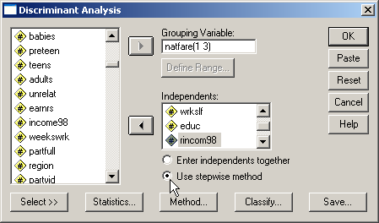
Specifying the method for including variables
SPSS provides us with two methods for including variables: to enter all of the independent variables at one time, and a stepwise method for selecting variables using a statistical test to determine the order in which variables are included.
Since the problem calls for identifying the best predictors, we click on the option button to Use stepwise method.

Slide 93
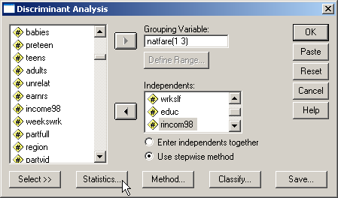
Requesting statistics for the output
Click on the Statistics… button to select statistics we will need for the analysis.

Slide 94
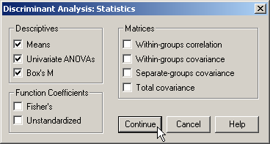
Specifying statistical output
First, mark the Means checkbox on the Descriptives panel. We will use the group means in our interpretation.
Second, mark the Univariate ANOVAs checkbox on the Descriptives panel. Perusing these tests suggests which variables might be useful descriminators.
Third, mark the Box’s M checkbox. Box’s M statistic evaluates conformity to the assumption of homogeneity of group variances.
Fourth, click on the Continue button to close the dialog box.

Slide 95

Specifying details for the stepwise method
Click on the Method… button to specify the specific statistical criteria to use for including variables.

Slide 96
Details for the stepwise method
First, mark the Mahalanobis distance option button on the Method panel.
Second, mark the Summary of steps checkbox to produce a summary table when a new variable is added.
Third, click on the Continue button to close the dialog box.
Third, click on the option button Use probability of F so that we can incorporate the level of significance specified in the problem.
Fourth, type the level of significance in the Entry text box. The Removal value is twice as large as the entry value.

Slide 97

Specifying details for classification
Click on the Classify… button to specify details for the classification phase of the analysis.

Slide 98
Details for classification - 1
First, mark the option button to Compute from group sizes on the Prior Probabilities panel. This incorporates the size of the groups defined by the dependent variable into the classification of cases using the discriminant functions.
Second, mark the Casewise results checkbox on the Display panel to include classification details for each case in the output.
Third, mark the Summary table checkbox to include summary tables comparing actual and predicted classification.

Slide 99
Details for classification - 2
Fourth, mark the Leave-one-out classification checkbox to request SPSS to include a cross-validated classification in the output. This option produces a less biased estimate of classification accuracy by sequentially holding each case out of the calculations for the discriminant functions, and using the derived functions to classify the case held out.

Slide 100
Details for classification - 3
Fifth, accept the default of Within-groups option button on the Use Covariance Matrix panel. The Covariance matrices are the measure of the dispersion in the groups defined by the dependent variable. If we fail the homogeneity of group variances test (Box’s M), our option is use Separate groups covariance in classification.
Seventh, click on the Continue button to close the dialog box.
Sixth, mark the Combined-groups checkbox on the Plots panel to obtain a visual plot of the relationship between functions and groups defined by the dependent variable.

Slide 101

Completing the discriminant analysis request
Click on the OK button to request the output for the disciminant analysis.

Slide 102
SAMPLE SIZE - 1
The minimum ratio of valid cases to independent variables for discriminant analysis is 5 to 1, with a preferred ratio of 20 to 1. In this analysis, there are 138 valid cases and 4 independent variables.
The ratio of cases to independent variables is 34.5 to 1, which satisfies the minimum requirement. In addition, the ratio of 34.5 to 1 satisfies the preferred ratio of 20 to 1.

Slide 103
SAMPLE SIZE - 2
In addition to the requirement for the ratio of cases to independent variables, discriminant analysis requires that there be a minimum number of cases in the smallest group defined by the dependent variable. The number of cases in the smallest group must be larger than the number of independent variables, and preferably contain 20 or more cases.
The number of cases in the smallest group in this problem is 32, which is larger than the number of independent variables (4), satisfying the minimum requirement. In addition, the number of cases in the smallest group satisfies the preferred minimum of 20 cases.

Slide 104
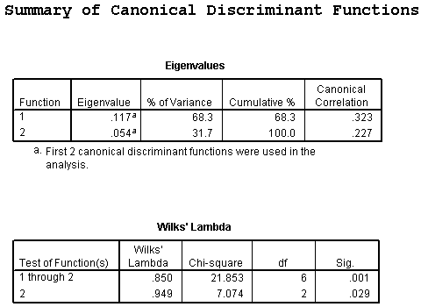
NUMBER OF DISCRIMINANT FUNCTIONS - 1
The maximum possible number of discriminant functions is the smaller of one less than the number of groups defined by the dependent variable and the number of independent variables.
In this analysis there were 3 groups defined by opinion about spending on welfare and 4 independent variables, so the maximum possible number of discriminant functions was 2.

Slide 105
NUMBER OF DISCRIMINANT FUNCTIONS - 2
In the table of Wilks' Lambda which tested functions for statistical significance, the stepwise analysis identified 2 discriminant functions that were statistically significant. The Wilks' lambda statistic for the test of function 1 through 2 functions (chi-square=21.853) had a probability of 0.001 which was less than or equal to the level of significance of 0.05.
After removing function 1, the Wilks' lambda statistic for the test of function 2 (chi-square=7.074) had a probability of 0.029 which was less than or equal to the level of significance of 0.05. The significance of the maximum possible number of discriminant functions supports the interpretation of a solution using 2 discriminant functions.

Slide 106
Independent variables and group membership: relationship of functions to groups
In order to specify the role that each independent variable plays in predicting group membership on the dependent variable, we must link together the relationship between the discriminant functions and the groups defined by the dependent variable, the role of the significant independent variables in the discriminant functions, and the differences in group means for each of the variables.
Function 2 separates survey respondents who thought we spend too little money on welfare (positive value of 0.235) from survey respondents who thought we spend too much money (negative value of -0.362) on welfare. We ignore the second group (-0.031) in this comparison because it was distinguished from the other two groups by function 1.
Function 1 separates survey respondents who thought we spend about the right amount of money on welfare (the positive value of 0.446) from survey respondents who thought we spend too much (negative value of -0.311) or little money (negative value of -0.220) on welfare.

Slide 107
Independent variables and group membership: which predictors to interpret
When we use the stepwise method of variable inclusion, we limit our interpretation of independent variable predictors to those listed as statistically significant in the table of Variables Entered/Removed.
We will interpret the impact on membership in groups defined by the dependent variable by the independent variables:
  number of hours worked in the past week
  self-employment.
  highest year of school completed
Had we use simultaneous entry of all variables, we would not have imposed this limitation.

Slide 108
Independent variables and group membership: predictor loadings on functions
We do not interpret loadings in the structure matrix unless they are 0.30 or higher.
Based on the structure matrix, the predictor variable strongly associated with discriminant function 2 which distinguished between survey respondents who thought we spend too little money on welfare and survey respondents who thought we spend too much money on welfare was self-employment (r=0.889).
Based on the structure matrix, the predictor variables strongly associated with discriminant function 1 which distinguished between survey respondents who thought we spend about the right amount of money on welfare and survey respondents who thought we spend too much or little money on welfare were number of hours worked in the past week (r=-0.582) and highest year of school completed (r=0.687).

Slide 109
Independent variables and group membership: predictors associated with first function - 1
The average number of hours worked in the past week for survey respondents who thought we spend about the right amount of money on welfare (mean=37.90) was lower than the average number of hours worked in the past weeks for survey respondents who thought we spend too little money on welfare (mean=43.96) and survey respondents who thought we spend too much money on welfare (mean=42.03).
This supports the relationship that "survey respondents who thought we spend about the right amount of money on welfare worked fewer hours in the past week than survey respondents who thought we spend too little or much money on welfare."

Slide 110
Independent variables and group membership: predictors associated with first function - 2
The average highest year of school completed for survey respondents who thought we spend about the right amount of money on welfare (mean=14.78) was higher than the average highest year of school completeds for survey respondents who thought we spend too little money on welfare (mean=13.73) and survey respondents who thought we spend too much money on welfare (mean=13.38).
This supports the relationship that "survey respondents who thought we spend about the right amount of money on welfare had completed more years of school than survey respondents who thought we spend too little or much money on welfare."

Slide 111
Independent variables and group membership: predictors associated with second function
Since self-employment is a dichotomous variable, the mean is not directly interpretable. Its interpretation must take into account the coding by which 1 corresponds to self-employed and 2 corresponds to someone else. The lower mean for survey respondents who thought we spend too much money on welfare (mean=1.75), when compared to the mean for survey respondents who thought we spend too little money on welfare (mean=1.93), implies that the group contained more survey respondents who were self-employed and fewer survey respondents who were working for someone else.
This supports the relationship that "survey respondents who thought we spend too much money on welfare were more likely to be self-employed than survey respondents who thought we spend too little money on welfare."

Slide 112
CLASSIFICATION USING THE DISCRIMINANT MODEL: by chance accuracy rate
The independent variables could be characterized as useful predictors of membership in the groups defined by the dependent variable if the cross-validated classification accuracy rate was significantly higher than the accuracy attainable by chance alone. Operationally, the cross-validated classification accuracy rate should be 25% or more higher than the proportional by chance accuracy rate.
The proportional by chance accuracy rate of was computed by squaring and summing the proportion of cases in each group from the table of prior probabilities for groups (0.406² + 0.362² + 0.232² = 0.350).

Slide 113
CLASSIFICATION USING THE DISCRIMINANT MODEL: criteria for classification accuracy
The cross-validated accuracy rate computed by SPSS was 50.0% which was greater than or equal to the proportional by chance accuracy criteria of 43.7% (1.25 x 35.0% = 43.7%). The criteria for classification accuracy is satisfied.

Slide 114
Answering the question in problem 3 - 1
From the list of variables "number of hours worked in the past week" [hrs1], "self-employment" [wrkslf], "highest year of school completed" [educ], and "income" [rincom98], the most useful predictors for distinguishing among groups based on responses to "opinion about spending on welfare" [natfare] are "number of hours worked in the past week" [hrs1], "self-employment" [wrkslf], and "highest year of school completed" [educ]. These predictors differentiate survey respondents who thought we spend too much money on welfare from survey respondents who thought we spend about the right amount of money on welfare who, in turn, are differentiated from survey respondents who thought we spend too little money on welfare.
The most important predictor of groups based on responses to opinion about spending on welfare was number of hours worked in the past week. The second most important predictor of groups based on responses to opinion about spending on welfare was self-employment. The third most important predictor of groups based on responses to opinion about spending on welfare was highest year of school completed.
Survey respondents who thought we spend about the right amount of money on welfare worked fewer hours in the past week than survey respondents who thought we spend too much or little money on welfare. Survey respondents who thought we spend about the right amount of money on welfare had completed more years of school than survey respondents who thought we spend too much or little money on welfare. Survey respondents who thought we spend too much money on welfare were more likely to be self-employed than survey respondents who thought we spend too little money on welfare.
The stepwise discriminant analysis included the three variables identified as the most use predictors.

Slide 115
Answering the question in problem 3 - 2
From the list of variables "number of hours worked in the past week" [hrs1], "self-employment" [wrkslf], "highest year of school completed" [educ], and "income" [rincom98], the most useful predictors for distinguishing among groups based on responses to "opinion about spending on welfare" [natfare] are "number of hours worked in the past week" [hrs1], "self-employment" [wrkslf], and "highest year of school completed" [educ]. These predictors differentiate survey respondents who thought we spend too much money on welfare from survey respondents who thought we spend about the right amount of money on welfare who, in turn, are differentiated from survey respondents who thought we spend too little money on welfare.
The most important predictor of groups based on responses to opinion about spending on welfare was number of hours worked in the past week. The second most important predictor of groups based on responses to opinion about spending on welfare was self-employment. The third most important predictor of groups based on responses to opinion about spending on welfare was highest year of school completed.
Survey respondents who thought we spend about the right amount of money on welfare worked fewer hours in the past week than survey respondents who thought we spend too much or little money on welfare. Survey respondents who thought we spend about the right amount of money on welfare had completed more years of school than survey respondents who thought we spend too much or little money on welfare. Survey respondents who thought we spend too much money on welfare were more likely to be self-employed than survey respondents who thought we spend too little money on welfare.
We found two statistically significant discriminant functions, making it possible to distinguish among the three groups defined by the dependent variable.
Moreover, the cross-validated classification accuracy surpassed the by chance accuracy criteria, supporting the utility of the model.

Slide 116
Answering the question in problem 3 - 3
From the list of variables "number of hours worked in the past week" [hrs1], "self-employment" [wrkslf], "highest year of school completed" [educ], and "income" [rincom98], the most useful predictors for distinguishing among groups based on responses to "opinion about spending on welfare" [natfare] are "number of hours worked in the past week" [hrs1], "self-employment" [wrkslf], and "highest year of school completed" [educ]. These predictors differentiate survey respondents who thought we spend too much money on welfare from survey respondents who thought we spend about the right amount of money on welfare who, in turn, are differentiated from survey respondents who thought we spend too little money on welfare.
The most important predictor of groups based on responses to opinion about spending on welfare was number of hours worked in the past week. The second most important predictor of groups based on responses to opinion about spending on welfare was self-employment. The third most important predictor of groups based on responses to opinion about spending on welfare was highest year of school completed.
Survey respondents who thought we spend about the right amount of money on welfare worked fewer hours in the past week than survey respondents who thought we spend too much or little money on welfare. Survey respondents who thought we spend about the right amount of money on welfare had completed more years of school than survey respondents who thought we spend too much or little money on welfare. Survey respondents who thought we spend too much money on welfare were more likely to be self-employed than survey respondents who thought we spend too little money on welfare.
The order of importance matched the order of entry in the table of "Variables Entered/Removed."

Slide 117
Answering the question in problem 3 - 4
The most important predictor of groups based on responses to opinion about spending on welfare was number of hours worked in the past week. The second most important predictor of groups based on responses to opinion about spending on welfare was self-employment. The third most important predictor of groups based on responses to opinion about spending on welfare was highest year of school completed.
Survey respondents who thought we spend about the right amount of money on welfare worked fewer hours in the past week than survey respondents who thought we spend too much or little money on welfare. Survey respondents who thought we spend about the right amount of money on welfare had completed more years of school than survey respondents who thought we spend too much or little money on welfare. Survey respondents who thought we spend too much money on welfare were more likely to be self-employed than survey respondents who thought we spend too little money on welfare.
1. True
2. True with caution
3. False
4. Inappropriate application of a statistic
We verified that each statement about the relationship between predictors and groups was correct.
The answer to the question is true with caution. A caution is added because of the inclusion of ordinal level variables.

Slide 118
Steps in discriminant analysis: level of measurement and initial sample size
The following is a guide to the decision process for answering
problems about the basic relationships in discriminant analysis:
Dependent non-metric?
Independent variables metric or dichotomous?
No
Inappropriate application of a statistic
Yes
Ratio of cases to independent variables at least 5 to 1?
No
Inappropriate application of a statistic
Yes
Yes
Number of cases in smallest group greater than number of independent variables?
No
Inappropriate application of a statistic
Yes
Yes

Slide 119
Steps in discriminant analysis: usable discriminant model
Run discriminant analysis, using method for including variables identified in the research question.
Sufficient statistically significant functions to distinguish DV groups?
No
False
Yes

Slide 120
Steps in discriminant analysis: relationships between IV's and DV
Stepwise method of entry used to include independent variables?
Yes
No
Entry order of variables interpreted correctly?
No
Yes
False
Relationships between individual IVs and DV groups interpreted correctly?
No
False
Yes

Slide 121
Steps in discriminant analysis: classification accuracy
Cross-validated accuracy is 25% higher than proportional by chance accuracy rate?
No
False
Yes
Yes

Slide 122
Steps in discriminant analysis: adding cautions to solution
Satisfies preferred ratio of cases to IV's of 20 to 1
No
True with caution
Yes
Yes
Satisfies preferred DV group minimum size of 20 cases?
No
True with caution
Yes
Yes
DV is non-metric level and IVs are interval level or dichotomous (not ordinal)?
No
True with caution
Yes
True

