Slide 1
Strategy for Complete discriminant Analysis
Assumption of normality, linearity, and homogeneity
Outliers
Multicollinearity
Validation
Sample problem
Steps in solving problems

Slide 2
Assumptions of normality, linearity, and homogeneity of variance
The ability of discriminant analysis to extract discriminant functions that are capable of producing accurate classifications is enhanced when the assumptions of normality, linearity, and homogeneity of variance are satisfied.
We will use the script for testing for normality and test substituting the log, square root, or inverse transformation when they induce normality in a variable that fails to satisfy the criteria for normality.
We can compare the accuracy rates in a model using transformed variables to one that does not to evaluate whether or not the improvement gained by transformed variables is sufficient to justify the interpretational burden of explaining transformations.

Slide 3
Assumption of linearity in discriminant analysis
Since the dependent variable is non-metric in discriminant analysis, there is not a linear relationship between the dependent variable and an independent variable.
In discriminant analysis, the assumption of linearity applies to the relationships between pairs of independent variable. To identify violations of linearity, each metric independent variable would have to be tested against all others.
Since non-linearity only reduces the power to detect relationships, the general advice is to attend to it only when we know that a variable in our analysis consistently demonstrated non-linear relationships with other independent variables.
We will not test for linearity in our problems.

Slide 4
Assumption of homogeneity of variance
The assumption of homogeneity of variance is particular important in the classification stage of discriminant analysis.
If one the groups defined by the dependent variable has greater dispersion than others, cases will tend to be overclassified in it.
Homogeneity of variance is tested with Box's M test, which tests the null hypotheses that the group variance-covariance matrices are equal. If we fail to reject this null hypothesis and conclude that the variances are equal, we use the SPSS default of using a pooled covariance matrix in classification.
If we reject the null hypothesis and conclude that the variances are heterogeneous, we substitute separate covariance matrices in the classification, and evaluate whether or not our classificaiton accuracy is improved.

Slide 5
Detecting outliers in discriminant analysis - 1
In the classification phase of discriminant analysis, each case will be predicted to be a member of one of the groups defined by the dependent variable.
The assignment is based on proximity, i.e. the case will be assigned to the group it is closest to in multidimensional space.
Just as we use z-scores to measure the location of a case in a distribution with a given mean and standard deviation, we can use Mahalanobis distance as a measure of the location of a case relative to the centroid and covariance matrix for the cases in the distribution for a group of cases. The centroid and covariance matrix are the multivariate equivalents of a mean and standard deviation.

Slide 6
Detecting outliers in discriminant analysis - 2
According to the SPSS Base 10.0 Applications Guide, page 259, "cases with large values of Mahalanobis distance from their group mean can be identified as outliers."
In the Casewise Statistics output, SPSS provides us with the Squared Mahalanobis Distance to the Centroid for each of the groups defined by the dependent variable.
If a case has a large Squared Mahalanobis Distance to the Centroid is most likely to belong to, it is an outlier.

Slide 7
Detecting outliers in discriminant analysis - 3
If we calculate the critical value that identifies a "large" value for Mahalanobis D² distance, we can scan the Casewise Statistics table to identify outliers.
When we identified multivariate outliers, we used the SPSS function CDF.CHISQ to calculate the probability of obtaining a D² of a certain size, given the number of independent variables in the analysis.
SPSS has a parallel function, IDF.CHISQ, that computes the size of D² needed to reach a specific probability, given the number of independent variables in the analysis.

Slide 8
Detecting outliers in discriminant analysis - 4
Since we are dealing with the classification phase of discriminant analysis, we use the number of independent variables included in computing the discriminant scores for cases.
For simultaneous discriminant analysis in which all independent variables are entered at the same time, we use the total number of independent variables in the calculations for the critical value for D².
For stepwise discriminant analysis, in which variables are entered by statistical criteria, we use the number of variables satisfying the statistical criteria in the calculations for the critical value for D².

Slide 9
Detecting outliers in discriminant analysis - 5
We will identify outliers as cases whose probability of being in the group that they are most likely to belong it is 0.01 or less. Since the IDF.CHISQ function is based on cumulative probabilities from the left tail of the distribution through the critical value, we will use 1.00 – 0.01 = 0.99 as the probability in the IDF.CHIDQ function.
For simultaneous discriminant analysis with 4 independent variables, the compute command for the critical value of D² is: COMPUTE critval = IDF.CHISQ(0.99, 4).
For stepwise discriminant analysis, in which 2 of for independent variables, the compute command for the critical value of D² is: COMPUTE critval = IDF.CHISQ(0.99, 2).

Slide 10
Multicollinearity
Multicollinearity has the same effect in discriminant analysis that it does in multiple regression, i.e. the importance of an independent variable will be undervalued because it has a very strong relationship to another independent variable or combination of independent variables.
Like multiple regression, multicollinearity in discriminant analysis is identified by examining tolerance values.
While tolerance is routinely included in the output for the stepwise method for including variables, it is not included for simultaneous entry of variables. If a tolerance problem occurs in a simultaneous entry problem, SPSS will include a table titled "Variables Failing Tolerance Test."
We should not attempt to interpret an analysis with a multicollinearity problem until we have resolved the problem by removing or combining the problemmatic variable.

Slide 11
Validation
The primary criteria for a successful discriminant analysis are:
the existence of sufficient statistically significant discriminant functions to distinguish among the groups defined by the dependent variable, and
an accuracy rate that substantially improves the accuracy rate obtainable by chance alone.
We are also concerned with the role of the individual independent variables, but we can expect to see greater variation in this aspect of validation. However, if we can verify the number of discriminant functions and the accuracy rate, we will require a caution if the role of the variables is not the same among split-sample models.

Slide 12
Overall strategy for solving problems
Run a baseline discriminant analysis using the method for including variables implied by the problem statement to find the baseline cross-validated accuracy rate for the model.
Test for useful transformations to improve normality.
Substitute transformed variables and check for outliers.
If cross-validated accuracy rate from discriminant analysis using transformed variables and omitting outliers is at least 2% better than baseline cross-validated accuracy rate, select it for interpretation; otherwise select baseline model.
If the Box’s M statistic is statistically significant, we violate the assumption of homogeneity of variance and re-run the analysis using separate covariance matrices for classification. If the accuracy rate increases by more than 2%, we interpret this model, otherwise return to model using pooled covariance.
If the cross-validated accuracy rate is 25% or more higher than proportional by chance accuracy rate, interpret the selected discriminant model:
Number of functions and importance of predictors
Role of individual variables on functions distinguishing among groups

Slide 13
Problem 1
In the dataset GSS2000.sav, is the following statement true, false, or an incorrect application of a statistic? Assume that there is no problem with missing data. Use a level of significance of 0.01 for evaluating assumptions. Use a level of significance of 0.05 for evaluating the statistical relationship.
From the list of variables "number of hours worked in the past week" [hrs1], "self-employment" [wrkslf], "highest year of school completed" [educ], and "income" [rincom98], the most useful predictors for distinguishing among groups based on responses to "opinion about spending on welfare" [natfare] are "number of hours worked in the past week" [hrs1], "self-employment" [wrkslf], and "highest year of school completed" [educ]. These predictors differentiate survey respondents who thought we spend too much money on welfare from survey respondents who thought we spend about the right amount of money on welfare who, in turn, are differentiated from survey respondents who thought we spend too little money on welfare.
The most important predictor of groups based on responses to opinion about spending on welfare was number of hours worked in the past week. The second most important predictor of groups based on responses to opinion about spending on welfare was self-employment. The third most important predictor of groups based on responses to opinion about spending on welfare was highest year of school completed.
Survey respondents who thought we spend about the right amount of money on welfare worked fewer hours in the past week than survey respondents who thought we spend too much or little money on welfare. Survey respondents who thought we spend about the right amount of money on welfare had completed more years of school than survey respondents who thought we spend too much or little money on welfare. Survey respondents who thought we spend too much money on welfare were more likely to be self-employed than survey respondents who thought we spend too little money on welfare.
1. True
2. True with caution
3. False
4. Inappropriate application of a statistic

Slide 14
Dissecting problem 1 - 1
The problem may give us different levels of significance for the analysis.
In this problem, we are told to use 0.05 as alpha for the discriminant analysis, but 0.01 for testing assumptions.
In the dataset GSS2000.sav, is the following statement true, false, or an incorrect application of a statistic? Assume that there is no problem with missing data. Use a level of significance of 0.01 for evaluating assumptions. Use a level of significance of 0.05 for evaluating the statistical relationship.
From the list of variables "number of hours worked in the past week" [hrs1], "self-employment" [wrkslf], "highest year of school completed" [educ], and "income" [rincom98], the most useful predictors for distinguishing among groups based on responses to "opinion about spending on welfare" [natfare] are "number of hours worked in the past week" [hrs1], "self-employment" [wrkslf], and "highest year of school completed" [educ]. These predictors differentiate survey respondents who thought we spend too much money on welfare from survey respondents who thought we spend about the right amount of money on welfare who, in turn, are differentiated from survey respondents who thought we spend too little money on welfare.

Slide 15
Dissecting problem 1 - 2
The variables listed first in the problem statement are the independent variables (IVs): "number of hours worked in the past week" [hrs1], "self-employment" [wrkslf], "highest year of school completed" [educ], and "income" [rincom98].
In the dataset GSS2000.sav, is the following statement true, false, or an incorrect application of a statistic? Assume that there is no problem with missing data. Use a level of significance of 0.01 for evaluating assumptions. Use a level of significance of 0.05 for evaluating the statistical relationship.
From the list of variables "number of hours worked in the past week" [hrs1], "self-employment" [wrkslf], "highest year of school completed" [educ], and "income" [rincom98], the most useful predictors for distinguishing among groups based on responses to "opinion about spending on welfare" [natfare] are "number of hours worked in the past week" [hrs1], "self-employment" [wrkslf], and "highest year of school completed" [educ]. These predictors differentiate survey respondents who thought we spend too much money on welfare from survey respondents who thought we spend about the right amount of money on welfare who, in turn, are differentiated from survey respondents who thought we spend too little money on welfare.
Survey respondents who thought we spend about the right amount of money on welfare worked fewer hours in the past week than survey respondents who thought we spend too much or little money on welfare. Survey respondents who thought we spend about the right amount of money on welfare had completed more years of school than survey respondents who thought we spend too much or little money on welfare. Survey respondents who thought we spend too much money on welfare were more likely to be self-employed than survey respondents who thought we spend too little money on welfare.
The variable used to define groups is the dependent variable (DV): "opinion about spending on welfare" [natfare].
When a problem asks us to identify the best or most useful predictors from a list of independent variables, we do stepwise discriminant analysis.

Slide 16
Dissecting problem 1 - 3
The problem identifies three groups for the dependent variable:
survey respondents who thought we spend too much money on welfare
survey respondents who thought we spend about the right amount of money on welfare
survey respondents who thought we spend too little money on welfare.
To distinguish among three groups, the analysis will be required to find two statistically significant discriminant functions.
In the dataset GSS2000.sav, is the following statement true, false, or an incorrect application of a statistic? Assume that there is no problem with missing data. Use a level of significance of 0.01 for evaluating assumptions. Use a level of significance of 0.05 for evaluating the statistical relationship.
From the list of variables "number of hours worked in the past week" [hrs1], "self-employment" [wrkslf], "highest year of school completed" [educ], and "income" [rincom98], the most useful predictors for distinguishing among groups based on responses to "opinion about spending on welfare" [natfare] are "number of hours worked in the past week" [hrs1], "self-employment" [wrkslf], and "highest year of school completed" [educ]. These predictors differentiate survey respondents who thought we spend too much money on welfare from survey respondents who thought we spend about the right amount of money on welfare who, in turn, are differentiated from survey respondents who thought we spend too little money on welfare.

Slide 17
Dissecting problem 1 - 4
In the dataset GSS2000.sav, is the following statement true, false, or an incorrect application of a statistic? Assume that there is no problem with missing data. Use a level of significance of 0.01 for evaluating assumptions. Use a level of significance of 0.05 for evaluating the statistical relationship.
From the list of variables "number of hours worked in the past week" [hrs1], "self-employment" [wrkslf], "highest year of school completed" [educ], and "income" [rincom98], the most useful predictors for distinguishing among groups based on responses to "opinion about spending on welfare" [natfare] are "number of hours worked in the past week" [hrs1], "self-employment" [wrkslf], and "highest year of school completed" [educ]. These predictors differentiate survey respondents who thought we spend too much money on welfare from survey respondents who thought we spend about the right amount of money on welfare who, in turn, are differentiated from survey respondents who thought we spend too little money on welfare.
The most important predictor of groups based on responses to opinion about spending on welfare was number of hours worked in the past week. The second most important predictor of groups based on responses to opinion about spending on welfare was self-employment. The third most important predictor of groups based on responses to opinion about spending on welfare was highest year of school completed.
Survey respondents who thought we spend about the right amount of money on welfare worked fewer hours in the past week than survey respondents who thought we spend too much or little money on welfare. Survey respondents who thought we spend about the right amount of money on welfare had completed more years of school than survey respondents who thought we spend too much or little money on welfare. Survey respondents who thought we spend too much money on welfare were more likely to be self-employed than survey respondents who thought we spend too little money on welfare.
1. True
2. True with caution
3. False
4. Inappropriate application of a statistic
In a stepwise analysis, we only interpret the independent variables that are entered in the stepwise analysis.
The importance of individual predictors is based on order of entry in the analysis.

Slide 18
Dissecting problem 1 - 5
From the list of variables "number of hours worked in the past week" [hrs1], "self-employment" [wrkslf], "highest year of school completed" [educ], and "income" [rincom98], the most useful predictors for distinguishing among groups based on responses to "opinion about spending on welfare" [natfare] are "number of hours worked in the past week" [hrs1], "self-employment" [wrkslf], and "highest year of school completed" [educ]. These predictors differentiate survey respondents who thought we spend too much money on welfare from survey respondents who thought we spend about the right amount of money on welfare who, in turn, are differentiated from survey respondents who thought we spend too little money on welfare.
The most important predictor of groups based on responses to opinion about spending on welfare was number of hours worked in the past week. The second most important predictor of groups based on responses to opinion about spending on welfare was self-employment. The third most important predictor of groups based on responses to opinion about spending on welfare was highest year of school completed.
Survey respondents who thought we spend about the right amount of money on welfare worked fewer hours in the past week than survey respondents who thought we spend too much or little money on welfare. Survey respondents who thought we spend about the right amount of money on welfare had completed more years of school than survey respondents who thought we spend too much or little money on welfare. Survey respondents who thought we spend too much money on welfare were more likely to be self-employed than survey respondents who thought we spend too little money on welfare.
1. True
2. True with caution
3. False
4. Inappropriate application of a statistic
The specific relationships listed in the problem indicate how the independent variable relates to groups of the dependent variable, e.g., the mean for hours worked in the past week will be lower for respondents who think we spend the right amount of money versus respondents who think we spend too much or too little.
In order for a stepwise analysis to be true, we must have enough statistically significant functions to distinguish among the groups, the order of entry must be correct, and each significant relationship must be interpreted correctly.

Slide 19
LEVEL OF MEASUREMENT - 1
In the dataset GSS2000.sav, is the following statement true, false, or an incorrect application of a statistic? Assume that there is no problem with missing data. Use a level of significance of 0.01 for evaluating assumptions. Use a level of significance of 0.05 for evaluating the statistical relationship.
From the list of variables "number of hours worked in the past week" [hrs1], "self-employment" [wrkslf], "highest year of school completed" [educ], and "income" [rincom98], the most useful predictors for distinguishing among groups based on responses to "opinion about spending on welfare" [natfare] are "number of hours worked in the past week" [hrs1], "self-employment" [wrkslf], and "highest year of school completed" [educ]. These predictors differentiate survey respondents who thought we spend too much money on welfare from survey respondents who thought we spend about the right amount of money on welfare who, in turn, are differentiated from survey respondents who thought we spend too little money on welfare.
Survey respondents who thought we spend about the right amount of money on welfare worked fewer hours in the past week than survey respondents who thought we spend too much or little money on welfare. Survey respondents who thought we spend about the right amount of money on welfare had completed more years of school than survey respondents who thought we spend too much or little money on welfare. Survey respondents who thought we spend too much money on welfare were more likely to be self-employed than survey respondents who thought we spend too little money on welfare.
Discriminant analysis requires that the dependent variable be non-metric and the independent variables be metric or dichotomous. "Opinion about spending on welfare" [natfare] is an ordinal level variable, which satisfies the level of measurement requirement.
It contains three categories: survey respondents who thought we spend too much money on welfare, survey respondents who thought we spend about the right amount of money on welfare, and survey respondents who thought we spend too little money on welfare.

Slide 20
LEVEL OF MEASUREMENT - 2
From the list of variables "number of hours worked in the past week" [hrs1], "self-employment" [wrkslf], "highest year of school completed" [educ], and "income" [rincom98], the most useful predictors for distinguishing among groups based on responses to "opinion about spending on welfare" [natfare] are "number of hours worked in the past week" [hrs1], "self-employment" [wrkslf], and "highest year of school completed" [educ]. These predictors differentiate survey respondents who thought we spend too much money on welfare from survey respondents who thought we spend about the right amount of money on welfare who, in turn, are differentiated from survey respondents who thought we spend too little money on welfare.
Survey respondents who thought we spend about the right amount of money on welfare worked fewer hours in the past week than survey respondents who thought we spend too much or little money on welfare. Survey respondents who thought we spend about the right amount of money on welfare had completed more years of school than survey respondents who thought we spend too much or little money on welfare. Survey respondents who thought we spend too much money on welfare were more likely to be self-employed than survey respondents who thought we spend too little money on welfare.
"Number of hours worked in the past week" [hrs1] and "highest year of school completed" [educ] are interval level variables, which satisfies the level of measurement requirements for discriminant analysis.
"Income" [rincom98] is an ordinal level variable. If we follow the convention of treating ordinal level variables as metric variables, the level of measurement requirement for discriminant analysis is satisfied. Since some data analysts do not agree with this convention, a note of caution should be included in our interpretation.
"Self-employment" [wrkslf] is a dichotomous or dummy-coded nominal variable which may be included in discriminant analysis.

Slide 21
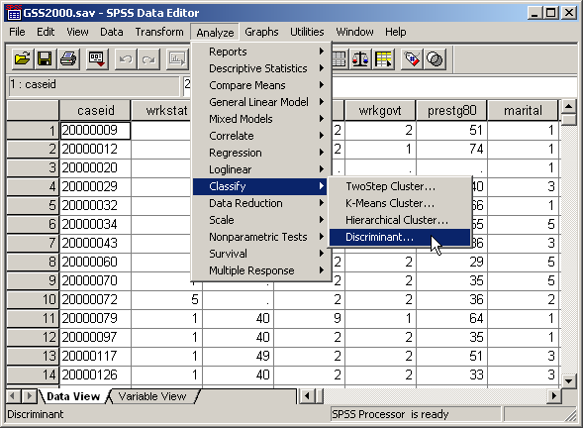
The baseline discriminant analysis
We begin our analysis by running a stepwise discriminant analysis with natfare as the dependent variable and hrs1, wrkslf, educ, and rincom98 as the independent variables.
Select the Classify | Discriminant… command from the Analyze menu.

Slide 22
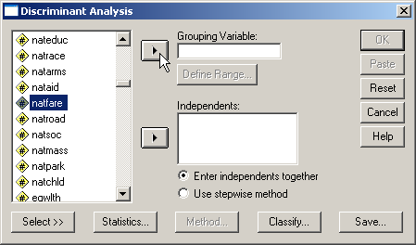
Selecting the dependent variable
First, highlight the dependent variable natfare in the list of variables.
Second, click on the right arrow button to move the dependent variable to the Grouping Variable text box.

Slide 23
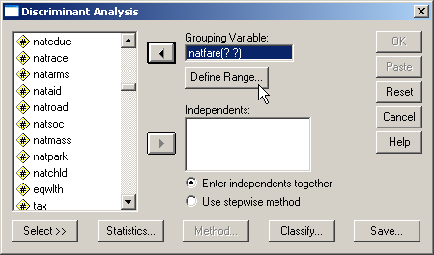
Defining the group values
When SPSS moves the dependent variable to the Grouping Variable textbox, it puts two question marks in parentheses after the variable name. This is a reminder that we have to enter the number that represent the groups we want to include in the analysis.
First, to specify the group numbers, click on the Define Range… button.

Slide 24
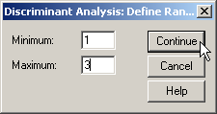
Completing the range of group values
The value labels for natfare show three categories:
1 = TOO LITTLE
2 = ABOUT RIGHT
3 = TOO MUCH
The range of values that we need to enter goes from 1 as the minimum and 3 as the maximum.
First, type in 1 in the Minimum text box.
Second, type in 3 in the Maximum text box.
Third, click on the Continue button to close the dialog box.
Note: if we enter the wrong range of group numbers, e.g., 1 to 2 instead of 1 to 3, SPSS will only include groups 1 and 2 in the analysis.

Slide 25
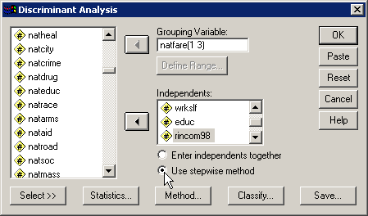
Specifying the method for including variables
SPSS provides us with two methods for including variables: to enter all of the independent variables at one time, and a stepwise method for selecting variables using a statistical test to determine the order in which variables are included.
Since the problem states the importance of the best subset of predictors, we mark the option button to Use stepwise method.

Slide 26
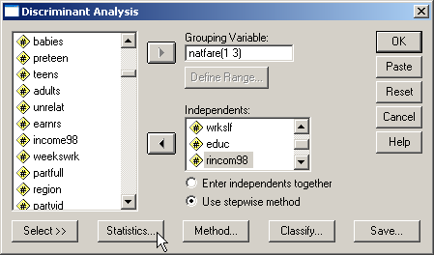
Requesting statistics for the output
Click on the Statistics… button to select statistics we will need for the analysis.

Slide 27
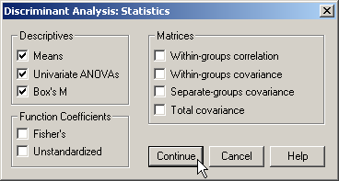
Specifying statistical output
First, mark the Means checkbox on the Descriptives panel. We will use the group means in our interpretation.
Second, mark the Univariate ANOVAs checkbox on the Descriptives panel. Perusing these tests suggests which variables might be useful descriminators.
Third, mark the Box’s M checkbox. Box’s M statistic evaluates conformity to the assumption of homogeneity of group variances.
Fourth, click on the Continue button to close the dialog box.

Slide 28
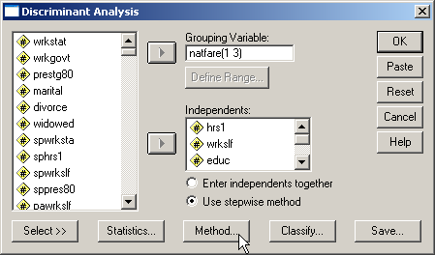
Specifying details for the stepwise method
Click on the Method… button to specify the specific statistical criteria to use for including variables.

Slide 29
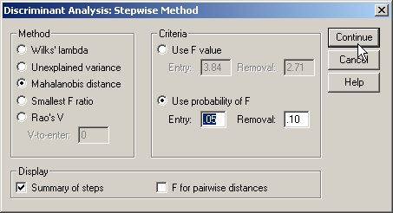
Details for the stepwise method
First, mark the Mahalanobis distance option button on the Method panel.
Second, mark the Summary of steps checkbox to produce a summary table when a new variable is added.
Third, click on the Continue button to close the dialog box.
Third, click on the option button Use probability of F so that we can incorporate the level of significance specified in the problem.
Fourth, type the level of significance in the Entry text box. The Removal value is twice as large as the entry value.

Slide 30

Specifying details for classification
Click on the Classify… button to specify details for the classification phase of the analysis.

Slide 31
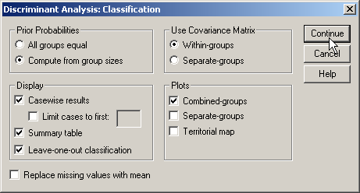
Details for classification - 1
First, mark the option button to Compute from group sizes on the Prior Probabilities panel. This incorporates the size of the groups defined by the dependent variable into the classification of cases using the discriminant functions.
Second, mark the Casewise results checkbox on the Display panel to include classification details for each case in the output.
Third, mark the Summary table checkbox to include summary tables comparing actual and predicted classification.

Slide 32
Details for classification - 2
Fourth, mark the Leave-one-out classification checkbox to request SPSS to include a cross-validated classification in the output. This option produces a less biased estimate of classification accuracy by sequentially holding each case out of the calculations for the discriminant functions, and using the derived functions to classify the case held out.

Slide 33
Details for classification - 3
Fifth, accept the default of Within-groups option button on the Use Covariance Matrix panel. The Covariance matrices are the measure of the dispersion in the groups defined by the dependent variable. If we fail the homogeneity of group variances test (Box’s M), our option is use Separate groups covariance in classification.
Seventh, click on the Continue button to close the dialog box.
Sixth, mark the Combined-groups checkbox on the Plots panel to obtain a visual plot of the relationship between functions and groups defined by the dependent variable.

Slide 34

Completing the discriminant analysis request
Click on the OK button to request the output for the disciminant analysis.

Slide 35
Initial sample size - 1
The initial sample size before excluding outliers and influential cases is 138 cases. With 4 independent variables, the ratio of cases to variables is 34.5 to 1, satisfying both the minimum ratio of 5 cases for each independent variable and the preferred ratio of 20 to 1.

Slide 36
Initial sample size - 2
In addition to the requirement for the ratio of cases to independent variables, discriminant analysis requires that there be a minimum number of cases in the smallest group defined by the dependent variable. The number of cases in the smallest group must be larger than the number of independent variables, and preferrably contain 20 or more cases.
The number of cases in the smallest group in this problem is 32, which is larger than the number of independent variables (4), satisfying the minimum requirement. In addition, the number of cases in the smallest group satisfies the preferred minimum of 20 cases.
If the sample size did not initially satisfy the minimum requirements, discriminant analysis is not appropriate.

Slide 37
Classification accuracy before transformations or removing outliers
Prior to any transformations of variables to satisfy the assumptions of discriminant analysis or removal of outliers, the cross-validated accuracy rate was 50.0%.
This accuracy rate is the benchmark that we will use to evaluate the utility of transformations and the elimination of outliers.

Slide 38
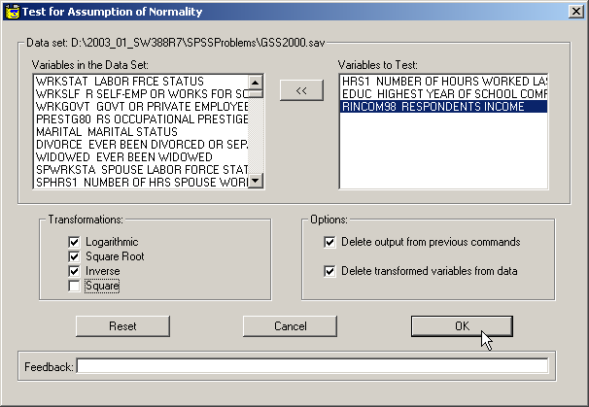
ASSUMPTION OF NORMALITY
There are three metric independent variables to test for normality:
"number of hours worked in the past week" [hrs1],
"highest year of school completed" [educ], and
"income" [rincom98],
To test for normality of, run the script: NormalityAssumptionAnd Transformations.SBS
First, move the three independent variables to thelist box of variables to test.
Second, click on the OK button to produce the output.

Slide 39
Normality of independent variable: highest year of school completed
The independent variable "highest year of school completed" [educ] does not satisfy the criteria for a normal distribution.
The skewness (-0.137) fell between -1.0 and +1.0, but the kurtosis (1.246) fell outside the range from -1.0 to +1.0.

Slide 40
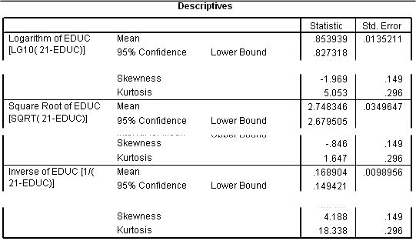
Normality of independent variable: highest year of school completed
Neither the logarithmic, the square root, nor the inverse transformation normalizes the variable.
A caution should be added to the findings.

Slide 41
Normality of independent variable: number of hours worked in the past week
The variable "number of hours worked in the past week" [hrs1] satisfies the criteria for a normal distribution. The skewness (-0.324) and kurtosis (0.935) were both between -1.0 and +1.0.

Slide 42
Normality of independent variable: income
The variable "income" [rincom98] satisfies the criteria for a normal distribution. The skewness (-0.686) and kurtosis (-0.253) were both between
-1.0 and +1.0.
Since we do not have any transformations to test, we can use the baseline model to examine outliers.
If we had transformation to test, we would run the discriminant analysis again, substituting the transformed variables before examining outliers.

Slide 43
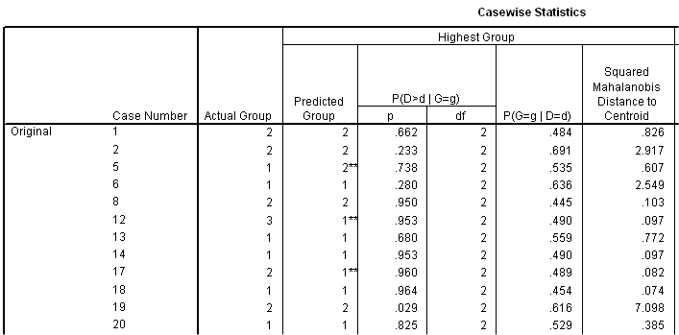
OUTLIERS
The classification output for individual cases can be used to detect outliers. In this context, an outlier is a case that is distant from the centroid of the group to which it has the highest probability of belonging.
Distance from the centroid of a group is measured by Mahalanobis Distance.
To identify outliers, we scan the column looking for cases with Mahalanobis D² distance greater than a critical value.

Slide 44
Using SPSS to calculate the critical value for Mahalanobis D²
The critical value for Mahalanobis D² is that value that would achieve a specified level of statistical significance given the number of variables that were included in its calculation.
Specifically, we will use an SPSS function to give us the critical value for a probability of 0.01 with the degrees of freedom equal to the number of variables used to compute D².

Slide 45
The number of variables used to compute Mahalanobis D²
In a direct entry discriminant analysis that includes all variables simultaneously, the number of variables used to compute the values of D² is equal to the number of independent variables included in the analysis.
In stepwise discriminant analysis, the number of variables used to compute the values of D² is equal to the number of independent variables selected for inclusion by the statistical procedure.
In this problem, 3 out of the 4 independent variables were used in the discriminant functions.

Slide 46
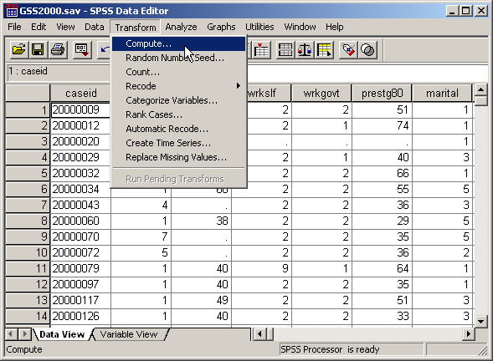
Computing the critical value for Mahalanobis D²
First, we open the window to compute a new variable by selecting the Compute… command from the Transform menu.

Slide 47
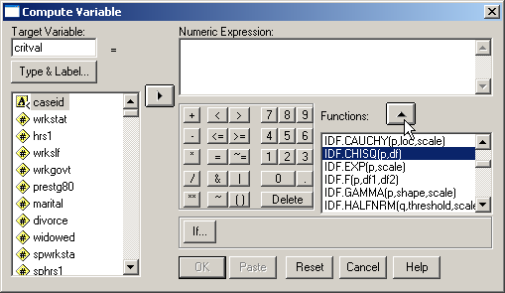
Selecting the SPSS function
First, we enter the acronym for the variable we want to create in the Target Variable textbox: critval, for critical value.
Third, we click on the up arrow button to move the function to the Numeric Expression textbox.
Second, we scroll down the list of SPSS function to highlight the one we need:
IDF.CHISQ(p, df)

Slide 48
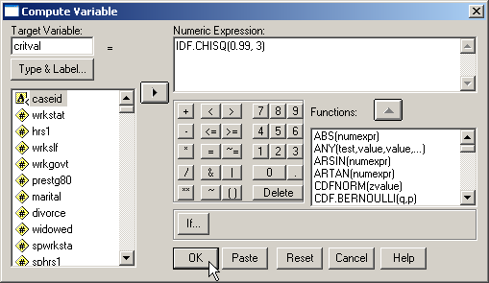
Completing the function arguments
First, the first argument to the IDF.CDF function, p, is replaced by the cumulative probability associated with the critical value, 0.99.
Second, the number of independent variables in the discriminant functions, 3, is used as the df, or degrees of freedom.
Third, click on the OK… button to compute the variable.

Slide 49
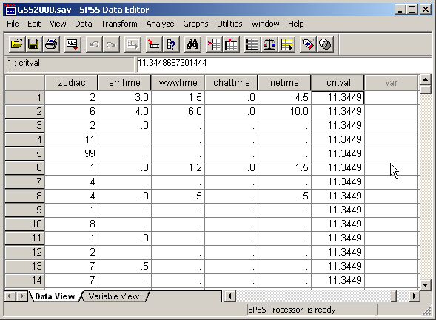
The critical value for Mahalanobis D²
The critical value is calculated as a new variable in the SPSS data editor. Even though we only need it calculated a single time, the compute crease a value for every case.
Now that we have the critical value, we can compare it to the values in the table of Casewise Statistics.

Slide 50
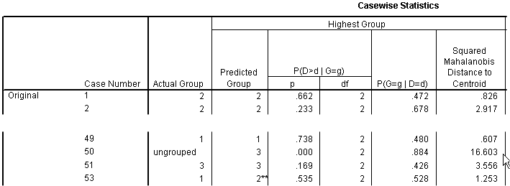
Skipping ungrouped cases
Case 50 has a D² 0f 16.603 which is its distance from the centroid of its predicted group 3. However, the actual group for the case was "ungrouped" meaning it was missing data for the dependent variable. This case is not counted as an outlier because it is already omitted from the calculations for the discriminant functions.

Slide 51
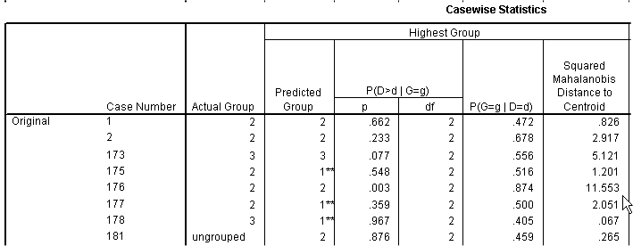
Identifying outliers
Case Number 176 has a D² 0f 11.553 which is its distance from the centroid of its predicted group 2, and which is larger than the critical value for D² of 11.345. This case is an outlier and should be omitted in our test for the impact of outliers on the analysis.
To omit it from the analysis, we will have to find its case id number and eliminate that. We cannot use case numbers to eliminate outliers, because omitting one case changes the case number for all of the other cases after it, and we are likely to exclude the wrong case.

Slide 52
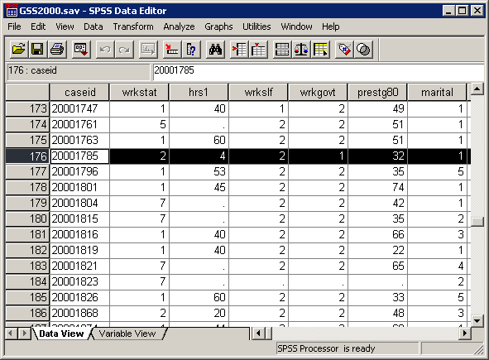
The caseid of the outlier
To omit the outlier, we scroll down the data editor to case 176 and note its caseid value, "20001785."
In this data set, caseids are string or text data, and we represent their values in quotation marks.

Slide 53
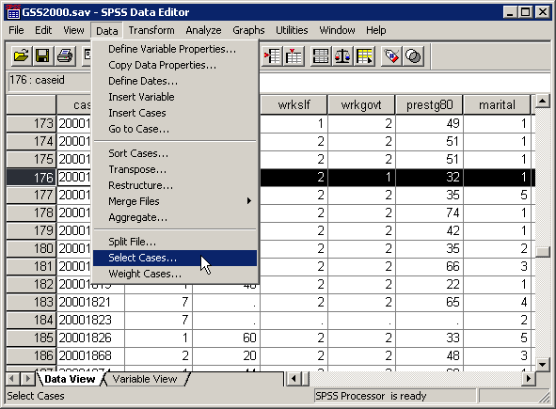
Omitting the outliers
To omit outliers, we select into the analysis, the cases that are not outliers.
First, select the Select Cases… command from the Transform menu.

Slide 54
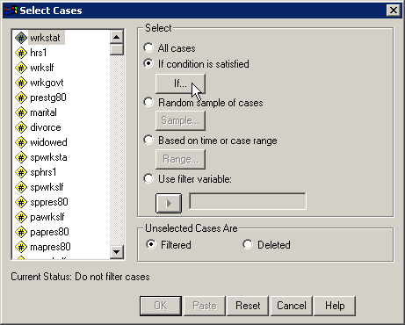
Specifying the condition to omit outliers
First, mark the If condition is satisfied option button to indicate that we will enter a specific condition for including cases.
Second, click on the If… button to specify the criteria for inclusion in the analysis.

Slide 55
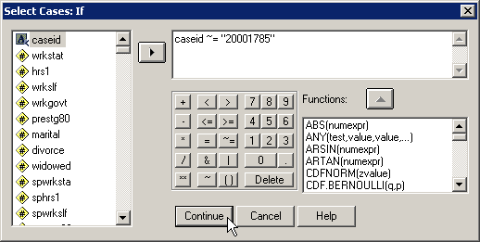
The formula for omitting outliers
To eliminate the outliers, we request the cases that are not outliers be included in the analysis. Using this formula, we are selecting cases that do not have a caseid of "20001785".
In the formula, the symbols ~= stands for "not equal to".
If we had more than one outlier, the formula would be expanded to:
caseid~="20001785" and caseid~="20005967" and caseid~="20006102" …
After typing in the formula, click on the Continue button to close the dialog box,

Slide 56
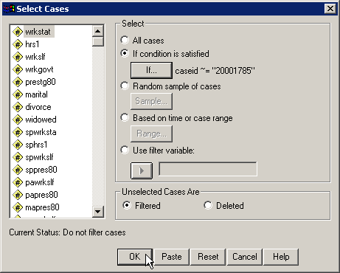
Completing the request for the selection
To complete the request, we click on the OK button.

Slide 57
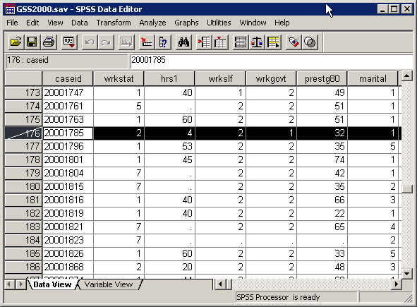
The omitted outlier
SPSS identifies the excluded cases by drawing a slash mark through the case number.

Slide 58
Classification accuracy without the outlier
Prior to any transformations of variables to satisfy the assumptions of normality and the removal of outliers, the cross-validated classification accuracy rate was 50.0%.
After substituting transformed variables and removing outliers, the cross-validated classification accuracy rate was 49.7%.

Slide 59
SELECTION OF MODEL FOR INTERPRETATION
Since the discriminant analysis using transformations and omitting outliers was less accurate in classifying cases than the discriminant analysis with all cases and no transformations, the discriminant analysis with all cases and no transformations was interpreted.

Slide 60
SAMPLE SIZE - 1
The minimum ratio of valid cases to independent variables for discriminant analysis is 5 to 1, with a preferred ratio of 20 to 1. In this analysis, there are 138 valid cases and 4 independent variables.
The ratio of cases to independent variables is 34.5 to 1, which satisfies the minimum requirement. In addition, the ratio of 34.5 to 1 satisfies the preferred ratio of 20 to 1.

Slide 61
SAMPLE SIZE - 2
In addition to the requirement for the ratio of cases to independent variables, discriminant analysis requires that there be a minimum number of cases in the smallest group defined by the dependent variable. The number of cases in the smallest group must be larger than the number of independent variables, and preferably contain 20 or more cases.
The number of cases in the smallest group in this problem is 32, which is larger than the number of independent variables (4), satisfying the minimum requirement. In addition, the number of cases in the smallest group satisfies the preferred minimum of 20 cases.

Slide 62
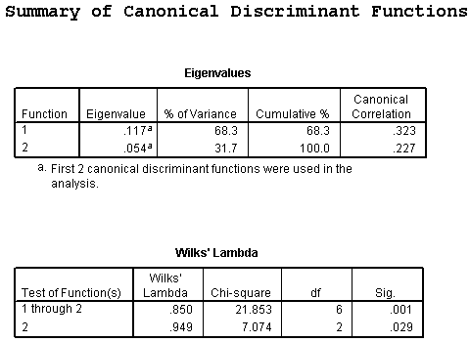
NUMBER OF DISCRIMINANT FUNCTIONS - 1
The maximum possible number of discriminant functions is the smaller of one less than the number of groups defined by the dependent variable and the number of independent variables.
In this analysis there were 3 groups defined by opinion about spending on welfare and 4 independent variables, so the maximum possible number of discriminant functions was 2.

Slide 63
NUMBER OF DISCRIMINANT FUNCTIONS - 2
In the table of Wilks' Lambda which tested functions for statistical significance, the stepwise analysis identified 2 discriminant functions that were statistically significant. The Wilks' lambda statistic for the test of function 1 through 2 functions (chi-square=21.853) had a probability of 0.001 which was less than or equal to the level of significance of 0.05.
After removing function 1, the Wilks' lambda statistic for the test of function 2 (chi-square=7.074) had a probability of 0.029 which was less than or equal to the level of significance of 0.05. The significance of the maximum possible number of discriminant functions supports the interpretation of a solution using 2 discriminant functions.

Slide 64
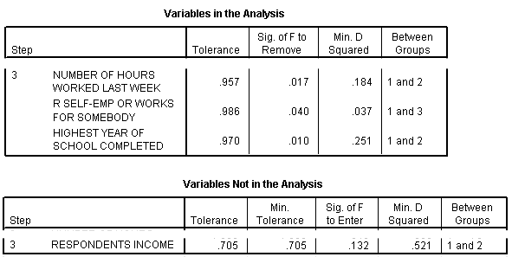
MULTICOLLINEARITY
Multicollinearity occurs when one independent variable is so strongly correlated with one or more other variables that its relationship to the dependent variable is likely to be misinterpreted. Its potential unique contribution to explaining the dependent variable is minimized by its strong relationship to other independent variables. Multicollinearity is indicated when the tolerance value for an independent variable is less than 0.10.
The tolerance values for all of the independent variables are larger than 0.10. Multicollinearity is not a problem in this discriminant analysis.

Slide 65
Independent variables and group membership: relationship of functions to groups
In order to specify the role that each independent variable plays in predicting group membership on the dependent variable, we must link together the relationship between the discriminant functions and the groups defined by the dependent variable, the role of the significant independent variables in the discriminant functions, and the differences in group means for each of the variables.
Function 2 separates survey respondents who thought we spend too little money on welfare (positive value of 0.235) from survey respondents who thought we spend too much money (negative value of -0.362) on welfare. We ignore the second group (-0.031) in this comparison because it was distinguished from the other two groups by function 1.
Function 1 separates survey respondents who thought we spend about the right amount of money on welfare (the positive value of 0.446) from survey respondents who thought we spend too much (negative value of -0.311) or little money (negative value of -0.220) on welfare.

Slide 66
Independent variables and group membership: which predictors to interpret
When we use the stepwise method of variable inclusion, we limit our interpretation of independent variable predictors to those listed as statistically significant in the table of Variables Entered/Removed.
We will interpret the impact on membership in groups defined by the dependent variable by the independent variables:
number of hours worked in the past week
self-employment.
highest year of school completed
Had we use simultaneous entry of all variables, we would not have imposed this limitation.

Slide 67
Independent variables and group membership: predictor loadings on functions
We do not interpret loadings in the structure matrix unless they are 0.30 or higher.
Based on the structure matrix, the predictor variable strongly associated with discriminant function 2 which distinguished between survey respondents who thought we spend too little money on welfare and survey respondents who thought we spend too much money on welfare was self-employment (r=0.889).
Based on the structure matrix, the predictor variables strongly associated with discriminant function 1 which distinguished between survey respondents who thought we spend about the right amount of money on welfare and survey respondents who thought we spend too much or little money on welfare were number of hours worked in the past week (r=-0.582) and highest year of school completed (r=0.687).

Slide 68
Independent variables and group membership: predictors associated with first function - 1
The average number of hours worked in the past week for survey respondents who thought we spend about the right amount of money on welfare (mean=37.90) was lower than the average number of hours worked in the past weeks for survey respondents who thought we spend too little money on welfare (mean=43.96) and survey respondents who thought we spend too much money on welfare (mean=42.03).
This supports the relationship that "survey respondents who thought we spend about the right amount of money on welfare worked fewer hours in the past week than survey respondents who thought we spend too little or much money on welfare."

Slide 69
Independent variables and group membership: predictors associated with first function - 2
The average highest year of school completed for survey respondents who thought we spend about the right amount of money on welfare (mean=14.78) was higher than the average highest year of school completeds for survey respondents who thought we spend too little money on welfare (mean=13.73) and survey respondents who thought we spend too much money on welfare (mean=13.38).
This supports the relationship that "survey respondents who thought we spend about the right amount of money on welfare had completed more years of school than survey respondents who thought we spend too little or much money on welfare."

Slide 70
Independent variables and group membership: predictors associated with second function
Since self-employment is a dichotomous variable, the mean is not directly interpretable. Its interpretation must take into account the coding by which 1 corresponds to self-employed and 2 corresponds to someone else. The lower mean for survey respondents who thought we spend too much money on welfare (mean=1.75), when compared to the mean for survey respondents who thought we spend too little money on welfare (mean=1.93), implies that the group contained more survey respondents who were self-employed and fewer survey respondents who were working for someone else.
This supports the relationship that "survey respondents who thought we spend too much money on welfare were more likely to be self-employed than survey respondents who thought we spend too little money on welfare."

Slide 71
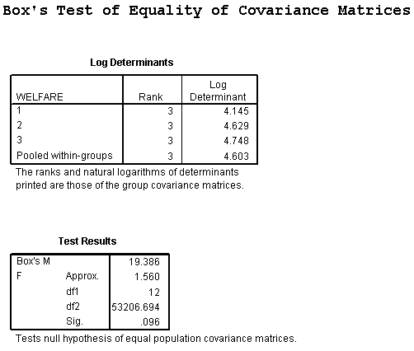
ASSUMPTION OF EQUAL DISPERSION FOR DEPENDENT VARIABLE GROUPS
The assumption of equal dispersion for groups defined by the dependent variable only affects the classification phase of discriminant analysis, and so is not evaluated until we are determining the final accuracy rate of the model.
Box's M test evaluated the homogeneity of dispersion matrices across the subgroups of the dependent variable. The null hypothesis is that the dispersion matrices are homogenous. If the analysis fails this test, we request the use of separate group dispersion matrices in the classification phase of the discriminant analysis to see it this improves our accuracy rate.

Slide 72
ASSUMPTION OF EQUAL DISPERSION FOR DEPENDENT VARIABLE GROUPS
In this analysis, Box's M statistic had a value of 19.386 with a probability of 0.096. Since the probability for Box's M is greater than the level of significance for testing assumptions (0.01), the null hypothesis is not rejected and the assumption of equal dispersion is satisfied.
We use the pooled or within-groups covariance matrix for classification.

Slide 73
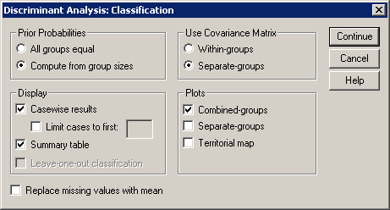
ASSUMPTION OF EQUAL DISPERSION FOR DEPENDENT VARIABLE GROUPS
Had we rejected the null hypothesis and concluded that dispersion was not equal across groups, we would have run the analysis again, specifying separate-groups covariance matrices for classification.
If classification using separate covariance matrices were more accurate by 2% or more, we would report classification accuracy based on this model rather than the one that use within-groups covariance.

Slide 74
CLASSIFICATION USING THE DISCRIMINANT MODEL: by chance accuracy rate
The independent variables could be characterized as useful predictors of membership in the groups defined by the dependent variable if the cross-validated classification accuracy rate was significantly higher than the accuracy attainable by chance alone. Operationally, the cross-validated classfication accuracy rate should be 25% or more higher than the proportional by chance accuracy rate.
The proportional by chance accuracy rate of was computed by squaring and summing the proportion of cases in each group from the table of prior probabilities for groups (0.406² + 0.362² + 0.232² = 0.350).

Slide 75
CLASSIFICATION USING THE DISCRIMINANT MODEL: criteria for classification accuracy
The cross-validated accuracy rate computed by SPSS was 50.0% which was greater than or equal to the proportional by chance accuracy criteria of 43.7% (1.25 x 35.0% = 43.7%). The criteria for classification accuracy is satisfied.

Slide 76
Answering the problem question - 1
From the list of variables "number of hours worked in the past week" [hrs1], "self-employment" [wrkslf], "highest year of school completed" [educ], and "income" [rincom98], the most useful predictors for distinguishing among groups based on responses to "opinion about spending on welfare" [natfare] are "number of hours worked in the past week" [hrs1], "self-employment" [wrkslf], and "highest year of school completed" [educ]. These predictors differentiate survey respondents who thought we spend too much money on welfare from survey respondents who thought we spend about the right amount of money on welfare who, in turn, are differentiated from survey respondents who thought we spend too little money on welfare.
The most important predictor of groups based on responses to opinion about spending on welfare was number of hours worked in the past week. The second most important predictor of groups based on responses to opinion about spending on welfare was self-employment. The third most important predictor of groups based on responses to opinion about spending on welfare was highest year of school completed.
Survey respondents who thought we spend about the right amount of money on welfare worked fewer hours in the past week than survey respondents who thought we spend too much or little money on welfare. Survey respondents who thought we spend about the right amount of money on welfare had completed more years of school than survey respondents who thought we spend too much or little money on welfare. Survey respondents who thought we spend too much money on welfare were more likely to be self-employed than survey respondents who thought we spend too little money on welfare.
The stepwise discriminant analysis included the three variables identified as the most useful predictors.

Slide 77
Answering the problem question - 2
From the list of variables "number of hours worked in the past week" [hrs1], "self-employment" [wrkslf], "highest year of school completed" [educ], and "income" [rincom98], the most useful predictors for distinguishing among groups based on responses to "opinion about spending on welfare" [natfare] are "number of hours worked in the past week" [hrs1], "self-employment" [wrkslf], and "highest year of school completed" [educ]. These predictors differentiate survey respondents who thought we spend too much money on welfare from survey respondents who thought we spend about the right amount of money on welfare who, in turn, are differentiated from survey respondents who thought we spend too little money on welfare.
The most important predictor of groups based on responses to opinion about spending on welfare was number of hours worked in the past week. The second most important predictor of groups based on responses to opinion about spending on welfare was self-employment. The third most important predictor of groups based on responses to opinion about spending on welfare was highest year of school completed.
Survey respondents who thought we spend about the right amount of money on welfare worked fewer hours in the past week than survey respondents who thought we spend too much or little money on welfare. Survey respondents who thought we spend about the right amount of money on welfare had completed more years of school than survey respondents who thought we spend too much or little money on welfare. Survey respondents who thought we spend too much money on welfare were more likely to be self-employed than survey respondents who thought we spend too little money on welfare.
We found two statistically significant discriminant functions, making it possible to distinguish among the three groups defined by the dependent variable.
Moreover, the cross-validated classification accuracy surpassed the by chance accuracy criteria, supporting the utility of the model.

Slide 78
Answering the problem question - 3
From the list of variables "number of hours worked in the past week" [hrs1], "self-employment" [wrkslf], "highest year of school completed" [educ], and "income" [rincom98], the most useful predictors for distinguishing among groups based on responses to "opinion about spending on welfare" [natfare] are "number of hours worked in the past week" [hrs1], "self-employment" [wrkslf], and "highest year of school completed" [educ]. These predictors differentiate survey respondents who thought we spend too much money on welfare from survey respondents who thought we spend about the right amount of money on welfare who, in turn, are differentiated from survey respondents who thought we spend too little money on welfare.
The most important predictor of groups based on responses to opinion about spending on welfare was number of hours worked in the past week. The second most important predictor of groups based on responses to opinion about spending on welfare was self-employment. The third most important predictor of groups based on responses to opinion about spending on welfare was highest year of school completed.
Survey respondents who thought we spend about the right amount of money on welfare worked fewer hours in the past week than survey respondents who thought we spend too much or little money on welfare. Survey respondents who thought we spend about the right amount of money on welfare had completed more years of school than survey respondents who thought we spend too much or little money on welfare. Survey respondents who thought we spend too much money on welfare were more likely to be self-employed than survey respondents who thought we spend too little money on welfare.
The order of importance matched the order of entry in the table of "Variables Entered/Removed."

Slide 79
Answering the problem question - 4
The most important predictor of groups based on responses to opinion about spending on welfare was number of hours worked in the past week. The second most important predictor of groups based on responses to opinion about spending on welfare was self-employment. The third most important predictor of groups based on responses to opinion about spending on welfare was highest year of school completed.
Survey respondents who thought we spend about the right amount of money on welfare worked fewer hours in the past week than survey respondents who thought we spend too much or little money on welfare. Survey respondents who thought we spend about the right amount of money on welfare had completed more years of school than survey respondents who thought we spend too much or little money on welfare. Survey respondents who thought we spend too much money on welfare were more likely to be self-employed than survey respondents who thought we spend too little money on welfare.
1. True
2. True with caution
3. False
4. Inappropriate application of a statistic
We verified that each statement about the relationship between predictors and groups was correct.
The answer to the question is true with caution. A caution is added because of the inclusion of ordinal level variables. A caution is added because of a violation of discriminant analysis assumptions.

Slide 80
Steps in discriminant analysis: level of measurement and initial sample size
The following is a guide to the decision process for answering
problems about the complete discriminant analysis:
Dependent non-metric?
Independent variables metric or dichotomous?
No
Inappropriate application of a statistic
Yes
Ratio of cases to independent variables at least 5 to 1?
No
Inappropriate application of a statistic
Yes
Yes
Number of cases in smallest group greater than number of independent variables?
No
Inappropriate application of a statistic
Yes
Yes

Slide 81
Steps in discriminant analysis: running the baseline model
Run baseline discriminant analysis, using method for including variables identified in the research question.
Record cross-validated classification accuracy for evaluation of transformations and removal of outliers.
Metric IV’s normally distributed?
Try:
1. Logarithmic transformation
2. Square root transformation
3. Inverse transformation
If unsuccessful, add caution for violation of discriminant analysis assumptions
No
Yes
Mahalanobis D² to most likely group greater than critical value?
Yes
Remove outliers from data set
No

Slide 82
Steps in discriminant analysis: picking discriminant model for interpretation
Were transformed variables substituted, or outliers and influential cases omitted?
No
Yes
Evaluate impact of transformations and removal of outliers by running discriminant again, using method for including variables identified in the research question.
Cross-validated accuracy for second discriminant analysis greater than accuracy of baseline by 2% or more?
Yes
No
Pick discriminant analysis with transformations and omitting outliers for interpretation
Pick baseline discriminant analysis for interpretation

Slide 83
Steps in discriminant analysis: usable discriminant model
Sufficient statistically significant functions to distinguish DV groups?
No
False
Yes
Tolerance for all IV’s greater than 0.10, indicating no multicollinearity?
No
False
Yes

Slide 84
Steps in discriminant analysis: assumption of equal dispersion
Probability of Box's M test less than or equal to level of significance for assumptions?
Yes
Re-run discriminant analysis, using separate-groups covariance matrices
for classification
No
Accuracy rate at least 2% higher using separate-groups covariance matrices?
No
Yes
Pick discriminant analysis using within-groups covariance for interpretation
Pick discriminant analysis using separate-groups covariance for interpretation

Slide 85
Steps in discriminant analysis: relationships between IV's and DV
Stepwise method of entry used to include independent variables?
Yes
No
Entry order of variables interpreted correctly?
No
Yes
False
Relationships between individual IVs and DV groups interpreted correctly?
No
False
Yes

Slide 86
Steps in discriminant analysis: classification accuracy
Cross-validated accuracy is 25% higher than proportional by chance accuracy rate?
No
False
Yes
Yes

Slide 87
Steps in discriminant analysis: adding cautions to solution
Satisfies preferred ratio of cases to IV's of 20 to 1
No
True with caution
Yes
Yes
Satisfies preferred DV group minimum size of 20 cases?
No
True with caution
Yes
Yes
DV is non-metric level and IVs are interval level or dichotomous (not ordinal)?
No
True with caution
Yes
True

