Slide 1
Principal component analysis
Principal component analysis
Strategy for solving problems
Sample problems
Steps in principal component analysis

Slide 2
Principal components factor analysis
Obtaining a factor solution through principal components analysis is an iterative process that usually requires repeating the SPSS factor analysis procedure a number of times to reach a satisfactory solution.
We begin by identifying a group of variables whose variance we believe can be represented more parsimoniously by a smaller set of factors, or components. The end result of the principal components analysis will tell us which variables can be represented by which components, and which variables should be retained as individual variables because the factor solution does not adequately represent their information.

Slide 3
Strategy for solving problems - 1
A principal component factor analysis requires:
  The variables included must be metric level or dichotomous (dummy-coded) nominal level
  The sample size must be greater than 50 (preferably 100)
  The ratio of cases to variables must be 5 to 1 or larger
  The correlation matrix for the variables must contain 2 or more correlations of 0.30 or greater
  Variables with measures of sampling adequacy less than 0.50 must be removed
  The overall measure of sampling adequacy is 0.50 or higher
  The Bartlett test of sphericity is statistically significant.
The first phase of a principal component analysis is devoted to verifying that we meet these requirements. If we do not meet these requirements, factor analysis is not appropriate.

Slide 4
Strategy for solving problems - 2
The second phase of a principal component factor analysis focuses on deriving a factor model, or pattern of relationships between variables and components, that satisfies the following requirements:
  The derived components explain 50% or more of the variance in each of the variables, i.e. have a communality greater than 0.50
  None of the variables have loadings, or correlations, of 0.40 or higher for more than one component, i.e. do not have complex structure
  None of the components has only one variable in it
To meet these requirements, we remove problematic variables from the analysis and repeat the principal component analysis.

Slide 5
Strategy for solving problems - 3
If, at the conclusion of this process, we have components that have more than one variable loading on them, have components that explain at least 50% of the variance in the included variables, and have components that collectively explain more than 60% of the variance in the set of variables, we can substitute the components for the variables in further analyses.
Variables that were removed in the analysis should be included individually in further analyses.
Substitution of components for individual variables is accomplished by using only the highest loading variable, or by combining the variables loading on each component to create a new variable.

Slide 6
Notes - 1
When evaluating measures of sampling adequacy, communalities, or factor loadings, we ignore the sign of the numeric value and base our decision on the size or magnitude of the value.
The sign of the number indicates the direction of the relationship.
A loading of -0.732 is just as strong as a loading of 0.732. The minus sign indicates an inverse or negative relationship; the absence of a sign is meant to imply a plus sign indicating a direct or positive relationship.

Slide 7
Notes - 2
If there are two or more components in the component matrix, the pattern of loadings is based on the SPSS Rotated Component Matrix. If there is only one component in the solution, the Rotated Component Matrix is not computed, and the pattern of loadings is based on the Component Matrix.
It is possible that the analysis will break down and we will have too few variables in the analysis to support the use of principal component analysis.

Slide 8
Problem 1
In the dataset GSS2000.sav, is the following statement true, false, or an incorrect application of a statistic? Answer the question based on the results of a principal component analysis prior to testing for outliers, split sample validation, and a test of reliability. Assume that there is no problematic pattern of missing data. Use a level of significance of 0.05.
Based on the results of a principal component analysis of the 8 variables "claims about environmental threats are exaggerated" [grnexagg], "danger to the environment from modifying genes in crops" [genegen], "America doing enough to protect environment" [amprogrn], "should be international agreements for environment problems" [grnintl], "poorer countries should be expected to do less for the environment" [ldcgrn], "economic progress in America will slow down without more concern for environment" [econgrn], "likelihood of nuclear power station damaging environment in next 5 years" [nukeacc], and "respondent's socioeconomic index" [sei], the information in these variables can be represented with 2 components and 4 individual variables.
Component 1 includes the variables "danger to the environment from modifying genes in crops" [genegen] and "likelihood of nuclear power station damaging environment in next 5 years" [nukeacc]. Component 2 includes the variables "claims about environmental threats are exaggerated" [grnexagg] and "poorer countries should be expected to do less for the environment" [ldcgrn]. The variables "respondent's socioeconomic index" [sei], "economic progress in America will slow down without more concern for environment" [econgrn], "should be international agreements for environment problems" [grnintl], and "America doing enough to protect environment" [amprogrn] were not included on the components and are retained as individual variables.
1. True
2. True with caution
3. False
4. Inappropriate application of a statistic

Slide 9
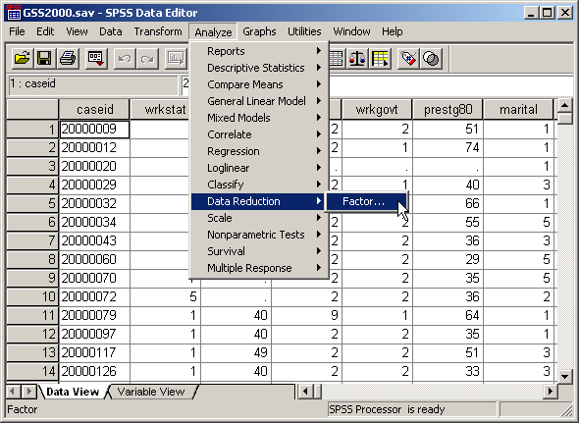
Computing a principal component analysis
To compute a principal component analysis in SPSS, select the Data Reduction | Factor… command from the Analyze menu.

Slide 10
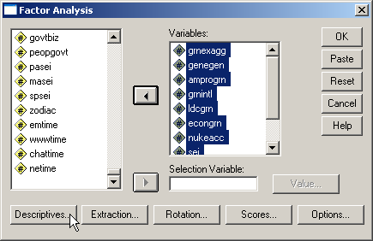
Add the variables to the analysis
First, move the variables listed in the problem to the Variables list box.
Second, click on the Descriptives… button to specify statistics to include in the output.

Slide 11
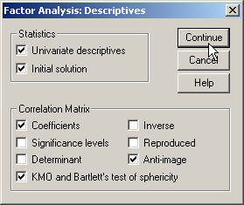
Compete the descriptives dialog box
First, mark the Univariate descriptives checkbox to get a tally of valid cases.
Sixth, click on the Continue button.
Second, keep the Initial solution checkbox to get the statistics needed to determine the number of factors to extract.
Fifth, mark the Anti-image checkbox to get more outputs used to assess the appropriateness of factor analysis for the variables.
Third, mark the Coefficients checkbox to get a correlation matrix, one of the outputs needed to assess the appropriateness of factor analysis for the variables.
Fourth, mark the KMO and Bartlett’s test of sphericity checkbox to get more outputs used to assess the appropriateness of factor analysis for the variables.

Slide 12
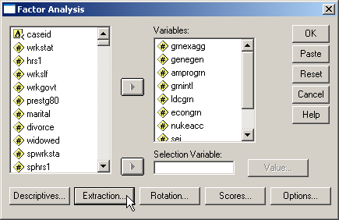
Select the extraction method
First, click on the Extraction… button to specify statistics to include in the output.
The extraction method refers to the mathematical method that SPSS uses to compute the factors or components.

Slide 13
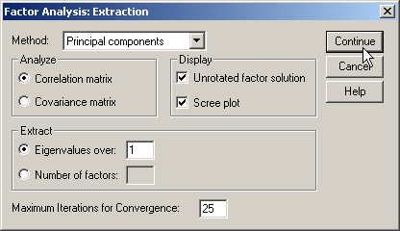
Compete the extraction dialog box
First, retain the default method Principal components.
Second, click on the Continue button.

Slide 14
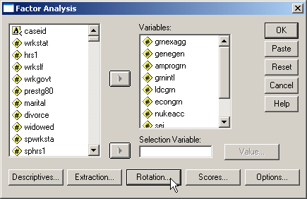
Select the rotation method
The rotation method refers to the mathematical method that SPSS rotate the axes in geometric space. This makes it easier to determine which variables are loaded on which components.
First, click on the Rotation… button to specify statistics to include in the output.

Slide 15
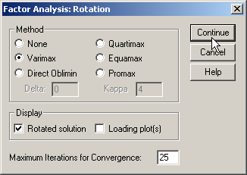
Compete the rotation dialog box
First, mark the Varimax method as the type of rotation to used in the analysis.
Second, click on the Continue button.

Slide 16
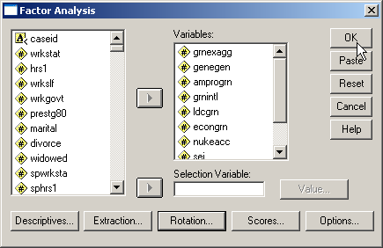
Complete the request for the analysis
First, click on the OK button to request the output.

Slide 17
Level of measurement requirement
"Respondent's socioeconomic index" [sei] is an interval level variable, which satisfy the level of measurement requirements for a principal component analysis.
"Claims about environmental threats are exaggerated" [grnexagg], "danger to the environment from modifying genes in crops" [genegen], "America doing enough to protect environment" [amprogrn], "should be international agreements for environment problems" [grnintl], "poorer countries should be expected to do less for the environment" [ldcgrn], "economic progress in America will slow down without more concern for environment" [econgrn], and "likelihood of nuclear power station damaging environment in next 5 years" [nukeacc] are ordinal level variables. If we follow the convention of treating ordinal level variables as metric variables, the level of measurement requirement for principal component analysis is satisfied. Since some data analysts do not agree with this convention, a note of caution should be included in our interpretation.

Slide 18
Sample size requirement: minimum number of cases
The number of valid cases for this set of variables is 67.
While principal component analysis can be conducted on a sample that has fewer than 100 cases, but more than 50 cases, we should be cautious about its interpretation.

Slide 19
Sample size requirement: ratio of cases to variables
The ratio of cases to variables in a principal component analysis should be at least 5 to 1.
With 67 and 8 variables, the ratio of cases to variables is 8.4 to 1, which exceeds the requirement for the ratio of cases to variables.

Slide 20
Appropriateness of factor analysis:
Presence of substantial correlations
Principal components analysis requires that there be some correlations greater than 0.30 between the variables included in the analysis.
For this set of variables, there are 10 correlations in the matrix greater than 0.30, satisfying this requirement. The correlations greater than 0.30 are highlighted in yellow.

Slide 21
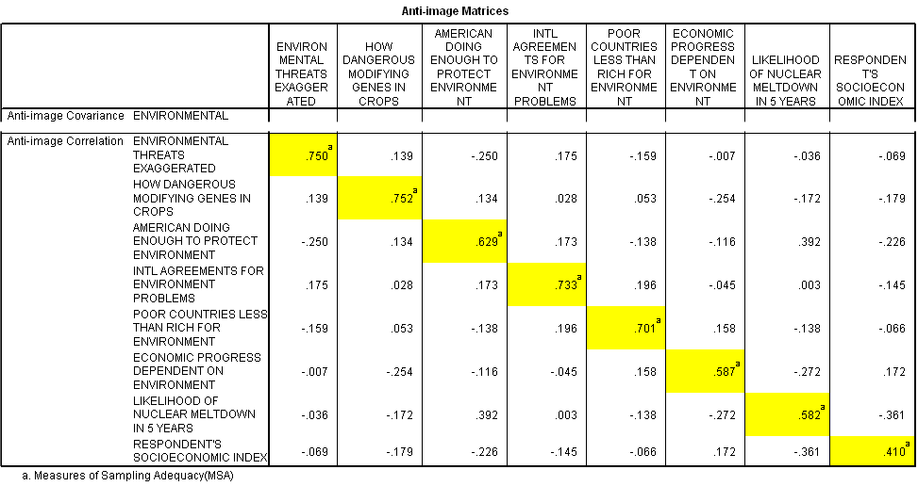
Appropriateness of factor analysis:
Sampling adequacy of individual variables
Principal component analysis requires that the Kaiser-Meyer-Olkin Measure of Sampling Adequacy be greater than 0.50 for each individual variable as well as the set of variables.
The Measure of Sampling Adequacy (MSA) is described at marvelous if it is 0.90 or greater, meritorious if it is in the 0.80's, middling if in the 0.70's, mediocre if in the in the 0.60's , miserable if in the 0.50's, and unacceptable if below 0.50.
There are two anti-image matrices: the anti-image covariance matrix and the anti-image correlation matrix. We are interested in the anti-image correlation matrix.

Slide 22
Appropriateness of factor analysis:
Sampling adequacy of individual variables
SPSS locates the Measures of Sampling Adequacy are on the diagonal of the anti-image correlation matrix, highlighted in yellow.
On iteration 1, the MSA for the variable "respondent's socioeconomic index" [sei] was 0.410 which was less than 0.50, so it was removed from the analysis.

Slide 23
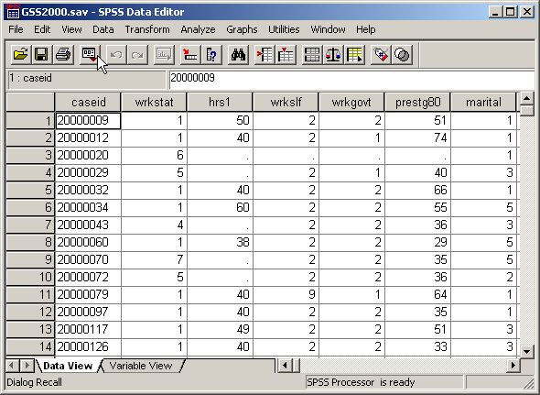
Excluding a variable from the factor analysis
To remove the variable "respondent's socioeconomic index" [sei] from the analysis, click on the Dialog Recall tool button to access the drop down menu.

Slide 24
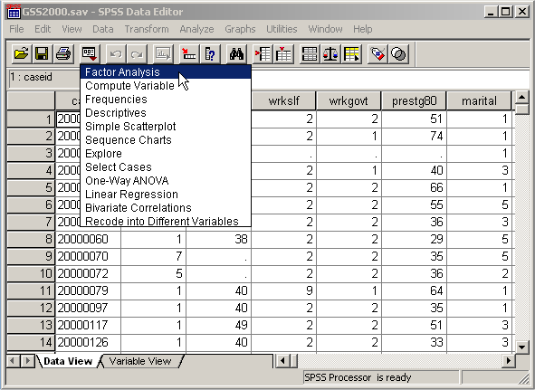
Repeating the factor analysis
In the drop down menu, select Factor Analysis to reopen the factor analysis dialog box.

Slide 25
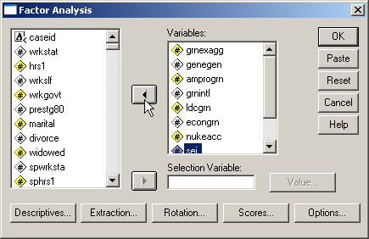
Removing the variable from the list of variables
First, highlight the sei variable.
Second, click on the left arrow button to remove the variable from the Variables list box.

Slide 26
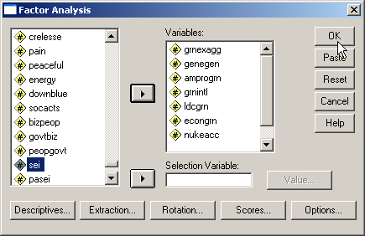
Replicating the factor analysis
The dialog recall command opens the dialog box with all of the settings that we had selected the last time we used factor analysis.
To replicate the analysis without the variable that we just removed, click on the OK button.

Slide 27
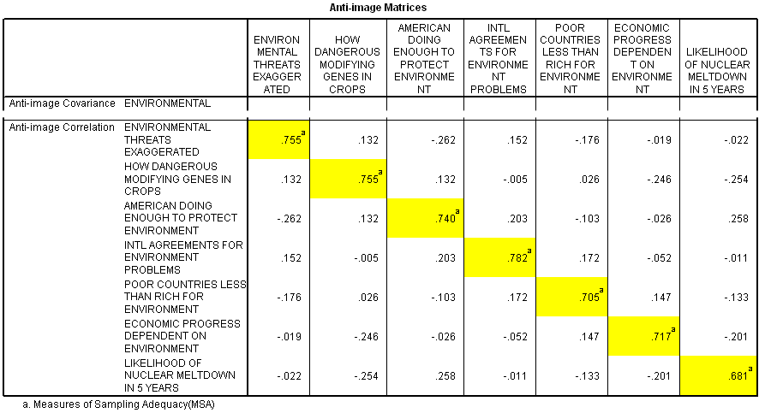
Appropriateness of factor analysis:
Sample adequacy for revised factor analysis
In the factor analysis with the sei variable removed, we see that the measures of sampling adequacy for the remaining variables are all greater than 0.50.
On iteration 2, the MSA for all of the individual variables still included in the analysis was greater than 0.5, supporting their retention in the analysis.

Slide 28
Appropriateness of factor analysis:
Sample adequacy for set of variables
In addition, the overall MSA for the set of variables included in the analysis was 0.734, which exceeds the minimum requirement of 0.50 for overall MSA.
The seven variables remaining in the analysis satisfy the criteria for appropriateness of factor analysis.

Slide 29
Appropriateness of factor analysis:
Bartlett test of sphericity
Principal component analysis requires that the probability associated with Bartlett's Test of Sphericity be less than the level of significance.
The probability associated with the Bartlett test is <0.001, which satisfies this requirement.
The next step is to determine the number of factors that should be included in the factor solution.

Slide 30
Number of factors to extract:
Latent root criterion
Using the output from iteration 2, there were 2 eigenvalues greater than 1.0.
The latent root criterion for number of factors to derive would indicate that there were 2 components to be extracted for these variables.

Slide 31
Number of factors to extract:
Percentage of variance criterion
In contrast, the cumulative proportion of variance criteria would require 3 components to satisfy the criterion of explaining 60% or more of the total variance.
A 3 components solution would explain 65.415% of the total variance.
Since the SPSS default is to extract the number of components indicated by the latent root criterion, our initial factor solution was based on the extraction of 2 components.

Slide 32
Evaluating communalities
Communalities represent the proportion of the variance in the original variables that is accounted for by the factor solution.
The factor solution should explain at least half of each original variable's variance, so the communality value for each variable should be 0.50 or higher.

Slide 33
Communality requiring variable removal
On iteration 2, the communality for the variable "economic progress in America will slow down without more concern for environment" [econgrn] was 0.437 which was less than 0.50.
The variable was removed and the principal component analysis was computed again.
In this iteration, there are actually three variables that have communalities less than 0.50. The variable with the smallest communality is selected for removal.

Slide 34
Repeating the factor analysis
In the drop down menu, select Factor Analysis to reopen the factor analysis dialog box.

Slide 35
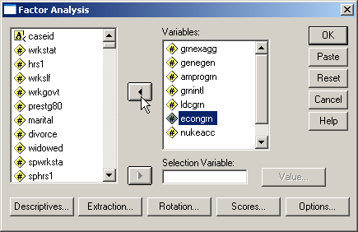
Removing the variable from the list of variables
First, highlight the econgrn variable.
Second, click on the left arrow button to remove the variable from the Variables list box.

Slide 36
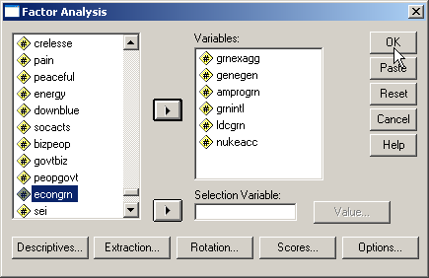
Replicating the factor analysis
The dialog recall command opens the dialog box with all of the settings that we had selected the last time we used factor analysis.
To replicate the analysis without the variable that we just removed, click on the OK button.

Slide 37
Communality requiring variable removal
On iteration 3, the communality for the variable "should be international agreements for environment problems" [grnintl] was 0.486 which was less than 0.50.
The variable was removed and the principal component analysis was computed again.

Slide 38
Repeating the factor analysis
In the drop down menu, select Factor Analysis to reopen the factor analysis dialog box.

Slide 39
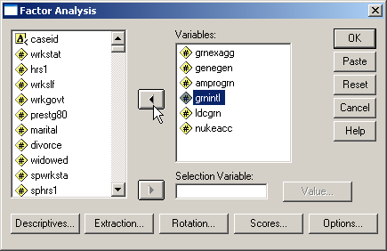
Removing the variable from the list of variables
First, highlight the grnintl variable.
Second, click on the left arrow button to remove the variable from the Variables list box.

Slide 40
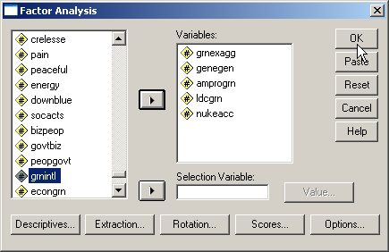
Replicating the factor analysis
The dialog recall command opens the dialog box with all of the settings that we had selected the last time we used factor analysis.
To replicate the analysis without the variable that we just removed, click on the OK button.

Slide 41
Communality satisfactory for all variables
Once any variables with communalities less than 0.50 have been removed from the analysis, the pattern of factor loadings should be examined to identify variables that have complex structure.
Complex structure occurs when one variable has high loadings or correlations (0.40 or greater) on more than one component. If a variable has complex structure, it should be removed from the analysis.
Variables are only checked for complex structure if there is more than one component in the solution. Variables that load on only one component are described as having simple structure.

Slide 42
Identifying complex structure
If only one component has been extracted, each variable can only load on that one factor, so complex structure is not an issue.
On iteration 4, the variable "America doing enough to protect environment" [amprogrn] was found to have complex structure.
Specifically, the variable had a loading of -0.581 on component 1 and a loading of 0.495 on component 2.
The variable should be removed and the principal component analysis should be repeated.

Slide 43
Repeating the factor analysis
In the drop down menu, select Factor Analysis to reopen the factor analysis dialog box.

Slide 44
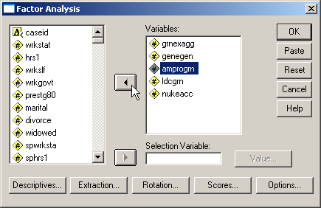
Removing the variable from the list of variables
First, highlight the amprogrn variable.
Second, click on the left arrow button to remove the variable from the Variables list box.

Slide 45
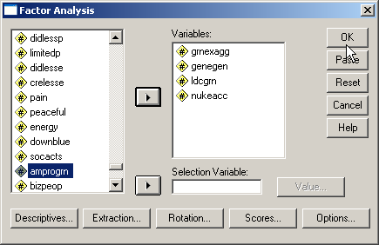
Replicating the factor analysis
The dialog recall command opens the dialog box with all of the settings that we had selected the last time we used factor analysis.
To replicate the analysis without the variable that we just removed, click on the OK button.

Slide 46
Checking for single-variable components
On iteration 5, none of the variables demonstrated complex structure.
It is not necessary to remove any additional variables because of complex structure.
After variables have been removed for low communalities and complex structure, the factor solution is examined to remove any components that have only a single variable loading on them.
If a component has only a single variable loading on it, the variable should be removed from the next iteration of the principal component analysis.

Slide 47
Variable loadings on components
On iteration 5, the 2 components in the analysis had more than one variable loading on each of them.
The communalities for all of the variables included on the components were greater than 0.50 and all variables had simple structure.
The principal component analysis has been completed.

Slide 48
Interpreting the principal components
The information in 4 of the variables can be represented by 2 components.
Component 1 includes the variables "danger to the environment from modifying genes in crops" [genegen] and "likelihood of nuclear power station damaging environment in next 5 years" [nukeacc]. We can substitute one component variable for this combination of variables in further analyses.
Component 2 includes the variables "claims about environmental threats are exaggerated" [grnexagg] and "poorer countries should be expected to do less for the environment" [ldcgrn]. We can substitute one component variable for this combination of variables in further analyses.

Slide 49
Variance explained in individual variables
The components explain at least 50% of the variance in each of the variables included in the final analysis.

Slide 50
Total variance explained
The 2 components explain 68.619% of the total variance in the variables which are included on the components.

Slide 51
Answering the problem question
The answer to the original question is true with caution.
Component 1 includes the variables "danger to the environment from modifying genes in crops" [genegen] and "likelihood of nuclear power station damaging environment in next 5 years" [nukeacc]. We can substitute one component variable for this combination of variables in further analyses.
Component 2 includes the variables "claims about environmental threats are exaggerated" [grnexagg] and "poorer countries should be expected to do less for the environment" [ldcgrn]. We can substitute one component variable for this combination of variables in further analyses.
The components explain at least 50% of the variance in each of the variables included in the final analysis.
The components explain 68.619% of the total variance in the variables which are included on the components.
A caution is added to our findings because of the inclusion of ordinal level variables in the analysis and the limited sample available for analysis.

Slide 52
Problem 2
2. In the dataset GSS2000.sav, is the following statement true, false, or an incorrect application of a statistic? Answer the question based on the results of a principal component analysis prior to testing for outliers, split sample validation, and a test of reliability. Assume that there is no problematic pattern of missing data. Use a level of significance of 0.05.
A principal component analysis of the variables "number of hours worked in the past week" [hrs1], "occupational prestige score" [prestg80], "age" [age], and "highest academic degree" [degree] does not result in any usable components that reduce the number of variable needed to represent the information in the original variables.
1. True
2. True with caution
3. False
4. Inappropriate application of a statistic

Slide 53
Computing a principal component analysis
To compute a principal component analysis in SPSS, select the Data Reduction | Factor… command from the Analyze menu.

Slide 54
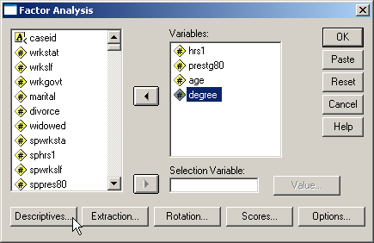
Add the variables to the analysis
First, move the variables listed in the problem to the Variables list box.
Second, click on the Descriptives… button to specify statistics to include in the output.

Slide 55
Compete the descriptives dialog box
First, mark the Univariate descriptives checkbox to get a tally of valid cases.
Sixth, click on the Continue button.
Second, keep the Initial solution checkbox to get the statistics needed to determine the number of factors to extract.
Fifth, mark the Anti-image checkbox to get more outputs used to assess the appropriateness of factor analysis for the variables.
Third, mark the Coefficients checkbox to get a correlation matrix, one of the outputs needed to assess the appropriateness of factor analysis for the variables.
Fourth, mark the KMO and Bartlett’s test of sphericity checkbox to get more outputs used to assess the appropriateness of factor analysis for the variables.

Slide 56
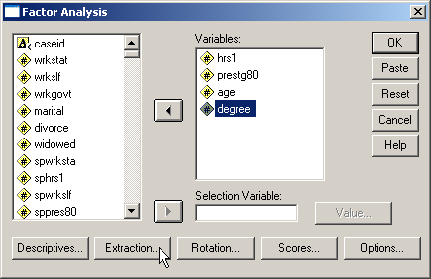
Select the extraction method
First, click on the Extraction… button to specify statistics to include in the output.

Slide 57
Compete the extraction dialog box
First, retain the default method Principal components.
Second, click on the Continue button.

Slide 58

Select the rotation method
First, click on the Rotation… button to specify statistics to include in the output.

Slide 59
Compete the rotation dialog box
First, mark the Varimax method as the type of rotation to used in the analysis.
Second, click on the Continue button.

Slide 60
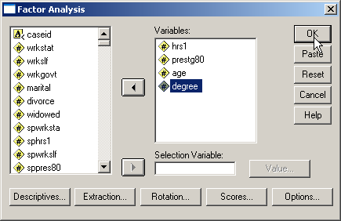
Complete the request for the analysis
First, click on the OK button to request the output.

Slide 61
Level of measurement requirement
"Number of hours worked in the past week" [hrs1], "occupational prestige score" [prestg80], and "age" [age] are interval level variables, which satisfy the level of measurement requirements for a principal component analysis.
"Highest academic degree" [degree] is an ordinal level variable. If we follow the convention of treating ordinal level variables as metric variables, the level of measurement requirement for principal component analysis is satisfied. Since some data analysts do not agree with this convention, a note of caution should be included in our interpretation.

Slide 62
Sample size requirement: minimum number of cases
The number of valid cases for this set of variables is 172.
The preferred minimum sample size requirement of 100 valid cases is satisfied.

Slide 63
Sample size requirement: ratio of cases to variables
The ratio of cases to variables in a principal component analysis should be at least 5 to 1.
With 172 and 4 variables, the ratio of cases to variables is 43.0 to 1, which exceeds the requirement for the ratio of cases to variables.

Slide 64
Appropriateness of factor analysis:
Presence of substantial correlations
Principal components analysis requires that there be some correlations greater than 0.30 between the variables included in the analysis.
For this set of variables, there is 1 correlation in the matrix greater than 0.30, which does not satisfy this requirement.
Since we do not satisfy a basic requirement for principal component factor analysis, the answer to the question is inappropriate application of a statistic

Slide 65
Steps in principal component analysis - 1
The following is a guide to the decision process for answering problems about principal component analysis:
Are the variables included in the analysis metric?
No
Incorrect application of a statistic
Yes
Is the number of valid cases 50 or more?
No
Incorrect application of a statistic
Yes
Is the ratio of cases to variables at least 5 to 1?
No
Incorrect application of a statistic
Yes

Slide 66
Steps in principal component analysis - 2
Are there two or more correlations that are 0.30 or greater?
No
Incorrect application of a statistic
Yes
Is the measure of sampling adequacy larger than 0.50 for each variable?
No
Remove variable with lowest MSA and repeat analysis
Yes
Overall measure of sampling adequacy greater than 0.50?
No
Incorrect application of a statistic
Yes

Slide 67
Steps in principal component analysis - 3
Probability for Bartlett test of sphericity less than level of significance?
No
Incorrect application of a statistic
Yes
Communality for each variable greater than 0.50?
No
Remove variable with lowest communality and repeat analysis
Yes

Slide 68
Steps in principal component analysis - 4
Does all variables show simple structure
(only 1 loading > 0.40)?
No
Remove variable with complex structure and repeat analysis
Yes
Do all of the components have more than one variable loading on it?
No
Remove single variable loading on component and repeat analysis
Yes
Are the number of components and pattern of loadings correct?
No
False
Yes

Slide 69
Steps in principal component analysis - 5
Are all of the metric variables included in the final analysis interval level?
No
True with caution
Yes
Is the sample size for the final analysis include 100 cases or more?
No
True with caution
Yes
Is the cumulative proportion of variance for variables 60% or higher?
No
True with caution
Yes
True

