Slide 1
One-sample T-test of a Population Mean
One-sample T-test of a Population Mean
Confidence Intervals for a Population Mean

Slide 2
Problem 1
Based on the dataset GSS2000.SAV, is the following statement true, false, or an incorrect application of a statistic? Use 0.05 as the level of significance.
For the population represented by this sample of survey respondents, the mean for the variable "HIGHEST YEAR OF SCHOOL COMPLETED" is greater than the mean of 12.82 found in a previous research study.
1. True
2. True with caution
3. False
4. Incorrect application of a statistic

Slide 3
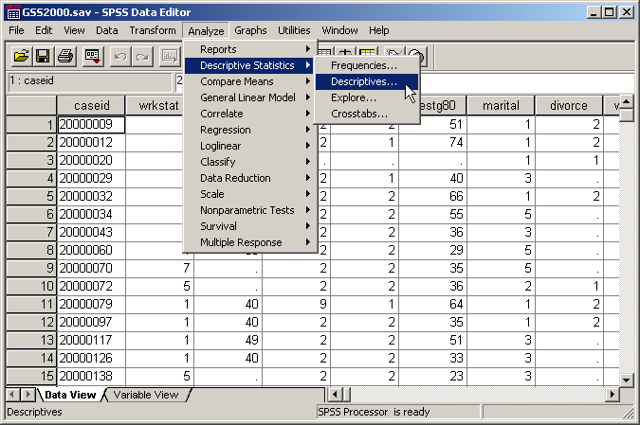
Request the statistics to evaluate normality
The one-sample t-test of a population mean assumes that the test variable is normally distributed. To evaluate this assumption, we need to compute the skewness and kurtosis of the distribution.

Slide 4
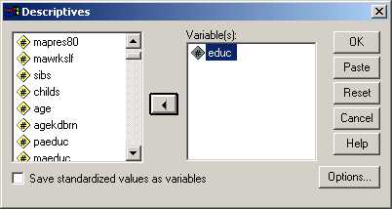
Select the variable to evaluate for normality
First, move the variable "educ" to the list of variables.

Slide 5
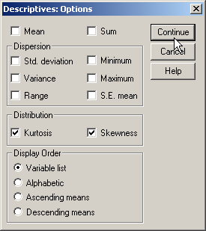
Request the skewness and kurtosis
First, mark the checkboxes for kurtosis and skewness in the Distribution panel.
Clear the checkboxes for the other statistics to cut down on the amount of output.
Second. click on the continue button to close the Options dialog box.

Slide 6
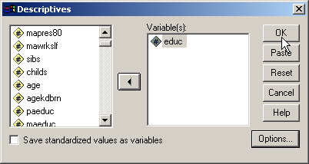
Complete the request to evaluate normality
Click on the OK button to complete the request.

Slide 7
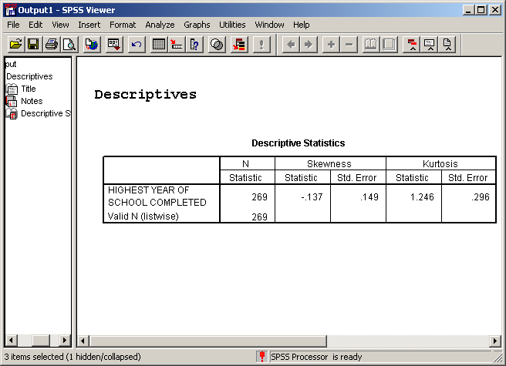
Statistical output to evaluate normality
The skewness of HIGHEST YEAR OF SCHOOL COMPLETED for the sample (-0.137) is within the range for normality (-1.0 to +1.0).
The kurtosis of HIGHEST YEAR OF SCHOOL COMPLETED for the sample (1.246) is outside the range for normality (-1.0 to +1.0). This condition violates the assumption of normality.
However, since the sample size of 269 is at least 30, the central limit theorem states that the sampling distribution of statistics will follow a normal distribution, and the use of the statistical test with this variable is appropriate.

Slide 8
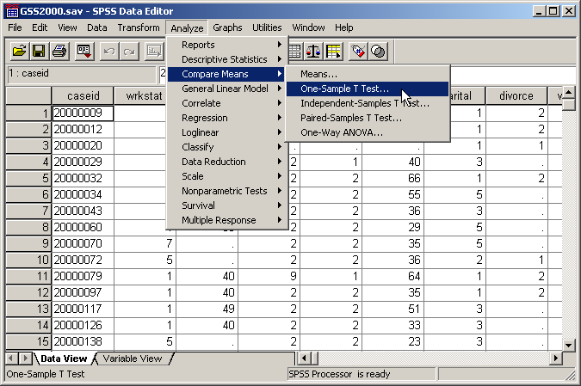
Request the one-sample t-test
To compute a one-sample t-test of a population mean in SPSS, select the Compare Means | One-Sample T-Test command from the Analyze menu.

Slide 9
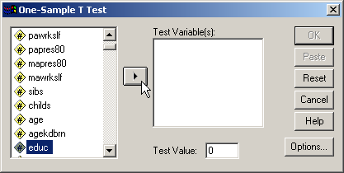
Select the variable for the one-sample t-test
Second, click on the arrow button to move the variable "educ" to the list of Test Variables.
First, highlight the variable "educ" to use in the t-test.

Slide 10
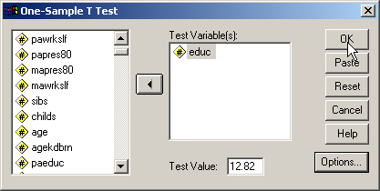
Enter the value for the population mean
Second, with the variable selected and the test value entered, click on the OK button to complete the request.
First, enter the value for the population mean specified in the problem (12.82) in the Test Value text box.

Slide 11
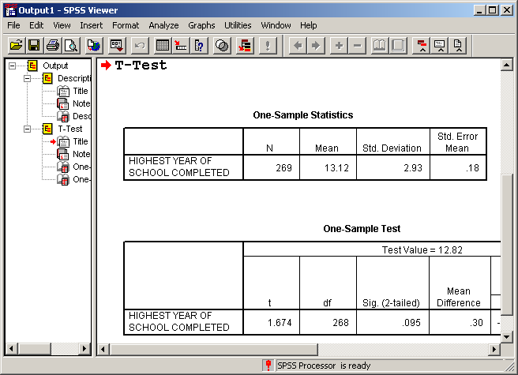
The SPSS Output for the One-Sample T-test
The SPSS output is for a two-tailed test for the research hypothesis that the mean of the population represented by the sample (13.12) is not is not equal to the population mean which we specified (12.82).
If the two-tailed hypothesis test is the one implied by the problem, we can computer the “Sig. (2-tailed)” probability to the level of significance stated in the problem.

Slide 12
Computing a one-tailed probability
In this problem, the research hypothesis states that the population mean is greater than 12.82. We need to derive the one-tailed probability from the “Sig. (2-tailed)” output. We do this by dividing the two-tailed probability by 2.
For this output, the one-tailed probability is:
0.095 / 2 = 0.048

Slide 13
The direction of the computed one-tailed test
There are two possible one-tailed tests: one for a greater than relationship and another for a less than relationship.
Which of these hypotheses is associated to the probability of 0.048 which we just calculated.
The one-tailed probability of 0.048 is associated with the comparison of the sample mean (13.12) to the specified population mean (12.82). Since the sample mean (13.12) is larger than the population mean (12.82), the probability of 0.048 is the probability for a greater than relationship, which is the relationship stated in the problem.

Slide 14
Interpret the output for the one-sample t-test
The probability of the test statistic for this problem is 0.048. We interpret this as the probability that we could draw a sample with a mean of 13.12 or greater from a population that has a mean of 12.82.
Since this probability is less than or equal to the level of significance of 0.05, we reject the null hypothesis and conclude that the analysis supports the research hypothesis. Based on the one-sample t-test, the population mean for the variable "HIGHEST YEAR OF SCHOOL COMPLETED" is greater than 12.82.
The answer to the question is true.

Slide 15
The probability for the other one-tailed test
The one-tailed probability of 0.048 is associated with the comparison of the sample mean (13.12) to the specified population mean (12.82). Since the sample mean (13.12) is larger than the population mean (12.82), the probability of 0.048 is the probability for a greater than relationship, which is the relationship stated in the problem.
Suppose the problem had stated the opposite relationship: “For the population represented by this sample of survey respondents, the mean for the variable "HIGHEST YEAR OF SCHOOL COMPLETED" is less than the mean of 12.82 found in a previous research study.” The probability for the less than relationship is the probability below the right tail:
1.0 – 0.048 = 0.952.

Slide 16
A caution about the probabilities for one-tailed tests
While most of the time we would expect to do a one-tailed test that corresponds to the relationship between the sample mean and the population mean, sometimes we do test a hypothesis in the opposite direction.
To detect these occasions, we need to compare the direction of a one-tailed test implied in the problem to the probability actually computed by SPSS.

Slide 17
Problem 2
Based on the dataset GSS2000.SAV, is the following statement true, false, or an incorrect application of a statistic? Use 0.01 as the level of significance.
For the population represented by this sample of survey respondents, the mean for the variable "TOTAL FAMILY INCOME" is less than the mean of 16.50 found in a previous research study.
1. True
2. True with caution
3. False
4. Incorrect application of a statistic

Slide 18
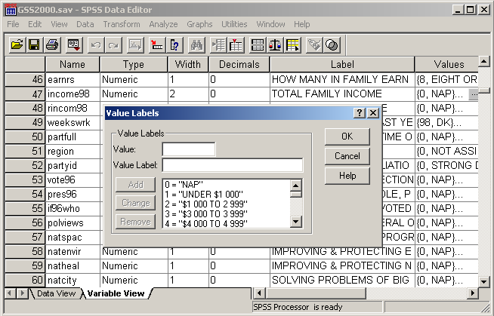
Solution 2
The one-sample t-test of a population mean requires that the variable be interval. The variable "TOTAL FAMILY INCOME" is ordinal, which does not meet this requirement.
The answer to the question is incorrect application of a statistic.

Slide 19
Problem 3
Based on the dataset GSS2000.SAV, is the following statement true, false, or an incorrect application of a statistic? Use 0.05 as the level of significance.
For the population represented by this sample of survey respondents, the mean for the variable "AGE OF RESPONDENT" is different from the mean of 43.80 found in a previous research study.
1. True
2. True with caution
3. False
4. Incorrect application of a statistic

Slide 20
Request the statistics to evaluate normality
The one-sample t-test of a population mean assumes that the test variable is normally distributed. To evaluate this assumption, we need to compute the skewness and kurtosis of the distribution.

Slide 21
Select the variable to evaluate for normality
First, move the variable "educ" to the list of variables.

Slide 22
Request the skewness and kurtosis
First, mark the checkboxes for kurtosis and skewness in the Distribution panel.
Clear the checkboxes for the other statistics to cut down on the amount of output.
Second. click on the continue button to close the Options dialog box.

Slide 23
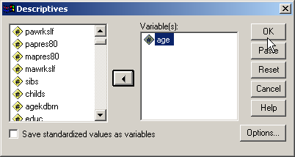
Complete the request to evaluate normality
Click on the OK button to complete the request.

Slide 24
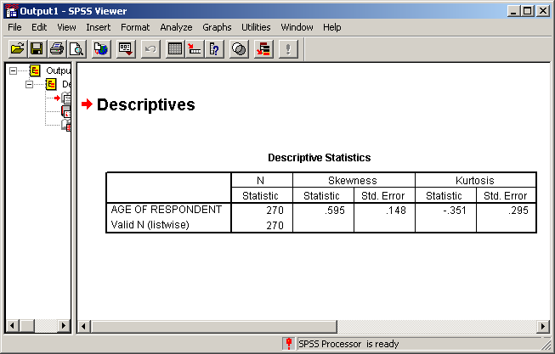
Statistical output to evaluate normality
The skewness of HIGHEST YEAR OF SCHOOL COMPLETED for the sample (0.595) is within the range for normality (-1.0 to +1.0).
The kurtosis of HIGHEST YEAR OF SCHOOL COMPLETED for the sample (-0.351) is outside the range for normality (-1.0 to +1.0). This condition violates the assumption of normality.
The assumption of normality required by the one-sample t-test of a population mean is satisfied.

Slide 25
Request the one-sample t-test
To compute a one-sample t-test of a population mean in SPSS, select the Compare Means | One-Sample T-Test command from the Analyze menu.

Slide 26
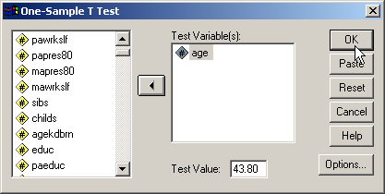
Enter the specifications for the t-test
Third, with the variable selected and the test value entered, click on the OK button to complete the request.
First, highlight the variable “age" to use in the t-test.
Second, enter the value for the population mean specified in the problem (43.80) in the Test Value text box.

Slide 27
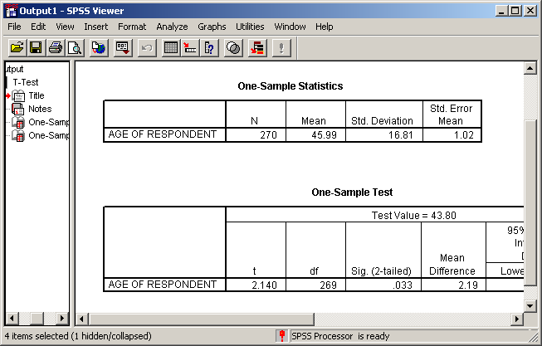
The probability of the test statistic
The research hypothesis implied by the the problem is a difference between sample and population mean – a non-directional, two-tailed test.
In this situation, we use the two-tailed probability output by SPSS, 0.033.

Slide 28
Decision for the one-sample t-test
The probability of the test statistic for this problem is 0.033. We interpret this as the probability that we could draw a sample with a mean as large as 45.99 from a population with a mean of 43.80.
Since this probability is less than or equal to the level of significance of 0.05, we reject the null hypothesis and conclude that the analysis supports the research hypothesis. Based on the one-sample t-test, the population mean for the variable "HIGHEST YEAR OF SCHOOL COMPLETED" is different from 43.80.
The answer to the question is true.

Slide 29
Steps in solving one-sample t-test problems
The following is a guide to the decision process for answering
One-sample T-test homework problems:
Is the level of measurement requirement satisfied?
No
Incorrect application of a statistic
Yes
Is the assumption of normality satisfied?
No
Add caution if the question turns out to be true
Yes
Is the probability of the test statistic less than the level of significance?
No
False
Yes
True

Slide 30
Problem 4
Based on the dataset GSS2000.SAV, is the following statement true, false, or an incorrect application of a statistic? Use 0.05 as the level of significance.
We can be 95% confident that the interval from 3.14 to 3.90 contains the population mean for the variable "NUMBER OF BROTHERS AND SISTERS".
1. True
2. True with caution
3. False
4. Incorrect application of a statistic

Slide 31
Request the statistics to evaluate normality
The one-sample t-test of a population mean assumes that the test variable is normally distributed. To evaluate this assumption, we need to compute the skewness and kurtosis of the distribution.

Slide 32
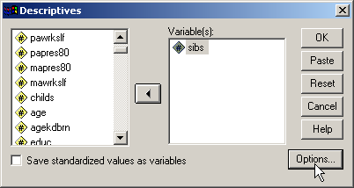
Select the variable to evaluate for normality
First, move the variable “sibs" to the list of variables.

Slide 33
Request the skewness and kurtosis
First, mark the checkboxes for kurtosis and skewness in the Distribution panel.
Clear the checkboxes for the other statistics to cut down on the amount of output.
Second. click on the continue button to close the Options dialog box.

Slide 34
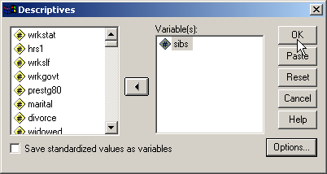
Complete the request to evaluate normality
Click on the OK button to complete the request.

Slide 35
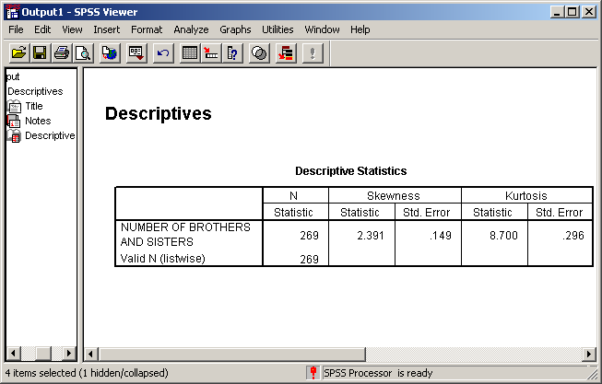
Statistical output to evaluate normality
The skewness of NUMBER OF BROTHERS AND SISTERS for the sample (2.391) is outside the range for normality (-1.0 to +1.0).
The kurtosis of NUMBER OF BROTHERS AND SISTERS for the sample (8.700) is outside the range for normality (-1.0 to +1.0)
However, since the sample size of 269 is at least 30, the central limit theorem states that the sampling distribution of statistics will follow a normal distribution, and the use of the statistical test with this variable is appropriate.

Slide 36
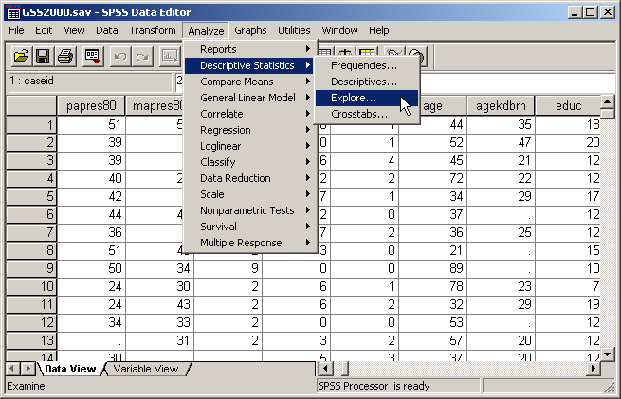
Request the confidence interval
To compute a confidence interval in SPSS, select the Descriptive Statistics | Explore… command from the Analyze menu.
Note: the confidence interval on the SPSS One-Sample T-Test output is the confidence interval for the difference between the sample mean and the population mean, not the confidence interval for the population mean, which we need for this problem.

Slide 37
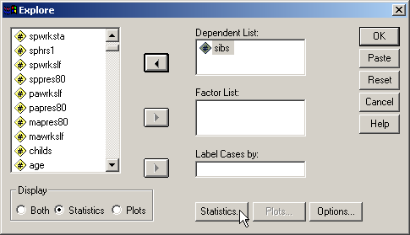
Select the variable for the analysis
First, move the variable “sibs” to the Dependent List.
Third, click on the Statistics... Button to specify the statistics we want.
Second, mark the Statistics option button to tell SPSS that we only want the Statistics output.

Slide 38
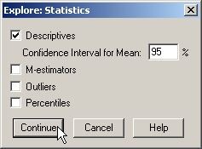
Specify the confidence interval
The confidence interval is part of the Descriptives output. First, mark the checkbox for Descriptives.
Second, type the size of the confidence interval that we want to compute.
The size of the confidence interval is the level of significance specified in the problem subtracted from 1.0.
1.0 – 0.05 = 0.95 or 95%
Third, click on the Continue Button to complete the specification.

Slide 39
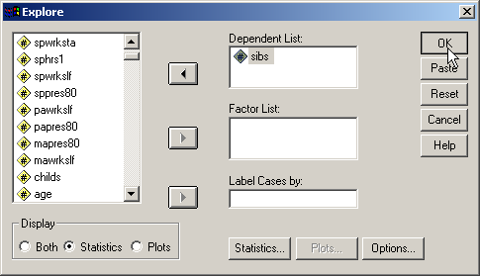
Complete the request for a confidence interval
Click on the OK button to complete the request for a confidence interval for the variable “sibs.”

Slide 40
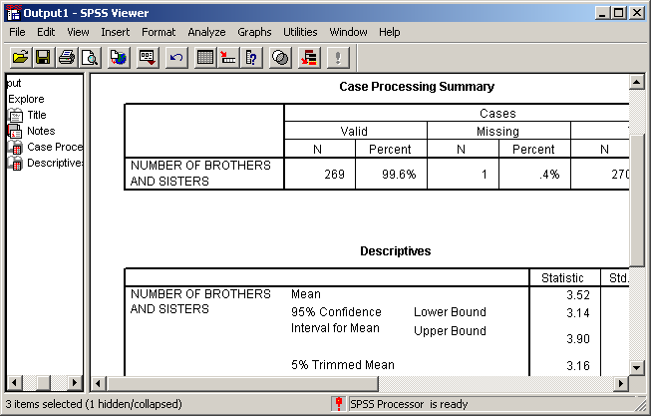
The confidence interval for a mean
The 95% confidence interval is from 3.14 to 3.90.
The answer to the question is true.

Slide 41
Alternative ways to phrase a confidence interval
It is very likely that the interval from 3.14 to 3.90 contains the population mean for the variable "NUMBER OF BROTHERS AND SISTERS".
We strongly believe that the interval from 3.14 to 3.90 contains the population mean for the variable "NUMBER OF BROTHERS AND SISTERS".
The probability is 0.95 that the interval from 3.14 to 3.90 contains the population mean for the variable "NUMBER OF BROTHERS AND SISTERS".
We can be 95% confident that the interval from 3.14 to 3.90 contains the population mean for the variable "NUMBER OF BROTHERS AND SISTERS".
These statements are different ways of stating a confidence interval.

Slide 42
Alternative ways to phrase a confidence interval
The probability is 0.95 that the population mean for the variable "NUMBER OF BROTHERS AND SISTERS" lies within the interval from 3.14 to 3.90.
This is an incorrect statement of a confidence interval. The probability value applies to the interval and not to the population mean. The population mean is a fixed value, even though we don't know what that value is.
If a homework problem were phrased this way, it would be false.

Slide 43
Steps in solving confidence interval problems - 1
The following is a guide to the decision process for answering
One-sample T-test homework problems:
Is the level of measurement requirement satisfied?
No
Incorrect application of a statistic
Yes
Is the assumption of normality satisfied?
No
Add caution if the question turns out to be true
Yes

Slide 44
Steps in solving confidence interval problems - 2
The following is a guide to the decision process for answering
One-sample T-test homework problems:
Yes
Is the statement of the confidence interval phrased correctly, and are the confidence interval values correct?
No
False
Yes
True

